Slide 1
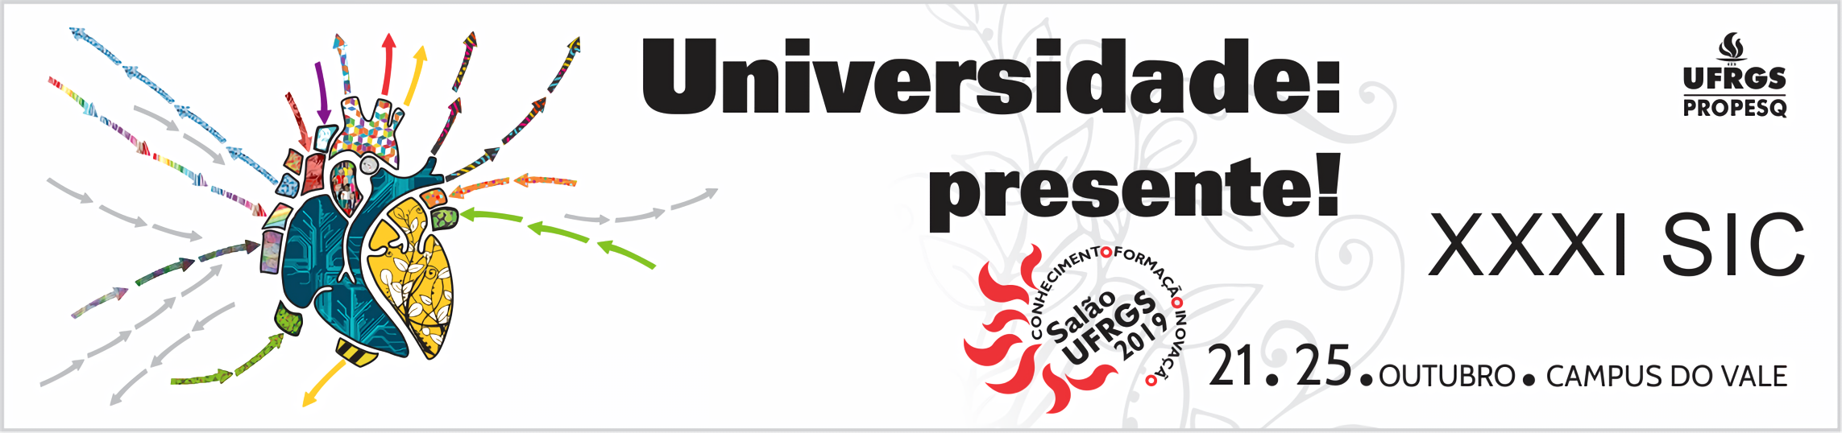


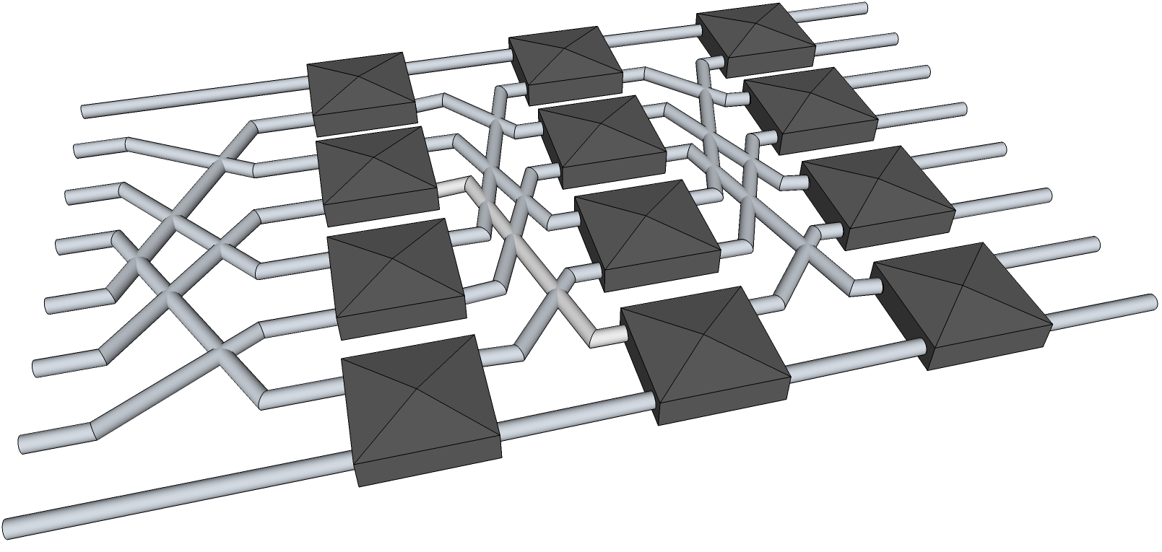

Computational Experiments on
Task-Based Parallel Applications
Henrique Corrêa Pereira da Silva¹ and Lucas Mello Schnorr² (advisor)
{hcpsilva¹, schnorr²}@inf.ufrgs.br
The need of ever-more performant systems led developers into parallelizing their applications;
However, utilizing homogeneous hardware is still the norm, which comes with great investment needs;
Given this reality, considerable effort has been poured into the development of middleware capable of effectively distributing the workload into more heterogeneous systems.
Directed Acyclic Graph
Contextualization
1st block
2nd block
3rd block
6
2
1
11
6
5
16
-3
Initial vector
T1
Executed in parallel
T2
T3
There are several popular parallel programming models, such as the message passing, shared memory or a mix of these, known as a hybrid model;
The implementation of such models in modern software is a known difficult, error-prone and time-consuming process;
Popular implementations of said models try to provide a user-friendly interface through better APIs or compiler directives;
Nonetheless, by the inherent fixed size of the parts in a problem decomposition, we still suffer from dynamic imbalance and, thus, loss of performance;
We can utilize said models to implement a higher-level approach, called task-based model, to divide our problem into smaller kernels of computation.
9
22
13
Motivation
Intermediary vector
Parameters:
Vector size: 8
Number of blocks: 3
Decay rate: 3
T4
Depend on the previous tasks
44
Return value
Figure 1: Example of the reduction of an vector into blocks and their respective tasks.
Thus far, we have implemented a block vector reduction using the task-based model, which example can be observed in Figure 1.
Using the initial number of blocks and its decay rate as parameters we have achieved a multi-level parallel vector reduction;
This initial implementation shows that StarPU is a viable and programmer-friendly way to apply the task-based model in modern software.
Results and conclusion
One of the middleware capable of such heterogeneous computation is called StarPU, which approaches the problem with the task-based model in hand;
By defining tasks into what’s called an directed acyclic graph (shown in Figure 1), the dependencies get naturally exposed and StarPU can then handle the distribution of said tasks onto the underlying hardware;
Said approach is not only programmer friendly but is also very powerful when it comes to declaring and visualizing dependencies;
This way, we intend to show that said model is a practical in achieving parallelism in modern software.
Methodology
Samuel Thibault. On Runtime Systems for Task-based Programming on Heterogeneous Platforms. Distributed, Parallel, and Cluster Computing [cs.DC]. Université de Bordeaux, 2018.
Garcia Pinto, V, Mello Schnorr, L, Stanisic, L, Legrand, A, Thibault, S, Danjean, V. A visual performance analysis framework for task‐based parallel applications running on hybrid clusters. Concurrency Computat Pract Exper. 2018; 30:e4472.
References
Acknowledgements:

