Slide 1



Python revisions
Tuples
Catarina Oliveira
IMP.GE.190.0

Slide 2
CONTENT
Conditions
Cycles
lists
input and output
Functions
tuples
Combination of lists and tuples
IMP.GE.190.0

Slide 3
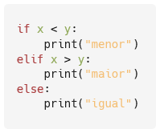
Conditions
IMP.GE.190.0

Slide 4
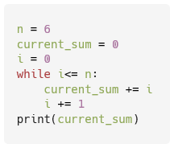
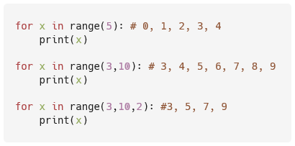
Cycles
IMP.GE.190.0

Slide 5
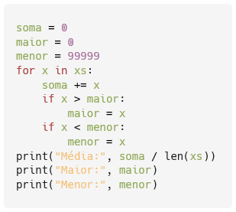
lists
Example
considering the list
xs = [12, 10, 32, 3, 66, 17, 42, 99, 20]
Determine the mean, largest, and smallest element
IMP.GE.190.0

Slide 6
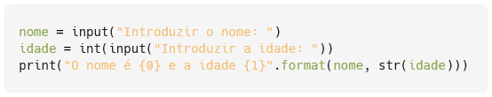
Input and Output
IMP.GE.190.0

Slide 7
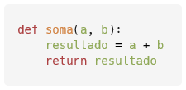


Functions
IMP.GE.190.0

Slide 8
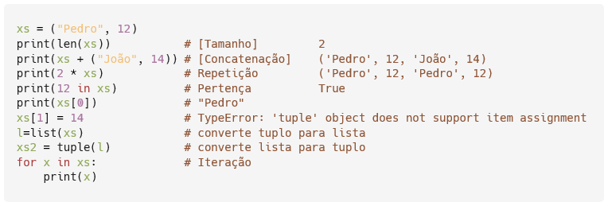
tuples
Ordered sequences of elements: (e1, e2, ..., en )
Access to elements by indexes
Immutable
Operations with tuples :
IMP.GE.190.0

Slide 9
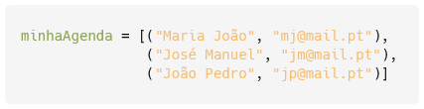
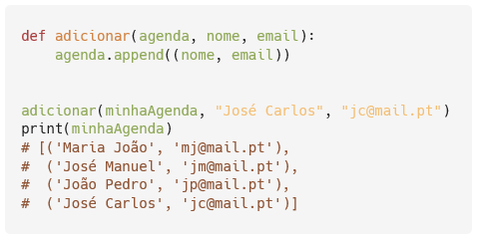
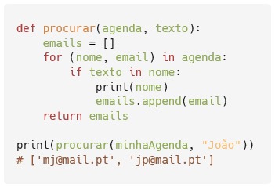
Combination of lists and tuples
represent an agenda
Add entries (name and email) to the calendar
Search for names in the agenda and return the email
IMP.GE.190.0

Slide 10
IMP.GE.190.0

