Slide 1
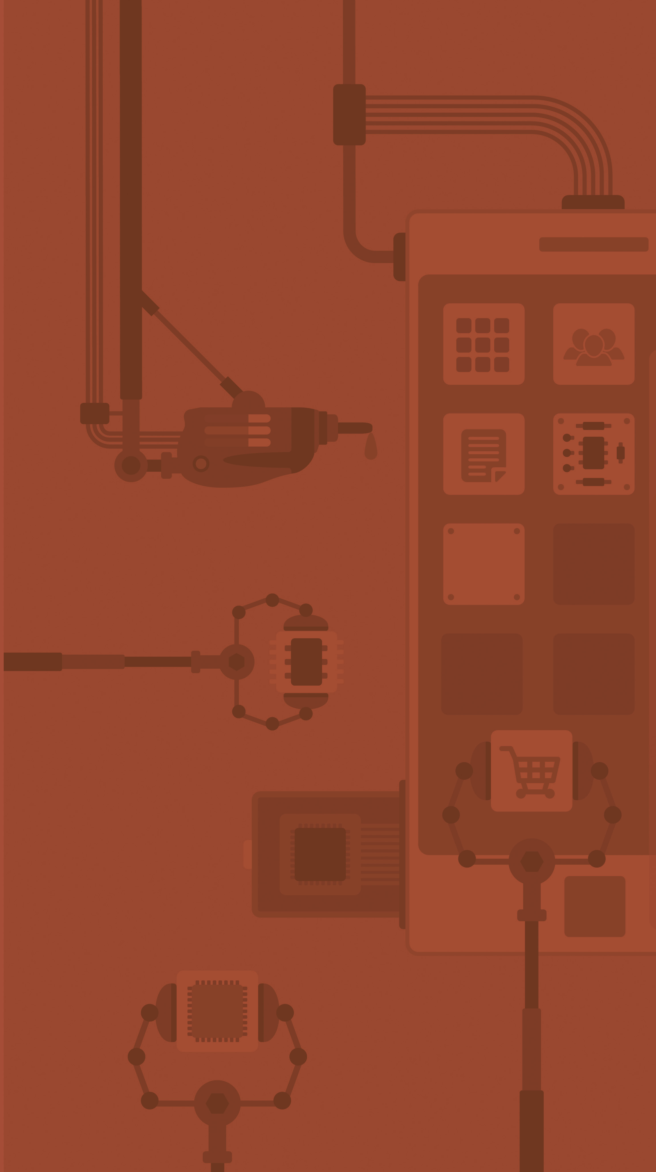


Dictionaries
Catarina Oliveira
IMP.GE.190.0

Slide 2
CONTENT
Dictionaries
Examples
Dictionaries vs Tuple Lists
dictionary methods
Browse dictionaries
Sorting of dictionaries
IMP.GE.190.0

Slide 3
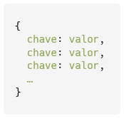

Dictionaries ( maps )
Data collections that associate a key with a value
Key ( key ): immutable
Value ( value ): any Python object
IMP.GE.190.0

Slide 4
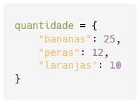



Examples
Create a dictionary to store fruit quantities
Item | Amount
bananas | 25
pears | 12
oranges | 10
show the dictionary
Consult the quantity of pears
Change the amount of bananas to 50:
IMP.GE.190.0

Slide 5



Examples
Add 15 to the amount of pears
Add the product “mangoes” with quantity 20 to the dictionary
See the final contents of the dictionary
IMP.GE.190.0

Slide 6

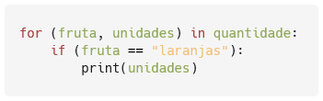

Dictionaries vs Tuple Lists
The amount of fruits could also be represented by a list of tuples
Problems :
Necessary to go through the whole list to check the value associated with a key ( ex : number of oranges?)
Allows repeated keys (the following would be possible :)
IMP.GE.190.0

Slide 7
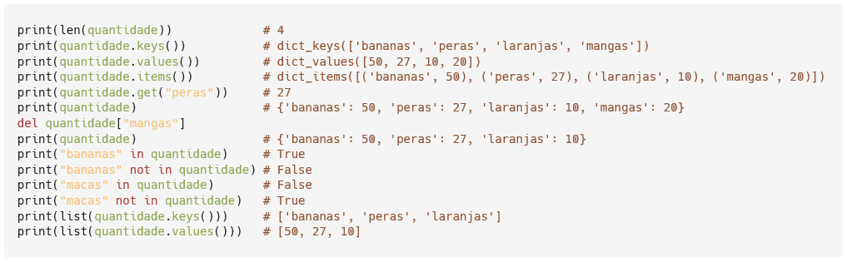
dictionary methods
Return the size of a dictionary: len (d)
Return keys from a dictionary: d.keys ()
Return values from a dictionary: d.values ()
Return the contents of a dictionary in a list of tuples: d.items ()
Return the value of a key: d.get (c)
Delete the key and its value from the dictionary: del d[c]
Test whether a key belongs/doesn't belong in the dictionary: in / not in
Convert dictionary keys to list: list ( d.keys ())
Convert dictionary values to list: list ( d.values ())
IMP.GE.190.0

Slide 8
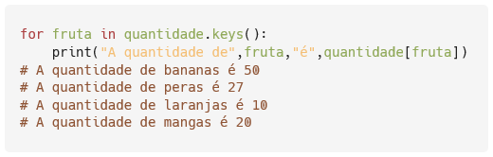
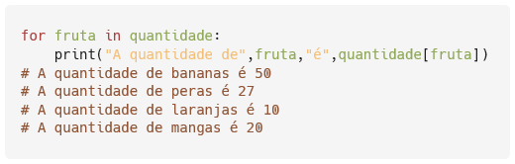
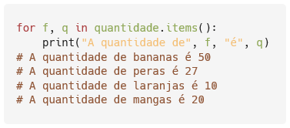
Browse dictionaries
IMP.GE.190.0

Slide 9
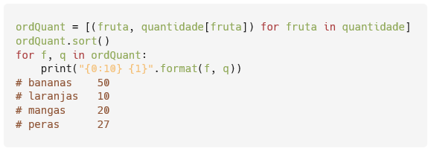
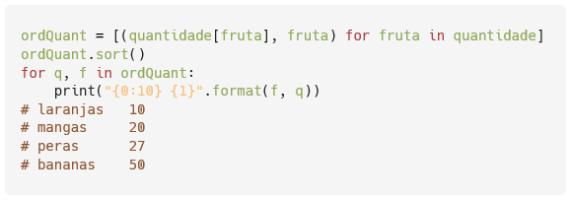
Sorting of dictionaries
Print, formatted, dictionary contents, sorted alphabetically by fruit name
Print, formatted, the contents of the dictionary, sorted by the amount of fruit
IMP.GE.190.0

Slide 10
IMP.GE.190.0

