Slide 1



Classes
Objects
Methods
Catarina Oliveira
IMP.GE.190.0

Slide 2
CONTENT
Class, _ _ init _ _ and self
Instance
_ _ str _ _
private variables
Instance and class variables
Instance Methods
class methods
Static Methods and Property Decorator @staticmethod
Getters and Property Decorator @property
Setters and Property Decorator @****.setter
Deleters and Property Decorator @****.deleter
Inheritance and super ()
IMP.GE.190.0

Slide 3
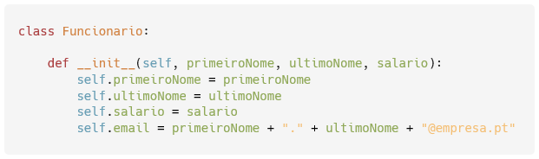
Class, _ _ init _ _ and self
Class
Structure that allows you to group data and methods
“Mold” of instances
Example: a company wants to represent its employees using a Python class. The data saved for each employee is:
First name
last name
Wage
Email
_ _ init _ _
Constructor
method that allows
Define the structure of the class
Construct an instance of the class
self
Reference to itself (instance)
IMP.GE.190.0

Slide 4



Instance
Instance : embodiment of an object of a class
Creating an instance of the employee class
Show instance content
Show the contents of one of the variables
Show instance contents as a dictionary
IMP.GE.190.0

Slide 5


_ _ str _ _
_ _ str _ _ method inside the class definition )
Show instance content
IMP.GE.190.0

Slide 6
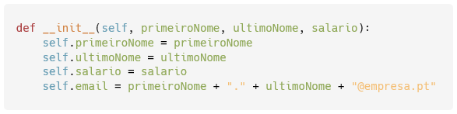
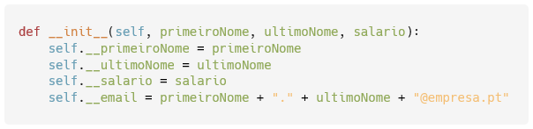
private variables
So far, we've looked at public variables (accessible from outside the class)
To use private variables (not accessible from outside the class, for security), add _ _ before the name
Thus, they are no longer accessible from outside the class.
IMP.GE.190.0

Slide 7
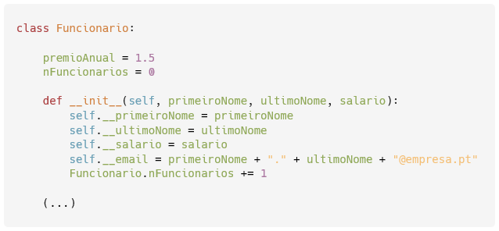
Instance and class variables
The variables we've seen so far are instance variables :
Can have different values for each instance of the class
Class variables :
Have the same value for all instances of the class
Are defined outside _ _ init _ _
All employees have an annual bonus proportional to their salary
Before instances are created, the # of employees created is 0
class variables
Instance Variables
When creating an instance, the number of employees is incremented
IMP.GE.190.0

Slide 8
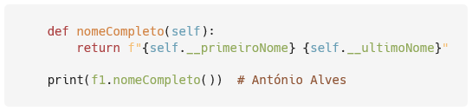
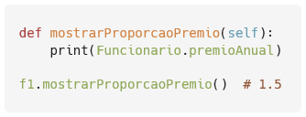

Instance Methods
Instance method :
Can have different outputs in each instance
Use instance variables
Can use class variables
Can be used in other methods
IMP.GE.190.0

Slide 9


class methods
Class method :
Has the same output for all instances
Does not use instance variables
Can not use any variables
Can use class variables
IMP.GE.190.0

Slide 10
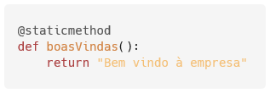
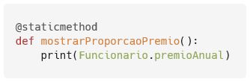
Static Methods and Property Decorator @staticmethod
Class methods do not use instance variables. They are static.
We can define them as such, no longer needing the self parameter.
Property is used decorator @staticmethod
IMP.GE.190.0

Slide 11
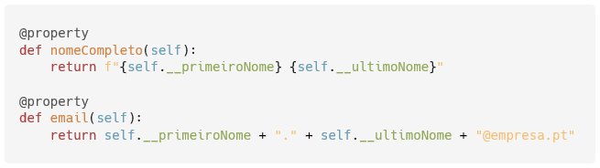


Getters and Property Decorator @property
Allows the definition of getters (used to obtain variable values)
fullname and email are now used as if they were variables (without parentheses)
Even when called by other methods
IMP.GE.190.0

Slide 12
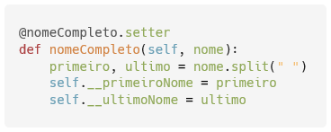

Setters and Property Decorator @****.setter
We can define setters (used to set variable values)
This method allows defining the firstName and lastName simultaneously, starting from a complete name
IMP.GE.190.0

Slide 13
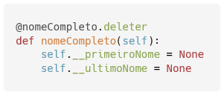
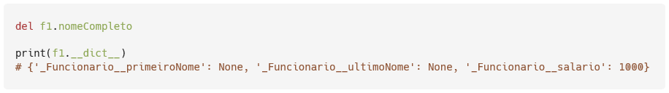
Deleters and Property Decorator @****.deleter
We can define deleters (used to “empty” / reset variable values)
This method allows you to “empty” firstName and lastName simultaneously.
As the email is constructed from these, it is also empty.
IMP.GE.190.0

Slide 14
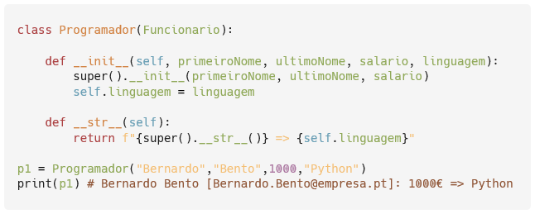
Inheritance and super ()
In programming, it is possible to define that a class ( subclass ) inherits the structure and methods of another class ( superclass )
Example: there is a special type of employee in the company (Programmer) who, in addition to information and methods for the employee, also keeps the programming language with which he works
Programmer ( Employee )
Programmer (subclass) inherits from Employee (superclass)
super ().xxx
Call the superclass's XXX method
Then we just have to deal with the variables specific to the subclass
print(p1)
By showing, Python knows it has to execute the _ _ str _ _ method defined for the subclass
IMP.GE.190.0

Slide 15
IMP.GE.190.0

