Slide 1



Modules
recursion
Catarina Oliveira
IMP.GE.190.0

Slide 2
CONTENT
Module
Examples:
import a module
import a function from a module
rename a module
class code organization
_ _ name _ _
packages
predefined modules
recursion
IMP.GE.190.0

Slide 3
Module
Python file that contains functions that can be reused by other Python files
IMP.GE.190.0

Slide 4

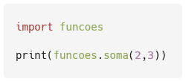
Example: import a module
funcoes.py file that contains a function sum( x,y ) that takes two values and returns their sum
main.py file that calls the sum( x,y ) function imported from the funcoes.py file
IMP.GE.190.0

Slide 5

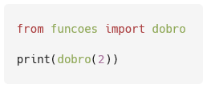
Example: import a function from a module
double(x) function in the funcoes.py file which returns twice the value it receives
Import only the double(x) function in the main.py file
IMP.GE.190.0

Slide 6
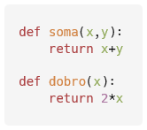
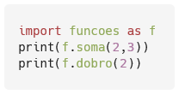
Example: Rename a module
The funcoes.py file contains the sum( x,y ) and double(x) functions
Using the functions, renaming the module
IMP.GE.190.0

Slide 7
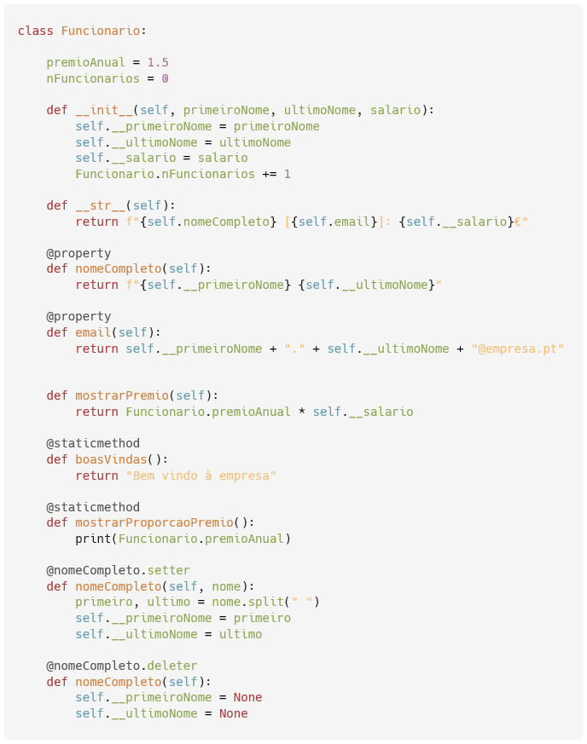
Example: Class Code Organization
Based on the example of the classes and objects, create the employee.py file with the Employee class
IMP.GE.190.0

Slide 8
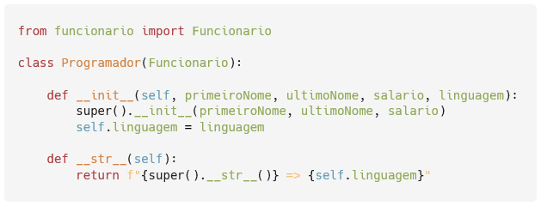
Example: Class Code Organization
programmer.py file (which imports the Employee class from the employee module ) with the Programmer class
IMP.GE.190.0

Slide 9
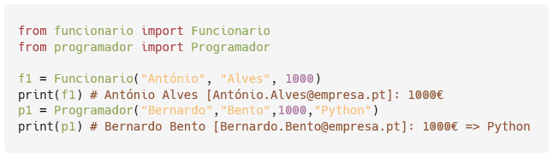
Example: Class Code Organization
main.py file that imports both classes, and creates and prints an employee and a scheduler
IMP.GE.190.0

Slide 10
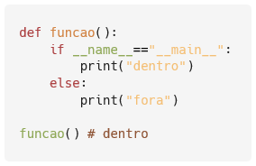
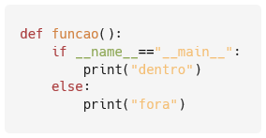
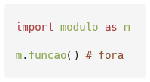
_ _ name _ _
Lets you define where the code runs
Run the module.py file
main.py file , which imports the module.py file
module.py
main.py
IMP.GE.190.0

Slide 11
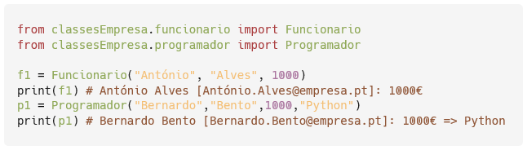
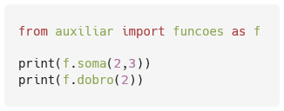
packages
In Python, we can create packages for code organization
init _ _ file is created . py ,
Empty
Indicates that the folder is a package
Example:
Create a package called helper
funcoes.py file into the package
Calling the functions becomes (automatically in the PyCharm IDE ):
Example:
Create a package called classesEmpresa
employee.py and programmer.py files into the package
updated imports
IMP.GE.190.0

Slide 12
predefined modules
Examples:
math - math functions
numpy - matrix calculation
pandas - tables and data
sklearn – machine learning
List of predefined modules: https://docs.python.org/3/py-modindex.html
IMP.GE.190.0

Slide 13
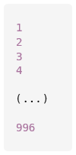
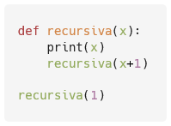

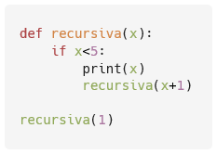
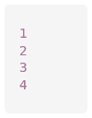
recursion
Happens when a function calls itself
The function is recursive
Recursion can create an infinite loop (Python limits the number of executions)
To know the recursion limit:
It is important to define a stopping criterion (with an if )
IMP.GE.190.0

Slide 14
IMP.GE.190.0

