Slide 1



Higher order functions
Comprehension
Generators
Catarina Oliveira
IMP.GE.190.0

Slide 2
CONTENT
Higher order functions:
map ()
functools.reduce ()
filter ()
lambda functions
List comprehension
Definition
Conditional
Comprehension of dictionaries
Definition
Conditional
generators
expression generator
IMP.GE.190.0

Slide 3
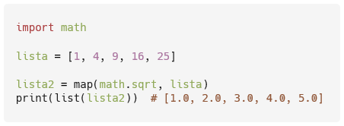
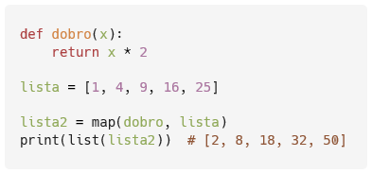
Higher order functions – map ()
Applies a function to each element of the list and returns the resulting list
Example : get the square root ( math module , sqrt function ) of the elements of a list
Example : obtaining the double (implement the function dobro(x) ) of the elements of a list
IMP.GE.190.0

Slide 4
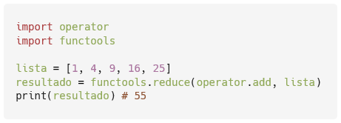
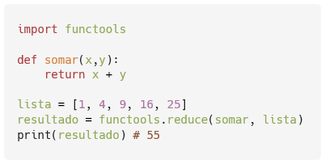
Higher order functions – functools.reduce ()
Applies a function to the elements of a list to aggregate them (module functools )
Example : add ( operator module , add function ) the elements of a list
Example : add (implement the function somar( x,y ) ) the elements of a list
IMP.GE.190.0

Slide 5
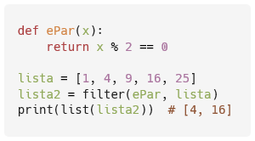
Higher order functions – filter ()
Filter elements from a list
Example : extract even elements (implement ePar (x) function ) from a list
IMP.GE.190.0

Slide 6


lambda functions
Small and anonymous functions
Syntax:
Example : lambda function to determine the quintuple of a number
IMP.GE.190.0

Slide 7

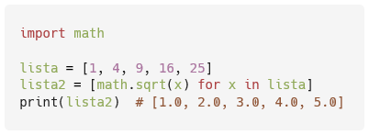
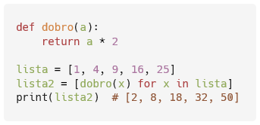
List comprehension
Applies an expressao to each element x of a lista (similar to map )
Example : get the square root ( math module , sqrt function ) of the elements of a list
Example : obtaining the double (implement the function dobro(x) ) of the elements of a list
IMP.GE.190.0

Slide 8

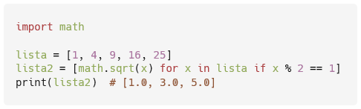
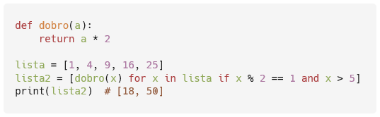
Comprehension of conditional lists
Applies exp to each element x of a lst that meets a condicao
Example : get the square root ( math module , sqrt function ) of the odd elements of a list
Example : obtaining the double (implementing the function dobro(x) ) of the odd elements greater than 5 of a list
IMP.GE.190.0

Slide 9
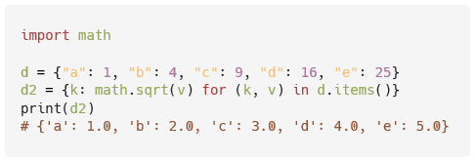
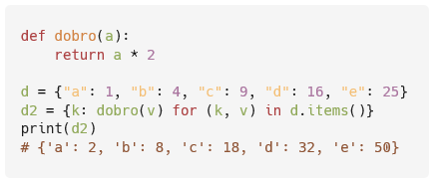
Comprehension of dictionaries
Comprehension can also be applied to dictionaries, with the same syntax
Example : get the square root ( math module , sqrt function ) of the elements of a dictionary
Example : get double (implement the function dobro(x) ) the elements of a dictionary
IMP.GE.190.0

Slide 10
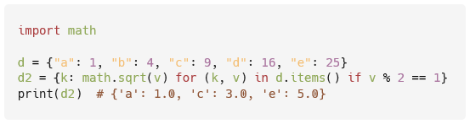
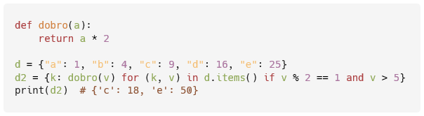
Comprehension of conditional dictionaries
Comprehension can also be applied to dictionaries with conditions
Example : getting the square root ( math module , sqrt function ) of the odd elements of a dictionary
Example : obtaining the double (implementing the function dobro(x) ) of the odd elements greater than 5 of a dictionary
IMP.GE.190.0

Slide 11
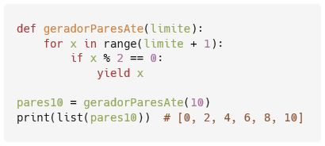
generators
Special procedures for controlling loops and iterators
Functions that use yield instead of return
Similar to functions that return arrays
Example : implement a generator to return even numbers lower than a given number
IMP.GE.190.0

Slide 12
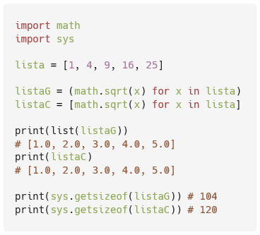
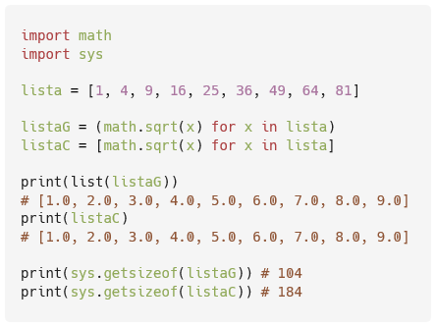
expression generator
Similar to list comprehension, but use () instead of []
Instead of list, returns generator → uses less memory
Example : get the square root ( math module , sqrt function ) of the elements of a list
IMP.GE.190.0

Slide 13
IMP.GE.190.0

