Slide 1



Writing and Reading Data Files
Catarina Oliveira
IMP.GE.190.0

Slide 2
CONTENT
file system
open/close files
file reading
file writing
Special file types
Read/Write CSV
Read/Write JSON
Read/Write XML
Read Web Pages
IMP.GE.190.0

Slide 3
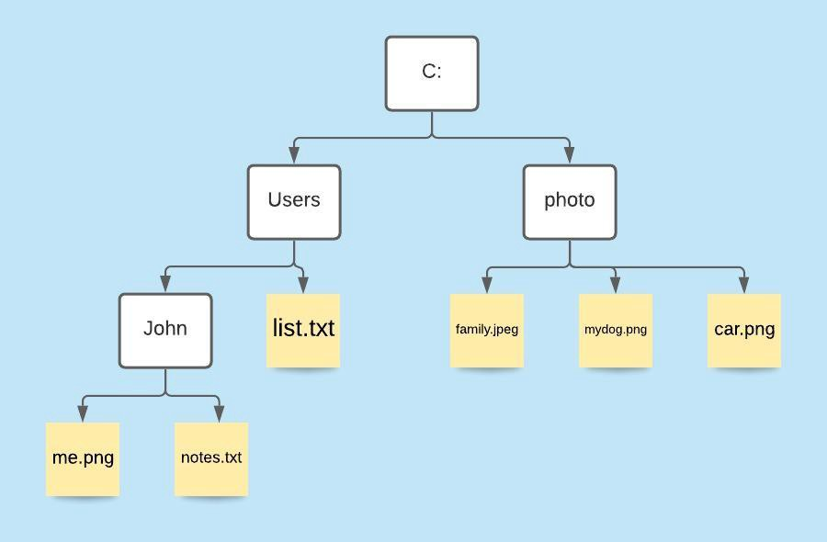
file system
identified by names
Eg: car.png
Organized hierarchically in folders
Ex (Windows): C:/ photo /car.png
Ex (Linux): / photo /car.png
What would be the path to the notes.txt file?
Windows
Linux
IMP.GE.190.0

Slide 4
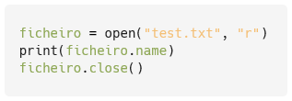

open/close files
In Python, files can be opened ( open ) in several ways:
r: read
w: write
a: add
x: create
At the end of use they must be closed ( close )
Example: Open file.txt in read mode and print the file name:
IMP.GE.190.0

Slide 5
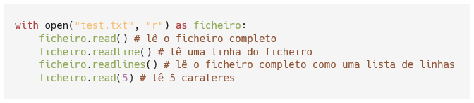
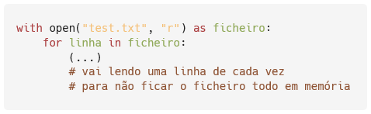
file reading
IMP.GE.190.0

Slide 6

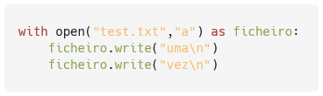

file writing
Open a file and write a string (overrides if existing)
Open a file and add two strings one at a time
Open a file and add two lines from a list of strings
IMP.GE.190.0

Slide 7
Special file types
Python has specific modules for processing files:
csv
JSON
XML
… and also for processing:
Web Pages
… between others
IMP.GE.190.0

Slide 8
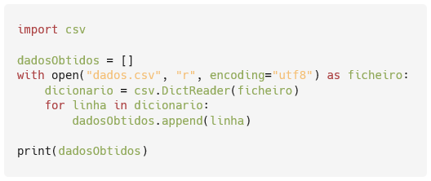
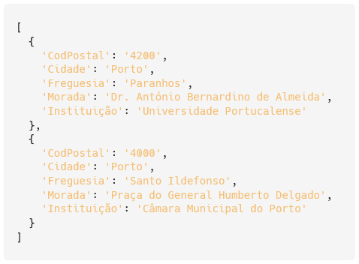
Read CSV (to a dictionary)
IMP.GE.190.0

Slide 9
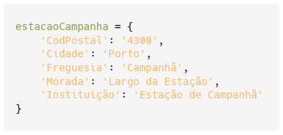
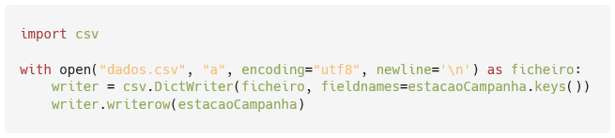
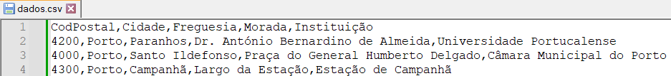
Write CSV (from a dictionary)
IMP.GE.190.0

Slide 10
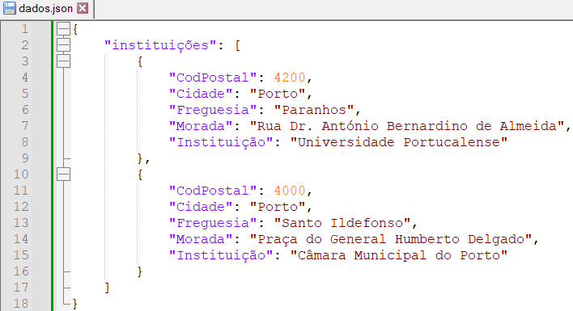
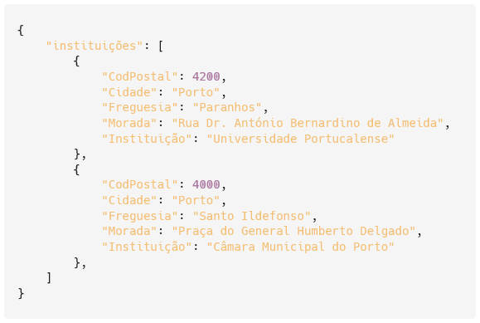
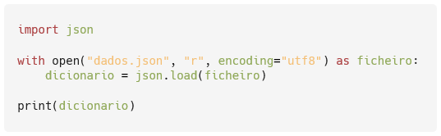
Read JSON (to a dictionary)
IMP.GE.190.0

Slide 11
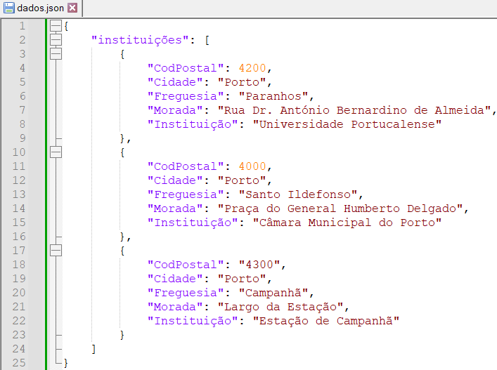
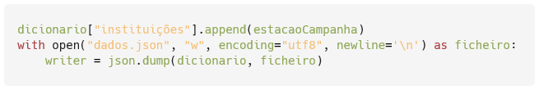
Write JSON (from a dictionary)
After reading:
IMP.GE.190.0

Slide 12
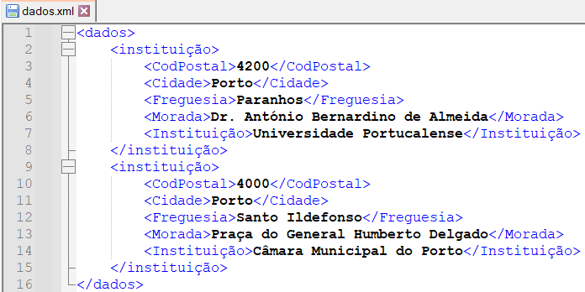
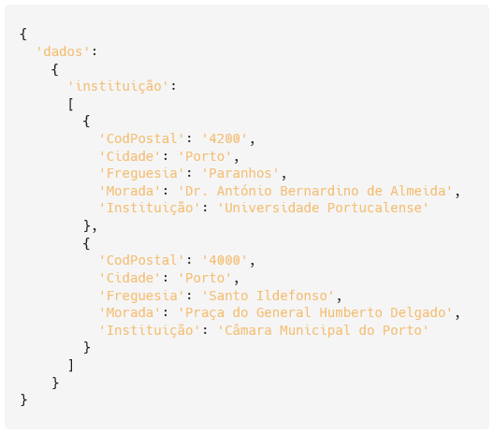
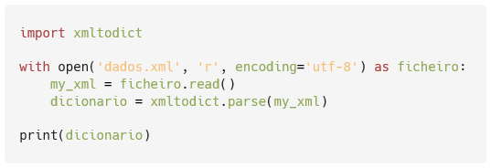
Read XML (to a dictionary)
IMP.GE.190.0

Slide 13
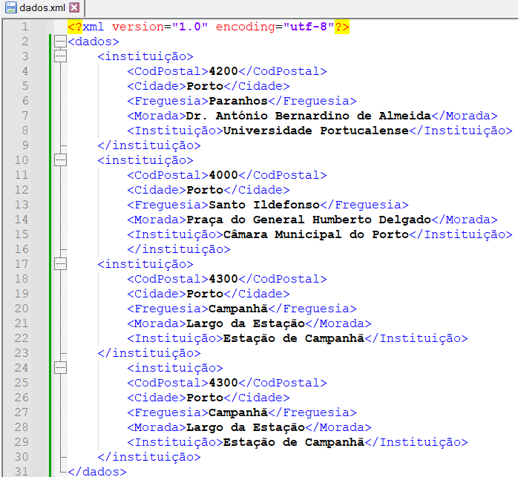
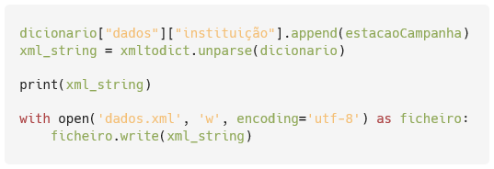
Write XML (from a dictionary)
After reading:
IMP.GE.190.0

Slide 14
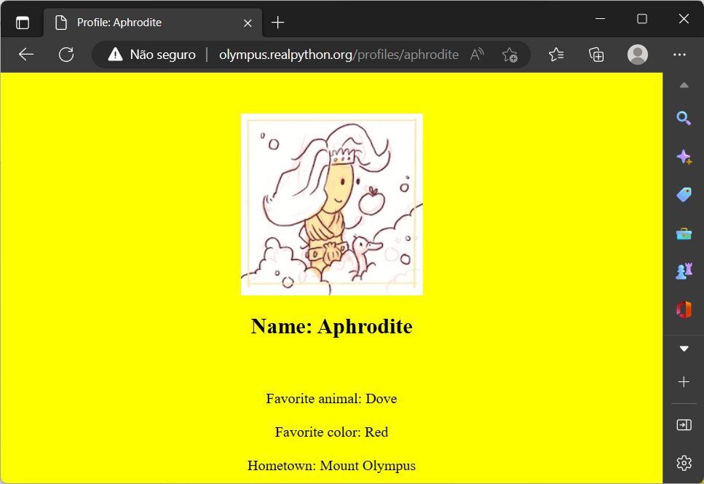
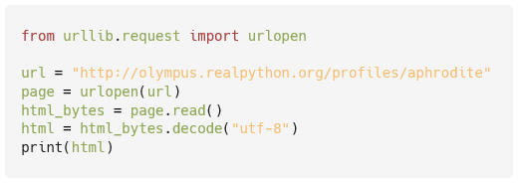
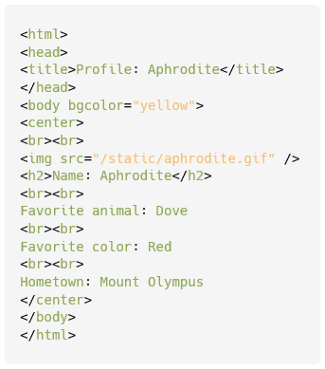
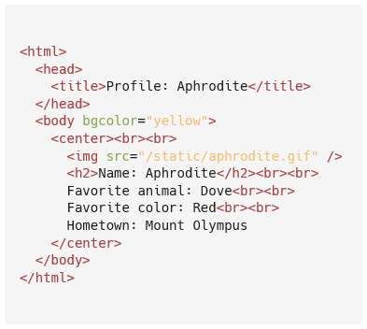
Read Web Pages
IMP.GE.190.0

Slide 15
IMP.GE.190.0

