Slide 1



Charts
Catarina Oliveira
IMP.GE.190.0

Slide 2
CONTENT
some libraries
matplotlib
2D curve
2 2D curves
3D curve
styles
Titles
Subtitles
Axes:
Limits
marks/intervals
Save
IMP.GE.190.0

Slide 3
some libraries
Plotly : https://plot.ly/python/
Creates publication-quality interactive graphics
Seaborn : https://seaborn.pydata.org/
Based on matplotlib .
Provides a high-level interface for drawing visually pleasing and informative statistical graphs.
Ggplot : https://pypi.org/project/ggplot/
Python implementation of grammar of graphics (used in R: https://ggplot2.tidyverse.org/reference/ggplot.html )
Altair: https://altair-viz.github.io/
Declarative Statistical Visualization Library
…
IMP.GE.190.0

Slide 4
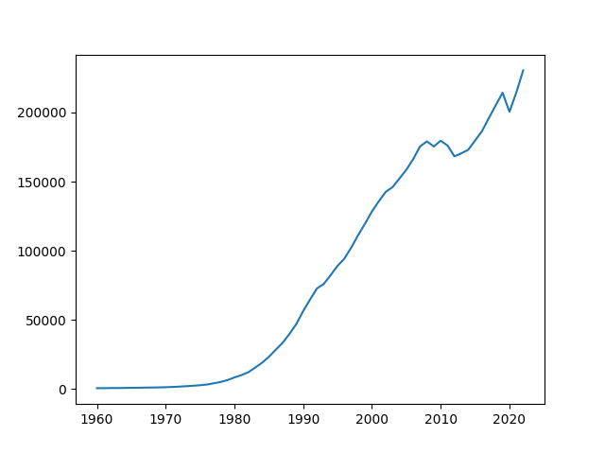
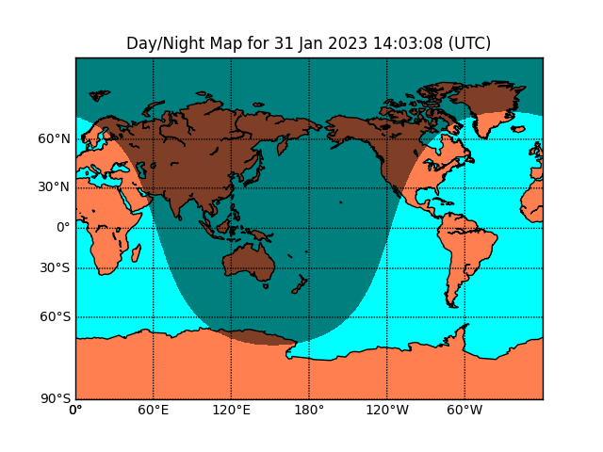
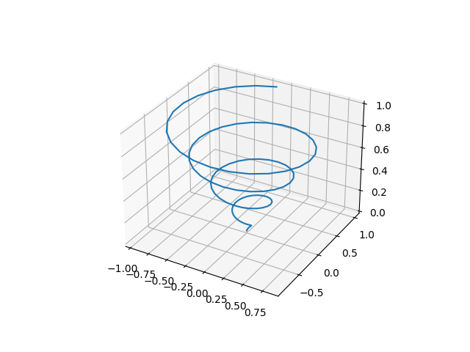
matplotlib
Library that allows you to make graphs in Python: https://matplotlib.org/
Output
JPG, PNG
PDF
…
types
2D
3D
Supports
Maps
interactive graphics
IMP.GE.190.0

Slide 5
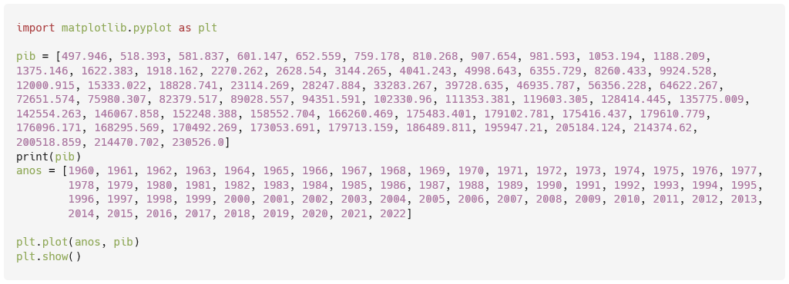
Matplotlib : 2D curve
IMP.GE.190.0

Slide 6
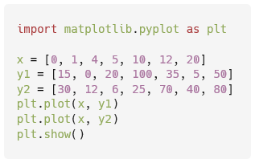
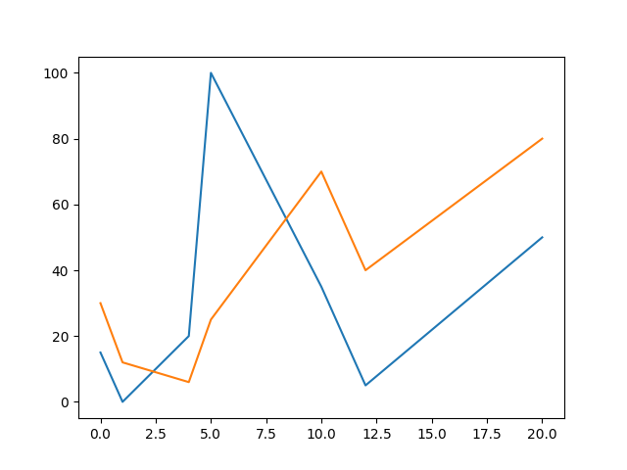
Matplotlib : 2 2D curves
IMP.GE.190.0

Slide 7
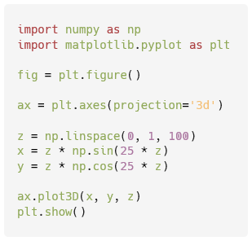
Matplotlib : 3D Curve
IMP.GE.190.0

Slide 8
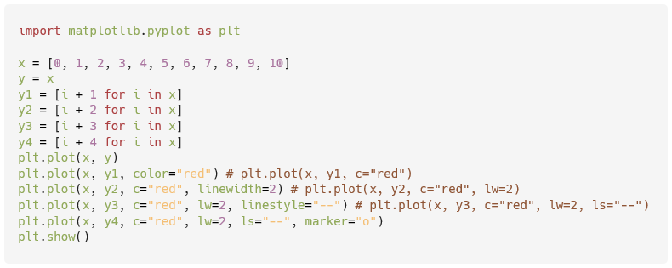
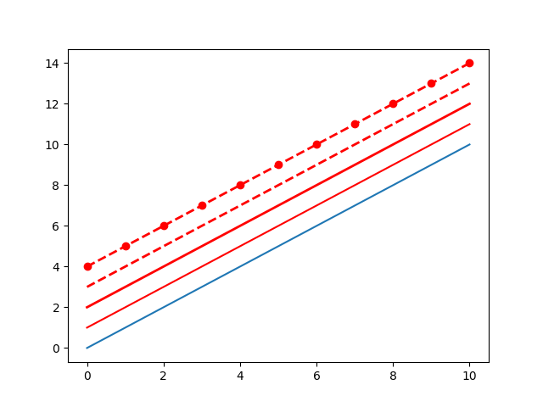
matplotlib : styles
Possible values:
color(c): https://matplotlib.org/2.0.2/api/colors_api.html
Ex: “ blue ”, “b”, “ red ”, “r”, “#0000ff”, “#ff0000”
linewidth ( lw ): any float
Eg: 1, 1.5, 2
linestyle ( ls ): https://matplotlib.org/stable/gallery/lines_bars_and_markers/linestyles.html
Ex: “--”, “ dashed ”, “:”, “ dotted ”
marker : https://matplotlib.org/stable/api/markers_api.html
For example: "o", "*", "1"
IMP.GE.190.0

Slide 9
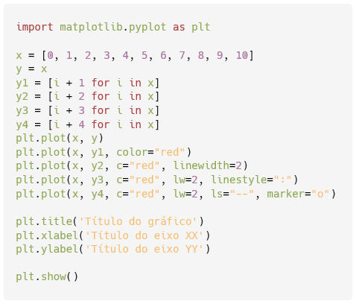
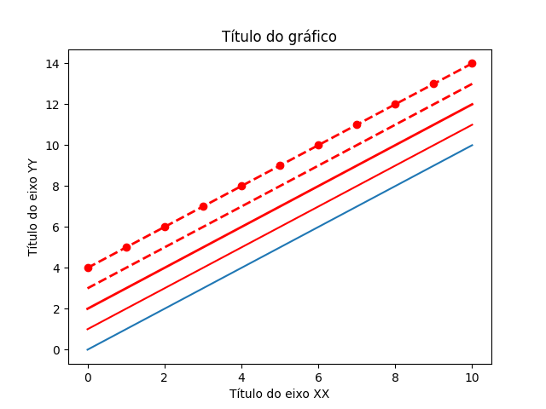
matplotlib : headings
IMP.GE.190.0

Slide 10
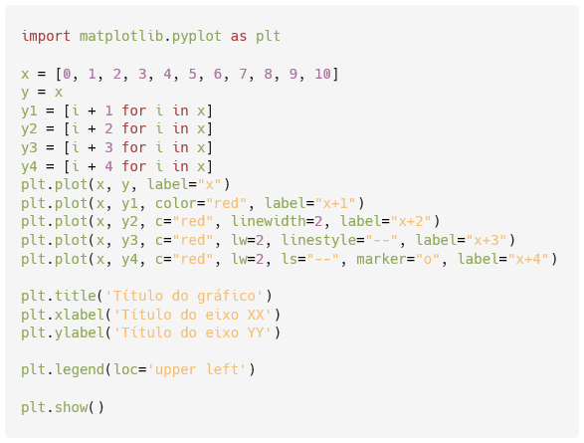
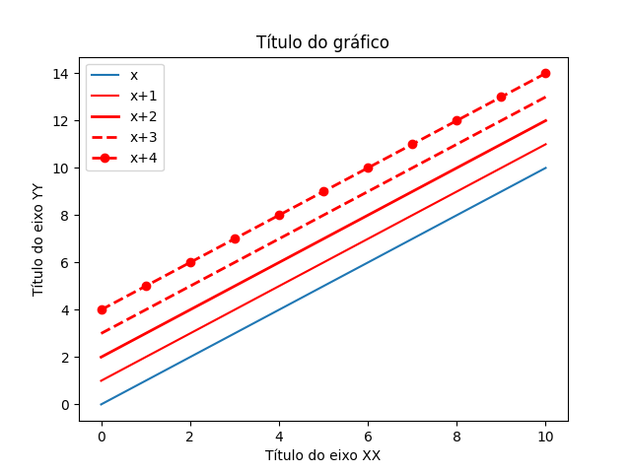
Matplotlib : subtitles
Text
IMP.GE.190.0

Slide 11
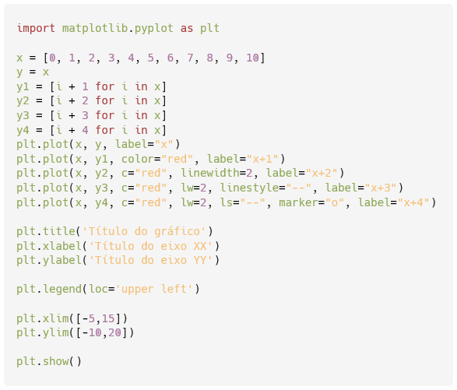
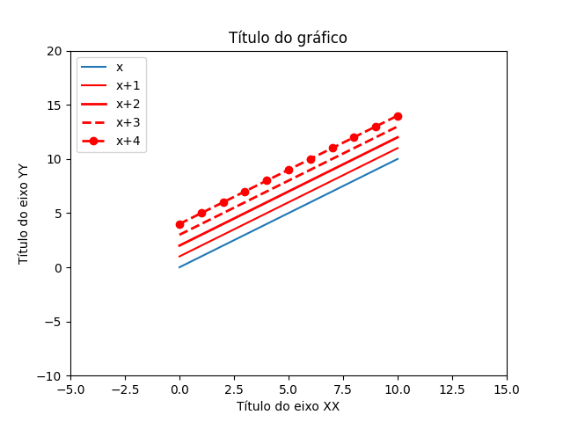
Matplotlib : axis limits
IMP.GE.190.0

Slide 12
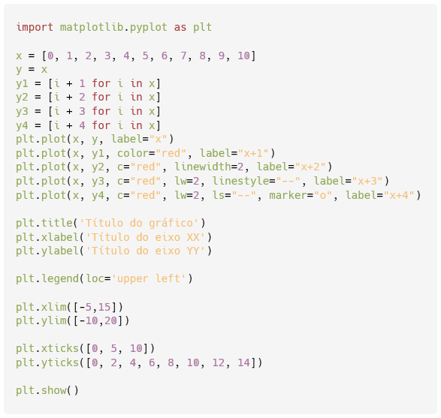
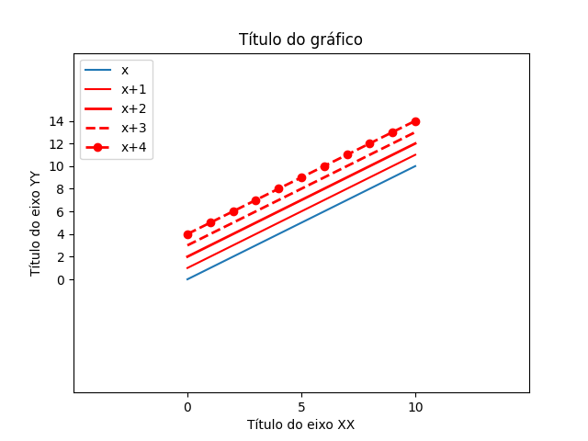
Matplotlib : axis marks/ranges
Text
IMP.GE.190.0

Slide 13
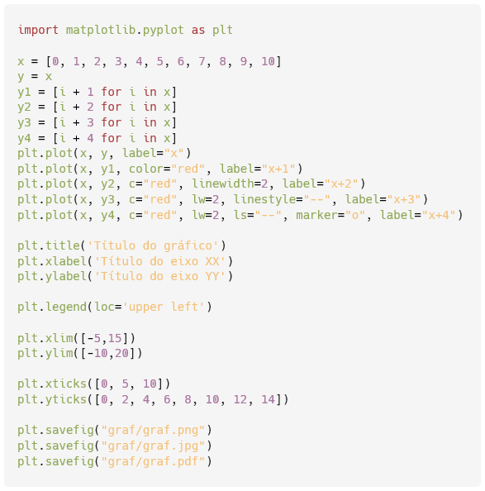
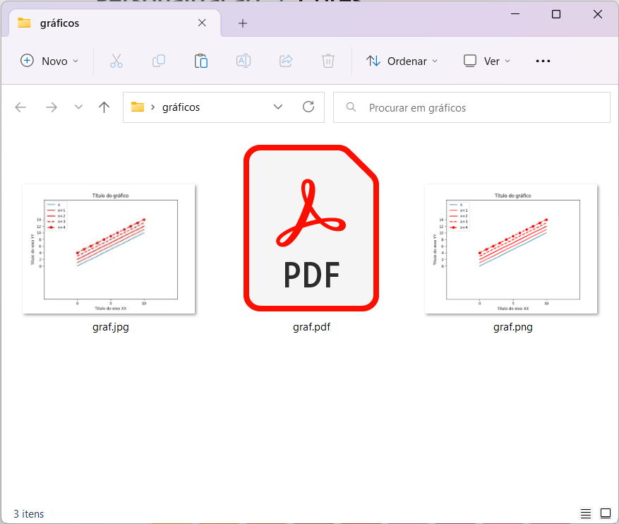
matplotlib : save
IMP.GE.190.0

Slide 14
IMP.GE.190.0

