Slide 1



pandas module
Catarina Oliveira
IMP.GE.190.0

Slide 2
CONTENT
What is it
Why use it
What it allows to do
Example
Example with CSV file
Example with JSON file
Data access in DataFrames
View data from DataFrame
Accessing part of the data in DataFrames : loc
Access part of data in DataFrames : iloc
Modify data from a DataFrame
Data cleaning: filling all Null and NaN
Data cleaning
Statistical measures of columns or rows
Operations with columns or rows
Statistical analysis
Charts
IMP.GE.190.0

Slide 3
What is it
Module used for data analysis
Allows:
Manipulate data structures of two types:
series
DataFrames
Assign names to rows/columns
Data Operations:
To analyze
To clean
To explore
manipulate and transform
Has support for missing data
Documentation: https://pandas.pydata.org/docs/
Series
DataFrame
IMP.GE.190.0

Slide 4
why use
It allows you to analyze big data and draw conclusions based on statistical theories.
It has mechanisms to clean up messy datasets and make them readable and relevant.
Relevant data is very important in data science.
IMP.GE.190.0

Slide 5
What allows to do
Data cleaning:
Can exclude rows that are not relevant or contain incorrect values, such as empty or NULL values.
Data analysis:
Provides answers about the data, for example:
Is there a correlation between two (or more) columns?
What is the average value?
Maximum value?
Minimum value?
IMP.GE.190.0

Slide 6
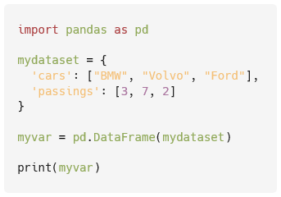
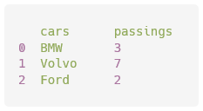
Example
IMP.GE.190.0

Slide 7
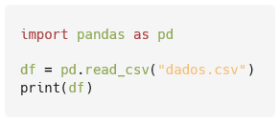
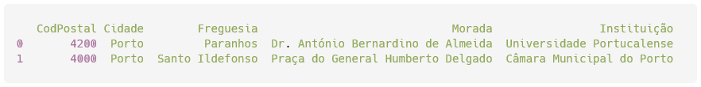
Example with CSV file
IMP.GE.190.0

Slide 8
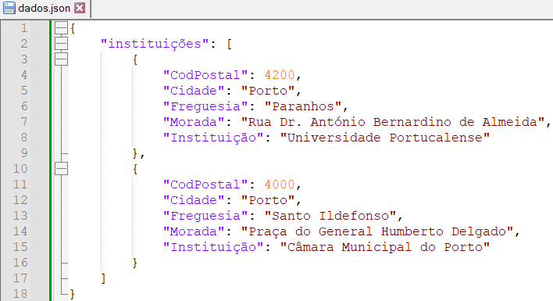
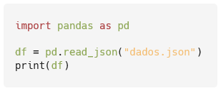
Example with JSON file
IMP.GE.190.0

Slide 9
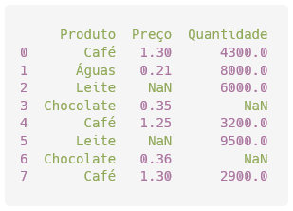
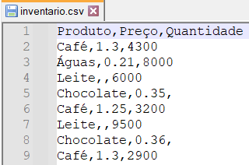
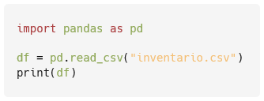
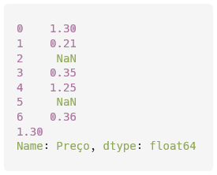
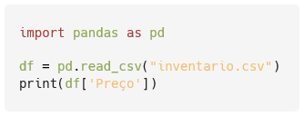
Data access in DataFrames
Show the entire DataFrame
Show only the “Price” column
IMP.GE.190.0

Slide 10
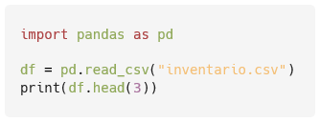
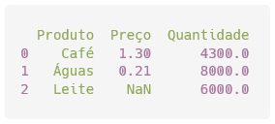
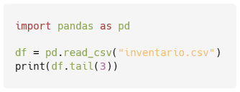
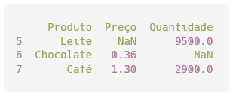
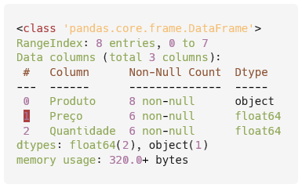
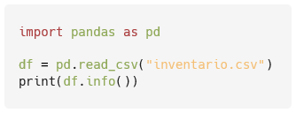
View data from DataFrame
Show first 3 lines
Show the last 3 lines
show info
IMP.GE.190.0

Slide 11
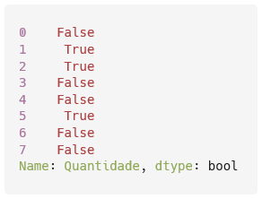
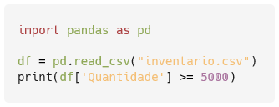
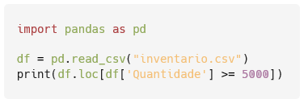
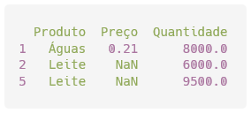
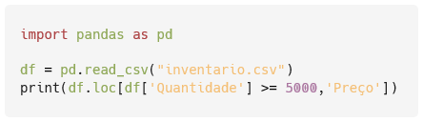
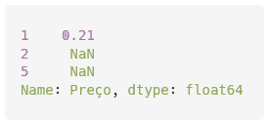
Accessing part of the data in DataFrames : loc
loc : allows accessing a group of rows and columns from labels or a boolean vector
https://pandas.pydata.org/docs/reference/api/pandas.DataFrame.loc.html
Which rows have “Quantity” greater than 5000
Show rows that have "Quantity" greater than 5000
Show the "Price" column for rows that have "Quantity" greater than 5000
IMP.GE.190.0

Slide 12
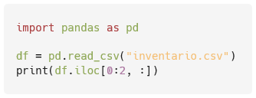
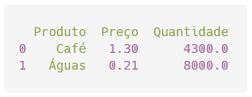
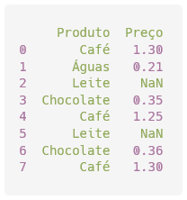
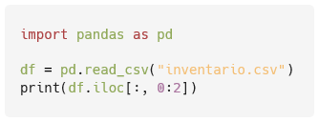
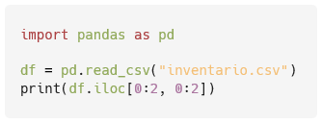
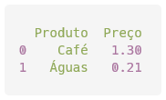
Access part of data in DataFrames : iloc
iloc : allows accessing a group of rows and columns from their indexes
https://pandas.pydata.org/docs/reference/api/pandas.DataFrame.iloc.html
Show rows with indexes 0 to 2 (0, 1, 2) of all columns
Show all rows of columns with indexes 0 to 2
Show rows with indexes 0 to 2 from columns with indexes 0 to 2
IMP.GE.190.0

Slide 13
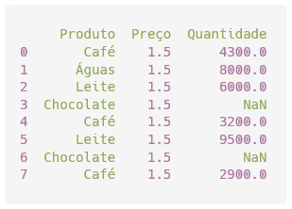
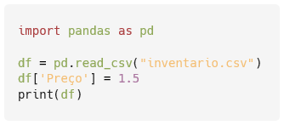
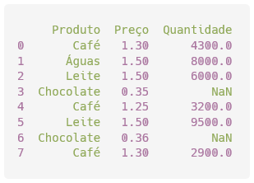
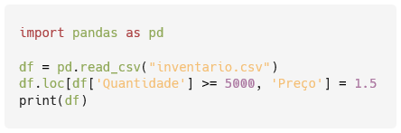
Modify data from a DataFrame
Change all prices to 1.5
Change all product prices with quantity greater than 5000 to 1.5
IMP.GE.190.0

Slide 14
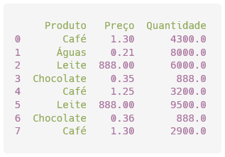
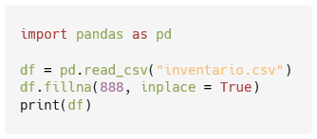
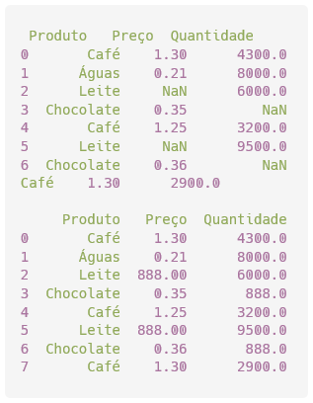
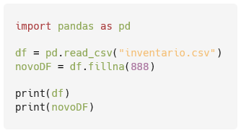
Data cleaning: filling all Null and NaN
Replace in original
Create a new DataFrame
IMP.GE.190.0

Slide 15
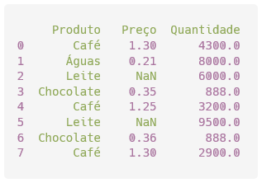
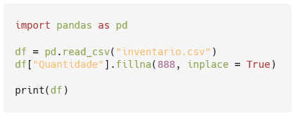
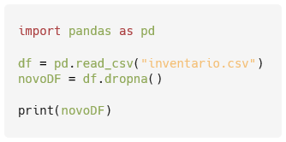
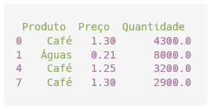
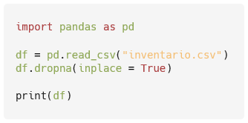
data cleaning
Replace in original DataFrame , Quantity column only
Create a new DataFrame ( df is not changed) without the rows with NaN
Remove lines with NaN from original
IMP.GE.190.0

Slide 16
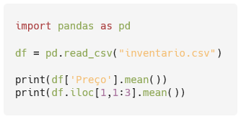

Statistical measures of columns or rows
mean
median
max
min
std
Get the average of the “Price” column and the average of the numeric values in row 1 (line indices start at 0)
IMP.GE.190.0

Slide 17
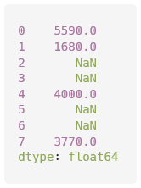
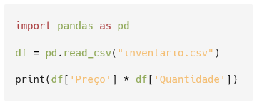
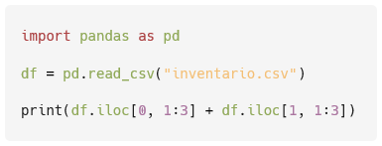
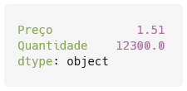
Operations with columns or rows
Sum
Subtraction
Division
...
Get the product of prices by quantity
Get the sum of prices and quantities from rows 0 and 1
IMP.GE.190.0

Slide 18
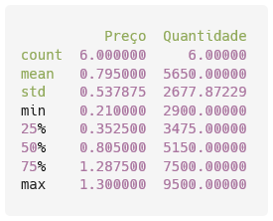
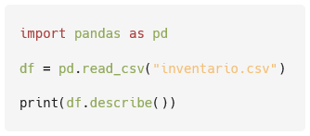
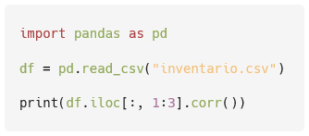

Statistical analysis
IMP.GE.190.0

Slide 19




Charts
IMP.GE.190.0

Slide 20
IMP.GE.190.0

