Slide 1
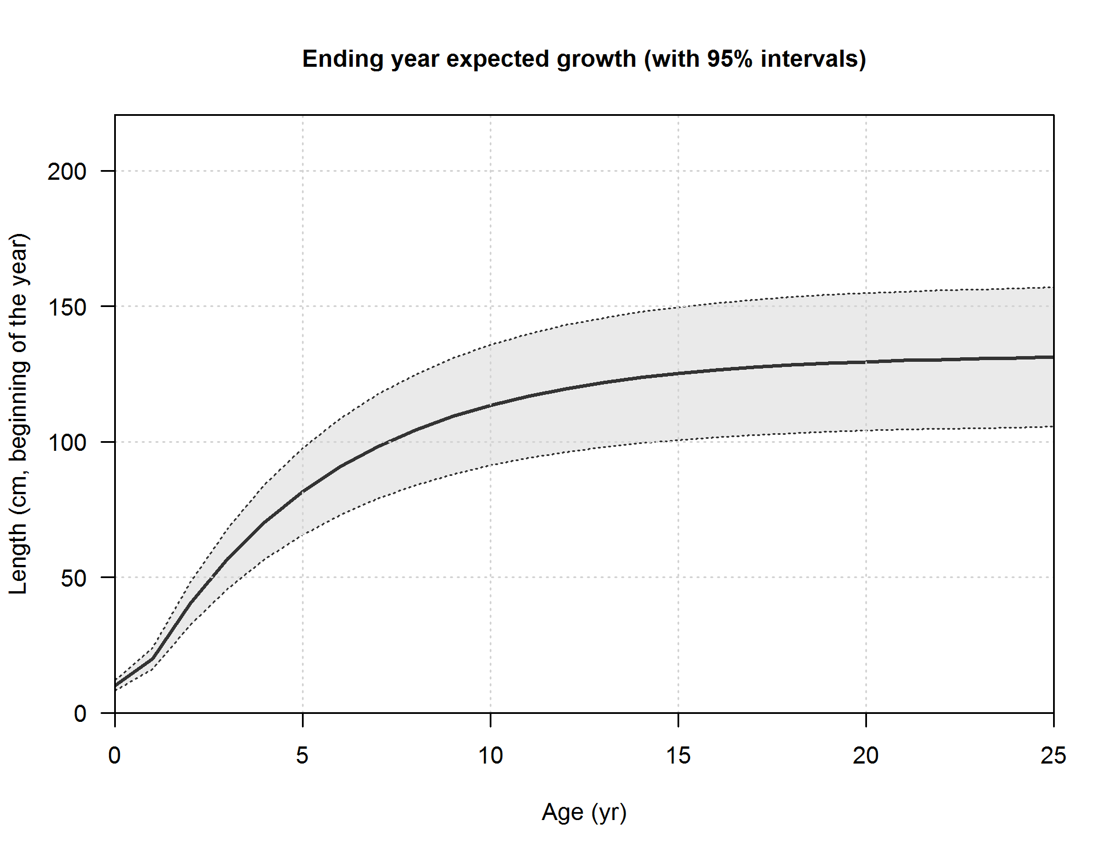
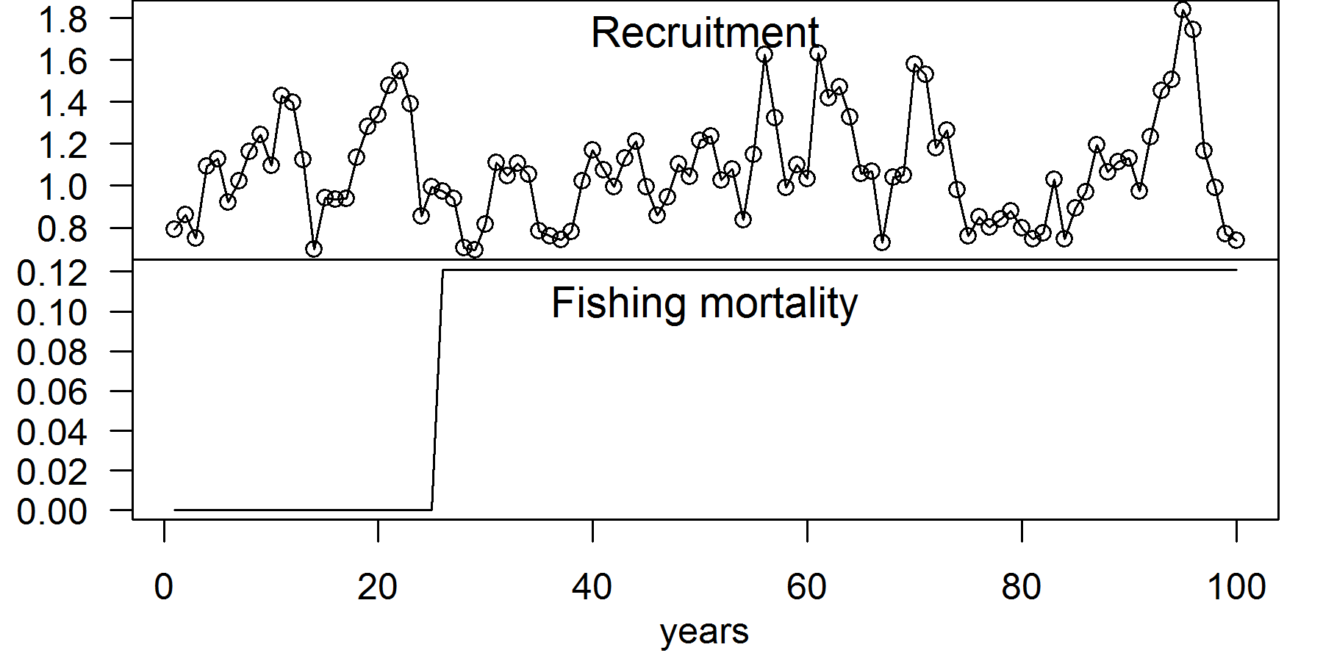
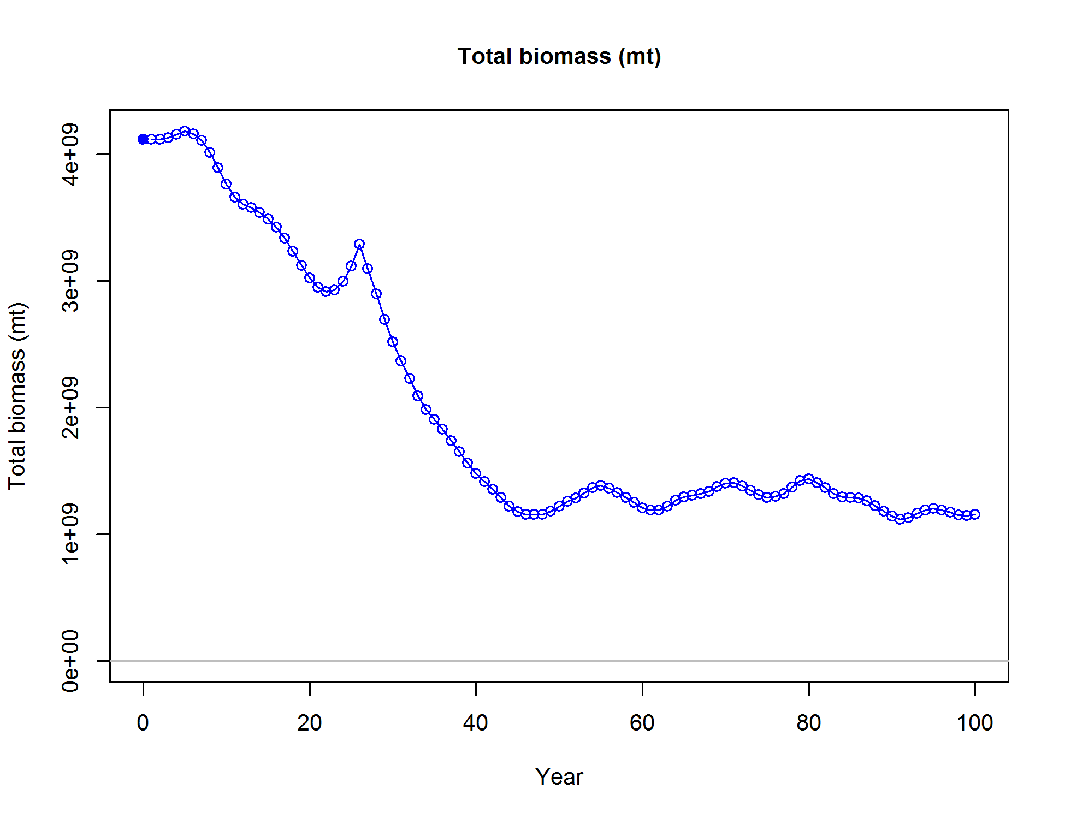
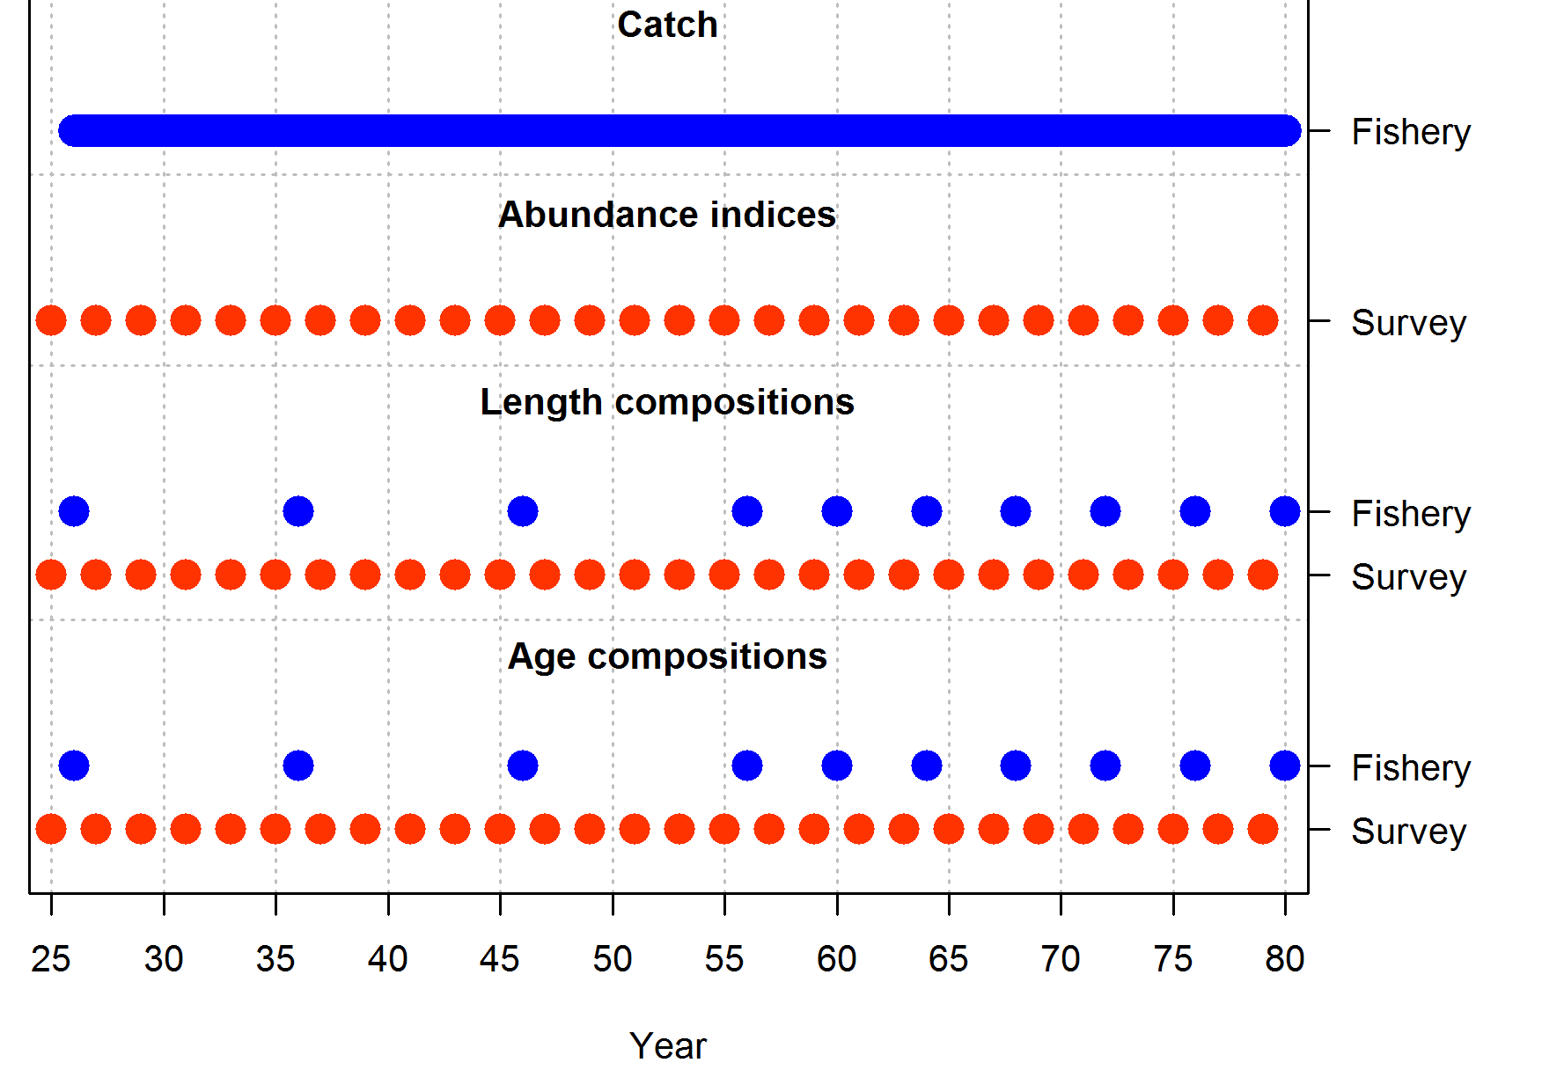
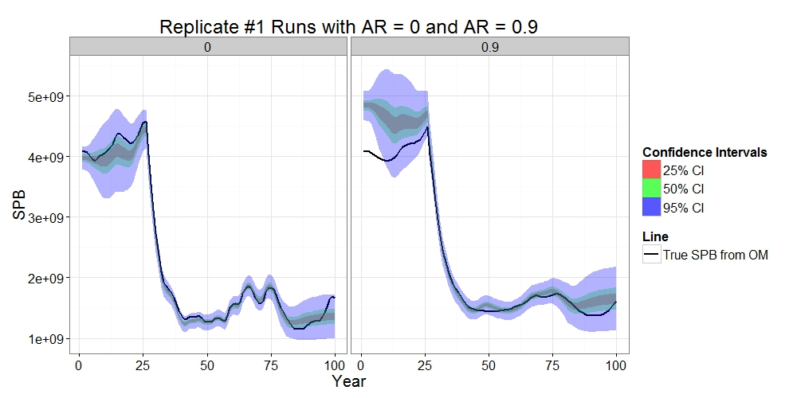
ss3sim (Anderson et al. 2014)
Operating Model (OM) – SS files
Input
e.g. biomass time series with unique process errors
(one of 50 replicates)
Sampling
Estimated biomass
Estimation Method
(EM) –
SS files
forecasts

