Slide 1
Social Engineering As A Service

Slide 2


Slide 3
WHAT IS SEAAS?

Slide 4



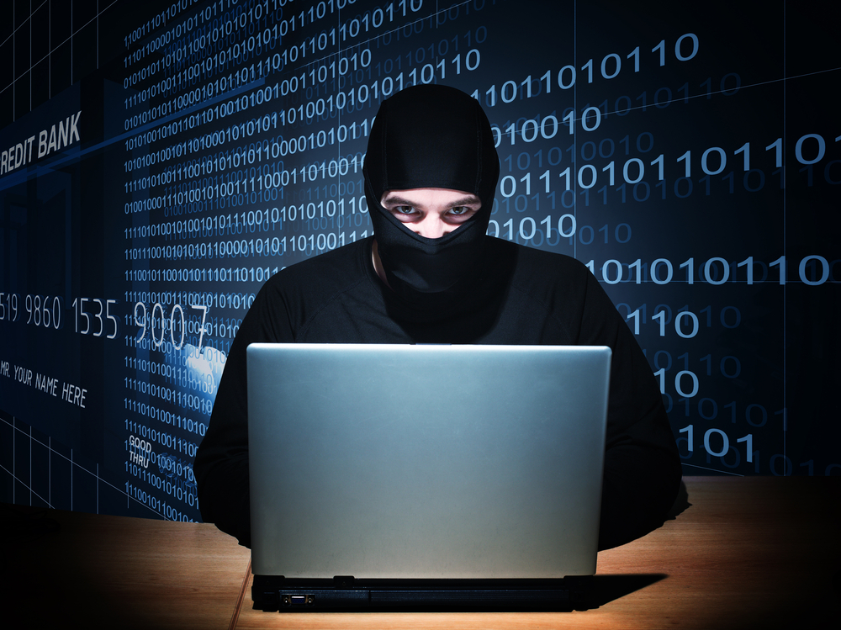

Slide 5
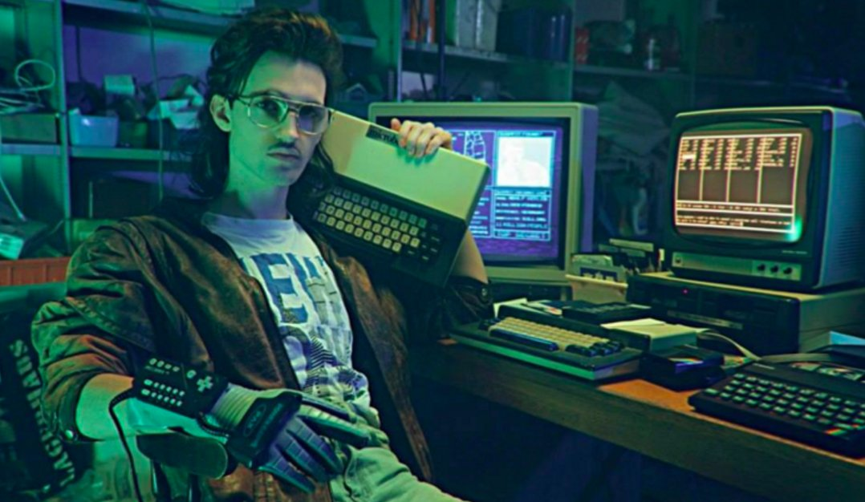

Slide 6
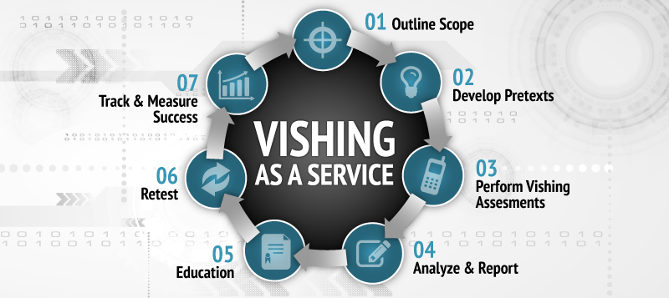

Slide 7
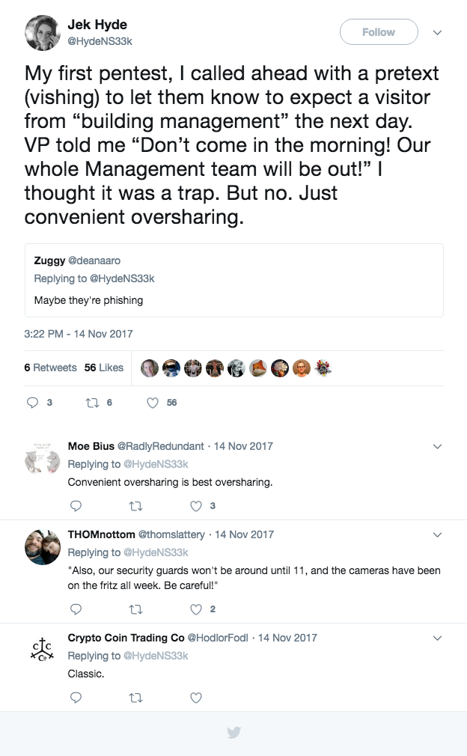

Slide 8
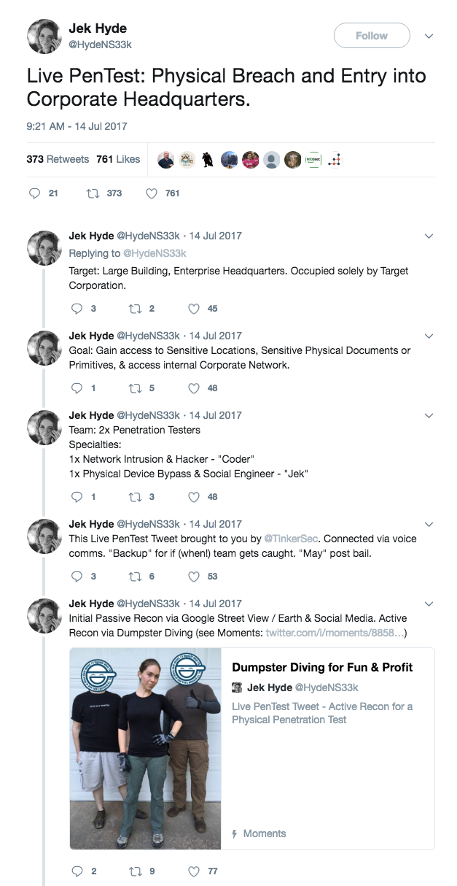

Slide 9
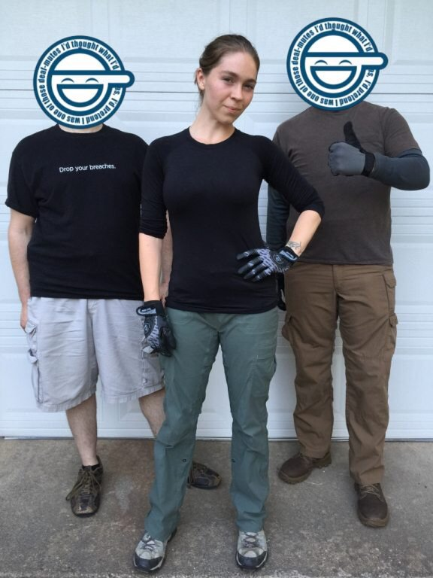

Slide 10
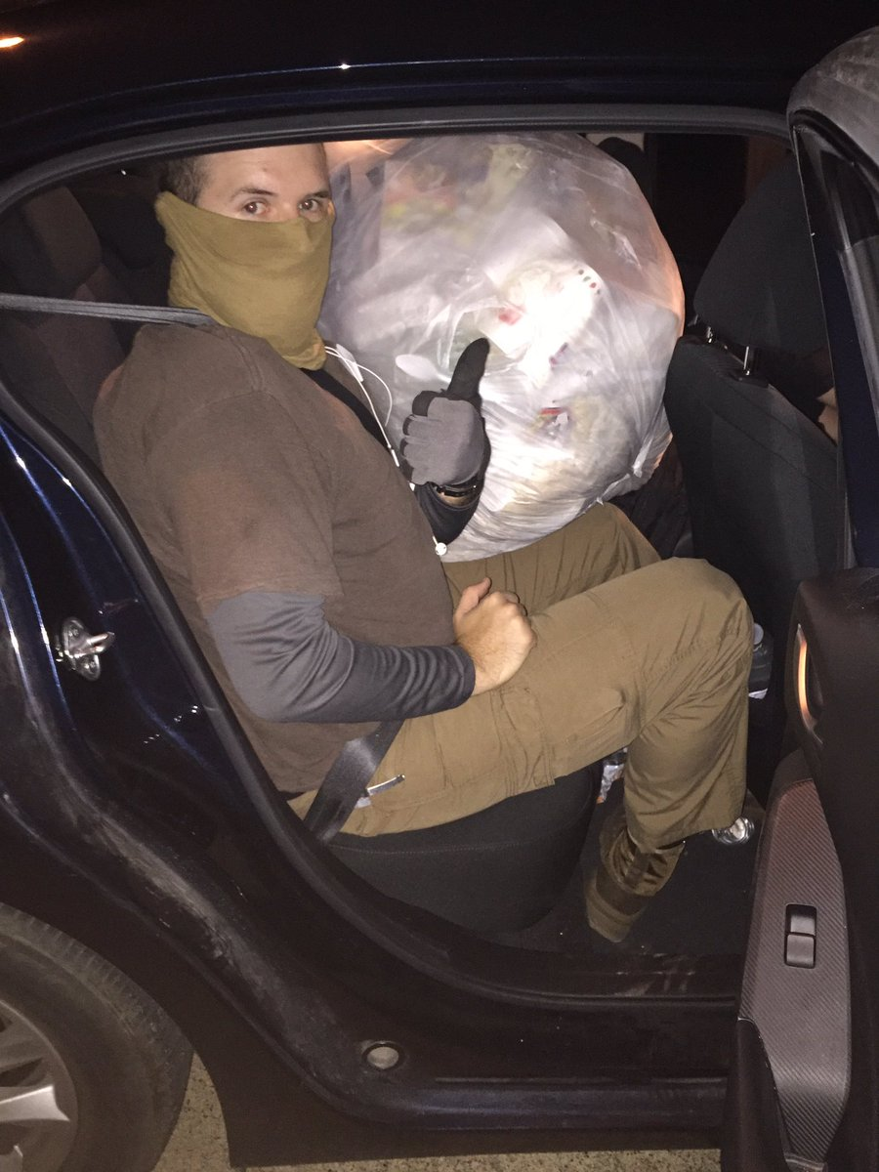

Slide 11
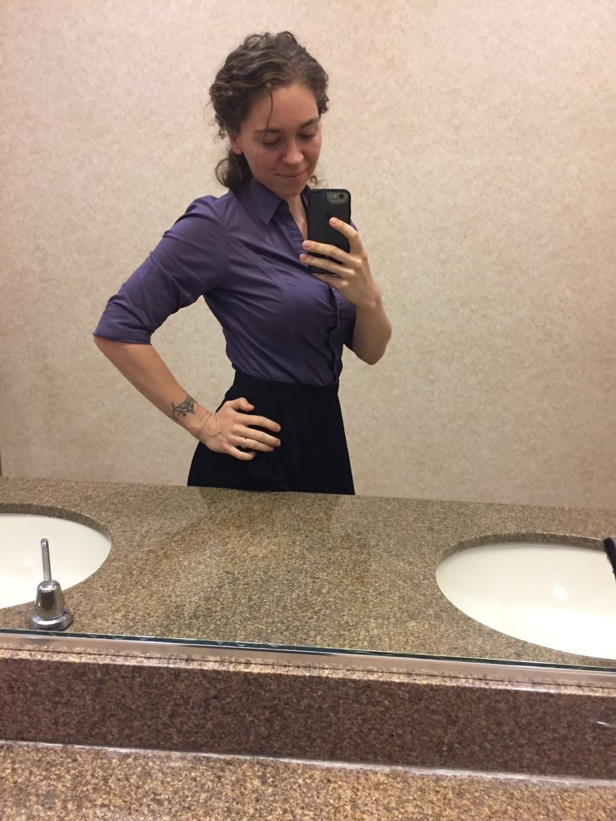

Slide 12


Slide 13
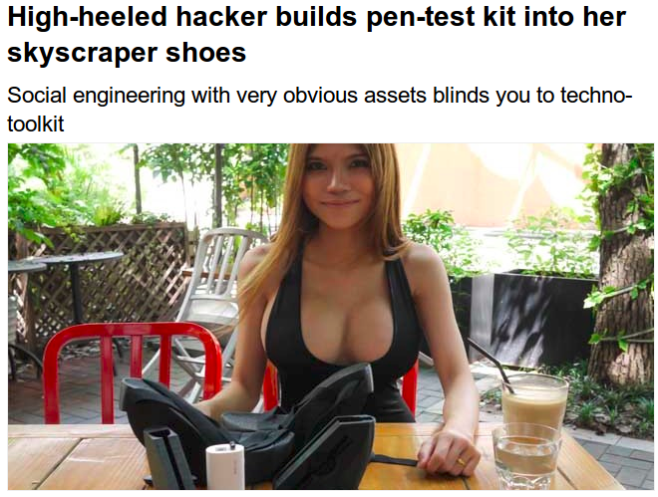
http://www.theregister.co.uk/2015/08/24/heeled_hacker_turns_wedges_into_concealed_pwn_weapons/

Slide 14
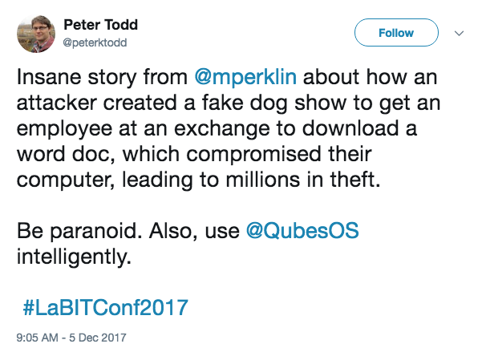

Slide 15
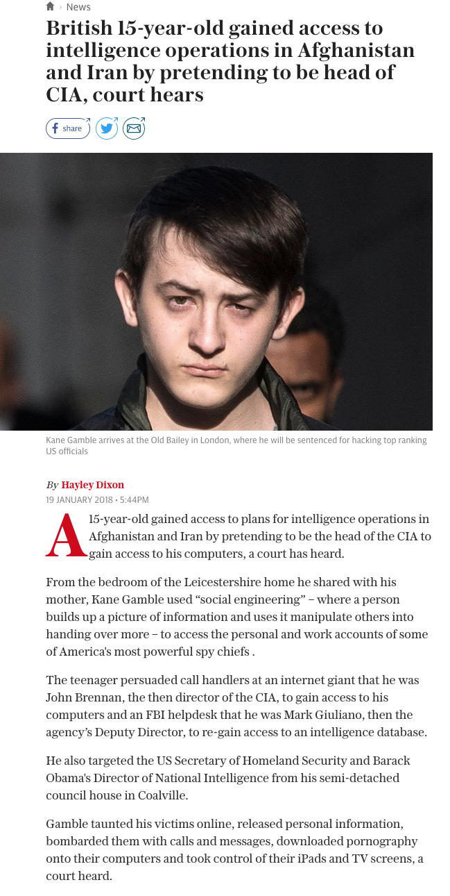

Slide 16


Slide 17
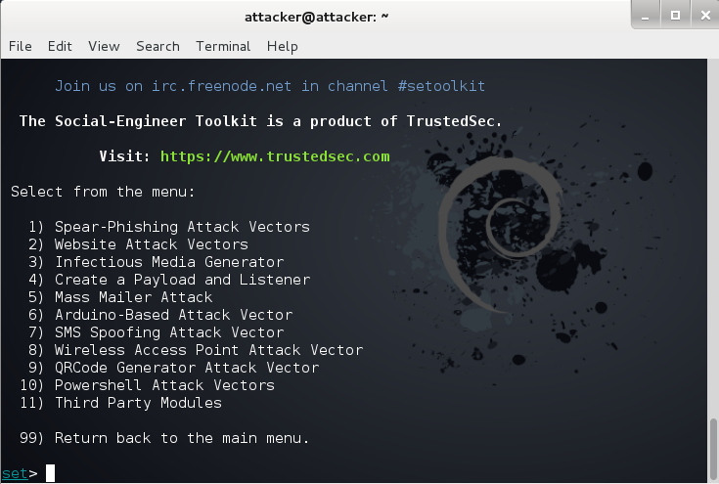

Slide 18
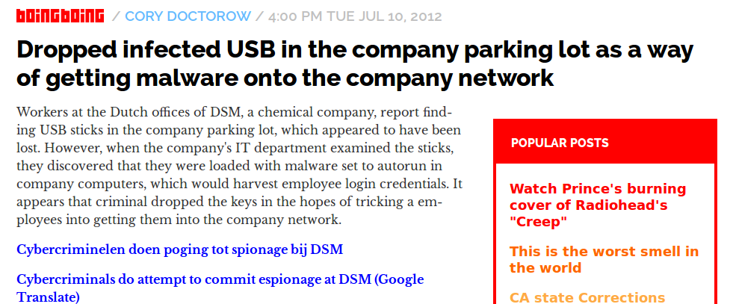
https://boingboing.net/2012/07/10/dropped-infected-usb-in-the-co.html

