Slide 1

Introducing CatBoost for Apache Spark
Andrei Khropov, CatBoost team @ Yandex
Notes:
Hello!
My name is Andrei Khropov, and I’m the lead developer of CatBoost for Apache Spark implementation.
Today we’re going to talk about CatBoost on Apache Spark.
But before that I will provide some information on CatBoost in general.
The intended audience of this presentation is data scientists and data engineers. People who apply machine learning techniques in practice. So we will focus on practical aspects and not machine learning theory.
For those who are interested in the mathematical and algorithmical foundations of CatBoost you can find the relevant papers on our website https://catboost.ai/.

Slide 2
Plan
What is CatBoost?
Why CatBoost?
Why CatBoost for Apache Spark?
CatBoost for Apache Spark and Competitors
Notes:
So, the plan of the presentation is:
First I’m going to talk about what is CatBoost.
Then I will answer the question why would you want to use CatBoost.
Then we will discuss what are the benefits of CatBoost for Apache Spark implementation.
And finally there will be a brief comparison with our main competitors among GBDT libraries.

Slide 3
What is CatBoost?
CatBoost is a machine learning algorithm that uses gradient boosting on decision trees (GBDT).
It is available as an open source library.
Notes:
So, what is CatBoost.
CatBoost is a machine learning algorithm that uses gradient boosting on decision trees (GBDT). We will briefly recall the basics of GBDT in the next few slides.
And it is available as an open source library with a permissive Apache 2 license, so it is both free as in freedom and free as in beer.

Slide 4
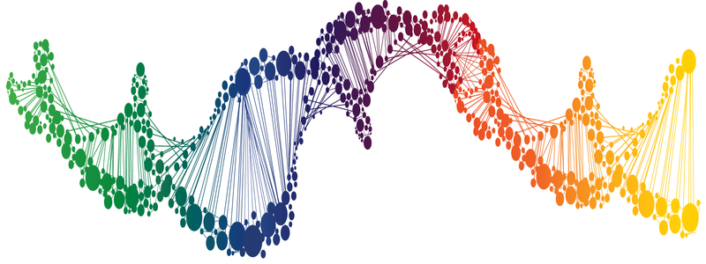
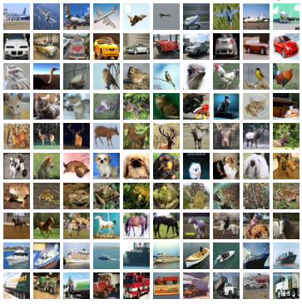
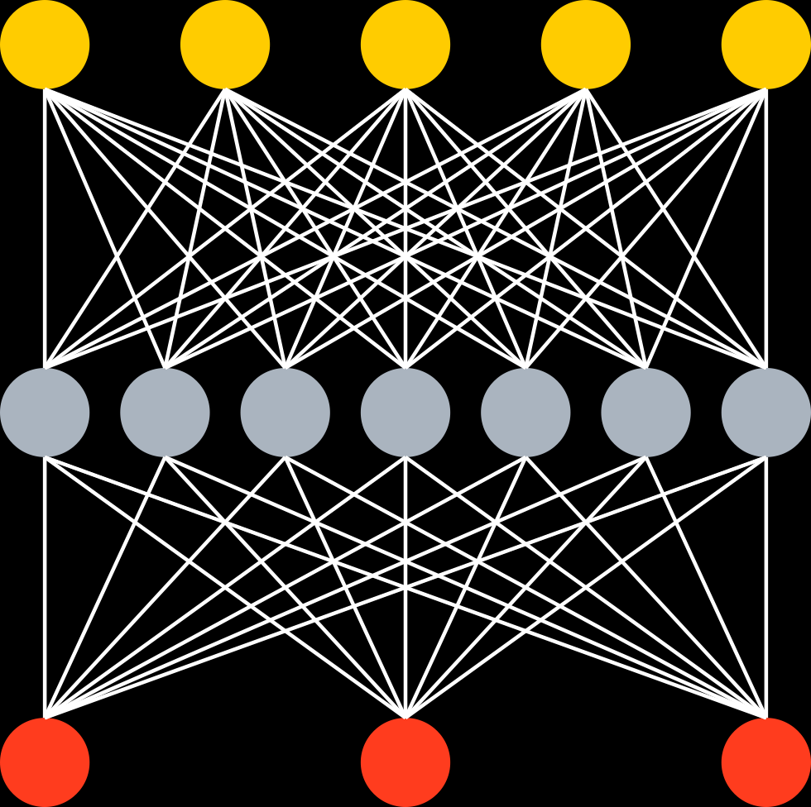
Data at hand
Tabular (or structured) data
Unstructured data
Well engineered features
^{Music track length} | ^{Year} | ^{Rating} | ^{Label}
² | ¹⁹⁹⁰ | ³ | ¹
³ | ¹⁹⁵⁰ | ⁵ | ⁰
¹⁵ | ¹⁹⁷⁰ | ⁴ | ¹
Music
DNA
Images
Text
End2End with Deep NN
GBDT
+
+
+
+
…
Big error
Better
Ship it
Notes:
Let’s start by talking about data that is used in machine learning.
Here you can see a one way to classify types of data used to solve practical problems today.
Firstly, we have so-called unstructured data, like images and video, where deep learning techniques are currently dominating.
Secondly, we have tabular, or structured data: well-engineered features are used to describe a sample we use to make predictions. Features are typically float numbers (integers are subset of float numbers).
For this type of data the state-of-the-art results are achieved by GBDT.

Slide 5
Tabular data? Decision trees!
Animal?
No
Yes
Not a cat
Have whiskers?
No
Yes
Not a cat
Purrs?
No
Yes
Cat!
Not a cat
Notes:
Let’s recall what are Decision Trees and why they are still so powerful.
Decision Tree is a simple structure with a some condition in its nodes and some values in its leaves.
In the simple case, model leaves contain final predictions, also there could be more complex leaves with additional values (like for example, for several classes) and even formulas in them.
The main disadvantage of Decision trees is that it’s really hard to avoid overfitting, or even full memorization of the training dataset. That leads to less then optimal generalization abilities of such models.
On this slide we have an example of a decision tree that is a simple binary classifier (answers the question ‘Is object a cat’ ?) on some objects with boolean features like ‘Is it an animal?’, ’Does it have whiskers?’, ‘does is purr?’

Slide 6
Gradient boosted decision trees
State-of-the-art quality on tabular data
Easy to use, no sophisticated parameter tuning
Works well with small data and scales for big data problems
+
+
+
+
…
Big error
Better
Ship it
Notes:
Gradient Boosted Decision Trees.
This technique is very easy to use, and it has a really small number of parameters you have to tune manually to achieve good quality of the model. For GBDT it is often enough to use just 3 parameters: a maximum depth of tree, a number of trees you want to train and a learning rate. And that’s all, you could spend the rest of time working with the data, not with model parameters tuning.
Gradient boosting works well on small datasets and scales well for big ones.
And this method allows you to accurately check and avoid overfitting – you could look at the target loss function values change on the validation set and stop training when it stops increasing and start to decrease or even cut some trees from your model after training.

Slide 7
Why CatBoost?
Sophisticated feature types support
Training with pairs
Good quality with default parameters
Fast applier
Extensive support of model formats
Model analysis tools
Stable, Production quality
Notes:
What distinguishes CatBoost from other GBDT libraries?
First – CatBoost takes its name from ‘Categorical Boosting’, it means that the main focus of CatBoost originally was to provide sophisticated categorical features support. You can read about it in detail in papers and in the other educational materials on our website. And recently CatBoost also added additional feature types – features derived from Text and Embeddings data.
Other distinguishing feature of CatBoost is that it supports training with pairs which is very useful for ranking problems. This feature is widely used in Yandex.Search.
We spend a lot of time tuning default parameters of CatBoost to make it work with pretty good quality with default parameters.
CatBoost standalone model applier is fast
Also CatBoost supports exporting models to the variety of common model formats so you can use it with multiple training and inference ecosystems.
CatBoost has many model analysis tools, including calculating feature importance, SHAP values and SHAP Interaction values.
At last, it is important to mention that CatBoost is stable and used in the production environment as well as for scientific research.

Slide 8
Features
Notes:
Let’s discuss feature types supported by CatBoost.

Slide 9
Features
Notes:
The first feature type is the most common one – when features are real numbers (or integers, which are actually a subset of real numbers).
Common examples are features like ‘length’, ‘weight’ and other measurements of something.
Decision trees work well with such features – decision functions in the nodes are predicates that compare a real value with some threshold that is selected during the training.

Slide 10
Features
Notes:
The second feature type is also common – it is when features take a limited set of distinct values. It’s very common that there’s no order between them so we cannot use comparison with thresholds like we did with numerical features.
They are often transformed to the binary numerical features using one-hot encoding but there’re more sophisticated techniques that can give better results. CatBoost uses them but the details are beyond the scope of this talk, see the relevant documentation on our website.

Slide 11
Features
Notes:
Sometimes features are less structured and contain texts in the raw form.
CatBoost has the built-in support for such features without additional pre-processing steps by external libraries.

Slide 12
Features
Notes:
Embeddings represent another type of complex features.
Their values are vectors of real values of fixed dimension. The sources of embedding mapping are usually some weakly structured data like texts. Real-valued vector representation is much more mathematically and algorithmically convinient.
CatBoost has some built-in support for Embeddings as input feature data.

Slide 13
Model formats
CatBoost Native
CoreML
ONNX
PMML
Raw code:
C++
Python
Notes:
CatBoost supports an extensive list of popular model formats.
CatBoost Native format is the primary file format used by CatBoost libraries and has the best features (in the `software features` meaning) coverage among all formats.
CoreML is a model format used primarily by Apple ecosystems.
ONNX is a well known model format for Neural Network models but is also supports some other machine learning model types like ensembles of decision trees which CatBoost uses.
PMML is another common model format
Finally, it is even possible to export CatBoost models as source code in either C++ or Python programming language. Such options are most library-independent and complied C++ code can be quite performant.

Slide 14
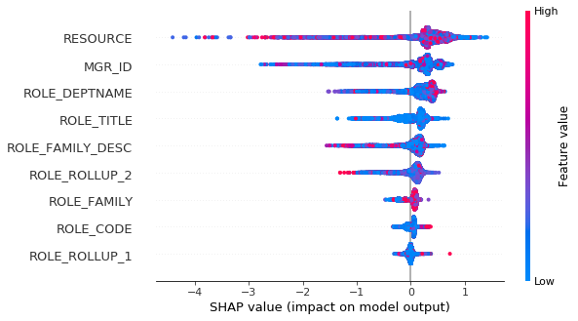
Model analysis
Example with SHAP values (uses ‘shap’ python package)
From https://github.com/catboost/tutorials/blob/master/model_analysis/shap_values_tutorial.ipynb
Notes:
Here’s an example of trained model analysis.
One of the popular techniques for analysis of feature importance and impact on the trained model Is SHAP values. Here’s an example from the tutorial on our website of SHAP values visualized for the trained CatBoost model.

Slide 15
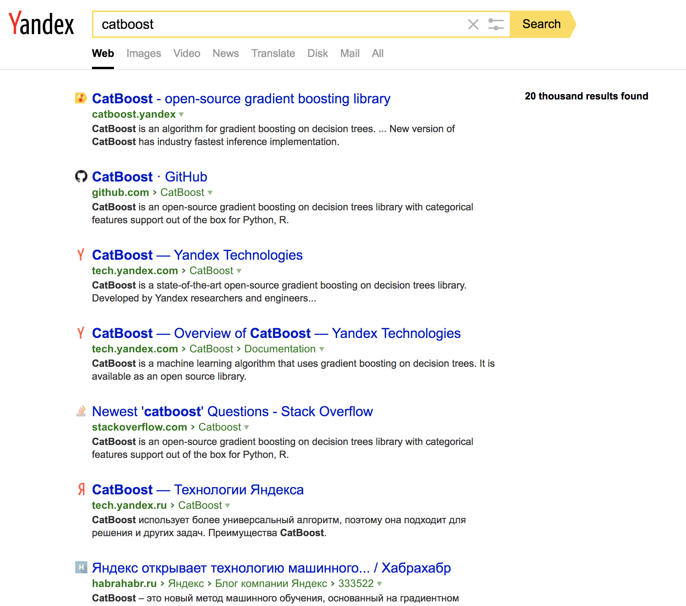
CatBoost in production
Yandex.Search
Big datasets up to several Terabytes
Multi-host multi-GPU training
… many other users inside Yandex
Notes:
As I’ve said CatBoost is stable and production-ready.
CatBoost has been originally created by Yandex, a leading ‘big tech’ company of Russia.
CatBoost is used extensively throughout Yandex, and one of the most important and demanding use cases is the ranking of results for the main Yandex web search engine.
The data is very big – datasets can reach up to several terabytes.
For such demanding tasks multi-host multi-GPU training is used.

Slide 16






CatBoost outside Yandex
Recommendations at Netflix
Hotel ranking in Aviasales
Protection against bots in CloudFlare
Particle classification in CERN
Medical research at University of NSW Sydney
Destination prediction in Careem taxi service
ML competitions on Kaggle
Join our Awesome Users List! ☺
Notes:
Let me now show you some use cases of CatBoost outside of Yandex
The first big example is Netflix, that uses CatBoost model as a part of it’s recommendation system
Another example – ranking hotel offerings for Aviasales airplane ticket booking system that helps to them to show the most relevant offers.
In CloudFlare CatBoost model is used to detect bot login attempts and protect against them.
Also, CatBoost model was a part of CERN LHCb particle classification – it classifies a particle as muon, proton or other type of particle
Also, CatBoost is used in ML contests on Kaggle.
And of course, it’s not a exhaustive listing ☺

Slide 17

Why CatBoost for Apache Spark?
Notes:
So, why implement CatBoost on Apache Spark platform?
If you’re listening to this talk you’re most likely already have a pretty good idea what Apache Spark is.
In a nutshell, Spark is a leading big data platform in the world and it is open source.

Slide 18
Why CatBoost for Apache Spark?
When data size is too big for a single machine
Notes:
The first case when CatBoost Spark could be useful is when your data size is too big for a single machine. It does not fit into RAM, so any operations on it are very slow. Or even worse it is beyond the limits of your permanent storage (SSD, HDD) capacity altogether.

Slide 19
Why CatBoost for Apache Spark?
When data size is too big for a single machine
Processing speed
Notes:
Even if your dataset sizes are within your local machine hardware limits you might want to utilize extra distributed processing power to take advantage of parallelism and perform your data operations faster.

Slide 20
Why CatBoost for Apache Spark?
When data size is too big for a single machine
Processing speed
When you need the flexibility of working with data on Spark
Notes:
As I’ve said Spark is a leading big data processing platform in the world.
It has an extensive API for data manipulation using SQL, Java, Scala, Python and R and some common machine learning algorithms implemented as libraries in the ecosystem as well.

Slide 21
Why CatBoost for Apache Spark?
When data size is too big for a single machine
Processing speed
When you need the flexibility of working with data on Spark
Low-level data processing in Spark Scala/Java API vs faster than Python API
Notes:
Another reason is that Low-level data processing in Spark Scala/Java API is faster than Python API typically used by data engineers and data scientists when they are working with data locally using libraries such as numpy, pandas and scikit-learn.
While these libraries are well-optimized for common operations if you have to manipulate data on the low level with your own functions processing individual data elements it is typically very slow with an interpreted language such as python. Most widespread python implementations also contain Global Interpreter Lock that limits the ability to write multithreaded code.

Slide 22
Why CatBoost for Apache Spark?
When data size is too big for a single machine
Processing speed
When you need the flexibility of working with data on Spark
Low-level data processing in Spark Scala/Java API vs faster than Python API
CatBoost model training and analysis with JVM platform API
(PySpark is also supported)
Notes:
Standalone CatBoost library does not have API bindings for training and model analysis on JVM platform, you can only use catboost-prediction package to apply models trained using other platforms.
So CatBoost Spark now fills this gap and allows training and model analysis with JVM API.
Note that PySpark API is also supported by CatBoost Spark.

Slide 23
Why CatBoost for Apache Spark?
When data size is too big for a single machine
Processing speed
When you need the flexibility of working with data on Spark
Low-level data processing in Spark Scala/Java API vs faster than Python API
CatBoost model training and analysis with JVM platform API
(PySpark is also supported)
API is fully compatible with Spark ML library
Notes:
I’m sure you’ve expected that but yes, CatBoost Spark API is fully compatible with Spark ML Library.
It means familiar interfaces, data compatibility, and other common usage patterns for Spark ML practitioners and possibility to include CatBoost processing into Spark ML Pipelines.

Slide 24

API is fully compatible with Spark ML library
from pyspark.sql import SparkSession
sparkSession = (SparkSession.builder
.master("local[*]")
.config(
"spark.jars.packages",
"ai.catboost:catboost-spark_2.4_2.12:0.25-rc4"
).getOrCreate()
)
import catboost_spark
trainDf = sparkSession.read().load("/my_datasets/train")
classifier = catboost_spark.CatBoostClassifier(iterations=20)
classifier.write().save("/my_classifier")
model = classifier.fit(trainDf)
model.write().save("/my_model")
applyDf = sparkSession.read().load("/my_datasets/for_application")
dfWithPredictions = model.predict(applyDf)
Notes:
Here’s a simple example on how to use CatBoost Spark with PySpark API.
All the usual patterns work as expected.
Creating classifier with parameters.
Saving it to Spark-supported storage.
Training on DataFrames with columns in usual formats.
Saving the resulting model to Spark-supported storage.
Applying the model on DataFrames.

Slide 25
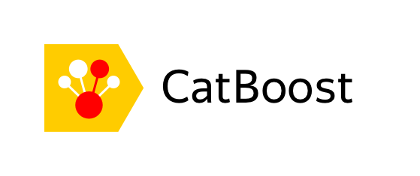


CatBoost for Spark vs Competitors
GPU support | No (planned) | No | Yes
Categorical features | Yes, including CTR statistics | Yes | Only preprocessed as one hot
Pairs | Yes | No | No
Pre-quantization | Yes | No | No
PySpark support | Yes | Yes | No
SparkR support | No | Beta | No
Notes:
On this slide you can see the feature comparison of CatBoost for Spark with our main competitors.
Note that the features mentioned are Spark-implementation specific (for example, standalone CatBoost libraries support GPUs and there’s a binding for R)
The features are:
GPU support. We are working on supporting distributed GPU training with Spark API.
Categorical features. CatBoost has more extensive categorical features support and it extends to the Spark implementation as well.
Pairs training. A special mode of training that uses ordered sample pairs as a target signal for training instead of individual labels. This feature is especially useful for ranking problems.
Pre-quantization. CatBoost allows to optimize processing time and memory requirements if the same dataset is reused multiple times by pre-quantization of numeric features. We will discuss it on the next slide.
PySpark and SparkR are APIs to use Spark from Python and R respectively. PySpark is fully supported by CatBoost Spark where there’s no SparkR support at the moment.

Slide 26
Feature quantization
Notes:
One important step often used in GBDT algorithms is the quantization of real-valued features. That is useful because it is very computationally intensive to search over all possible splits between data points. So, the common technique is to partition the real line for each feature into bins (by so called ‘borders’) and consider bin borders for split candidates instead of all possible splits between feature values in the dataset.
There’re multiple techniques to choose borders ranging from simple uniform partitioning of observed range to feature values in the dataset to more complex techniques that try to choose borders in such a way to maintain uniform density of data points for each bin between borders (you can see such an example on the right side of the slide).
The detailed discussion of these algorithms is outside the score of this presentation.
Quantized datasets are also usually much more storage-efficient, depending on the number of borders one feature can now be stored from 1 bit (if it has only 1 border) to 1 or 2 bytes (up to 255 and 65535 borders respectively).
CatBoost considers up to 255 borders by default so dataset size is typically reduced 4x (from 4-byte floats to 1-byte bins). For Spark it is even more advantageous (8x) as Spark MLLib typically stores features in Vectors with 8-byte Double values.
If the same dataset is used for training (or other uses like feature analysis) multiple times and quantization procedure parameters are the same you can save processing resources and memory if you prequantize this dataset and cache the result (using Pool.quantize function).

Slide 27
CatBoost Spark Performance vs Competitors
 | Criteo derived 170 m samples 65 features |  | Epsilon 400 k samples 2000 features |  | Higgs 10.5 m samples 28 features
 | total | per iter | total | per iter | total | per iter
 | 53 m 52 s | 2.8 s | 1 h 5 m | 3.7 s | 7 m 40 s | 0.31 s
 | 59 m | 3.5 s | 2 h 36 m | 9.4 s | 2 h 25 m | 8.7 s
 | est. 8 h | 28.9 s | 17 m 25 s | 1 s | 10 m | 0.6 s
Cluster configuration – 16 nodes x 16 cores
Time on 1000 iterations, total time includes preprocessing
Notes:
On this slide you can see benchmarks comparing CatBoost on Spark performance with our main competitors.

Slide 28
The End
CatBoost website: https://catboost.ai/
CatBoost documentation: https://catboost.ai/docs
CatBoost on GitHub: https://github.com/catboost
CatBoost for Apache Spark home: https://github.com/catboost/catboost/tree/master/catboost/spark/catboost4j-spark
Notes:
This is the final slide.
Thank you for your attention.
Here are some useful links about both CatBoost in general and about CatBoost for Apache Spark implementation in particular.

