Slide 1
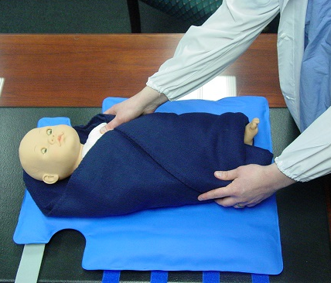
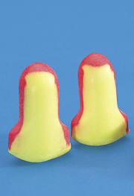
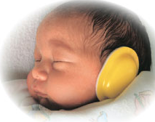
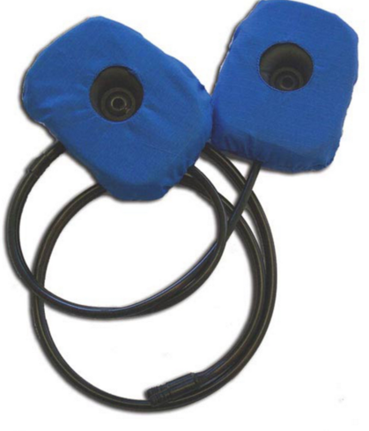
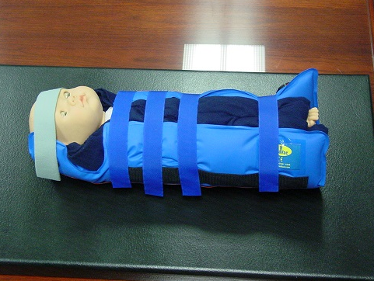

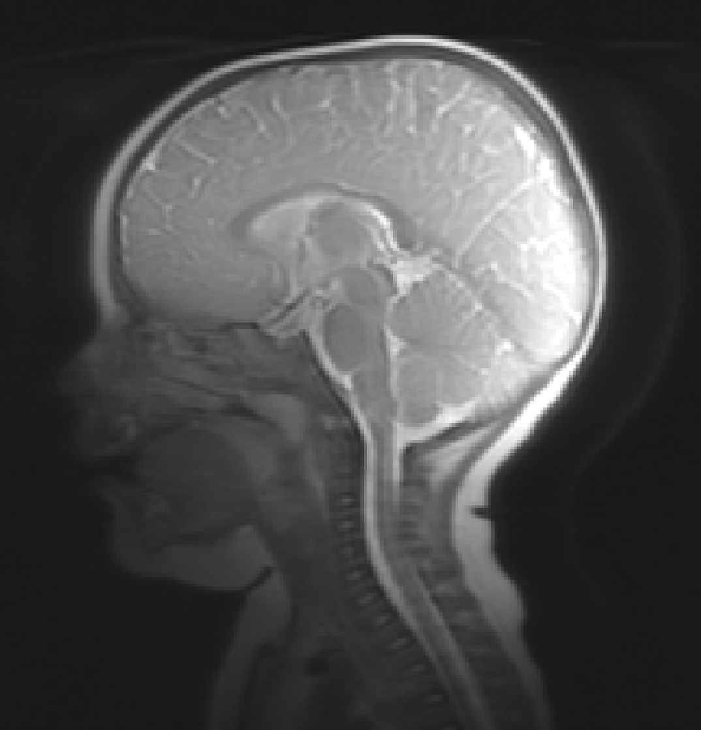
Step 1:
Place swaddled infant on wrap
Step 2:
Place earplugs
(Cut to fit ear)
Step 3:
Cover earplugs with minimuff
Step 4:
Place sound pads outside of minimuffs
Step 5:
Secure sound pads in place; secure wrap
Step 6:
Play soothing sounds through sound pads
Step 7:
Place infant on table
Step 8:
When asleep, begin scan
Step 9:
If infant awakens, sooth and restart as needed

