Slide 1
A Multi-Agent Simulation Environment of Hereditary Diseases
Demetrios G. Eliades

Slide 2
Slides Index
How, What, Why?
Introduction to Hereditary Diseases
Presentation of “GeneCity”
Novel Elements in use
Sample Experiments
Conclusion

Slide 3
The Questions
In a society of healthy persons, a person with a hereditary disease enters. How is this spread with time?
A person who is carrier of a disease, falls in love with another person, also a carrier. How does this changes the marriage selections?

Slide 4
Current Research
Different Approaches
Medicine – Genetics
Demography – Human Ecology
Mathematics – Statistics
Psychology
Pursue of a unified model for the research of
the epidemiological behaviour
of hereditary diseases in a society.

Slide 5
Goals
Build a model which will :
Simulate the Demographical Growth of a Population
Instantiate and Study of the Spread of a Disease
Build necessary tools to observe the model
Output and store data for meta-analysis

Slide 6
Technologies Used
Multi Agent Systems
Genetic Algorithms
Reinforced Learning
Cellular Automata

Slide 7
Transmit Methods
Autosomal Recessive: heterozygote (or carrier) Healthy, homozygote Patient
Autosomal Dominant: heterozygote and homozygote Patient
Χ-Linked (Sex Related):
man and X-mutation Patient
46 Chromosomes:
22 Pairs Autosomes
2 Sex {Male ΧΥ, Female ΧΧ}

Slide 8
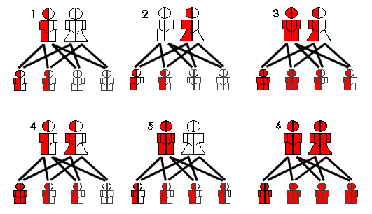
Autosomal

Slide 9
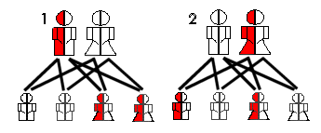
X-Linked
Male:
ΧΥ healthy
χΥ patient
Female:
ΧΧ healthy
χΧ healthy
Χχ healthy

Slide 10
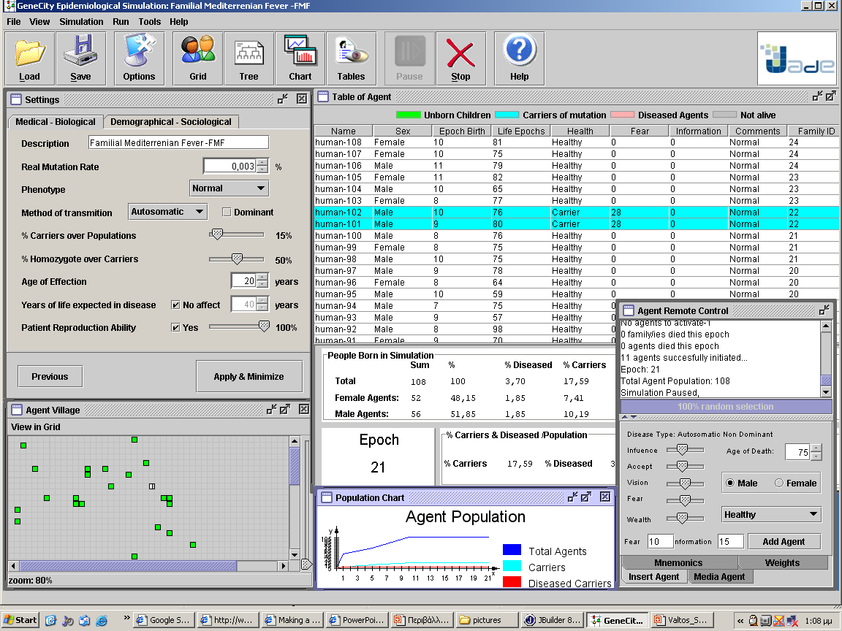
Genecity Environment
Main Menu
Selection Buttons
Configuration
Tables of Data
Remote Control
Agent Grid
Dynamic Graphs

Slide 11


Agent Communication
Graphical Enviroment
SuperAgent
ΜediaAgent
MatchAgent
Society of Agents

Slide 12
Agent Representation
Healthy Woman
Families Representation Green: %Healthy
Red: %Diseased
Healthy Man
Carrier Woman
Carrier Man
Patient Woman
Patient Man

Slide 13
Partner Choice
Agent Chosen Randomly
Exchange of Information about themselves
If marriage, then removed from Grid and return as family
Use a variation of the Stable Marriage Problem Algorithm

Slide 14
Criteria of Selection
Is the other person a patient?
What is the probability of having patient children if in marriage;
Is the disease deadly;
Does the other person have “negative Phenotype”;
Extra criteria
Distance in Grid (social, natural)
Wealth (beauty, money)
Age Difference (etc)

Slide 15
What is Measured
Population of society
Populations of diseased and carriers
Mean value of exchange information
Mean number of people informed for disease
Mean amount of information by Media Agent
Births and Deaths per epoch
Mean number of new families

Slide 16
Novelties
Media – Agent: Provides information about a disease (as Media or Health Education)
Dynamic Instantiation of Agent in the system, with its characteristics pre-defined

Slide 17
Novelties
Medical Genealogical Tree
Information for the disease form Neighbourhood
Total and Real-time change of Setup

Slide 18
Example A
Entrance of an Autosome Dominant diseased person in a healthy population:

Slide 19
Example B
Prejudice society for the X-link patients

