Slide 1
AI-Powered Godown Monitoring System
for Post-Harvest Loss Prevention
Team InnovativeX
Team ID: H26AGR06
TEAM LEAD
Vandana P.R.
TEAM MEMBERS
Chinnam Rushya
T. Divya Sri
COLLEGE
SASTRA Deemed University
1

Slide 2
Problem Statement
A large share of India's stored paddy and pulses is lost after harvest — not in the field, but inside the godown — because spoilage (mold, pests, moisture damage) is usually discovered only during infrequent manual inspection, by which point the loss is already done.
Objectives
Reactive
▸ Continuously monitor godown conditions (temperature, humidity, gas) instead of periodic manual checks
▸ Use computer vision to catch visible spoilage signs (mold, pest damage, discoloration) directly from grain images
▸ Fuse sensor + vision signals into a single, explainable real-time risk score per storage zone
▸ Automatically alert stakeholders via WhatsApp before a zone crosses into high-loss territory
▸ Prove the full workflow in software first, so hardware investment follows validated logic, not the other way around
Manual inspection finds spoilage after it has already spread
Siloed data
Temp/humidity loggers exist, but rarely fused with vision or alerting
Late alerts
No automatic, real-time notification to stakeholders on rising risk
2

Slide 3
Existing Solutions & Identified Gaps
Existing Approach
What It Does
Identified Gap
Manual visual inspection
Warehouse staff periodically check stock by eye
Reactive and infrequent — spoilage is usually already advanced by the time it's caught
Basic IoT dataloggers
Log temperature/humidity to a dashboard
No gas/CO₂ leading indicator, no vision, no automated scoring or alerting — just raw numbers
Standalone AI grain-quality classifiers
Classify grain images, typically at intake/procurement
One-time check only — not continuous in-storage monitoring, not fused with environmental data
Commercial cold-chain monitoring systems
Continuous monitoring with hardware + alerts
Expensive, hardware-heavy, built for refrigerated storage — not ambient godowns used for paddy/pulses
3

Slide 4
System Design
CV Classifier
MobileNetV2 model
Alert Dispatch
Twilio WhatsApp, with in-app fallback log
Simulated / Real Sensors
Temp · Humidity · Gas (CO₂ proxy) per zone
FastAPI Backend
main.py — single-process API (serves dashboard too)
Risk Engine
risk.py — rule-based scoring + sensor/vision fusion
Grain Image Upload
Zone photo via dashboard
Web Dashboard
Polls /risk/{zone} every few seconds, shows zone cards
4

Slide 5
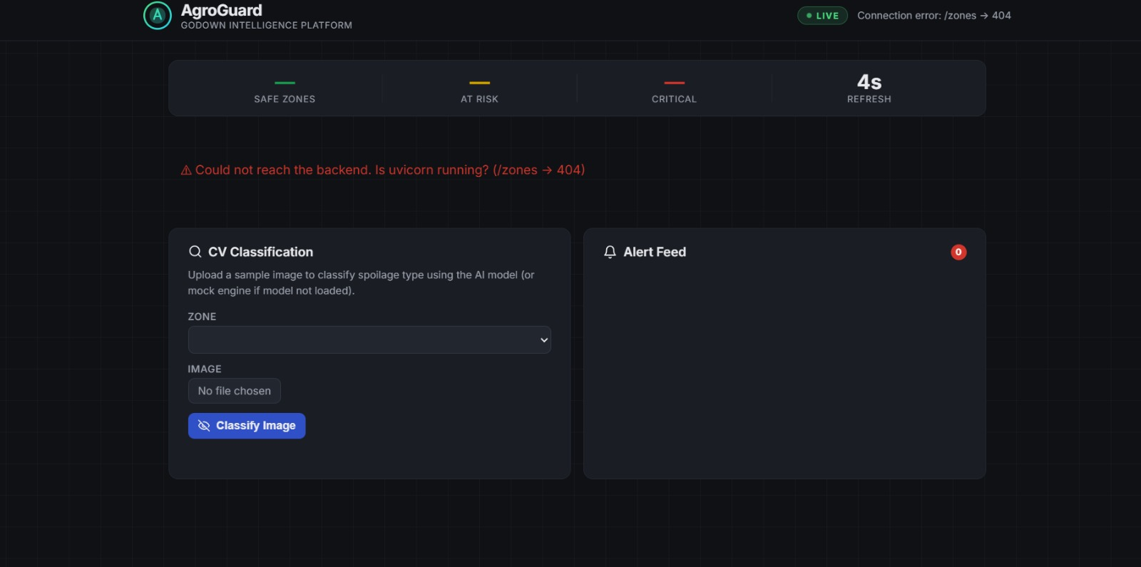
Implementation Progress
Development Status
Working Demonstration
Backend, dashboard, and alert log are built and verified working end-to-end locally (mock/heuristic classification, simulated sensors, rule-based risk scoring, in-app alert log).
Functionalities Completed
▸ FastAPI backend serving live simulated sensor readings for 3 godown zones
▸ Rule-based risk scoring engine combining humidity, temperature, and gas thresholds
▸ Image upload + classification endpoint (HSV heuristic fallback working; MobileNetV2 training pipeline ready)
▸ WhatsApp alert dispatch via Twilio Sandbox, with automatic in-app log fallback
▸ Web dashboard polling live per-zone risk cards, color-coded by severity
Preliminary Results
▸ Risk score correctly escalates for the "leaky roof" zone as humidity/gas drift upward
▸ Alerts fire at threshold with cooldown working as intended; classifier flags low-confidence results as "uncertain"
5

