Slide 1
CS 412 Intro. to Data Mining
Chapter 4. Data Warehousing and On-line Analytical Processing
Jiawei Han, Computer Science, Univ. Illinois at Urbana-Champaign, 2106

Slide 2
Chapter 4: Data Warehousing and On-line Analytical Processing
Data Warehouse: Basic Concepts
Data Warehouse Modeling: Data Cube and OLAP
Data Warehouse Implementation
Summary
Notes:
MJ:
Data warehouses generalize and consolidate data in multidimensional space.
(TODO: data warehouse vs. operational databases vs. data mart; OLAP vs. OLTP)
Construction of DWs: data cleaning, data integration, data transformation.
DWs provide OLAP tools for interactive analysis of multidimensional data of varied granularities.
Data mining functions (association, classification, prediction, clustering) are integrated with OLAP operations to enhance interactive mining of knowledge at multiple levels of abstraction.
They form an essential step in the knowledge discovery process.

Slide 3
What is a Data Warehouse?
Defined in many different ways, but not rigorously
A decision support database that is maintained separately from the organization’s operational database
Support information processing by providing a solid platform of consolidated, historical data for analysis
“A data warehouse is a subject-oriented, integrated, time-variant, and nonvolatile collection of data in support of management’s decision-making process.”—W. H. Inmon
Data warehousing:
The process of constructing and using data warehouses
Notes:
MJ:
DW provides architectures and tools for business executives to systematically organize, understand, and use their data to make decisions.
William Inmon is an American computer scientist. He is recognized as the father of the data warehouse. He coined the term data warehouse in 1990 and is considered the father of the $28 billion industry.
Born in 1945. Received B.S. in Math from Yale, M.S. in CS from New Maxico State Univ.
He has worked for American Management Systems before 1991.
He founded two companies Prism Solutions, Pine Cone Systems 91-99.
In 1999, he created the Corporate Information Factory Web site to educate professionals and decision makers about data warehousing and the Corporate Information Factory.
In 2007, he was named by Computerworld as one of the ten people that most influenced the first 40 years of the computer industry: Whitfield Diffie (information security, Turing Award, Keynote Speaker in KDD’16).
Two books. "Building the Data Warehouse" (1992, with later editions) and "DW 2.0: The Architecture for the Next Generation of Data Warehousing" (2008).
Four key features - distinguish DW from other data repository systems (relational database systems, transaction processing systems, file systems). Will introduce them one by one.
1. To support decision support 2. Integrate different sources 3. Integrate data of different time
4. Nonvolatile: store on disks, permanently able to be visited, though you shut down the machines

Slide 4
Data Warehouse—Subject-Oriented
Organized around major subjects, such as customer, product, sales
Focusing on the modeling and analysis of data for decision makers, not on daily operations or transaction processing
Provide a simple and concise view around particular subject issues by excluding data that are not useful in the decision support process
Notes:
MJ:
Major subjects. ER (entity-relationship) model: courses, students and course-student relationships. Super large. Often the ER model may have 50-60 kinds of relationships.
For a real company it is too difficult to count the number of entity relationships in the ER model.
A picture on the wall from the top to the bottom. Takes a person several days to understand the relationships. If you want to analyze the data, make the decision, you cannot take such too complicated data. You should take one subject.
Take customer. Take sales (take only the relationships from sales to other entities: states, dates…).

Slide 5
Data Warehouse—Integrated
Constructed by integrating multiple, heterogeneous data sources
relational databases, flat files, on-line transaction records
Data cleaning and data integration techniques are applied.
Ensure consistency in naming conventions, encoding structures, attribute measures, etc. among different data sources
Ex. Hotel price: differences on currency, tax, breakfast covered, and parking
When data is moved to the warehouse, it is converted
Notes:
MJ:
Take hotel as example. Take Holiday Inn: different currencies in different countries, different tax rates, some cover breakfast/parking and some do not (Europe vs US). Lots of work on data cleaning.

Slide 6
Data Warehouse—Time Variant
The time horizon for the data warehouse is significantly longer than that of operational systems
Operational database: current value data
Data warehouse data: provide information from a historical perspective (e.g., past 5-10 years)
Every key structure in the data warehouse
Contains an element of time, explicitly or implicitly
But the key of operational data may or may not contain “time element”
Notes:
MJ:
Operational database: you are working on the database (request, response, select, insert). When you request your balance of your bank account, the system will visit the operational database and return you the current data (balance). It’s fast.
When you want to analyze the data, you want to take the historical petabytes of data. The big data have to be managed in DW.
Time Variant: adding one more dimension, the time dimension, to the database → DW. This is the major difference between operational database and DW.

Slide 7
Data Warehouse—Nonvolatile
Independence
A physically separate store of data transformed from the operational environment
Static: Operational update of data does not occur in the data warehouse environment
Does not require transaction processing, recovery, and concurrency control mechanisms
Requires only two operations in data accessing:
initial loading of data and access of data
Notes:
MJ: No matter what happened, you turn on the system. The data are still there. You separately store the data in a physical space from the operational environment.
When you are operating the database, the DW doesn’t have to follow every step/operation.
Operational databases have “lock” to control the visits when you deposit or draw money from your bank account. But DW doesn’t have the lock. It has delay from the operational database.
It usually takes hours or days to load/update the data or sync with the operational database.

Slide 8
Why a Separate Data Warehouse?
Different functions and different data:
missing data: Decision support requires historical data which operational DBs do not typically maintain
data consolidation: DS requires consolidation (aggregation, summarization) of data from heterogeneous sources
data quality: different sources typically use inconsistent data representations, codes and formats which have to be reconciled
Note: There are more and more systems which perform OLAP (online analytical processing) analysis directly on relational databases
Notes:
MJ:
Missing data: You cannot find historical data from operational databases.
Data quality: DW requires lots of data preprocessing (cleaning, aggregation…)

Slide 9
OLTP vs. OLAP
OLTP: Online transactional processing
DBMS operations
Query and transactional processing
OLAP: Online analytical processing
Data warehouse operations
Drilling, slicing, dicing, etc.
Notes:
MJ: OLTP (transactional): manage the operational database – database management system operations. Very popular in the industry.
OLAP: support DW operations. Another industry standard.
Who use OLTP/OLAP?
Knowledge worker: mine the patterns, prediction, decisions.
Why use it? How the DB was designed?
Data structure? How the users use it?
What is the unit of work? ...
Metric: evaluate the performance (high or low)

Slide 10
Data Warehouse: A Multi-Tiered Architecture
Top Tier: Front-End Tools
Middle Tier: OLAP Server
Bottom Tier: Data Warehouse Server
Data
Notes:
MJ:
DW bridges the data from operational databases and the query, report and analysis (front-end tools) of decision makers.
Point to the “data marts (for different departments)”.
S1: Split DW into data marts. (projection)
S2: First build data marts independently and then merge them.

Slide 11
Three Data Warehouse Models
Enterprise warehouse
Collects all of the information about subjects spanning the entire organization
Data Mart
A subset of corporate-wide data that is of value to a specific groups of users
Its scope is confined to specific, selected groups, such as marketing data mart
Independent vs. dependent (directly from warehouse) data mart
Virtual warehouse
A set of views over operational databases
Only some of the possible summary views may be materialized
Notes:
MJ:
From the view of enterprise.
DW: for Holiday Inn.
Data marts: Champaign’s Holiday Inn; Advertisement and promotions of Holiday Inn.
Data marts are usually implemented on low-cost departmental servers.

Slide 12
Extraction, Transformation, and Loading (ETL)
Data extraction
get data from multiple, heterogeneous, and external sources
Data cleaning
detect errors in the data and rectify them when possible
Data transformation
convert data from legacy or host format to warehouse format
Load
sort, summarize, consolidate, compute views, check integrity, and build indicies and partitions
Refresh
propagate the updates from the data sources to the warehouse
Notes:
MK 08.11.09 Former title: Data Warehouse Back-End Tools and Utilities
MJ:
From operational databases to data warehouse.

Slide 13
Metadata Repository
Meta data is the data defining warehouse objects. It stores:
Description of the structure of the data warehouse
schema, view, dimensions, hierarchies, derived data defn, data mart locations and contents
Operational meta-data
data lineage (history of migrated data and transformation path), currency of data (active, archived, or purged), monitoring information (warehouse usage statistics, error reports, audit trails)
The algorithms used for summarization
The mapping from operational environment to the data warehouse
Data related to system performance
warehouse schema, view and derived data definitions
Business data
business terms and definitions, ownership of data, charging policies
Notes:
MJ:
The algorithms used for summarization: I2, CaseOLAP.
DBMS vs. MySQL/SQL Server Administrator (anyone used it)?
DW vs. more complicated administrator here…

Slide 14
Chapter 4: Data Warehousing and On-line Analytical Processing
Data Warehouse: Basic Concepts
Data Warehouse Modeling: Data Cube and OLAP
Data Warehouse Implementation
Summary

Slide 15
From Tables and Spreadsheets to Data Cubes
A data warehouse is based on a multidimensional data model which views data in the form of a data cube
A data cube, such as sales, allows data to be modeled and viewed in multiple dimensions
Dimension tables, such as item (item_name, brand, type), or time(day, week, month, quarter, year)
Fact table contains measures (such as dollars_sold) and keys to each of the related dimension tables
Data cube: A lattice of cuboids
In data warehousing literature, an n-D base cube is called a base cuboid
The top most 0-D cuboid, which holds the highest-level of summarization, is called the apex cuboid
The lattice of cuboids forms a data cube.
Notes:
MJ:
..such as sales (when it is a subject to be oriented)…
Spreadsheets: Excel files

Slide 16
Data Cube: A Lattice of Cuboids
all
0-D (apex) cuboid
time
item
location
supplier
1-D cuboids
time,location
item,location
location,supplier
time,item
2-D cuboids
time,supplier
item,supplier
time,location,supplier
3-D cuboids
time,item,location
time,item,supplier
item,location,supplier
4-D (base) cuboid
time, item, location, supplier
Notes:
MJ:
Every dimension still has multiple levels (time: year, month, week, day, hour).
Every cuboid is a cube. We call a lattice of cuboids (all the cubes) as data cube.

Slide 17
Conceptual Modeling of Data Warehouses
Modeling data warehouses: dimensions & measures
Star schema: A fact table in the middle connected to a set of dimension tables
Snowflake schema: A refinement of star schema where some dimensional hierarchy is normalized into a set of smaller dimension tables, forming a shape similar to snowflake
Fact constellations: Multiple fact tables share dimension tables, viewed as a collection of stars, therefore called galaxy schema or fact constellation
Notes:
MJ:
Star, Snowflake, Galaxy (constellation – collection of stars)

Slide 18
Star Schema: An Example
time
time_key
day
day_of_the_week
month
quarter
year
item
item_key
item_name
brand
type
supplier_type
Sales Fact Table
time_key
item_key
branch_key
branch
location
location_key
branch_key
branch_name
branch_type
location_key
street
city
state_or_province
country
units_sold
dollars_sold
avg_sales
Measures
Notes:
MJ:
3 measures
4 dimensional keys: every dimension has different levels
Top-to-bottom (often big to small, high-level to low-level, few to many, sometimes there is no hierarchy) but “location” in this figure reversed the hierarchy.
Roll up (summarize the data): climb the hierarchy → going down in the figure
Drill down (from the top to the bottom, from few to many, from big to small)

Slide 19
Snowflake Schema: An Example
time
item
time_key
day
day_of_the_week
month
quarter
year
item_key
item_name
brand
type
supplier_key
supplier
Sales Fact Table
supplier_key
supplier_type
time_key
item_key
branch_key
branch
location
location_key
location_key
street
city_key
branch_key
branch_name
branch_type
units_sold
dollars_sold
city
city_key
city
state_or_province
country
avg_sales
Measures
Notes:
MJ:
Example: (1) 4th Street, Champaign, Illinois, US
(2) 6th Street, Champaign, Illinois, US
(3) Green Street, Champaign, Illinois, US
…Street, Champaign; (another table) Champaign, Illinois, US
Which one is better?
Snowflake schema: save storage cost (you have to link the tables/relations when you compute)
Star schema: save computing cost (some companies still use star schema, not snowflake schema)

Slide 20
Fact Constellation: An Example
time
time_key
day
day_of_the_week
month
quarter
year
item
Shipping Fact Table
item_key
item_name
brand
type
supplier_type
Sales Fact Table
time_key
time_key
item_key
shipper_key
item_key
branch_key
from_location
branch
location_key
location
to_location
branch_key
branch_name
branch_type
units_sold
location_key
street
city
province_or_state
country
dollars_cost
dollars_sold
units_shipped
avg_sales
shipper
Measures
shipper_key
shipper_name
location_key
shipper_type
Notes:
MJ:
Sales and Shipping tables can share items, locations, time tables.

Slide 21
A Concept Hierarchy for a Dimension (location)
all
all
region
Europe
...
North_America
country
Germany
...
Spain
Canada
...
Mexico
city
Frankfurt
...
Vancouver
...
Toronto
office
L. Chan
...
M. Wind
Notes:
MJ:
Levels and values of a dimension
Q1: How to construct the concept hierarchy from structured data (Web Tables)?
Q2: How to … from (unstructured) text data?

Slide 22
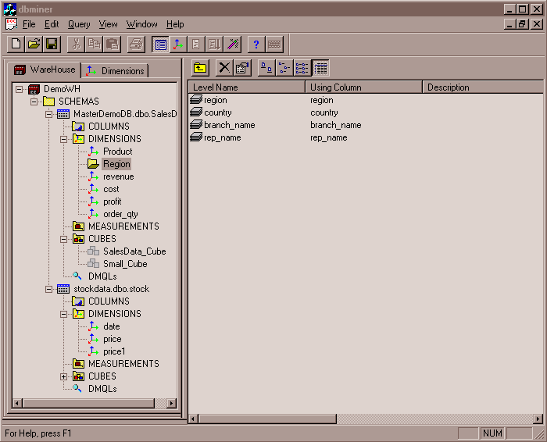
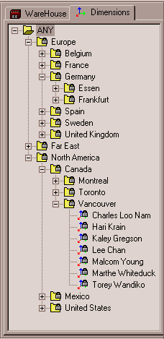
View of Warehouses and Hierarchies
Specification of hierarchies
Schema hierarchy
day < {month < quarter; week} < year
Set_grouping hierarchy
{1..10} < inexpensive
Notes:
MJ:
Microsoft…

Slide 23
Multidimensional Data
Sales volume as a function of product, month, and region
Dimensions: Product, Location, Time
Hierarchical summarization paths
Region
Industry Region Year
Category Country Quarter
Product City Month Week
Office Day
Product
Month
Notes:
MJ:
Sometimes not a strict hierarchy, but a network/graph.

Slide 24
A Sample Data Cube
Date
Total annual sales
of TVs in U.S.A.
1Qtr
2Qtr
3Qtr
4Qtr
sum
Product
TV
PC
U.S.A
VCR
sum
Canada
Country
Mexico
sum
All, All, All
Notes:
MJ:
Orange cuboid, green cuboid, dark blue cuboid (the apex cuboid).

Slide 25
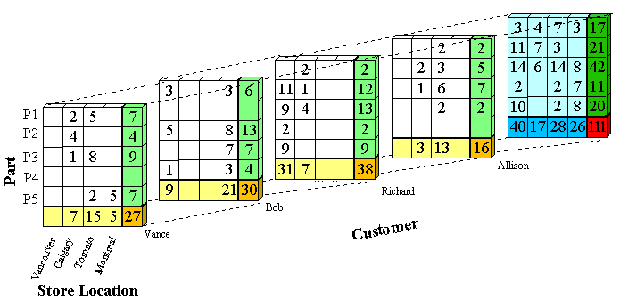
Product
4 Qtr
3 Qtr
2 Qtr
Date
1 Qtr
Mexico
Canada
Cuba
U.S.A
Country

Slide 26
Cuboids Corresponding to the Cube
all
0-D (apex) cuboid
product
date
country
1-D cuboids
product,date
product,country
date, country
2-D cuboids
3-D (base) cuboid
product, date, country

Slide 27
Typical OLAP Operations
Roll up (drill-up): summarize data
by climbing up hierarchy or by dimension reduction
Drill down (roll down): reverse of roll-up
from higher level summary to lower level summary or detailed data, or introducing new dimensions
Slice and dice: project and select
Pivot (rotate):
reorient the cube, visualization, 3D to series of 2D planes
Other operations
Drill across: involving (across) more than one fact table
Drill through: through the bottom level of the cube to its back-end relational tables (using SQL)
Notes:
MJ:
Drill across: A-B-C to A-B-D
Drill through: you cannot find details from the data when you generate the cube. You have to go to back-end relational tables. (not cube operations but SQL operations)

Slide 28
Typical OLAP Operations
Notes:
MJ:
Right, bottom: drill down on time, from quarters to months (Q1-Q4 to Jan-Dec)
Right, top: roll up from cities to countries (Vancouver, Toronto, NY, Chicago to Canada, USA)
Left, top: dice (select Q1 and Q2 on time dimension, Toronto and Vancouver on location dimension)
Left, bottom: slice (project to time = Q1, 3D to 2D), pivot (rotate)

Slide 29
Data Cube Measures: Three Categories
Distributive: if the result derived by applying the function to n aggregate values is the same as that derived by applying the function on all the data without partitioning
E.g., count(), sum(), min(), max()
Algebraic: if it can be computed by an algebraic function with M arguments (where M is a bounded integer), each of which is obtained by applying a distributive aggregate function
avg(x) = sum(x) / count(x)
Is min_N() an algebraic measure?
Holistic: if there is no constant bound on the storage size needed to describe a subaggregate.
E.g., median(), mode(), rank()
Notes:
MJ:
We want to distribute tasks to different levels of the hierarchy – fast!
1. Distributive: like MapReduce. If the measure operation allows you to split the cube into pieces and calculate, and then aggregate the results to derive the final results…
Ex: the total sales in US from 2010-2015? – dividing into states/years and then putting together
2. Average? Avg_Illinois + Avg_California +Avg_Oklahoma? Wrong. You have to take the counts into consideration. If you want to do it distributively, you have to communite two values (sum and count), not just one (avg).
Min_N: the N minimal values?
Std?
3. Holistic: you send 1, 2, 8, 10 values? No way! You have to get all the data. Median… if we want exact value, not approximated value.

Slide 30
How about standard_deviation()

Slide 31
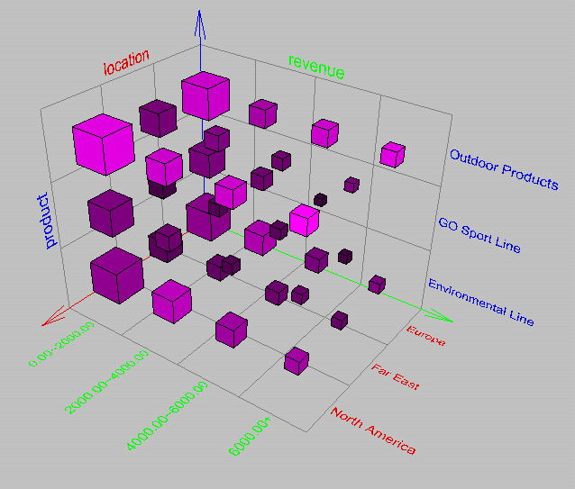
Browsing a Data Cube
Visualization
OLAP capabilities
Interactive manipulation
Notes:
MJ:
Dimensions, size, brightness, density…for different measures (visualization)

Slide 32
Chapter 4: Data Warehousing and On-line Analytical Processing
Data Warehouse: Basic Concepts
Data Warehouse Modeling: Data Cube and OLAP
Data Warehouse Implementation
Summary

Slide 33
Efficient Data Cube Computation
Data cube can be viewed as a lattice of cuboids
The bottom-most cuboid is the base cuboid
The top-most cuboid (apex) contains only one cell
How many cuboids in an n-dimensional cube with L levels?
Materialization of data cube
Full materialization: Materialize every (cuboid)
No materialization: Materialize none (cuboid)
Partial materialization: Materialize some cuboids
Which cuboids to materialize?
Selection based on size, sharing, access frequency, etc.
Why this formula?
Industry Region Year
Category Country Quarter
Product City Month Week
Office Day
Notes:
MJ:
i: dimension
Cumulative product
Why +1: There is an invisible level: “all”.
The number of cuboids: 4 dimensions, 4 levels each dimension -> 5*5*5*5 = 625 cuboids
Sharing: Month – lots of months but easy to compute for Quarter, Year…
Trade-off: size vs. sharing.

Slide 34
The “Compute Cube” Operator
Cube definition and computation in DMQL
define cube sales [item, city, year]: sum (sales_in_dollars)
compute cube sales
Transform it into a SQL-like language (with a new operator cube by, introduced by Gray et al.’96)
SELECT item, city, year, SUM (amount)
FROM SALES
CUBE BY item, city, year
Need compute the following Group-Bys
(date, product, customer),
(date, product),(date, customer), (product, customer),
(date), (product), (customer)
()
()
(city)
(item)
(year)
(city, item)
(city, year)
(item, year)
(city, item, year)
Notes:
MJ:
James Nicholas “Jim” Gray (born January 12, 1944; presumed lost at sea January 28, 2007 – 63-year-old; declared deceased May 16, 2012) was an American computer scientist who received the Turing Award in 1998 “for seminal contributions to database and transaction processing research and technical leadership in system implementation.”
“Gone missing” http://research.microsoft.com/en-us/um/people/gray/
Gray pursued his career primarily working as a researcher and software designer at a number of industrial companies, including IBM, Tandem Computers, and DEC. He joined Microsoft in 1995 and was a Technical Fellow for the company.
Jim Gray ICDE’96, DMKD’97 (cited by 2808)
Data cube: A relational aggregation operator generalizing group-by, cross-tab, and sub-totals
“Cube by”: (many) group-bys (+ cross-table + sub-totals)

Slide 35
Indexing OLAP Data: Bitmap Index
Index on a particular column
Each value in the column has a bit vector: bit-op is fast
The length of the bit vector: # of records in the base table
The i-th bit is set if the i-th row of the base table has the value for the indexed column
not suitable for high cardinality domains
A recent bit compression technique, Word-Aligned Hybrid (WAH), makes it work for high cardinality domain as well [Wu, et al. TODS’06]
Base table
Index on Region
Index on Type
Notes:
Bit-map index compression methods should be introduced –JH
MJ:
Value (base table) to column name (index table)
P1: if #cells = #Rec * #Value is too big: too large 0/1 bit sequences
P2: if #Value is too big: ? (only when the values are not that many)
The most popular for indexing is B+ tree.

Slide 36
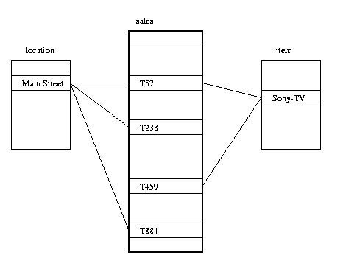
Indexing OLAP Data: Join Indices
Join index: JI(R-id, S-id) where R (R-id, …)  S (S-id, …)
Traditional indices map the values to a list of record ids
It materializes relational join in JI file and speeds up relational join
In data warehouses, join index relates the values of the dimensions of a start schema to rows in the fact table.
E.g., fact table: Sales and two dimensions city and product
A join index on city maintains for each distinct city a list of R-IDs of the tuples recording the Sales in the city
Join indices can span multiple dimensions
Notes:
MJ:
Indexing for “join” operation results
Popular in relational tables.

Slide 37
Efficient Processing OLAP Queries
Determine which operations should be performed on the available cuboids
Transform drill, roll, etc. into corresponding SQL and/or OLAP operations, e.g., dice = selection + projection
Determine which materialized cuboid(s) should be selected for OLAP op.
Let the query to be processed be on {brand, province_or_state} with the condition “year = 2004”, and there are 4 materialized cuboids available:
1) {year, item_name, city}
2) {year, brand, country}
3) {year, brand, province_or_state}
4) {item_name, province_or_state} where year = 2004
Which should be selected to process the query?
Explore indexing structures and compressed vs. dense array structs in MOLAP

Slide 38
OLAP Server Architectures
Relational OLAP (ROLAP)
Use relational or extended-relational DBMS to store and manage warehouse data and OLAP middle ware
Include optimization of DBMS backend, implementation of aggregation navigation logic, and additional tools and services
Greater scalability
Multidimensional OLAP (MOLAP)
Sparse array-based multidimensional storage engine
Fast indexing to pre-computed summarized data
Hybrid OLAP (HOLAP) (e.g., Microsoft SQLServer)
Flexibility, e.g., low level: relational, high-level: array
Specialized SQL servers (e.g., Redbricks)
Specialized support for SQL queries over star/snowflake schemas
Notes:
MJ:
ROLAP: use DBMS to store and manage DW, OLAP
MOLAP: array-based
HOLAP: SQL Server (Relational + Multidimensional array; user-guided)
Redbricks bought by IBM:
http://www-03.ibm.com/software/products/en/redbrick (not sure if still exists)
ROLAP:
ROLAP-based cubing algorithms (Agarwal et al. ‘96)
Array-based cubing algorithms (Zhao et al. ‘97)
Bottom-up computation method (Beyer & Ramarkrishman ‘99)
H-cubing technique (Han, Jian Pei, Guozhu Dong & Ke Wang, SIGMOD’01)
Dong: Wright State Univ
Pei, Wang: Simon Fraser (Georgia Tech)

Slide 39
Chapter 4: Data Warehousing and On-line Analytical Processing
Data Warehouse: Basic Concepts
Data Warehouse Modeling: Data Cube and OLAP
Data Warehouse Implementation
Summary

Slide 40
Summary
Data warehousing: A multi-dimensional model of a data warehouse
A data cube consists of dimensions & measures
Star schema, snowflake schema, fact constellations
OLAP operations: drilling, rolling, slicing, dicing and pivoting
Data Warehouse Architecture, Design, and Usage
Multi-tiered architecture
Business analysis design framework
Information processing, analytical processing, data mining
Implementation: Efficient computation of data cubes
Partial vs. full vs. no materialization
Indexing OALP data: Bitmap index and join index
OLAP query processing
OLAP servers: ROLAP, MOLAP, HOLAP

Slide 41
References (I)
S. Agarwal, R. Agrawal, P. M. Deshpande, A. Gupta, J. F. Naughton, R. Ramakrishnan, and S. Sarawagi. On the computation of multidimensional aggregates. VLDB’96
D. Agrawal, A. E. Abbadi, A. Singh, and T. Yurek. Efficient view maintenance in data warehouses. SIGMOD’97
R. Agrawal, A. Gupta, and S. Sarawagi. Modeling multidimensional databases. ICDE’97
S. Chaudhuri and U. Dayal. An overview of data warehousing and OLAP technology. ACM SIGMOD Record, 26:65-74, 1997
J. Gray, et al. Data cube: A relational aggregation operator generalizing group-by, cross-tab and sub-totals. Data Mining and Knowledge Discovery, 1:29-54, 1997.
A. Gupta and I. S. Mumick. Materialized Views: Techniques, Implementations, and Applications. MIT Press, 1999
J. Han. Towards on-line analytical mining in large databases. SIGMOD Record, 1998
V. Harinarayan, A. Rajaraman, and J. D. Ullman. Implementing data cubes efficiently. SIGMOD’96

Slide 42
References (II)
C. Imhoff, N. Galemmo, and J. G. Geiger. Mastering Data Warehouse Design: Relational and Dimensional Techniques. John Wiley, 2003
W. H. Inmon. Building the Data Warehouse. John Wiley, 1996
R. Kimball and M. Ross. The Data Warehouse Toolkit: The Complete Guide to Dimensional Modeling. 2ed. John Wiley, 2002
P. O'Neil and D. Quass. Improved query performance with variant indexes. SIGMOD'97
S. Sarawagi and M. Stonebraker. Efficient organization of large multidimensional arrays. ICDE'94
P. Valduriez. Join indices. ACM Trans. Database Systems, 12:218-246, 1987.
J. Widom. Research problems in data warehousing. CIKM’95.
K. Wu, E. Otoo, and A. Shoshani, Optimal Bitmap Indices with Efficient Compression, ACM Trans. on Database Systems (TODS), 31(1), 2006, pp. 1-38.

Slide 43


