Slide 1
CS 412 Intro. to Data Mining
Chapter 7 : Advanced Frequent Pattern Mining
Qi Li, Computer Science, Univ. Illinois at Urbana-Champaign, 2018

Slide 2
Chapter 7 : Advanced Frequent Pattern Mining
Mining Diverse Patterns
Constraint-Based Frequent Pattern Mining
Sequential Pattern Mining
Graph Pattern Mining
Pattern Mining Application: Mining Software Copy-and-Paste Bugs
Summary

Slide 3
Mining Diverse Patterns
Mining Multiple-Level Associations
Mining Multi-Dimensional Associations
Mining Quantitative Associations
Mining Negative Correlations
Mining Compressed and Redundancy-Aware Patterns

Slide 4
Mining Multiple-Level Frequent Patterns
Items often form hierarchies
E.g.: Dairyland 2% milk; Wonder wheat bread
How to set min-support thresholds?
Uniform support
Reduced support
Level 1
min_sup = 5%
Milk
[support = 10%]
Level 1
min_sup = 5%
Level 2
min_sup = 5%
2% Milk
[support = 6%]
Skim Milk
[support = 2%]
Level 2
min_sup = 1%
Uniform min-support across multiple levels (reasonable?)
Level-reduced min-support: Items at the lower level are expected to have lower support
Efficient mining: Shared multi-level mining
Use the lowest min-support to pass down the set of candidates

Slide 5
Redundancy Filtering at Mining Multi-Level Associations
Multi-level association mining may generate many redundant rules
Redundancy filtering: Some rules may be redundant due to “ancestor” relationships between items
milk ⇒ wheat bread [support = 8%, confidence = 70%] (1)
2% milk ⇒ wheat bread [support = 2%, confidence = 72%] (2)
Suppose the 2% milk sold is about ¼ of milk sold in gallons
(2) should be able to be “derived” from (1)

Slide 6
Redundancy Filtering at Mining Multi-Level Associations
milk ⇒ wheat bread [support = 8%, confidence = 70%] (1)
2% milk ⇒ wheat bread [support = 2%, confidence = 72%] (2) A rule is redundant if its support is close to the “expected” value, according to its “ancestor” rule, and it has a similar confidence as its “ancestor”
Rule (1) is an ancestor of rule (2), which one to prune?

Slide 7
Customized Min-Supports for Different Kinds of Items
We have used the same min-support threshold for all the items or item sets to be mined in each association mining
In reality, some items (e.g., diamond, watch, …) are valuable but less frequent
It is necessary to have customized min-support settings for different kinds of items
One Method: Use group-based “individualized” min-support
E.g., {diamond, watch}: 0.05%; {bread, milk}: 5%; …
How to mine such rules efficiently?
Existing scalable mining algorithms can be easily extended to cover such cases

Slide 8
Mining Multi-Dimensional Associations
Single-dimensional rules (e.g., items are all in “product” dimension)
buys(X, “milk”) ⇒ buys(X, “bread”)
Multi-dimensional rules (i.e., items in ≥ 2 dimensions or predicates)
Inter-dimension association rules (no repeated predicates)
age(X, “18-25”) ∧ occupation(X, “student”) ⇒ buys(X, “coke”)
Hybrid-dimension association rules (repeated predicates)
age(X, “18-25”) ∧ buys(X, “popcorn”) ⇒ buys(X, “coke”)
Attributes can be categorical or numerical
Categorical Attributes (e.g., profession, product: no ordering among values): Data cube for inter-dimension association
Quantitative Attributes: Numeric, implicit ordering among values—discretization, clustering, and gradient approaches

Slide 9
Mining Quantitative Associations
Mining associations with numerical attributes
E.g.: Numerical attributes: age and salary
Methods
Static discretization based on predefined concept hierarchies
Discretization on each dimension with hierarchy
age: {0-10, 10-20, …, 90-100} → {young, mid-aged, old}
Dynamic discretization based on data distribution
Clustering: Distance-based association
First one-dimensional clustering, then association
Deviation analysis:
Gender = female ⇒ Wage: mean=$7/hr (overall mean = $9)

Slide 10
Mining Extraordinary Phenomena in Quantitative Association Mining
Mining extraordinary (i.e., interesting) phenomena
E.g.: Gender = female ⇒ Wage: mean=$7/hr (overall mean = $9)
LHS: a subset of the population
RHS: an extraordinary behavior of this subset
The rule is accepted only if a statistical test (e.g., Z-test) confirms the inference with high confidence
Subrule: Highlights the extraordinary behavior of a subset of the population of the super rule
E.g.: (Gender = female) ^ (South = yes) ⇒ mean wage = $6.3/hr
Rule condition can be categorical or numerical (quantitative rules)
E.g.: Education in [14-18] (yrs) ⇒ mean wage = $11.64/hr

Slide 11
Rare Patterns
Rare patterns
Very low support but interesting (e.g., buying Rolex watches)
How to mine them? Setting individualized, group-based min-support thresholds for different groups of items

Slide 12
Negative Patterns
Negative patterns
Negatively correlated: Unlikely to happen together
Ex.: Since it is unlikely that the same customer buys both a Ford Expedition (an SUV car) and a Ford Fusion (a hybrid car), buying a Ford Expedition and buying a Ford Fusion are likely negatively correlated patterns
How to define negative patterns?
A support-based definition of negative correlated patterns
If itemsets A and B are both frequent but rarely occur together, i.e., sup(A U B) << sup (A) × sup(B)
Does this remind you the definition of lift?

Slide 13
Defining Negative Correlated Patterns
Is this a good definition for large transaction datasets?
Ex.: Suppose a store sold two needle packages A and B 100 times each, but only one transaction contained both A and B
When there are in total 200 transactions, we have
s(A U B) = 0.005, s(A) × s(B) = 0.25, s(A U B) << s(A) × s(B)
But when there are 10⁵ transactions, we have
s(A U B) = 1/10⁵, s(A) × s(B) = 1/10³ × 1/10³, s(A U B) > s(A) × s(B)
What is the problem?—Null transactions: The support-based definition is not null-invariant!

Slide 14
Defining Negative Correlation: Need Null-Invariance in Definition
A good definition on negative correlation should take care of the null-invariance problem
Whether two itemsets A and B are negatively correlated should not be influenced by the number of null-transactions
A Kulczynski measure-based definition
If itemsets A and B are frequent but
(s(A U B)/s(A) + s(A U B)/s(B))/2 < є,
where є is a negative pattern threshold, then A and B are negatively correlated
For the same needle package problem:
No matter there are in total 200 or 10⁵ transactions
If є = 0.01, we have
(s(A U B)/s(A) + s(A U B)/s(B))/2 = (0.01 + 0.01)/2 < є

Slide 15

Mining Compressed Patterns
Pat-ID | Item-Sets | Support
P1 | {38,16,18,12} | 205227
P2 | {38,16,18,12,17} | 205211
P3 | {39,38,16,18,12,17} | 101758
P4 | {39,16,18,12,17} | 161563
P5 | {39,16,18,12} | 161576
Why mining compressed patterns? Too many scattered patterns but not so meaningful
Pattern distance measure
δ-clustering: For each pattern P, find all patterns which can be expressed by P and whose distance to P is within δ (δ-cover)
All patterns in the cluster can be represented by P
Closed patterns
P1, P2, P3, P4, P5
Emphasizes too much on support
Max-patterns
P3: information loss
Desired output (a good balance):
P2, P3, P4

Slide 16
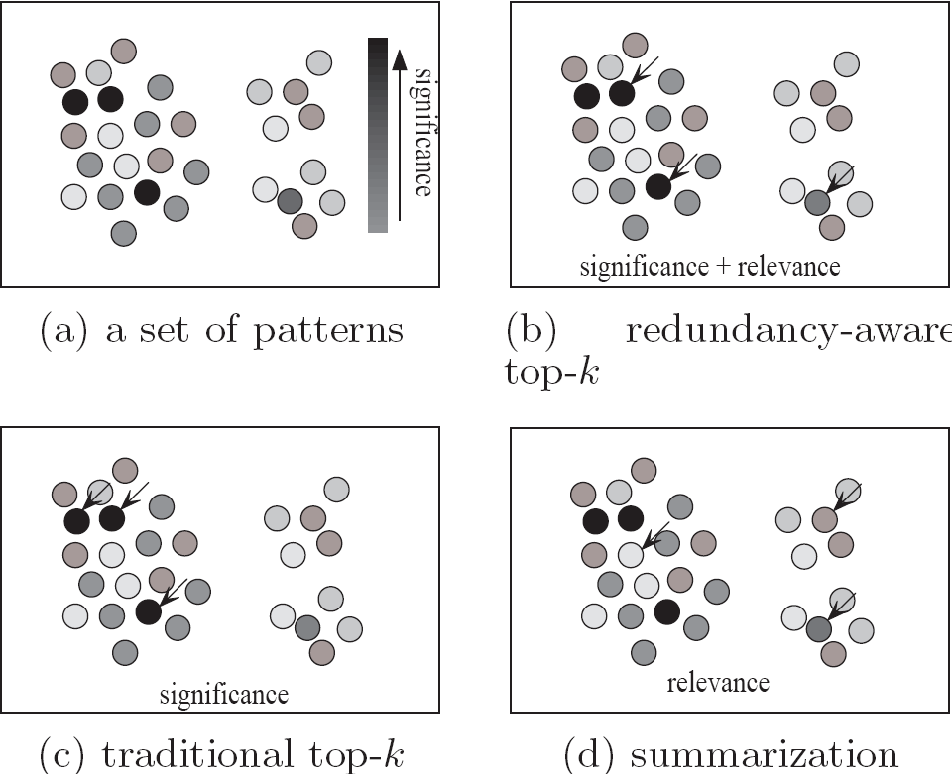
Redundancy-Aware Top-k Patterns
Desired patterns: high significance & low redundancy
Method: Use MMS (Maximal Marginal Significance) for measuring the combined significance of a pattern set
Xin et al., Extracting Redundancy-Aware Top-K Patterns, KDD’06

Slide 17
Chapter 7 : Advanced Frequent Pattern Mining
Mining Diverse Patterns
Constraint-Based Frequent Pattern Mining
Sequential Pattern Mining
Graph Pattern Mining
Pattern Mining Application: Mining Software Copy-and-Paste Bugs
Summary

Slide 18
Constraint-Based Pattern Mining
Why Constraint-Based Mining?
Different Kinds of Constraints: Different Pruning Strategies
Constrained Mining with Pattern Anti-Monotonicity
Constrained Mining with Pattern Monotonicity
Constrained Mining with Convertible Constraints
Constrained Mining with Data Anti-Monotonicity
Constrained Mining with Succinct Constraints
Handling Multiple Constraints

Slide 19
Why Constraint-Based Mining?
Pattern mining in practice: Often a user-guided, interactive process
User directs what to be mined using a data mining query language (or a graphical user interface), specifying various kinds of constraints
What is constraint-based mining?
Mine together with user-provided constraints
Why constraint-based mining?
User flexibility: User provides constraints on what to be mined
Optimization: System explores such constraints for mining efficiency
E.g., Push constraints deeply into the mining process

Slide 20
Various Kinds of User-Specified Constraints in Data Mining
Knowledge type constraint—Specifying what kinds of knowledge to mine
E.g.: Classification, association, clustering, outlier finding, …
Data constraint—using SQL-like queries
E.g.: Find products sold together in NY stores this year
Dimension/level constraint—similar to projection in relational database
E.g.: In relevance to region, price, brand, customer category
Interestingness constraint—various kinds of thresholds
E.g.: Strong rules: min_sup ≥ 0.02, min_conf ≥ 0.6, min_correlation ≥ 0.7
Rule (or pattern) constraint
E.g.: Small sales (price < $10) triggers big sales (sum > $200)
The focus of this study

Slide 21
Pattern Space Pruning with Pattern Anti-Monotonicity
A constraint c is anti-monotone
If an itemset S violates constraint c, so does any of its superset
That is, mining on itemset S can be terminated
E.g. 1: c₁: sum(S.price) ≤ v is anti-monotone
E.g. 2: c₂: range(S.profit) ≤ 15 is anti-monotone
Itemset ab violates c₂ (range(ab) = 40)
So does every superset of ab
Item | Price | Profit
a | 100 | 40
b | 40 | 0
c | 150 | −20
d | 35 | −15
e | 55 | −30
f | 45 | −10
g | 80 | 20
h | 10 | 5
Note: item.price > 0
Profit can be negative

Slide 22
Pattern Space Pruning with Pattern Anti-Monotonicity
TID | Transaction
10 | a, b, c, d, f, h
20 | b, c, d, f, g, h
30 | b, c, d, f, g
40 | a, c, e, f, g
E.g. 3. c₃: sum(S.Price) ≥ v is not anti-monotone
E.g. 4. Is c₄: support(S) ≥ σ anti-monotone?
Yes! Apriori pruning is essentially pruning with an anti-monotonic constraint!
min_sup = 2
Item | Price | Profit
a | 100 | 40
b | 40 | 0
c | 150 | −20
d | 35 | −15
e | 55 | −30
f | 45 | −10
g | 80 | 20
h | 10 | 5

Slide 23
Pattern Monotonicity and Its Roles
TID | Transaction
10 | a, b, c, d, f, h
20 | b, c, d, f, g, h
30 | b, c, d, f, g
40 | a, c, e, f, g
A constraint c is monotone: If an itemset S satisfies the constraint c, so does any of its superset
That is, we do not need to check c in subsequent mining
E.g. 1: c₁: sum(S.Price) ≥ v is monotone
E.g. 2: c₂: min(S.Price) ≤ v is monotone
E.g. 3: c₃: range(S.profit) ≥ 15 is monotone
Itemset ab satisfies c₃
So does every superset of ab
min_sup = 2
Item | Price | Profit
a | 100 | 40
b | 40 | 0
c | 150 | −20
d | 35 | −15
e | 55 | −30
f | 45 | −10
g | 80 | 20
h | 10 | 5

Slide 24
Apriori for Pattern Anti-Monotone Constraint
Item | Price
1 | 1
2 | 2
3 | 3
4 | 4
5 | 5
Database D
F₁
C₁
Can be chopped early
Scan D
C₂
C₂
F₂
Scan D
Min_sup=2
Constraint:
Sum{S.price} < 5
C₃
Scan D
F₃
Notes:
Pattern pruning; anti-monotone
Assume 5.price=5

Slide 25
Convertible Constraints: Ordering Data in Transactions
TID | Transaction
10 | a, b, c, d, f, h
20 | a, b, c, d, f, g, h
30 | b, c, d, f, g
40 | a, c, e, f, g
Convert tough constraints into (anti-)monotone by proper ordering of items in transactions
Examine c₁: avg(S.profit) > 20
Order items in (profit) value-descending order
<a, g, h, b, f, d, c, e>
An itemset ab violates c₁ (avg(ab) = 20)
So does ab* (i.e., ab-projected DB)
C₁: anti-monotone if patterns grow in the right order!
min_sup = 2
Item | Price | Profit
a | 100 | 40
b | 40 | 0
c | 150 | −20
d | 35 | −15
e | 55 | −30
f | 45 | −5
g | 80 | 30
h | 10 | 5

Slide 26
Can item-reordering work for Apriori? Can’t!
TID | Transaction
10 | a, b, c, d, f, h
20 | a, b, c, d, f, g, h
30 | b, c, d, f, g
40 | a, c, e, f, g
constraint: avg(S.profit) > 20
F₁
F₂
Scan D
Chopped too early
min_sup = 2
Item | Price | Profit
a | 100 | 40
b | 40 | 0
c | 150 | −20
d | 35 | −15
e | 55 | −30
f | 45 | −5
g | 80 | 30
h | 10 | 5
avg(gf) = 12.5 < 20, avg(af) = 17.5 < 20, avg(ag) = 35 > 20
But avg(agf) = 21.7 > 20
Apriori will not generate “agf” as a candidate

Slide 27
Data Space Pruning with Data Anti-Monotonicity
TID | Transaction
10 | a, b, c, d, f, h
20 | b, c, d, f, g, h
30 | b, c, d, f, g
40 | a, c, e, f, g
A constraint c is data anti-monotone: In the mining process, if a data entry t cannot contribute to a pattern p satisfying c, t cannot contribute to p’s superset either
Data space pruning: Data entry t can be pruned
E.g. 1: c₁: sum(S.Profit) ≥ v is data anti-monotone
Let constraint c₁ be: sum(S.Profit) ≥ 25
T₃₀: {b, c, d, f, g} can be removed since none of their combinations can make an S whose sum of the profit is ≥ 25
min_sup = 2
Item | Price | Profit
a | 100 | 40
b | 40 | 0
c | 150 | −20
d | 35 | −15
e | 55 | −30
f | 45 | −10
g | 80 | 20
h | 10 | 5

Slide 28
Data Space Pruning with Data Anti-Monotonicity
TID | Transaction
10 | a, b, c, d, f, h
20 | b, c, d, f, g, h
30 | b, c, d, f, g
40 | a, c, e, f, g
A constraint c is data anti-monotone: In the mining process, if a data entry t cannot contribute to a pattern p satisfying c, t cannot contribute to p’s superset either
Data space pruning: Data entry t can be pruned
E.g. 2: c₂: min(S.Price) ≤ v is data anti-monotone
Consider v = 5 but every item in a transaction, say T₅₀ , has a price higher than 10
E.g. 3: c₃: range(S.Profit) > 25 is data anti-monotone
min_sup = 2
Item | Price | Profit
a | 100 | 40
b | 40 | 0
c | 150 | −20
d | 35 | −15
e | 55 | −30
f | 45 | −10
g | 80 | 20
h | 10 | 5

Slide 29
Data Space Pruning Should Be Explored Recursively
b’s-proj. DB
TID | Transaction
10 | a, b, c, d, f, h
20 | b, c, d, f, g, h
30 | b, c, d, f, g
40 | a, c, e, f, g
Item | Profit
a | 40
b | 0
c | −20
d | −15
e | −30
f | −10
g | 20
h | 5
Example. c₃: range(S.Profit) > 25
We check b’s projected database
But item “a” is infrequent (sup = 1)
After removing “a (40)” from T₁₀
T₁₀ cannot satisfy c₃ any more
Since “b (0)” and “c (−20), d (−15), f (−10), h (5)”
By removing T₁₀, we can also prune “h” in T₂₀
TID | Transaction
10 | a, c, d, f, h
20 | c, d, f, g, h
30 | c, d, f, g
min_sup = 2
b’s-proj. DB
TID | Transaction
10 | a, c, d, f, h
20 | c, d, f, g, h
30 | c, d, f, g

Slide 30
Data Space Pruning Should Be Explored Recursively
Constraint:
range{S.profit} > 25
b’s-proj. DB
TID | Transaction
10 | a, c, d, f, h
20 | c, d, f, g, h
30 | c, d, f, g
Recursive
Data
Pruning
b’s FP-tree
single branch: cdfg: 2
Only a single branch “cdfg: 2” to be mined in b’s projected DB
Note: c₃ prunes T₁₀ effectively only after “a” is pruned (by min-sup) in b’s projected DB

Slide 31
Succinctness: Pruning Both Data and Pattern Spaces
Succinctness: If the constraint c can be enforced by directly manipulating the data
E.g. 1: To find those patterns without item i
Remove i from DB and then mine (pattern space pruning)
E.g. 2: To find those patterns containing item i
Mine only i-projected DB (data space pruning)
E.g. 3: c₃: min(S.Price) ≤ v is succinct
Start with only items whose price ≤ v and remove transactions with high-price items only (pattern + data space pruning)
E.g. 4: c₄: sum(S.Price) ≥ v is not succinct
It cannot be determined beforehand since sum of the price of itemset S keeps increasing

Slide 32
Apriori + Succinct Constraint
Database D
F₁
Min_sup=2
Constraint:
min{S.price} <= 2
C₁
Scan D
Item | Price
1 | 1
2 | 2
3 | 3
4 | 4
5 | 5
Chopped too early
Database D
F₁
C₁
Scan D
Min_sup=2
Constraint:
min{S.price} <= 1
Notes:
Must contain 1

Slide 33
Constrained FP-Growth: Push a Succinct Constraint Deep
Item | Price
1 | 1
2 | 2
3 | 3
4 | 4
5 | 5
Min_sup=2
Constraint:
min{S.price} <= 2
Remove
infrequent
length 1
No Need to project on 3 or 5
1-Projected DB
2-Projected DB

Slide 34
Different Kinds of Constraints Lead to Different Pruning Strategies
In summary, constraints can be categorized as Pattern space pruning constraints vs. data space pruning constraints
Pattern space pruning constraints | Data space pruning constraints
Anti-monotonic: If constraint c is violated, its further mining can be terminated Monotonic: If c is satisfied, no need to check c again Convertible: c can be converted to monotonic or anti-monotonic if items can be properly ordered in processing Succinct: If the constraint c can be enforced by directly manipulating the data | Data succinct: Data space can be pruned at the initial pattern mining process Data anti-monotonic: If a transaction t does not satisfy c, then t can be pruned to reduce data processing effort

Slide 35
How to Handle Multiple Constraints?
It is beneficial to use multiple constraints in pattern mining
But different constraints may require potentially conflicting item-ordering
If there exists conflict ordering between c₁ and c₂
Try to sort data and enforce one constraint first (which one?)
Then enforce the other constraint when mining the projected databases
E.g. c₁: avg(S.profit) > 20, and c₂: avg(S.price) < 50
Assum c₁ has more pruning power
Sort in profit descending order and use c₁ first
For each project DB, sort trans. in price ascending order and use c₂ at mining

Slide 36
Summary: Constraint-Based Pattern Mining
Why Constraint-Based Mining?
Different Kinds of Constraints: Different Pruning Strategies
Constrained Mining with Pattern Anti-Monotonicity
Constrained Mining with Pattern Monotonicity
Constrained Mining with Convertible Constraints
Constrained Mining with Data Anti-Monotonicity
Constrained Mining with Succinct Constraints
Handling Multiple Constraints

Slide 37
Chapter 7 : Advanced Frequent Pattern Mining
Mining Diverse Patterns
Constraint-Based Frequent Pattern Mining
Sequential Pattern Mining
Graph Pattern Mining
Pattern Mining Application: Mining Software Copy-and-Paste Bugs
Summary

Slide 38
Sequential Pattern Mining
Sequential Pattern and Sequential Pattern Mining
GSP: Apriori-Based Sequential Pattern Mining
SPADE: Sequential Pattern Mining in Vertical Data Format
PrefixSpan: Sequential Pattern Mining by Pattern-Growth
CloSpan: Mining Closed Sequential Patterns
Constraint-Based Sequential-Pattern Mining

Slide 39
Sequence Databases & Sequential Patterns
Sequential pattern mining has broad applications
Customer shopping sequences
Purchase a laptop first, then a digital camera, and then a smartphone, within 6 months
Medical treatments, natural disasters (e.g., earthquakes), science & engineering processes, stocks and markets, ...
Weblog click streams, calling patterns, …
Software engineering: Program execution sequences, …
Biological sequences: DNA, protein, …
Transaction DB, sequence DB vs. time-series DB
Gapped vs. non-gapped sequential patterns
Shopping sequences, clicking streams vs. biological sequences

Slide 40
Sequential Pattern and Sequential Pattern Mining
Sequential pattern mining: Given a set of sequences, find the complete set of frequent subsequences (i.e., satisfying the min_sup threshold)
A sequence: < (ef) (ab) (df) c b >
A sequence database
SID | Sequence
10 | <a(abc)(ac)d(cf)>
20 | <(ad)c(bc)(ae)>
30 | <(ef)(ab)(df)cb>
40 | <eg(af)cbc>
An element may contain a set of items (also called events)
* Items within an element are unordered and we list them alphabetically

Slide 41
Sequential Pattern and Sequential Pattern Mining
Sequential pattern mining: Given a set of sequences, find the complete set of frequent subsequences (i.e., satisfying the min_sup threshold)
<a(bc)dc> is a subsequence of <a(abc)(ac)d(cf)>
A sequence database
SID | Sequence
10 | <a(abc)(ac)d(cf)>
20 | <(ad)c(bc)(ae)>
30 | <(ef)(ab)(df)cb>
40 | <eg(af)cbc>
Given support threshold min_sup = 2, <(ab)c> is a sequential pattern

Slide 42
Sequential Pattern Mining Algorithms
Algorithm requirement: Efficient, scalable, finding complete set, incorporating various kinds of user-specific constraints
The Apriori property still holds: If a subsequence s₁ is infrequent, none of s₁’s super-sequences can be frequent
Representative algorithms
GSP (Generalized Sequential Patterns): Srikant & Agrawal @ EDBT’96)
Vertical format-based mining: SPADE (Zaki@Machine Leanining’00)
Pattern-growth methods: PrefixSpan (Pei, et al. @TKDE’04)
Mining closed sequential patterns: CloSpan (Yan, et al. @SDM’03)
Constraint-based sequential pattern mining (to be covered in the constraint mining section)

Slide 43
GSP: Apriori-Based Sequential Pattern Mining
Initial candidates: All 8-singleton sequences
<a>, <b>, <c>, <d>, <e>, <f>, <g>, <h>
Scan DB once, count support for each candidate
min_sup = 2
SID | Sequence
10 | <(bd)cb(ac)>
20 | <(bf)(ce)b(fg)>
30 | <(ah)(bf)abf>
40 | <(be)(ce)d>
50 | <a(bd)bcb(ade)>
Cand. | sup
<a> | 3
<b> | 5
<c> | 4
<d> | 3
<e> | 3
<f> | 2
<g> | 1
<h> | 1

Slide 44
GSP: Apriori-Based Sequential Pattern Mining
Generate length-2 candidate sequences
singleton x singleton
 | <a> | <b> | <c> | <d> | <e> | <f>
<a> | <aa> | <ab> | <ac> | <ad> | <ae> | <af>
<b> | <ba> | <bb> | <bc> | <bd> | <be> | <bf>
<c> | <ca> | <cb> | <cc> | <cd> | <ce> | <cf>
<d> | <da> | <db> | <dc> | <dd> | <de> | <df>
<e> | <ea> | <eb> | <ec> | <ed> | <ee> | <ef>
<f> | <fa> | <fb> | <fc> | <fd> | <fe> | <ff>
min_sup = 2
Apriori Pruning
Cand. | sup
<a> | 3
<b> | 5
<c> | 4
<d> | 3
<e> | 3
<f> | 2
<g> | 1
<h> | 1
w/o pruning:
8*8 + 8*7/2 = 92
length-2 candidates
w/ pruning:
6*6 + 6*5/2 = 51
length-2 candidates
sets
 | <a> | <b> | <c> | <d> | <e> | <f>
<a> |  | <(ab)> | <(ac)> | <(ad)> | <(ae)> | <(af)>
<b> |  |  | <(bc)> | <(bd)> | <(be)> | <(bf)>
<c> |  |  |  | <(cd)> | <(ce)> | <(cf)>
<d> |  |  |  |  | <(de)> | <(df)>
<e> |  |  |  |  |  | <(ef)>
<f>

Slide 45
GSP Mining and Pruning
5th scan: 1 cand. 1 length-5 seq. pat.
<(bd)cba>
4th scan: 8 cand. 7 length-4 seq. pat.
<abba> <(bd)bc> …
3rd scan: 46 cand. 20 length-3 seq. pat. 20 cand. not in DB at all
<abb> <aab> <aba> <baa> <bab> …
2nd scan: 51 cand. 19 length-2 seq. pat. 10 cand. not in DB at all
<aa> <ab> … <af> <ba> <bb> … <ff> <(ab)> … <(ef)>
1st scan: 8 cand. 6 length-1 seq. pat.
<a> <b> <c> <d> <e> <f> <g> <h>
min_sup = 2
Remove
Candidates not in DB
Candidates < min_sup
SID | Sequence
10 | <(bd)cb(ac)>
20 | <(bf)(ce)b(fg)>
30 | <(ah)(bf)abf>
40 | <(be)(ce)d>
50 | <a(bd)bcb(ade)>

Slide 46
GSP Mining and Pruning
Repeat (for each level (i.e., length-k))
Scan DB to find length-k frequent sequences
Generate length-(k+1) candidate sequences from length-k frequent sequences using Apriori
set k = k+1
Until no frequent sequence or no candidate can be found
GSP (Generalized Sequential Patterns): Srikant & Agrawal @ EDBT’96)

Slide 47
Sequential Pattern Mining in Vertical Data Format: The SPADE Algorithm
A sequence database is mapped to: <SID, EID>
Grow the subsequences (patterns) one item at a time by Apriori candidate generation
SID | Sequence
1 | <a(abc)(ac)d(cf)>
2 | <(ad)c(bc)(ae)>
3 | <(ef)(ab)(df)cb>
4 | <eg(af)cbc>
min_sup = 2
Ref: SPADE (Sequential PAttern Discovery using Equivalent Class) [M. Zaki 2001]

Slide 48
PrefixSpan: A Pattern-Growth Approach
SID | Sequence
10 | <a(abc)(ac)d(cf)>
20 | <(ad)c(bc)(ae)>
30 | <(ef)(ab)(df)cb>
40 | <eg(af)cbc>
min_sup = 2
Prefix and suffix
Given <a(abc)(ac)d(cf)>
Prefixes: <a>, <aa>, <a(ab)>, <a(abc)>, …
Suffix: Prefixes-based projection
Prefix | Suffix (Projection)
<a> | <(abc)(ac)d(cf)>
<aa> | <(_bc)(ac)d(cf)>
<ab> | <(_c)(ac)d(cf)>
PrefixSpan Mining: Prefix Projections
Step 1: Find length-1 sequential patterns
<a>, <b>, <c>, <d>, <e>, <f>
Step 2: Divide search space and mine each projected DB
<a>-projected DB,
<b>-projected DB,
…
<f>-projected DB, …
PrefixSpan (Prefix-projected Sequential pattern mining) Pei, et al. @TKDE’04

Slide 49
PrefixSpan: Mining Prefix-Projected DBs
SID | Sequence
10 | <a(abc)(ac)d(cf)>
20 | <(ad)c(bc)(ae)>
30 | <(ef)(ab)(df)cb>
40 | <eg(af)cbc>
min_sup = 2
Length-1 sequential patterns
<a>, <b>, <c>, <d>, <e>, <f>
prefix <a>
prefix <b>
prefix <c>, …, <f>
<a>-projected DB
<(abc)(ac)d(cf)>
<(_d)c(bc)(ae)>
<(_b)(df)cb>
<(_f)cbc>
<b>-projected DB
<(_c)(ac)d(cf)>
<(_c)(ae)>
<(df)cb>
<c>
…
… …
prefix <aa>
prefix <af>
Major strength of PrefixSpan:
No candidate subseqs. to be generated
Projected DBs keep shrinking
<aa>-projected DB
…
<af>-projected DB

Slide 50
Implementation Consideration: Pseudo-Projection vs. Physical Projection
Major cost of PrefixSpan: Constructing projected DBs
Suffixes largely repeating in recursive projected DBs
When DB can be held in main memory, use pseudo projection
No physically copying suffixes
Pointer to the sequence
Offset of the suffix
But if it does not fit in memory
Physical projection
Suggested approach:
Integration of physical and pseudo-projection
Swapping to pseudo-projection when the data fits in memory
s = <a(abc)(ac)d(cf)>
<a>
s|<a>: ( , 2)
<(abc)(ac)d(cf)>
<ab>
s|<ab>: ( , 5)
<(_c)(ac)d(cf)>

Slide 51
CloSpan: Mining Closed Sequential Patterns
A closed sequential pattern s: There exists no superpattern s’ such that s’ כ s, and s’ and s have the same support
Which ones are closed? <abc>: 20, <abcd>:20, <abcde>: 15

Slide 52
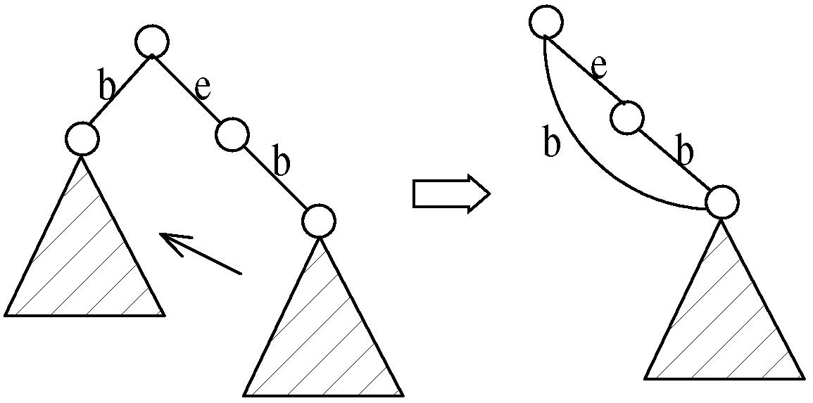
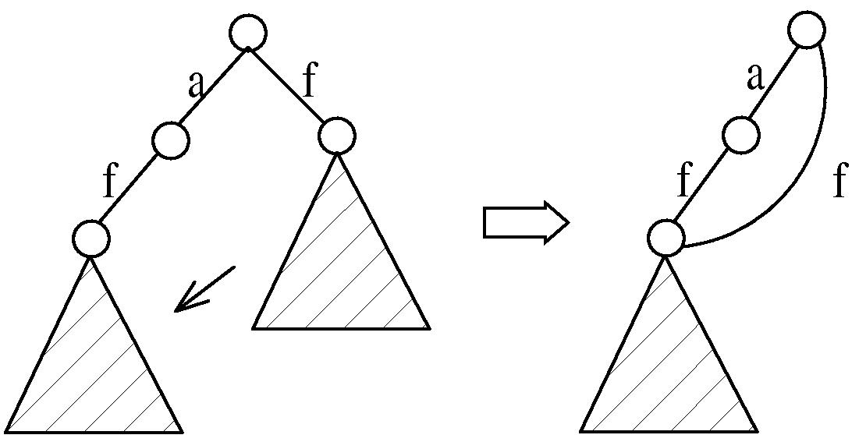
CloSpan: Mining Closed Sequential Patterns
Why directly mine closed sequential patterns?
Reduce # of (redundant) patterns
Attain the same expressive power
Property P₁: If s כ s₁, s is closed iff two project DBs have the same size
Explore Backward Subpattern and Backward Superpattern pruning to prune redundant search space
Greatly enhances efficiency (Yan, et al., SDM’03)

Slide 53
CloSpan: When Two Projected DBs Have the Same Size
If s כ s₁, s is closed iff two project DBs have the same size
When two projected sequence DBs have the same size?
Here is one example:
ID | Sequence
1 | <aefbcg>
2 | <afegb(ac)>
3 | <(af)ea>
min_sup = 2
<a>
<b>
<e>
<f>
<efbcg>
<fegb(ac)>
<(_f)ea>
<cg>
<(ac)>
<fbcg>
<gb(ac)>
<a>
<bcg>
<egb(ac)>
<ea>
<af>
size = 6)
Backward subpattern pruning
<bcg>
<egb(ac)>
<ea>
<b>
Only need to keep size = 12 (including parentheses)
<cg>
<(ac)>
Backward superpattern pruning

Slide 54
Constraint-Based Sequential-Pattern Mining
Share many similarities with constraint-based itemset mining
Anti-monotonic: If S violates c, the super-sequences of S also violate c
sum(S.price) < 150; min(S.value) > 10
Monotonic: If S satisfies c, the super-sequences of S also do so
element_count (S) > 5; S ⊇ {PC, digital_camera}
Data anti-monotonic: If a sequence s₁ with respect to S violates c₃, s₁ can be removed
c₃: sum(S.price) ≥ v
Succinct: Enforce constraint c by explicitly manipulating data
S ⊇ {i-phone, MacAir}
Convertible: Projection based on the sorted value not sequence order
value_avg(S) < 25; profit_sum (S) > 160
max(S)/avg(S) < 2; median(S) – min(S) > 5

Slide 55
Timing-Based Constraints in Seq.-Pattern Mining
Order constraint: Some items must happen before the other
{algebra, geometry} → {calculus} (where “→” indicates ordering)
Anti-monotonic: Constraint-violating sub-patterns pruned
Min-gap/max-gap constraint: Confines two elements in a pattern
E.g., mingap = 1, maxgap = 4
Succinct: Enforced directly during pattern growth
Max-span constraint: Maximum allowed time difference between the 1st and the last elements in the pattern
E.g., maxspan (S) = 60 (days)
Succinct: Enforced directly when the 1st element is determined
Window size constraint: Events in an element do not have to occur at the same time: Enforce max allowed time difference
E.g., window-size = 2: Various ways to merge events into elements

Slide 56
Episodes and Episode Pattern Mining
Episodes and regular expressions: Alternative to seq. patterns
Serial episodes: AB
Parallel episodes: A|B
Regular expressions: (A|B)C*(DE)
E.g. Given a large shopping sequence database, one may like to find
Suppose the pattern order follows the template (A|B)C*(D E), and
Sum of the prices of A, B, C*, D, and E is greater than $100, where C* means C appears *-times
How to efficiently mine such episode patterns?
a total order relationship: first A then B
a partial order relationship: A and B can be in any order
(DE) means D, E happen in the same time window

Slide 57
Chapter 7 : Advanced Frequent Pattern Mining
Mining Diverse Patterns
Constraint-Based Frequent Pattern Mining
Sequential Pattern Mining
Graph Pattern Mining
Pattern Mining Application: Mining Software Copy-and-Paste Bugs
Summary

Slide 58
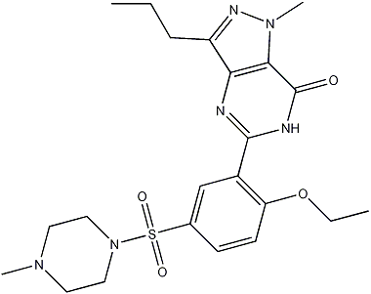
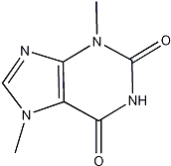
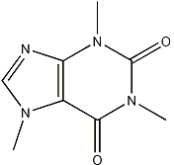
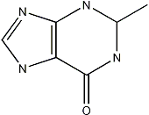
What Is Graph Pattern Mining?
Chem-informatics:
Mining frequent chemical compound structures
Social networks, web communities, tweets, …
Finding frequent research collaboration subgraphs

Slide 59
Frequent (Sub)Graph Patterns
Given a labeled graph dataset D = {G₁, G₂, …, G_{n}), the supporting graph set of a subgraph g is D_{g} = {G_{i} | g ⊆ G_{i}, G_{i} ∈D}
support(g) = |D_{g}|/ |D|
A (sub)graph g is frequent if support(g) ≥ min_sup
Ex.: Chemical structures
Graph Dataset
Alternative:
Mining frequent subgraph patterns from a single large graph or network
(A)
(B)
(C)
min_sup = 2
Frequent Graph Patterns
(1)
(2)
support = 67%

Slide 60
Applications of Graph Pattern Mining
Bioinformatics
Gene networks, protein interactions, metabolic pathways
Chem-informatics: Mining chemical compound structures
Social networks, web communities, tweets, …
Cell phone networks, computer networks, …
Web graphs, XML structures, Semantic Web, information networks
Software engineering: Program execution flow analysis
Building blocks for graph classification, clustering, compression, comparison, and correlation analysis
Graph indexing and graph similarity search

Slide 61
Graph Pattern Mining Algorithms: Different Methodologies
Generation of candidate subgraphs
Apriori vs. pattern growth (e.g., FSG vs. gSpan)
Search order
Breadth vs. depth
Elimination of duplicate subgraphs
Passive vs. active (e.g., gSpan [Yan & Han, 2002])
Support calculation
Store embeddings (e.g., GASTON [Nijssen & Kok, 2004], FFSM [Huan, Wang, & Prins, 2003], MoFa [Borgelt & Berthold, ICDM’02])
Order of pattern discovery
Path → tree → graph (e.g., GASTON [Nijssen & Kok, 2004])

Slide 62
Apriori-Based Approach
The Apriori property (anti-monotonicity): A size-k subgraph is frequent if and only if all of its subgraphs are frequent
A candidate size-(k+1) edge/vertex subgraph is generated if its corresponding two k-edge/vertex subgraphs are frequent
Iterative mining process:
Candidate-generation → candidate pruning → support counting → candidate elimination
(k+1)-edge
k-edge
G₁
G
G₂
G’
…
G’’
G_{n}
Join

Slide 63
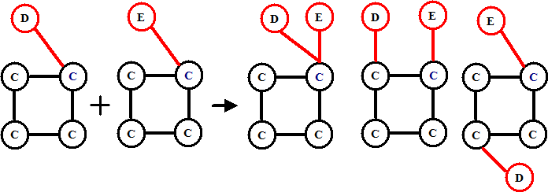
Candidate Generation: Vertex Growing vs. Edge Growing
Methodology: Breadth-search, Apriori joining two size-k graphs
Many possibilities at generating size-(k+1) candidate graphs
Generating new graphs with one more vertex
AGM (Inokuchi, Washio, & Motoda, PKDD’00)
Generating new graphs with one more edge
FSG (Kuramochi & Karypis, ICDM’01)
Performance shows via edge growing is more efficient

Slide 64
Pattern-Growth Approach
Depth-first growth of subgraphs from k-edge to (k+1)-edge, then (k+2)-edge subgraphs
(k+2)-edge
Major challenge
Generating many duplicate subgraphs
Major idea to solve the problem
Define an order to generate subgraphs
DFS spanning tree: Flatten a graph into a sequence using depth-first search
gSpan (Yan & Han, ICDM’02)
(k+1)-edge
G₁
…
k-edge
G₂
duplicate
graphs
G
…
G_{n}
…
Notes:
Apriori:
Step1: Join two k-1 edge graphs (these two graphs share a same k-2 edge subgraph) to generate a k-edge graph
Step2: Join the tid-list of these two k-1 edge graphs, then see whether its count is larger than the minimum support
Step3: Check all k-1 subgraph of this k-edge graph to see whether all of them are frequent
Step4: After G successfully pass Step1-3, do support computation of G in the graph dataset, See whether it is really frequent.
gSpan:
Step1: Right-most extend a k-1 edge graph to several k edge graphs.
Step2: Enumerate the occurrence of this k-1 edge graph in the graph dataset, meanwhile, counting these k edge graphs.
Step3: Output those k edge graphs whose support is larger than the minimum support.
Pros:
1: gSpan avoid the costly candidate generation and testing some infrequent subgraphs.
2: No complicated graph operations, like joining two graphs and calculating its k-1 subgraphs.
3. gSpan is very simple
The key is how to do right most extension efficiently in graph. We invented DFS code for graph.

Slide 65
gSPAN: Graph Pattern Growth in Order
Right-most path extension in subgraph pattern growth
Right-most path: The path from root to the right-most leaf (choose the vertex with the smallest index at each step)
Reduce generation of duplicate subgraphs
Completeness: The enumeration of graphs using right-most path extension is complete
DFS code: Flatten a graph into a sequence using depth-first search
e₀: (0,1)
0
e₁: (1,2)
1
e₂: (2,3)
2
e₃: (3,0)
4
e₄: (2,4)
3

Slide 66
Why Mine Closed Graph Patterns?
Challenge: An n-edge frequent graph may have 2^{n} subgraphs
Motivation: Explore closed frequent subgraphs to handle graph pattern explosion problem
A frequent graph G is closed if there exists no supergraph of G that carries the same support as G
Lossless compression: Does not contain non-closed graphs, but still ensures that the mining result is complete
Algorithm CloseGraph: Mines closed graph patterns directly
If this subgraph is closed in the graph dataset, it implies that none of its frequent super-graphs carries the same support

Slide 67
CloseGraph: Directly Mining Closed Graph Patterns
CloseGraph: Mining closed graph patterns by extending gSpan (Yan & Han, KDD’03)
At what condition can we
stop searching their children,
i.e., early termination?
G₁
k-edge
G₂
Suppose G and G₁ are frequent, and G is a subgraph of G₁
If in any part of the graph in the dataset where G occurs, G₁ also occurs, then we need not grow G (except some special, subtle cases), since none of G’s children will be closed except those of G₁
G
…
G_{n}
(k+1)-edge
Notes:
Apriori:
Step1: Join two k-1 edge graphs (these two graphs share a same k-2 edge subgraph) to generate a k-edge graph
Step2: Join the tid-list of these two k-1 edge graphs, then see whether its count is larger than the minimum support
Step3: Check all k-1 subgraph of this k-edge graph to see whether all of them are frequent
Step4: After G successfully pass Step1-3, do support computation of G in the graph dataset, See whether it is really frequent.
gSpan:
Step1: Right-most extend a k-1 edge graph to several k edge graphs.
Step2: Enumerate the occurrence of this k-1 edge graph in the graph dataset, meanwhile, counting these k edge graphs.
Step3: Output those k edge graphs whose support is larger than the minimum support.
Pros:
1: gSpan avoid the costly candidate generation and testing some infrequent subgraphs.
2: No complicated graph operations, like joining two graphs and calculating its k-1 subgraphs.
3. gSpan is very simple
The key is how to do right most extension efficiently in graph. We invented DFS code for graph.

Slide 68
Experiment and Performance Comparison
The AIDS antiviral screen compound dataset from NCI/NIH
The dataset contains 43,905 chemical compounds
Discovered patterns: The smaller minimum support, the bigger and more interesting subgraph patterns discovered
20%
10%
5%
# of Patterns: Frequent vs. Closed
Runtime: Frequent vs. Closed
Run time (sec)
Number of patterns
Minimum support
Minimum support

Slide 69
Chapter 7 : Advanced Frequent Pattern Mining
Mining Diverse Patterns
Constraint-Based Frequent Pattern Mining
Sequential Pattern Mining
Graph Pattern Mining
Pattern Mining Application: Mining Software Copy-and-Paste Bugs
Summary

Slide 70
Pattern Mining Application: Software Bug Detection
Mining rules from source code
Bugs as deviant behavior (e.g., by statistical analysis)
Mining programming rules (e.g., by frequent itemset mining)
Mining function precedence protocols (e.g., by frequent subsequence mining)
Revealing neglected conditions (e.g., by frequent itemset/subgraph mining)
Mining rules from revision histories
By frequent itemset mining
Mining copy-paste patterns from source code
Find copy-paste bugs (e.g., CP-Miner [Li et al., OSDI’04]) (to be discussed here)
Reference: Z. Li, S. Lu, S. Myagmar, Y. Zhou, “CP-Miner: A Tool for Finding Copy-paste and Related Bugs in Operating System Code”, OSDI’04

Slide 71
Application Example: Mining Copy-and-Paste Bugs
Copy-pasting is common
12% in Linux file system
19% in X Window system
Copy-pasted code is error-prone
Mine “forget-to-change” bugs by sequential pattern mining
Build a sequence database from source code
Mining sequential patterns
Finding mismatched identifier names & bugs
void __init prom_meminit(void)
{
……
for (i=0; i<n; i++) {
total[i].adr = list[i].addr;
total[i].bytes = list[i].size;
total[i].more = &total[i+1];
}
……
Code copy-and- pasted but forget to change “id”!
for (i=0; i<n; i++) {
taken[i].adr = list[i].addr;
taken[i].bytes = list[i].size;
taken[i].more = &total[i+1];
}
(Simplified example from linux-2.6.6/arch/sparc/prom/memory.c)
Courtesy of Yuanyuan Zhou@UCSD

Slide 72
Building Sequence Database from Source Code
(mapped to)
Hash values
Statement → number
Tokenize each component
Different operators, constants, key words → different tokens
Same type of identifiers → same token
Program → A long sequence
Cut the long sequence by blocks
65 16 16 71 … 65
16
16
71
for (i=0; i<n; i++) {
total[i].adr = list[i].addr;
total[i].bytes = list[i].size;
total[i].more = &total[i+1];
} …… for (i=0; i<n; i++) {
taken[i].adr = list[i].addr;
taken[i].bytes = list[i].size;
taken[i].more = &total[i+1];
}
old = 3;
new = 3;
Map a statement to a number
Tokenize
Final sequence DB: (65) (16, 16, 71) … (65) (16, 16, 71)
5 61 20
5 61 20
Hash
16
16
Courtesy of Yuanyuan Zhou@UCSD

Slide 73
Sequential Pattern Mining & Detecting “Forget-to-Change” Bugs
Modification to the sequence pattern mining algorithm
Constrain the max gap
Composing Larger Copy-Pasted Segments
Combine the neighboring copy-pasted segments repeatedly
Find conflicts: Identify names that cannot be mapped to the corresponding ones
E.g., 1 out of 4 “total” is unchanged, unchanged ratio = 0.25
If 0 < unchanged ratio < threshold, then report it as a bug
CP-Miner reported many C-P bugs in Linux, Apache, … out of millions of LOC (lines of code)
(16, 16, 71) …… (16, 16, 10, 71)
Allow a maximal gap: inserting statements in copy-and-paste
f (a1);
f (a2);
f (a3);
f1 (b1);
f1 (b2);
f2 (b3);
conflict
Courtesy of Yuanyuan Zhou@UCSD

Slide 74
Chapter 7 : Advanced Frequent Pattern Mining
Mining Diverse Patterns
Constraint-Based Frequent Pattern Mining
Sequential Pattern Mining
Graph Pattern Mining
Pattern Mining Application: Mining Software Copy-and-Paste Bugs
Summary

Slide 75
Summary: Advanced Frequent Pattern Mining
Mining Diverse Patterns
Mining Multiple-Level Associations
Mining Multi-Dimensional Associations
Mining Quantitative Associations
Mining Negative Correlations
Mining Compressed and Redundancy-Aware Patterns
Sequential Pattern Mining
Sequential Pattern and Sequential Pattern Mining
GSP: Apriori-Based Sequential Pattern Mining
SPADE: Sequential Pattern Mining in Vertical Data Format
PrefixSpan: Sequential Pattern Mining by Pattern-Growth
CloSpan: Mining Closed Sequential Patterns
Constraint-Based Frequent Pattern Mining
Why Constraint-Based Mining?
Constrained Mining with Pattern Anti-Monotonicity
Constrained Mining with Pattern Monotonicity
Constrained Mining with Data Anti-Monotonicity
Constrained Mining with Succinct Constraints
Constrained Mining with Convertible Constraints
Handling Multiple Constraints
Constraint-Based Sequential-Pattern Mining
Graph Pattern Mining
Graph Pattern and Graph Pattern Mining
Apriori-Based Graph Pattern Mining Methods
gSpan: A Pattern-Growth-Based Method
CloseGraph: Mining Closed Graph Patterns
Pattern Mining Application: Mining Software Copy-and-Paste Bugs

Slide 76
References: Mining Diverse Patterns
R. Srikant and R. Agrawal, “Mining generalized association rules”, VLDB'95
Y. Aumann and Y. Lindell, “A Statistical Theory for Quantitative Association Rules”, KDD'99
K. Wang, Y. He, J. Han, “Pushing Support Constraints Into Association Rules Mining”, IEEE Trans. Knowledge and Data Eng. 15(3): 642-658, 2003
D. Xin, J. Han, X. Yan and H. Cheng, "On Compressing Frequent Patterns", Knowledge and Data Engineering, 60(1): 5-29, 2007
D. Xin, H. Cheng, X. Yan, and J. Han, "Extracting Redundancy-Aware Top-K Patterns", KDD'06
J. Han, H. Cheng, D. Xin, and X. Yan, "Frequent Pattern Mining: Current Status and Future Directions", Data Mining and Knowledge Discovery, 15(1): 55-86, 2007
F. Zhu, X. Yan, J. Han, P. S. Yu, and H. Cheng, “Mining Colossal Frequent Patterns by Core Pattern Fusion”, ICDE'07

Slide 77
References: Constraint-Based Frequent Pattern Mining
R. Srikant, Q. Vu, and R. Agrawal, “Mining association rules with item constraints”, KDD'97
R. Ng, L.V.S. Lakshmanan, J. Han & A. Pang, “Exploratory mining and pruning optimizations of constrained association rules”, SIGMOD’98
G. Grahne, L. Lakshmanan, and X. Wang, “Efficient mining of constrained correlated sets”, ICDE'00
J. Pei, J. Han, and L. V. S. Lakshmanan, “Mining Frequent Itemsets with Convertible Constraints”, ICDE'01
J. Pei, J. Han, and W. Wang, “Mining Sequential Patterns with Constraints in Large Databases”, CIKM'02
F. Bonchi, F. Giannotti, A. Mazzanti, and D. Pedreschi, “ExAnte: Anticipated Data Reduction in Constrained Pattern Mining”, PKDD'03
F. Zhu, X. Yan, J. Han, and P. S. Yu, “gPrune: A Constraint Pushing Framework for Graph Pattern Mining”, PAKDD'07

Slide 78
References: Sequential Pattern Mining
R. Srikant and R. Agrawal, “Mining sequential patterns: Generalizations and performance improvements”, EDBT’96
M. Zaki, “SPADE: An Efficient Algorithm for Mining Frequent Sequences”, Machine Learning, 2001
J. Pei, J. Han, B. Mortazavi-Asl, J. Wang, H. Pinto, Q. Chen, U. Dayal, and M.-C. Hsu, "Mining Sequential Patterns by Pattern-Growth: The PrefixSpan Approach", IEEE TKDE, 16(10), 2004
X. Yan, J. Han, and R. Afshar, “CloSpan: Mining Closed Sequential Patterns in Large Datasets”, SDM'03
J. Pei, J. Han, and W. Wang, "Constraint-based sequential pattern mining: the pattern-growth methods", J. Int. Inf. Sys., 28(2), 2007
M. N. Garofalakis, R. Rastogi, K. Shim: Mining Sequential Patterns with Regular Expression Constraints. IEEE Trans. Knowl. Data Eng. 14(3), 2002
H. Mannila, H. Toivonen, and A. I. Verkamo, “Discovery of frequent episodes in event sequences”, Data Mining and Knowledge Discovery, 1997

Slide 79
References: Graph Pattern Mining
C. Borgelt and M. R. Berthold, Mining molecular fragments: Finding relevant substructures of molecules, ICDM'02
J. Huan, W. Wang, and J. Prins. Efficient mining of frequent subgraph in the presence of isomorphism, ICDM'03
A. Inokuchi, T. Washio, and H. Motoda. An apriori-based algorithm for mining frequent substructures from graph data, PKDD'00
M. Kuramochi and G. Karypis. Frequent subgraph discovery, ICDM'01
S. Nijssen and J. Kok. A Quickstart in Frequent Structure Mining can Make a Difference. KDD'04
N. Vanetik, E. Gudes, and S. E. Shimony. Computing frequent graph patterns from semistructured data, ICDM'02
X. Yan and J. Han, gSpan: Graph-Based Substructure Pattern Mining, ICDM'02
X. Yan and J. Han, CloseGraph: Mining Closed Frequent Graph Patterns, KDD'03
X. Yan, P. S. Yu, J. Han, Graph Indexing: A Frequent Structure-based Approach, SIGMOD'04
X. Yan, P. S. Yu, and J. Han, Substructure Similarity Search in Graph Databases, SIGMOD'05

Slide 80

Notes:
Little Mermaid, Hans Christian Andersen

