Slide 1

OSS API GW
Oracle SOA Training
Bahman 1401

Slide 2
OUTLINE
Overview of Oracle SOA | ~15m
Web Services Introduction | ~1h
Service Component Architecture (SCA) | ~2h
SOA Installation | ~5h
Managing and Monitoring Infrastructure and Applications | ~1h
Business Process Execution Language (BPEL) | ~5h
Creating Adapter Services | ~2h
Activities in Oracle BPEL Component Designer | ~2h
Orchestrating Services with Oracle BPEL (External References) | ~3h
Working with Mediator Components | ~1h
Fault Handling and Exception Management | ~1h
MDS Introduction | ~1h
Sensors | ~1h

Slide 3
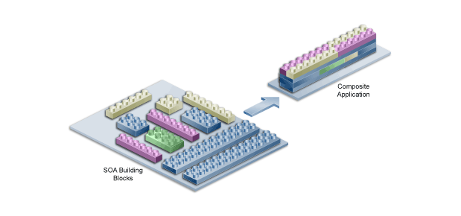
Intoduction to SOA
What is Service-Oriented Architecture
What is SOA: Service-oriented architecture (SOA) is a method of software development that uses software components called services to create business applications.
Benefits
Faster time to market
Efficient maintenance
Greater adaptability
Limitation
Limited scalability
Increasing interdependencies
Single point of failure

Slide 4
Web Services Introduction
Topics:
Overview of XML, XSD, Web-Services, SOAP, WSDL
Web Services Sample Demonstration
Understanding WSDL

Slide 5
Web Services Introduction
Overview of XML, XSD, Web-Services, WSDL , SOAP
XML: eXtensible Markup Language
Use Tags to elements within a document
Designed to store and transport data
XSD: XML Schema Definition
Several Standard to form XML file and validate:
XSD
DTD
…
Web Services
Web Services
The latest distributed technology and, as we will see, the most suitable technology for the realization of SOA. They have become the commonly used technology for interoperability and the integration of applications and information systems. Web Services provide the technological foundation for achieving interoperability between applications using different software platforms, operating systems, and programming.

Slide 6
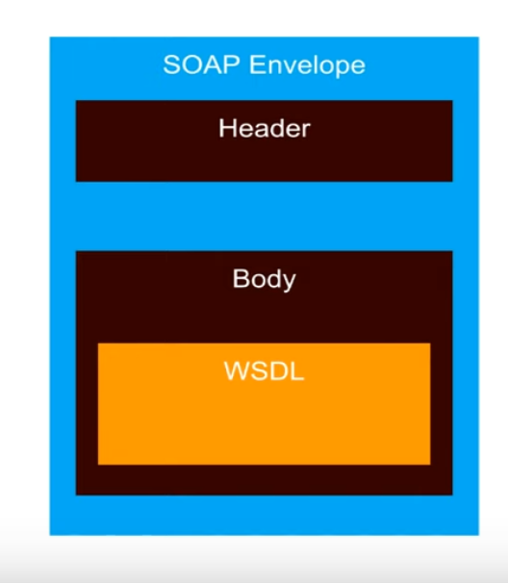
Web Services Introduction
WSDL: Web Service Description Language
An XML-based definition language used for describing the functionality of
SOAP-based Service
SOAP: Simple Object Access Protocol
A messaging protocol specification for exchanging structured information in the implementation of web services. It uses XML information set for its message format.

Slide 7
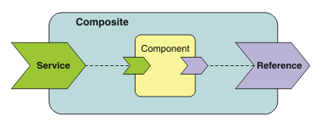
Service Component Architecture (SCA)
What is SCA:
Service Component Architecture (SCA) is a set of specifications that describe a programming model for building applications and systems using a Service-Oriented Architecture (SOA). The specifications describe how to create composite applications.
A composite application is created by combining one or more components that together implement the business logic of the new application.
A simple type of component has one service and one reference.
Service: is an addressable interface for the component that can contain one or more operations.
reference is a dependency on a service that is provided by another component.

Slide 8
Service Component Architecture (SCA)
The bindings for the component can be defined in both the service and the reference:
Component services use bindings to describe the access mechanism that other internal components have to use to call the component.
Component references use bindings to describe the access mechanism that is used to call other components.
Component services and references are internal and are used only for component-to-component communication.
To create an external interface, the component must be deployed inside a composite.
A very simple composite has one external service and one external reference:
Composite services use bindings to describe the access mechanism that external clients must use to call the service
Composite references use bindings to describe the access mechanism that is used to call another service.

Slide 9
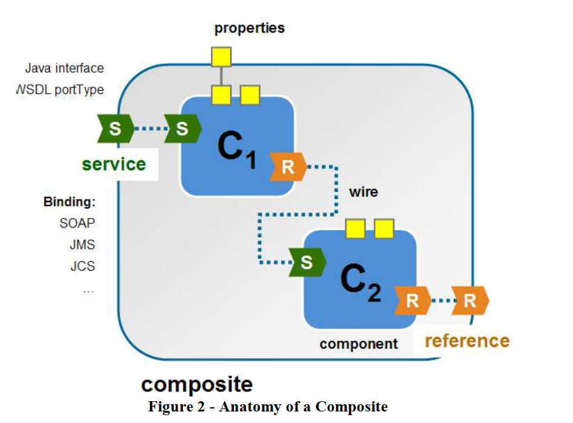
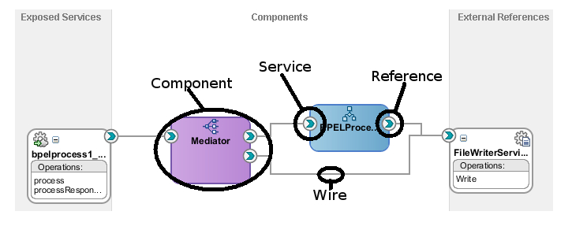
Service Component Architecture (SCA)
ORACLE SOA SCA
The entry point to the composite itself is the Service which exposes a chain of one or more components (each with its own Service interface) that are bound/linked together as dependencies (known as References) through Wires.
The components can be local (such as a BPEL process or JCA adapter) or they can be remote using a protocol such as Web services.
Finally, the specification allows for each of the components to have properties for customization within a particular use or deployment (e.g. the directory to which a completed Purchase Order document should be written).

Slide 10
Service Component Architecture (SCA)
The following summarizes the 5 key elements of SCA shown above:
Composite: deployment unit
Service: entry-point into the composite. Services exposed by the component that are callable from outside the composite are called promoted services
Component: provides the logic to be used within the composite
Reference: refers to internal and external services. As per the SCA spec, references to external services are called “promoted references”
Wire: connects services, components and references – no special semantic.
Properties: allow for customization of a component’s behavior in a particular deployment

Slide 11
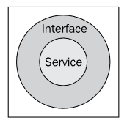
Service Component Architecture (SCA)
Some of Oracle SOA Components
Service Infrastructure
Service Infra allows the linking of components via the internal message routing structure. Along with this, it allows the data flow.
Services
The most basic unit of service-oriented architecture is the service. This may be provided directly by a web service-enabled piece of code or it may be exposed by encapsulating an existing resource.
The only way to access a service is through its defined interface.
A wrapper or part of service
Specific interface specified in WSDL file.
A WSDL file specifies the operations supported by the service. Each operation describes the expected format of the input message and if a message is returned it also describes the format of that message

Slide 12
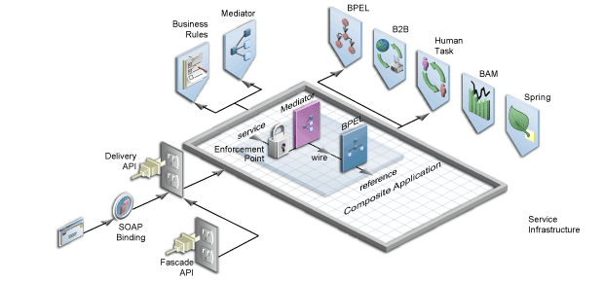
Service Component Architecture (SCA)
Oracle Adapters:
Services are often surfaced through adapters that take an existing piece of functionality and "adapt" it to the SOA world, the Oracle Adapters uses the JCA technology to establish a link between the Oracle SOA Suite and the external systems.
Out-of-the-box adapters:
File adapter
FTP adapter
Database adapter
JMS adapter
MQ adapter
AQ adapter
Socket adapter
BAM adapter

Slide 13
Service Component Architecture (SCA)
Oracle Mediator
Analogous to a load balancer routing HTTP traffic, the Oracle Mediator routes data from service providers to external partners. In addition, it can subscribe to and publish business events. Used for filtering, transforming, adapting, and routing messages. (page 163 12c)
Oracle BPEL Process Manager
Oracle BPEL Process Manager provides the standard for assembling a set of discrete services into an end-to-end process flow, radically reducing the cost and complexity of process integration initiatives. Orchestrating service calls, manipulating XML messages, performing flow logic with if-then-else and for-loops, handling exceptions as well as performing parallel processing are the sweet spot for this component.

Slide 14
SOA Installation
In this Section
Review the infrastructure
Installing DB
Installing Oracle FMW
Installing Oracle SOA Suite
Creating Domain
What is RCU (Repository Creation Utility)
How to create new Domain using config.sh
Various Domain configuration and architecture

Slide 15
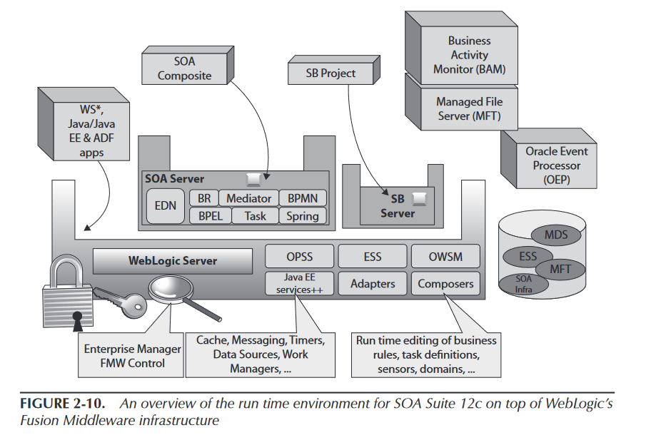
SOA Installation
Fusion Middleware infrastructure
— SOA Suite 12c runs inside WebLogic Server 12c
— The SCA and Service Bus engines live inside the Java EE container.
— The underlying run-time infrastructure of Fusion Middleware 12c the WebLogic Server platform, managed through its Administration Console.

Slide 16
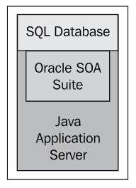
SOA Installation
The SOA Suite is built on top of a Java Enterprise Edition (Java EE) infrastructure
Although SOA Suite is certified with several different Java EE servers, including IBM WebSphere, it will most commonly be used with the Oracle WebLogic server.
The Oracle WebLogic Server (WLS) will probably always be the first available Java EE platform for SOA Suite
In addition to a Java EE application server, the SOA Suite also requires a database.
The database is used to maintain configuration information and also records of runtime interactions.

Slide 17
SOA Installation
Steps of Creating SOA Infrastructure
Steps of Creating New Domain
Installing a supported Database
(on one server for Cluster Architecture)
Create New SOA Environment
Installing
FMW (weblogic)
On every server (for Cluster Deployment)
Create Repository
Using RCU
Create Domain
Using config.sh
Installing
SOA Suite On every server (for Cluster Deployment)
Runnning Domain
Creating Domain

Slide 18
SOA Installation
To Run SOA
1. Create Repository (For SOA Configuration)
Use rcu utility available under : will create a repository on provided DB(mostly oracle DB used)
$WLS_HOME/bin/rcu
Requires a database software to create needed repositories
Create Domain:
Using tool:
$WLS_HOME/oracle_common/common/bin/config.sh
3. Check for Created Database Repositories
a. using oracle shell user:
oracle_user_home>$ sqlplus / as sysdba
b. using oracle toad :
new session
make connection to database running on 10.19.10.161:1501
Let’s Create a Domain!

Slide 19
SOA Installation
For Cluster Architecture:
We need to pack the created domain in Admin Server and unpack it on worker machines
In worker machines:
We need to use wlst.sh tool to enroll managed server machines
$WLS_HOME/common/bin/
./pack.sh –managed=true –domain=$DOMAIN_HOME –template=${DOMAIN_HOME}-template.jar –template_name=<domain_name>
$ scp <created-template.jar> <sameuser>@<managed_server>:<exact same path>
Unpack .jar in destination server using tool: unpack.sh
Available under: $WLS_HOME/common/bin

Slide 20
Managing and Monitoring Infrastructure and Applications
Admin Server
Port 162:10001
Manager Server 161:10003
$ORACLE_BASE/user_projects/domains/soatrain

Slide 21
Managing and Monitoring Infrastructure and Applications
In this section:
Starting / Stopping Environment (Domain)
Review FMW Console
Review FWM Enterprise Manager

Slide 22
Managing and Monitoring Infrastructure and Applications
Starting / Stopping Environment (Domain)
Starting for the first time:
Creating security properties file:
$ mkdir -p $DOMAIN_HOME/servers/AdminServer/security
$ echo "username=weblogic" > $DOMAIN_HOME/servers/AdminServer/security/boot.properties
$ echo "password=Password1" >> $DOMAIN_HOME/servers/AdminServer/security/boot.properties
Starting Weblogic Server
$DOMAIN_HOME/startWebLogic.sh
Nohup ./startWeblogic.sh > ./startWeblogic.log
Starting Node Managers
$ $DOMAIN_HOME\bin\startNodeManager.sh
Stopping Weblogic Server
$ $DOMAIN_HOME/bin/stopWebLogic.sh
Stopping Node Managers
$ $DOMAIN_HOME/bin/stopNodemanager.sh

Slide 23
Managing and Monitoring Infrastructure and Applications (Session 4)
Review Weblogic Console
Review Weblogic Enterprise Manger
Adding Application Server on JDeveloper

Slide 24
When to use the Mediator
Because the Mediator runs within an SCA Assembly, it has the most efficient bindings to other SCA Assembly components, specifically the BPEL engine. This lets us focus on using the Mediator to provide service virtualization services within SCA assemblies. The Mediator enables the virtualization of inputs and outputs within an SCA Assembly. This leads us to four key uses of the Mediator within SCA. Routing between components in an SCA Assembly Validation of incoming messages into an SCA Assembly Transformation of data from one format to another within an SCA Assembly Filtering to allow

Slide 25
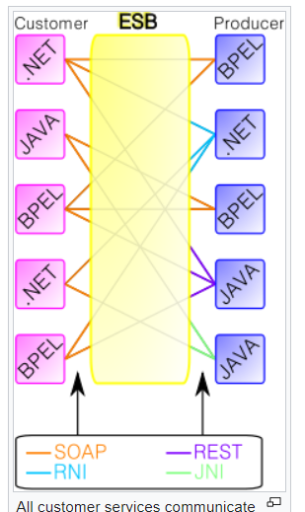
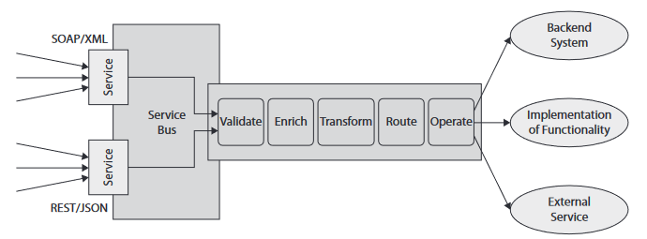
Oracle Service Bus
The concept of the enterprise service bus is analogous to the bus concept found in computer hardware architecture combined with the modular and concurrent design of high-performance computer operating systems.
Simply put, the Service Bus in SOA Suite is a stateless, synchronous request/response engine that is a very fast, uniform intermediary between service consumers and heterogeneous services and backend systems, see Figure 3-1. The Service Bus implements the VETRO pattern. This acronym stands for Validate, Enrich, Transform, Route, and Operate.

Slide 26
Business Process Execution Language(BPEL)
BPEL (Business Process Execution Language)
BPEL is a programming language for implementing process flows and composite (or orchestrated) services.

Slide 27
Business Process Execution Language(BPEL)
Creating Composite
Application : Within JDeveloper, an application is the main container for our work. It consists of a directory where all our application projects will be created.
In Jdeveloper:
1 – Adding Application Server (optional)
We can deploy application directly into added server
We can make package and transfer it to application server
Create an application
Create a Project
Use components to create a composite

Slide 28
Creating Adapter Services
Adapters:
The Oracle Technology Adapters are stand-alone applications, deployed in the J2CA container of WebLogic as a type of application called Resource Application.
This standard describes a number of aspects of connecting to enterprise systems
Connection and transaction management, security, and lifecycle management and handling of events and incoming messages from the enterprise system.
Some of Adapters:
Database
JMS (Java Messaging System)
File and FTP (File Transfer Protocol)
Advanced Queuing (AQ)
Coherence
LDAP (Lightweight Directory Access Protocol)
User Messaging Service (UMS) for email, VoIP, FAX
…

Slide 29
Creating Adapter Services
Adapters:
Adapters provide the bridge to other technologies and communication protocols than those native to the SOA Suite.
A crucial aspect of the adapters is their ability to communicate in XML terms with the SOA Suite, regardless of the format used for interacting with enterprise systems.
The adapter configuration wizard generates a number of files. These largely fall into three categories:
Adapter metadata files that instruct the Resource Adapter application at run time on what exactly to do (which SQL to execute, which JMS Queue to publish to, which file to read)
XSD that describes the XML data structure for the data that is passed into and/or is received from the adapter;

Slide 30
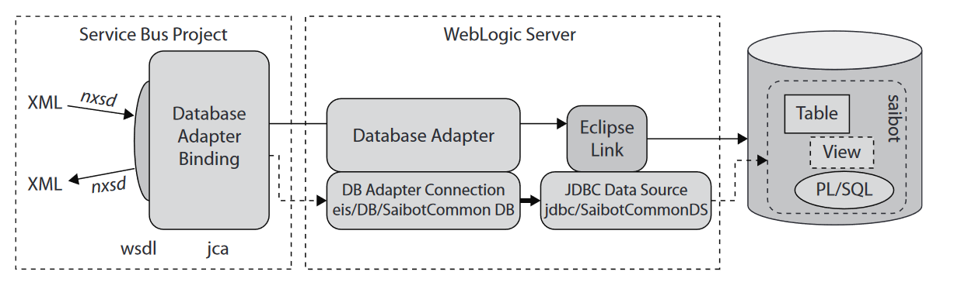
Creating Adapter Services
Database Adapter
Retrieving Information from the Database.
An implementation of a database connector.
It enables SOA composite applications to communicate with databases through JDBC.
JDBC: Java DataBase Connectivity

Slide 31
Creating Adapter Services
In order to use DB Adapter in SOA
First we need to configure Data Source in WEBLOGIC Console
Console / Services
New Generic Data Source
Name of DataSource
JNDI Name:
JNDI : Java Naming and Directory Interfaces
Is an JAVA API provides naming and directory functionality to applications
It allows Java Software Clients to discover and look up data and resources via a name
JNDI allows distributed applications to look up services in an abstract, resource-independent way.
A JNDI Data Source object is a file that contains a configuration details necessary to connect to Database.
jdbc/<given name for datasource name>

Slide 32
Creating Adapter Services
Configuring Data Source in Weblogic Console (continue)
Database Driver:
Oracle’s Driver (Thin XA for Interface connections; Versions:Any)
Connection Properties:
Information, credentials of Database
In JDBC Datasources: Check the created one
Console/Deployment/DBAdpater/Configuration/Outbound Connection Pool
New Outbound Connection Pool
Default Outbound Connection Group
JNDI name for DBAdapter : eis/db/<name sid>
Give jndi of Datasource to the adapters outboung connection name
Update DBAdapter

Slide 33
Creating Adapter Services
Using DB Adapter in BPEL:
Creating XML Schema
Adding BEPL
Adding DB Adapter
New Connection
Add JNDI Name for DbAdapter
Operation
Importing Table
Primary Key
Add Parameter
SQL Construction

Slide 34
Activities in Oracle BPEL Component Designer
Create A BEPL with DBAdapter: in Jdev
Add NewDbAdapter
Define the Connection Specification
JNDI Name
App Server Connection
Select the operation type
Import Tables

Slide 35
Orchestrating Services with Oracle BPEL (External References)
Calling External Web Services using BPEL

Slide 36








High Level Design
Enterprise Applications
Integration Layer
API Management Layer
Gateway/EDGE
Consumers
API Manager
Micro Orchestration
Throttling
Traffic Management
Mediation
Authentication
Authorization
Service Metadata
Enterprise Service Integration
Cloud Applications
Service Orchestration
Message Queuing
Business Process Orchestration
Microservice Applications
Database Connectivity
GW 1
On Premise Applications
GW 2
Analytics Services
Data Repository
Real Time Monitoring
Historic Traffic Analytics
Deep Log Observability
Local Data Storage
Caching Mechanisms
In-Memory Store
Master Data Correlations
Application Specific Data Store
High Availability
Load Balancing
Reverse Proxy
Access Management
Performance Acceleration
Location Specific Delivery
Database

Slide 37
Low Level Design
All Servers’ Operating System: RHEL 7.
Internal APIs
Weblogic
Admin Server
(10.19.10.161)
WSO2 MySql DB Pod(10.19.10.165)
Repository Server
10.19.10.161
2 Instances of
Oracle Database Running on Pod
SOA Worker N1
10.19.10.162
SOA Cluster
WSO2 N1
10.19.10.165
Nginx Edge1
10.19.10.168
SOA Worker N2
10.19.10.163
WSO2 N2
10.19.10.166
Nginx Edge2
10.19.10.169
SOA Worker N3
10.19.10.164

Slide 38
Services on Servers
Server | OS | Services
10.19.10.161 | Oracle LS 7.9 | Podman Oracle DB Weblogic FMW Weblogic SOA Mysql DB Zabbix Agent
10.19.10.162 | RHEL Server 7.9 | Podman Weblogic FMW Weblogic SOA Zabbix Agent
10.19.10.163 | RHEL Server 7.9 | Podman Weblogic FMW Weblogic SOA Zabbix Agent
10.19.10.164 | RHEL Server 7.9 | Podman Weblogic FMW Weblogic SOA Zabbix Agent WSO2 Api Manager Mysql DB
Server | OS | Services
10.19.10.165 | RHEL Server 7.9 | WSO API Manager WSO Micro Int. Mysql-DB Podman Filebeat Zabbix Agent
10.19.10.166 | RHEL Server 7.9 | WSO API Manager Mysql-DB Podman Filebeat Zabbix Agent
10.19.10.167 | RHEL Server 7.9 | Zabbix Server Zabbix Agent Elasticsearch Kibana Logstash Zabbix Agent
10.19.10.168-9 | RHEL Server 7.9 | Nginx Zabbix Agent

Slide 39
API Manager Key Features - WSO2
Supports publishing SOAP, REST, JSON and XML style services as APIs
Publish APIs to a selected set of gateways in a multi-gateway environment
Manage API visibility to restrict access to specific partners or customers
Manage API lifecycle: create, publish, block, deprecate and retire
Manage API versions
Apply security policies to API: Authentication & Authorization
Graphical experience: browse and search
Enforces rate limiting and throttling policies
Horizontally scalable with easy cluster deployment
REST API with and extensible security mechanism: OAuth 2.0 by default
Integrates into enterprise identity systems including LDAP
Pluggable into third party systems and billing systems

Slide 40
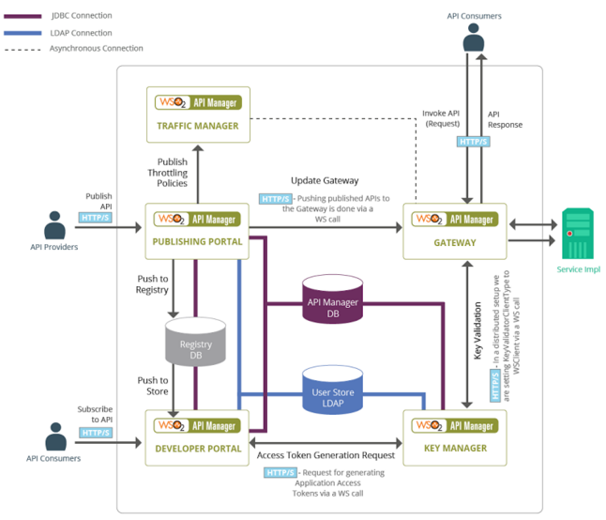
WSO2 Architecture

Slide 41
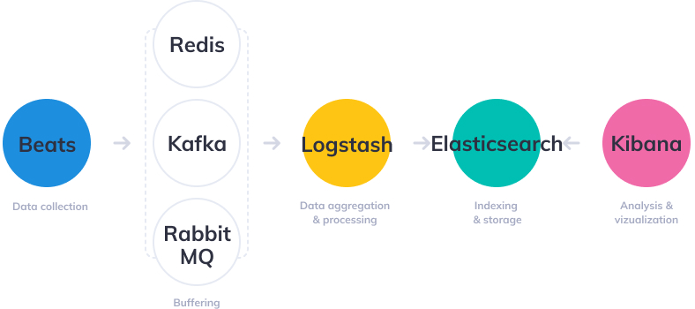
ELK Components

