Slide 1

OSS API GW
Oracle SOA Training
Bahman 1401

Slide 2
OUTLINE
Overview of Oracle SOA | ~15m
Web Services Introduction | ~1h
Service Component Architecture (SCA) | ~2h
SOA Installation | ~5h
Managing and Monitoring Composite Applications | ~1h
Creating Adapter Services | ~2h
Business Process Execution Language(BPEL) | ~5h
Activities in Oracle BPEL Component Designer | ~1h
Orchestrating Services with Oracle BPEL
Working with Mediator Components | ~3h
Fault Handling and Exception Management | ~2h
MDS Introduction | ~2h
Sensors | ~2h

Slide 3








High Level Design
Enterprise Applications
Integration Layer
API Management Layer
Gateway/EDGE
Consumers
API Manager
Micro Orchestration
Throttling
Traffic Management
Mediation
Authentication
Authorization
Service Metadata
Enterprise Service Integration
Cloud Applications
Service Orchestration
Message Queuing
Business Process Orchestration
Microservice Applications
Database Connectivity
GW 1
On Premise Applications
GW 2
Analytics Services
Data Repository
Real Time Monitoring
Historic Traffic Analytics
Deep Log Observability
Local Data Storage
Caching Mechanisms
In-Memory Store
Master Data Correlations
Application Specific Data Store
High Availability
Load Balancing
Reverse Proxy
Access Management
Performance Acceleration
Location Specific Delivery
Database

Slide 4
Low Level Design
All Servers’ Operating System: RHEL 7.
Internal APIs
Weblogic
Admin Server
(10.19.10.161)
WSO2 MySql DB Pod(10.19.10.165)
Repository Server
10.19.10.161
2 Instances of
Oracle Database Running on Pod
SOA Worker N1
10.19.10.162
SOA Cluster
WSO2 N1
10.19.10.165
Nginx Edge1
10.19.10.168
SOA Worker N2
10.19.10.163
WSO2 N2
10.19.10.166
Nginx Edge2
10.19.10.169
SOA Worker N3
10.19.10.164

Slide 5
Services on Servers
Server | OS | Services
10.19.10.161 | Oracle LS 7.9 | Podman Oracle DB Weblogic FMW Weblogic SOA Mysql DB Zabbix Agent
10.19.10.162 | RHEL Server 7.9 | Podman Weblogic FMW Weblogic SOA Zabbix Agent
10.19.10.163 | RHEL Server 7.9 | Podman Weblogic FMW Weblogic SOA Zabbix Agent
10.19.10.164 | RHEL Server 7.9 | Podman Weblogic FMW Weblogic SOA Zabbix Agent WSO2 Api Manager Mysql DB
Server | OS | Services
10.19.10.165 | RHEL Server 7.9 | WSO API Manager WSO Micro Int. Mysql-DB Podman Filebeat Zabbix Agent
10.19.10.166 | RHEL Server 7.9 | WSO API Manager Mysql-DB Podman Filebeat Zabbix Agent
10.19.10.167 | RHEL Server 7.9 | Zabbix Server Zabbix Agent Elasticsearch Kibana Logstash Zabbix Agent
10.19.10.168-9 | RHEL Server 7.9 | Nginx Zabbix Agent

Slide 6
API Manager Key Features - WSO2
Supports publishing SOAP, REST, JSON and XML style services as APIs
Publish APIs to a selected set of gateways in a multi-gateway environment
Manage API visibility to restrict access to specific partners or customers
Manage API lifecycle: create, publish, block, deprecate and retire
Manage API versions
Apply security policies to API: Authentication & Authorization
Graphical experience: browse and search
Enforces rate limiting and throttling policies
Horizontally scalable with easy cluster deployment
REST API with and extensible security mechanism: OAuth 2.0 by default
Integrates into enterprise identity systems including LDAP
Pluggable into third party systems and billing systems

Slide 7
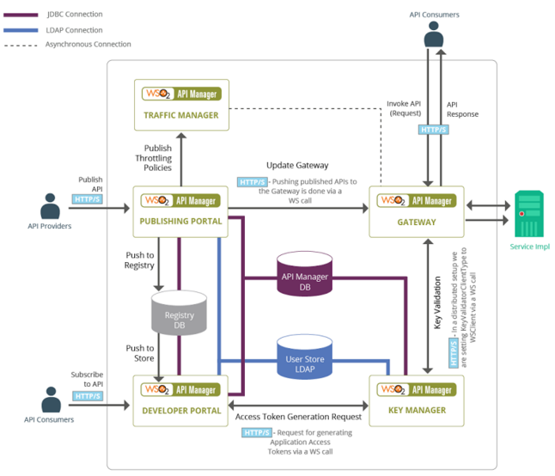
WSO2 Architecture

Slide 8
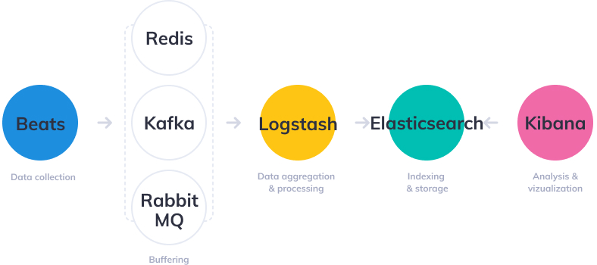
ELK Components

