Slide 1
[intro]

Slide 2
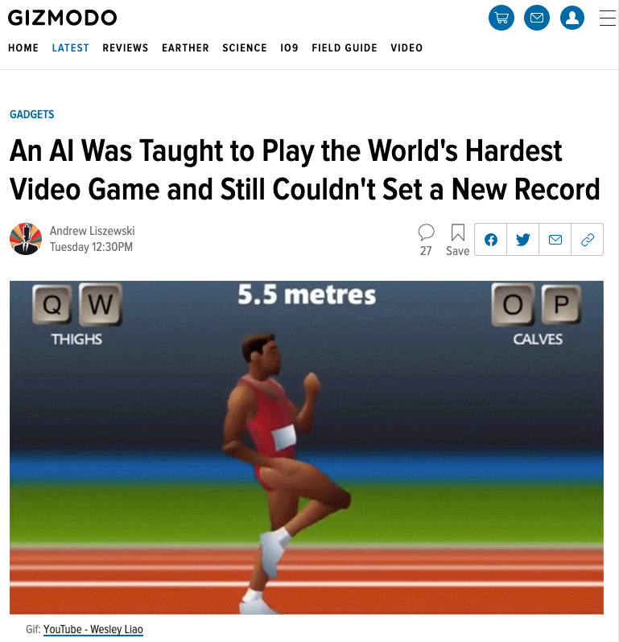

Slide 3
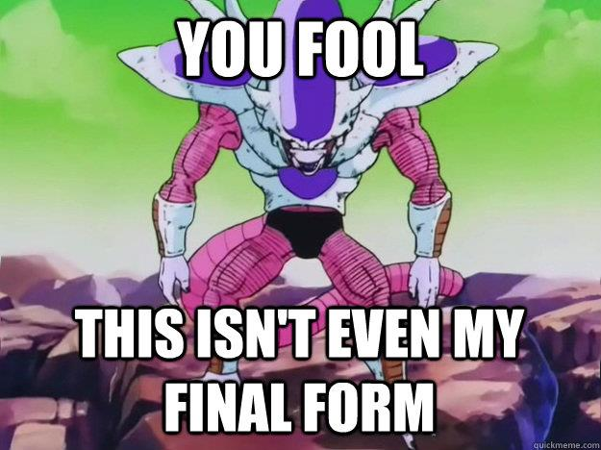

Slide 4
 | Old Agent | New Agent
Algorithm | ACER | Prioritized DDQN

Slide 5

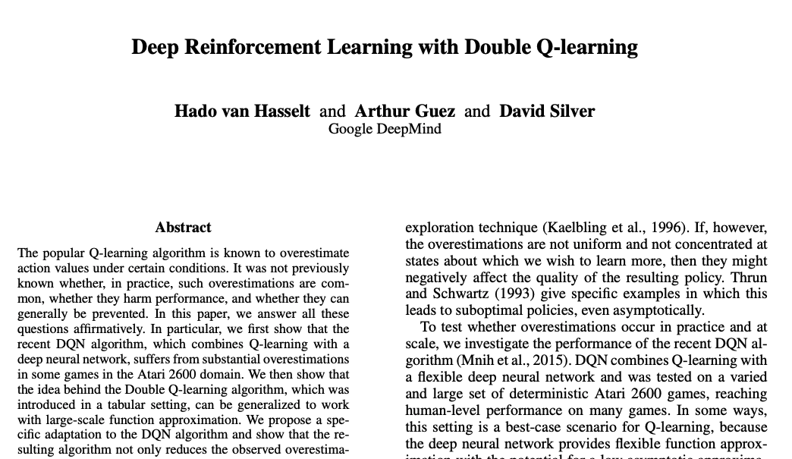
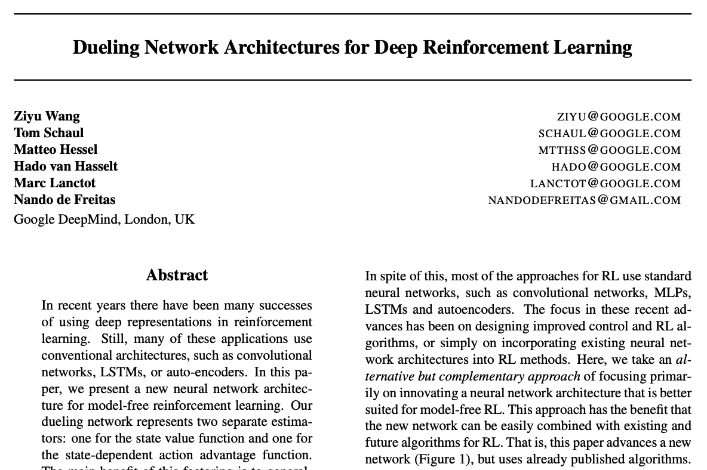
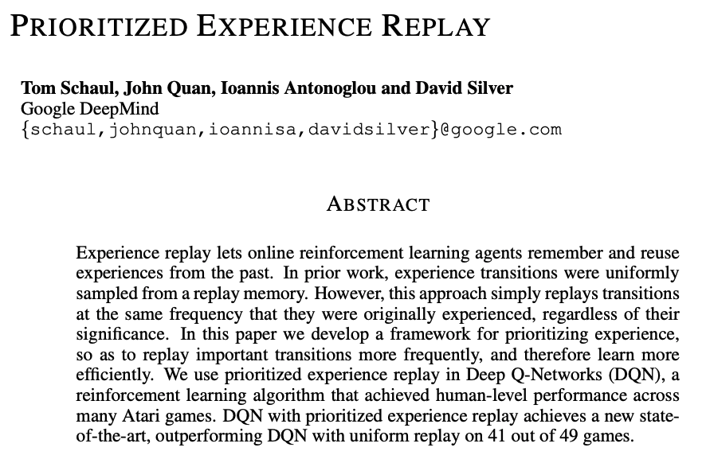

Slide 6
 | Old Agent | New Agent
Algorithm | ACER | Prioritized DDQN

Slide 7
 | Old Agent | New Agent
Algorithm | ACER | Prioritized DDQN
Reward | Forward velocity Torso height penalty Torso bouncing penalty | Forward velocity

Slide 8
 | Old Agent | New Agent
Algorithm | ACER | Prioritized DDQN
Reward | Forward velocity Torso height penalty Torso bouncing penalty | Forward velocity
Actions per second | ~9 | Training: ~18 Testing: ~25

Slide 9
 | Old Agent | New Agent
Algorithm | ACER | Prioritized DDQN
Reward | Forward velocity Torso height penalty Torso bouncing penalty | Forward velocity
Actions per second | ~9 | Training: ~18 Testing: ~25
Learning | Kurodo’s runs Self-learning | ACER’s runs Self-learning

Slide 10
 | Old Agent | New Agent
Algorithm | ACER | Prioritized DDQN
Reward | Forward velocity Torso height penalty Torso bouncing penalty | Forward velocity
Actions per second | ~9 | Training: ~18 Testing: ~25
Learning | Kurodo’s runs Self-learning | ACER’s runs Self-learning
Training time | ~65 hours | ~40 hours

Slide 11
Pre-training with ACER’s data | 2 min
Self-training | 40 hrs
Total training time | ~40 hrs

