Slide 2
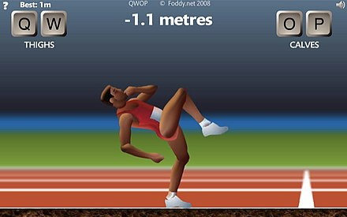



Game UI
RL Environment
Selenium / Chomedriver
Adapter
Game State
Game Engine
Actions
RL Agent

Slide 3
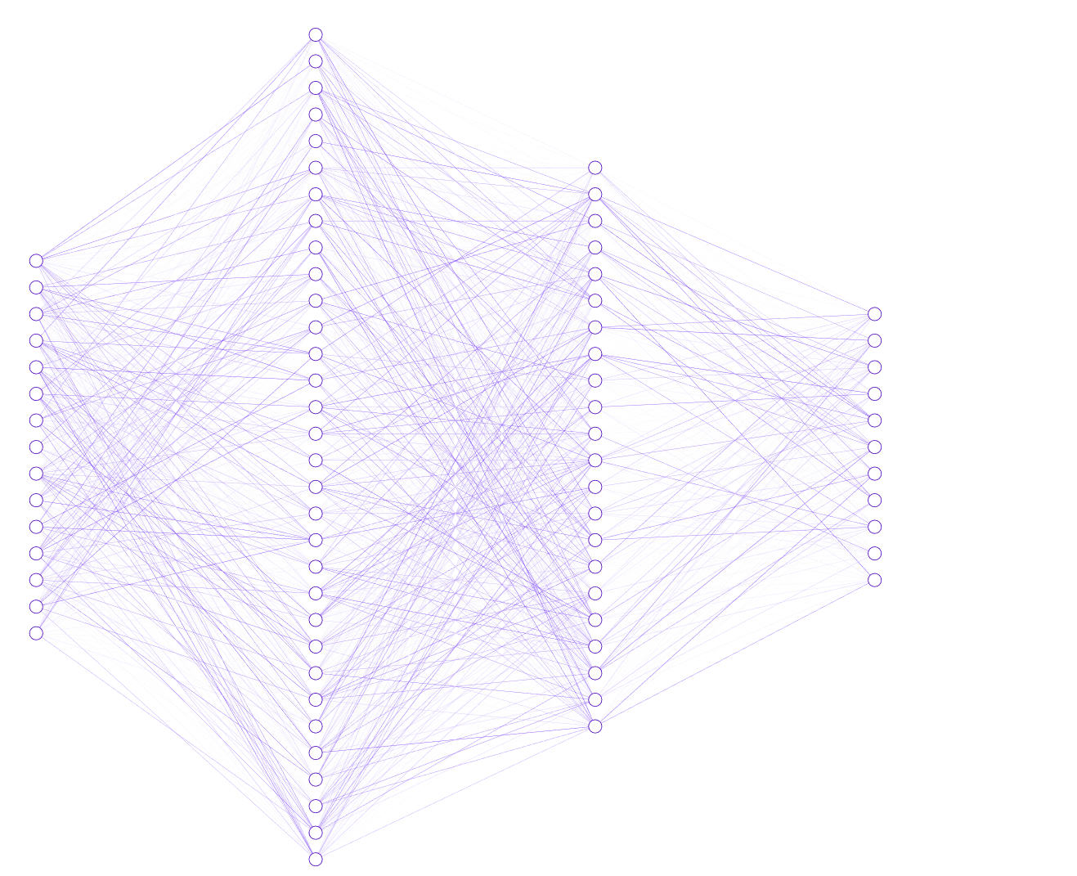
256 nodes + ReLU
Body Parts
Head
Position X: 2.5
Position Y: 1.2
Velocity X: 0.7
Velocity Y: 0.1
Angle :-0.3
Torso
...
Left Arm
...
Left Thigh
...
[other…]
...
Joints
Left Hip
Angle :-0.8
Right Hip
Angle : 1.3
Left Elbow
Angle : 0.5
[other…]
...
128 nodes + ReLU
71 input
nodes
11 output probabilities
Sample action from distribution
‘qp’
‘qp’: 62%
‘q’ : 14%
‘p’ : 8%
‘qo’: 6%
.
.
.
~

