Slide 1
[training video with intro]
Notes:
In this video I’ll be showing you how I built an AI bot to not only beat QWOP but also achieve a top 10 speed run. This was done using a combination of reinforcement learning and imitation learning. First, I’ll show you the final agent’s best recorded run, and then I’ll go into the details of how it was made.
I have wanted to build a QWOP bot for a long time but wasn’t equipped with the knowledge to do it until fairly recently
First I’ll go through the environment setup and how the agent interacts with the game
Then I’ll go over the approach and algorithms used to create the agent
Next the training process and the tricks I used to get the AI to learn faster and learn advanced techniques
And lastly, the agent’s best recorded speedrun
Feel free to skip to the section that most interests you
Let’s get started

Slide 2

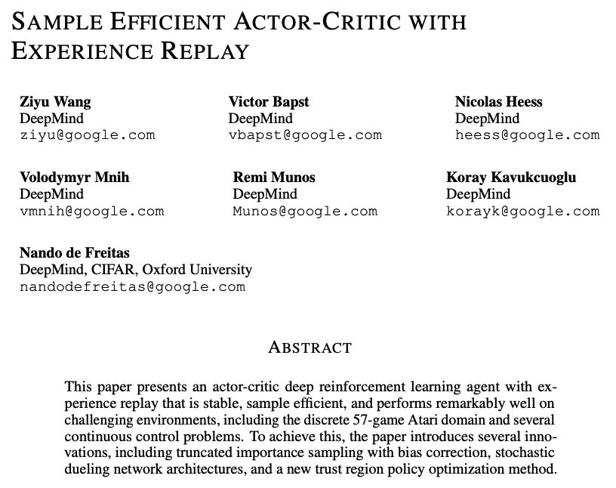
Notes:
The agent’s main learning algorithm is called Actor-Critic with Experience Replay (ACER)², which was published by Deepmind a couple of years ago. It combines Actor-Critic with a replay buffer for both on-policy and off-policy learning. This basically means the agent not only learns from its most recent experience, but also from older experiences stored in memory. Learning from the replay buffer allows ACER to learn faster than some of its counterparts

Slide 3
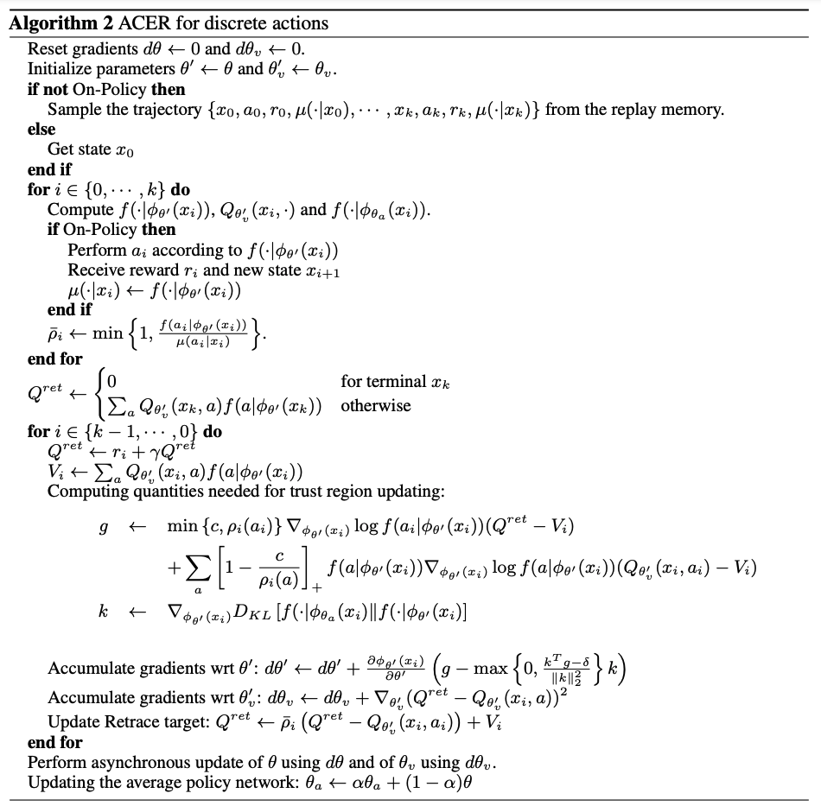
Notes:
This is what ACER’s learning procedure looks like. I’m not going to go into too much detail here. It’s a lot of math. But essentially, it has a couple of tweaks to help deal with off-policy learning including Retrace Q-value estimation, importance weight truncation, and efficient trust region policy optimization.
If you’re interested, check out the original paper, which I’ll link below.

Slide 4
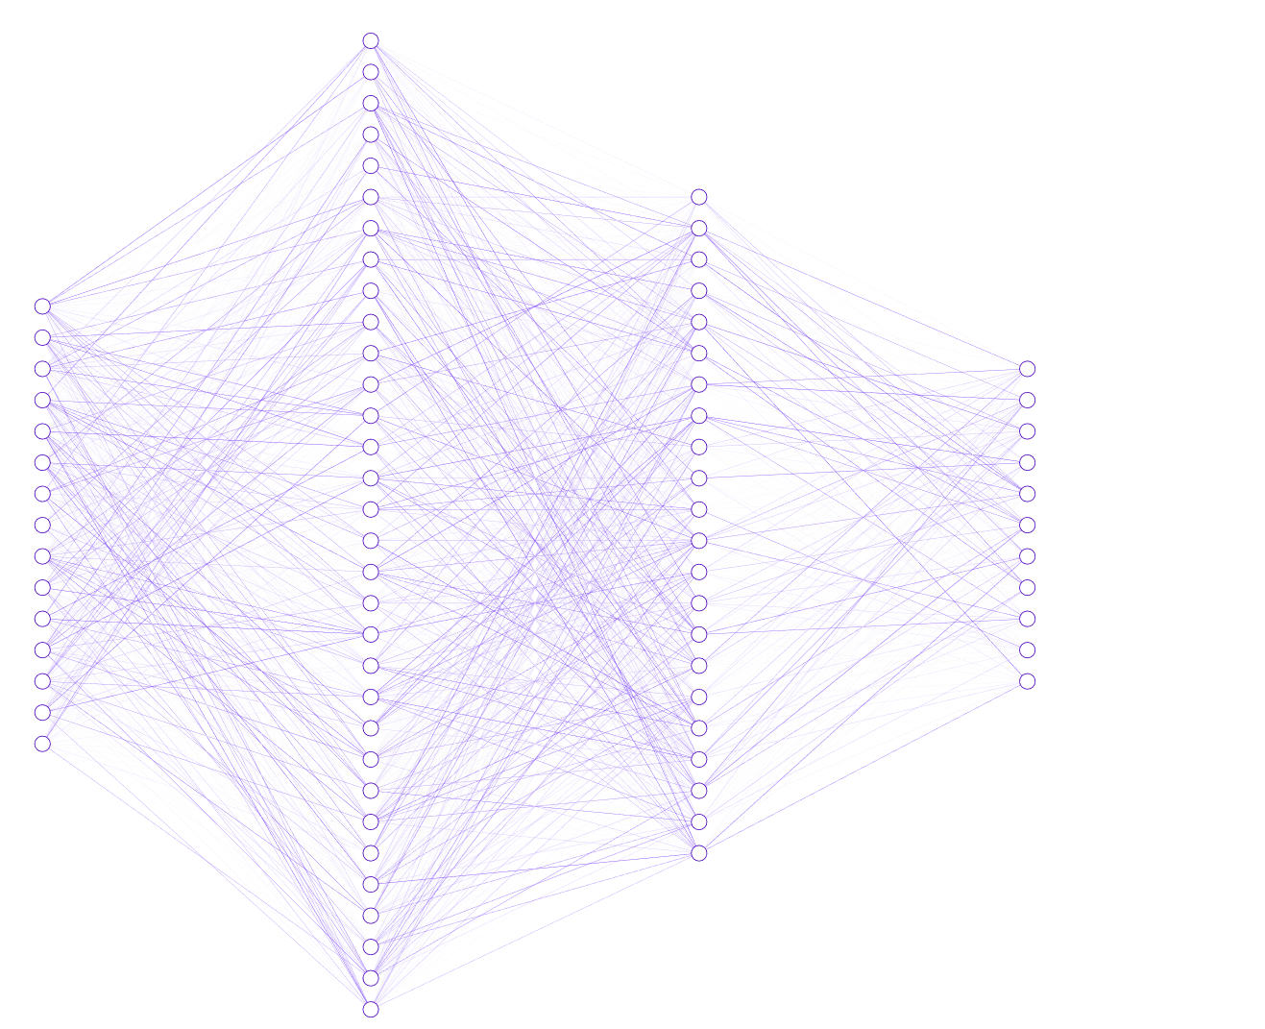
256 nodes + ReLU
Body Parts
Head
Position X: 2.5
Position Y: 1.2
Velocity X: 0.7
Velocity Y: 0.1
Angle :-0.3
Torso
...
Left Arm
...
Left Thigh
...
[other…]
...
Joints
Left Hip
Angle :-0.8
Right Hip
Angle : 1.3
Left Elbow
Angle : 0.5
[other…]
...
128 nodes + ReLU
71 input
nodes
11 output probabilities
Sample action from distribution
‘qp’
‘qp’: 62%
‘q’ : 14%
‘p’ : 8%
‘qo’: 6%
.
.
.
~
Notes:
Now let’s take a peek inside the agent’s brain. It’s a fairly small neural network with 2 hidden layers of 256 and 128 nodes, all fully connected with ReLU activations.
As you can see here, the network ingests measurements from the game engine, processes it using the hidden layers, and then produces a probability distribution over all actions. It then randomly picks an action by drawing from that distribution.

Slide 5
[Starting to play by itself]
Notes:
Now that the agent is setup, it’s off the races.

Slide 6
8 hours later…

Slide 7
[Learning to finish by knee scraping]
Notes:
Unfortunately, by itself, the only way it learned to finish the 100m was through “knee-scraping.” This is pretty consistent with many previous attempts at building QWOP bots.
The agent isn’t discovering the idea strides and how to use legs like a human. Instead it just learns the safest and slowest method to reach the finish line.
It does learn to finish though, but it tasks about XX minutes

Slide 8



Notes:
So then I thought, hm if only there was a way to show the agent how legs are meant to be used.
Well, it just so happens that I’m human and I know how to use legs. Maybe I can teach the agent through some examples.

Slide 9

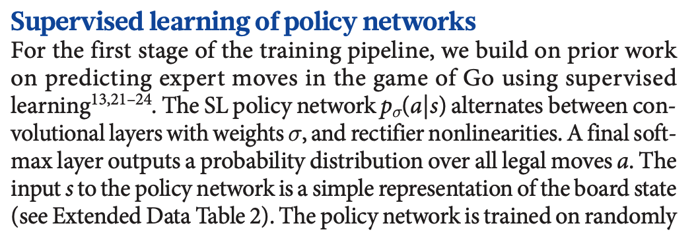
Mastering the game of Go with deep neural networks and tree search (Silver et al., 2016)
Notes:
This idea is not new. It’s actually how first iteration of AlphaGo was trained. It learned to mimic human behavior before training by itself.

Slide 10
[Me playing]
Notes:
so I tried to learn the game myself. Unfortunately, it turns out I’m quite bad at the game. After a day of practice I could only run about 28 meters max.
Although I played poorly, I was still kind of using legs in way that a human would. So maybe the agent can learn a thing or two from that

Slide 11
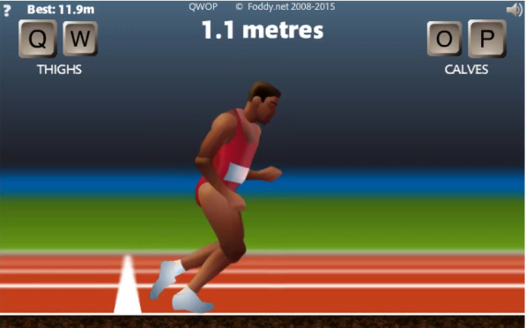
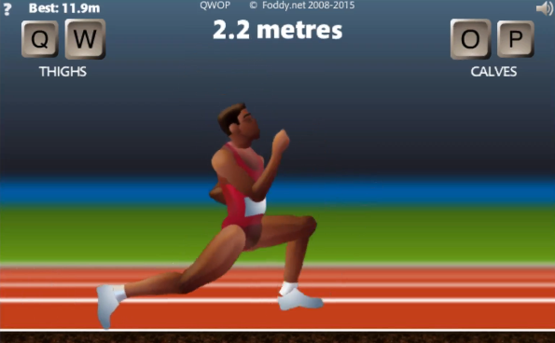
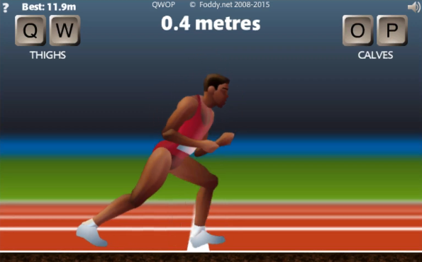
50 games of me playing (terribly)
Encode games as experiences
{
‘states’: [[...]],
‘obs’: [[...]],
‘actions’: [...],
‘rewards’: [...],
‘episode_returns’: [...],
‘episode_starts’: [...]
}
.
.
.
Notes:
So I recorded and encoded 50 episodes of my bad play
Then I encoded the games as numpy arrays, which is a format that the agent can understand
And then fed it to the agent as pre-training data, which means it learns from this experience before any self-training

Slide 12
[Show it trying to stride]
Notes:
Here’s how it performed after pre-training. Not surprisingly, the result is quite poor — the agent understands the idea of a stride but has no idea how to actually apply it.
After pre-training I then let the agent train by itself and marinate on technique to see if it could make use of it.

Slide 13
20 hours later…

Slide 14
[Show result after training]
Notes:
After 20 hours, the agent actually learned to take strides and run like a human! This means it was able to learn mechanics from me, a total amateur, and refine it to the point where it can actually run pretty smoothly.
With this method it was able to complete the race in 1m 25s, which is a top 15 speedrun but still far from the top.
The problem was the agent wasn’t discovering a special technique used by all of the top speed runners. The technique is to swing the legs upwards and forwards to create extra momentum. I wanted to teach the AI this technique but I was definitely not skilled enough to demonstrate, so I reached out for help.

Slide 15

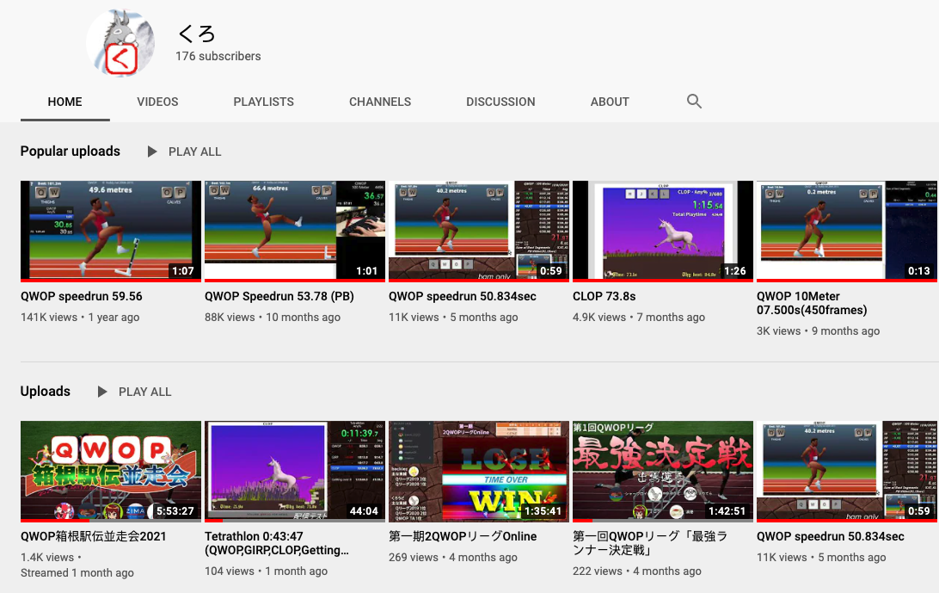
Notes:
One of the people I reached out to was Kurodo, one of the worlds top top QWOP speed runners. He has some amazing QWOP content on his twitch and youtube channel, which I’ll link below.

Slide 16
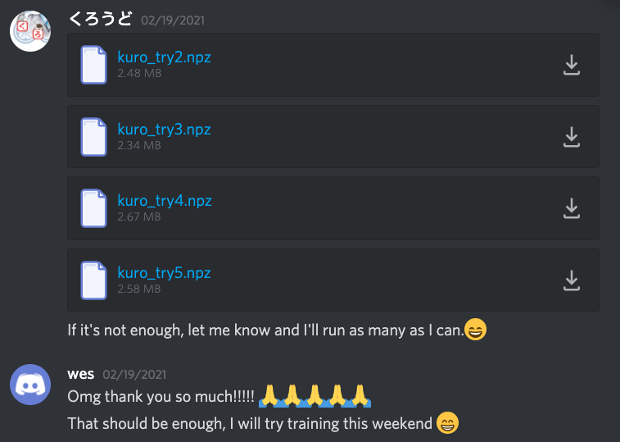
Notes:
Luckily he was able to get my code running, and was generous enough to record and encode 50 games for the agent to train on.

Slide 17
[Play kuro pretrained – performs badly]
Notes:
With these recorded games, I first tried supervised pre-training like before but the results weren’t great. The agent could not make use of the data immediately, and then quickly forgets / overwrites the pre-training experience.

Slide 18

Kurodo’s experiences
AI’s own experiences
AI’s memory
(for replay learning)
Notes:
I then tried injecting the experience directly into the ACER replay buffer for off-policy learning. Half of the agent’s memory would be games it played and the other half would be Kurodo’s experiences.

Slide 19
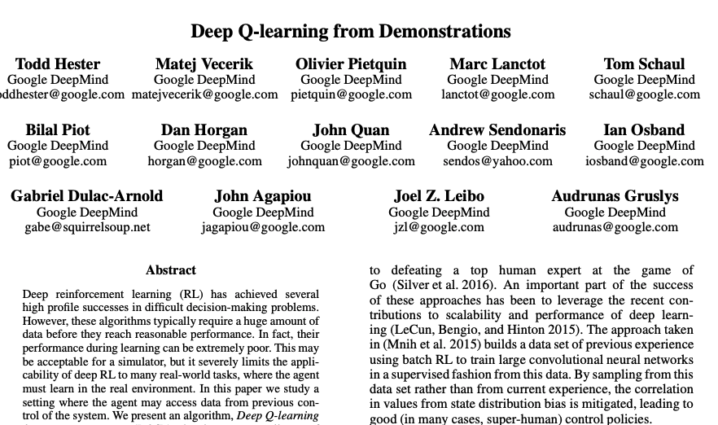
Notes:
This approach is somewhat similar to Deep Q-learning from Demonstrations (DQfD)⁶ except we don’t add all the demonstrations at the start, we add demonstrations at the same rate as real experience.
If interested, definitely check out this paper.

Slide 20
[showing the AI learning swinging technique]
Notes:
This scheme ended up working really well and the agent was able to learn this leg swing technique.
However, the agent’s policy (actions) would become unstable after a while because it was unable to fully reconcile the external data with its own policy. At which point I removed the expert data from its memory and let it continue training by itself.

Slide 21
Pre-training with Kurodo’s data | 2 min
Self-training | 25 hrs
Self-training with Kurodo’s data in replay buffer | 15 hrs
Self-training | 25 hrs
Total training time | ~65 hrs
Notes:
This is the training schedule of the final agent
pre-training, 25 hours by itself, 15 hours with Kurodo’s data, and another 25 hours by itself.

Slide 22
[Final speed run with music]
Notes:
And now, for the moment we’ve been waiting for, here’s the final speed run

Slide 23
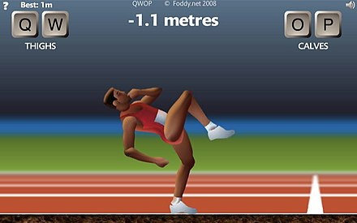



Game UI
RL Environment
Selenium / Chomedriver
Adapter
Game State
Game Engine
Actions
RL Agent
Notes:
The first step was to connect the QWOP to the AI agent so that it can interact with the game. To retrieve the game state, I wrote a Javascript adapter that extracted key variables from the game engine and made them accessible externally.
Then Selenium was used to read game variables in Python and to send key presses to the browser.
Next, the game was wrapped in an OpenAI gym style environment, which defined the state space, action space, and reward function. The state consisted of position, velocity and angle for each body part and joint. The action space consisted of 11 possible actions: each of the 4 QWOP buttons, 6 two-button combinations, and no keypress. The reward function was the velocity of the runner plus penalties for having the torso too close to the ground. Each key press action is sent to the game for about 0.1 seconds, meaning the agent can make about 10 actions per second.

