Slide 1

Exploratory Data Analysis
BANK MARKETING ANALYSIS USING
MACHINE LEARNING
14/08/2021

Slide 2

Agenda
Executive Summary
Problem Statement
Approach
EDA
EDA Summary
Recommendations

Slide 3
PROBLEM DESCRIPTION
We are given data related to direct marketing campaigns i.e. phone calls of a bank in Portugal.
The classification goal is to predict whether a client will subscribe or not(yes/no) to a term deposit (variable y).

Slide 4
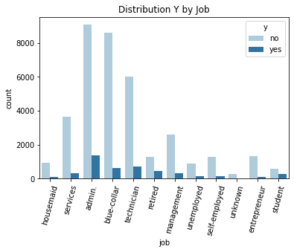
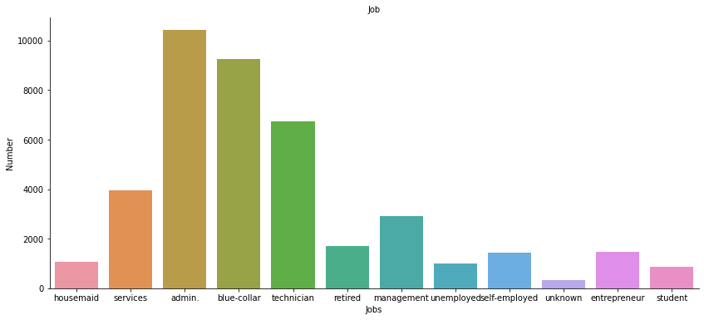
FEATURE COMPARISON
From the above we can see that majority of the clients work as admin.
Equally those who work in admin subscribed more to the term deposit.

Slide 5
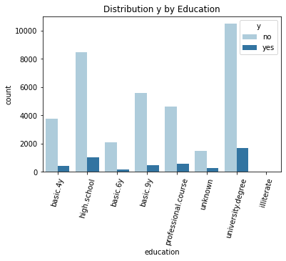
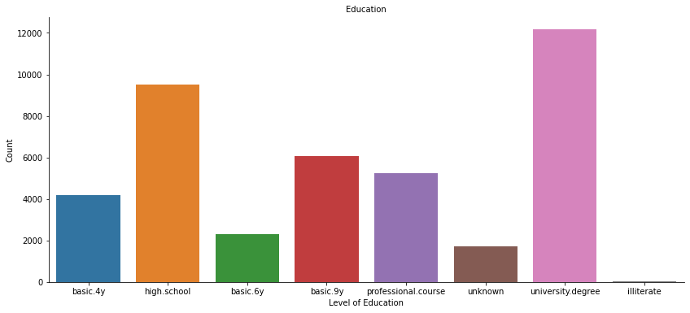
EDUCATION
From the plot most of clients who were contacted completed a university degree.
Most of those who subscribed completed a university degree .

Slide 6
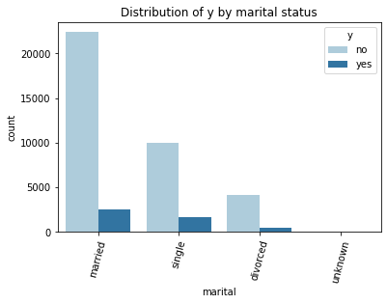
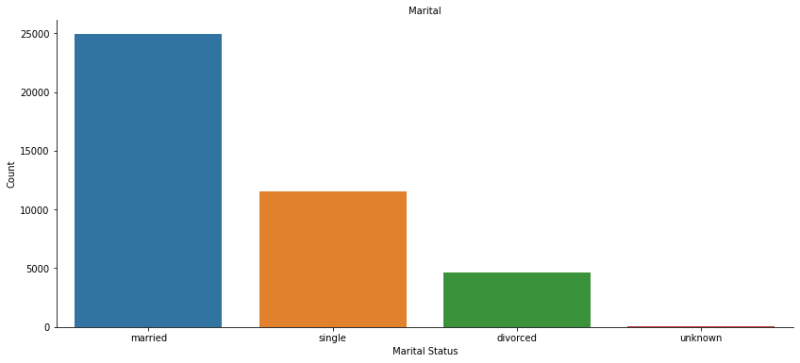
MARITAL
Majority of the clients were married and they subscribed slightly more than those who were single.

Slide 7
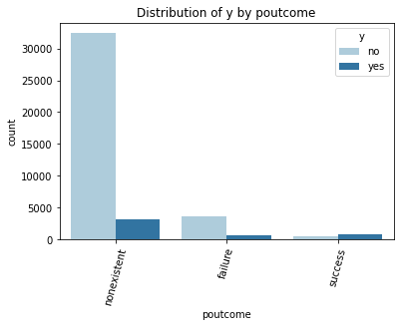
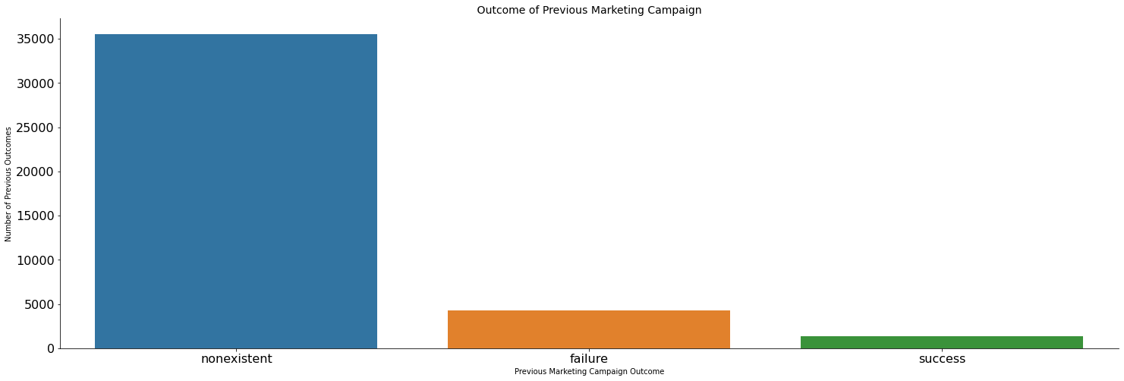
POUTCOME
Considering the outcome of the previous campaign, majority of the clients contacted were new clients and they subscribed more compared to those who had been contacted before.

Slide 8
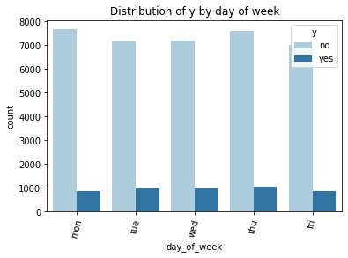
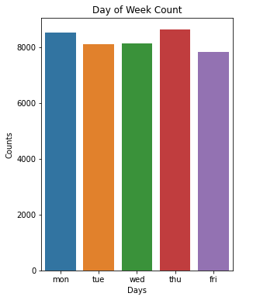
DAY OF WEEK
Clients were contacted on Monday, Tuesday, Wednesday, Thursday and Friday with the least number of clients being contacted on Friday.
Almost an equal number of clients contacted subscribed .

Slide 9
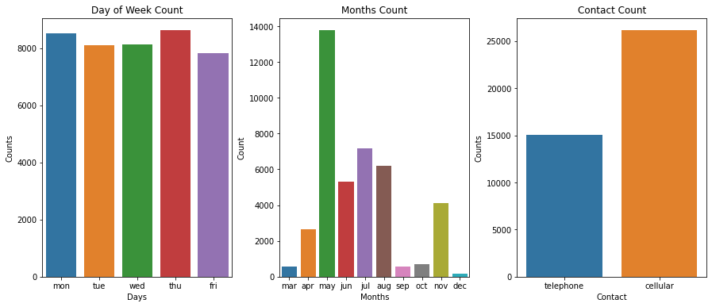
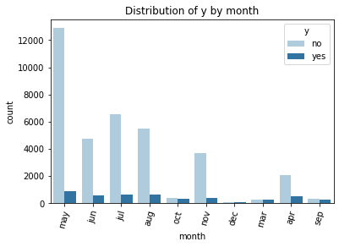
MONTH
Clients were contacted most in the month of May and more clients equally subscribed in May.

Slide 10
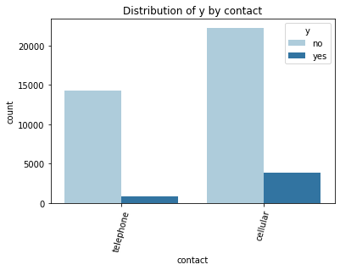
CONTACT
Majority of the clients were contacted by cellular and they subscribed more compared to those who used telephone.

Slide 11
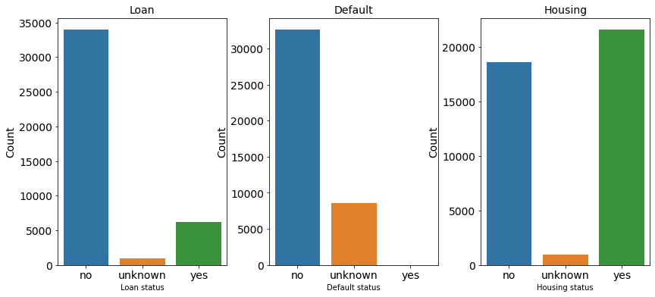
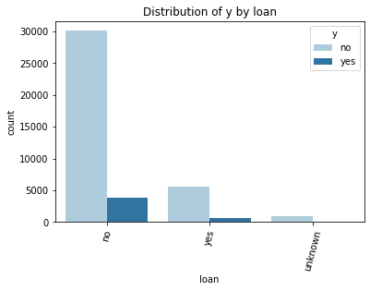
LOAN
The bank mostly contacted clients who did not have loans.

Slide 12
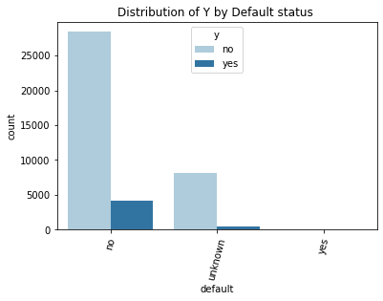
DEFAULT
The contacted mostly clients who had not defaulted .
Most of the clients who had not defaulted in their credit and they subscribed more compared to those whose default status was unknown.

Slide 13
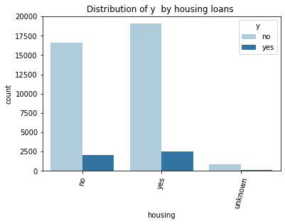
HOUSING
From the plots majority of clients had housing loans .
Those who had loans subscribed slightly more than those who didn’t have loans.

Slide 14
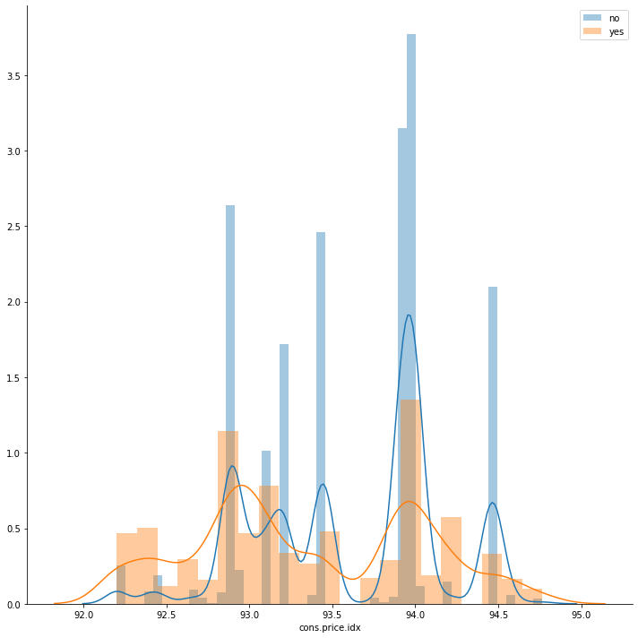
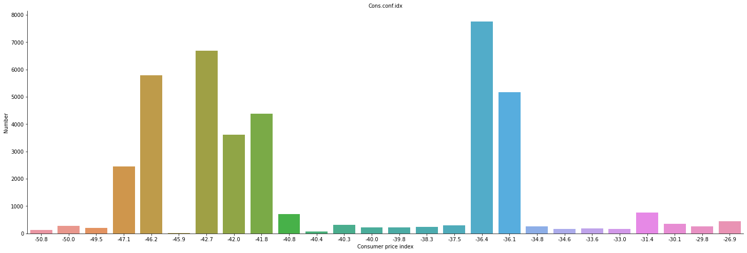
CONS.PRICE.IDX
From the plot we can see cons.price.idx would be useful in prediction.

Slide 15
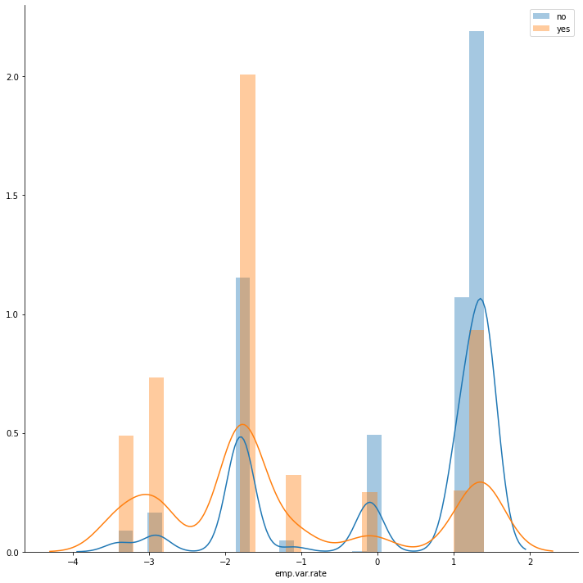
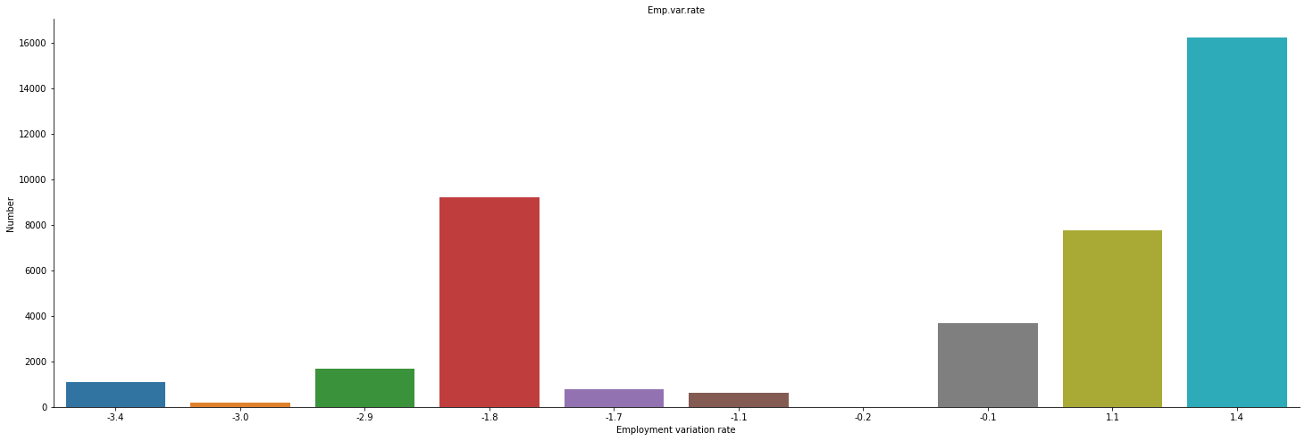
EMP.VAR.RATE
From the plots we see that emp.var.rate would be very useful in prediction.

Slide 16
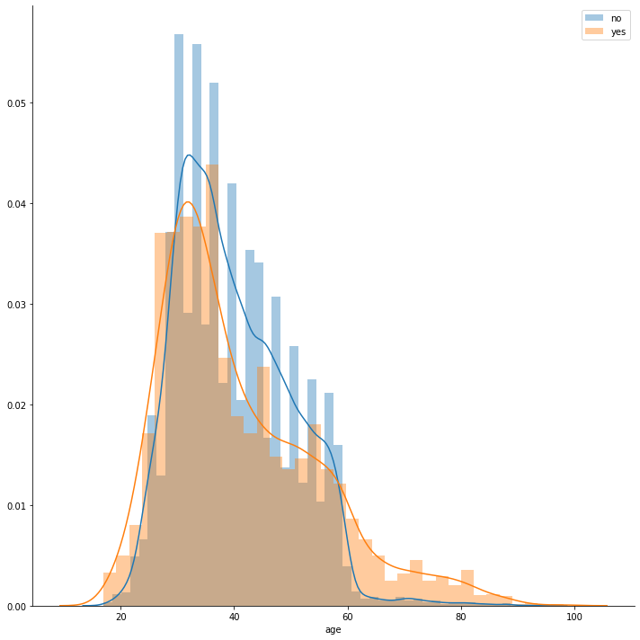
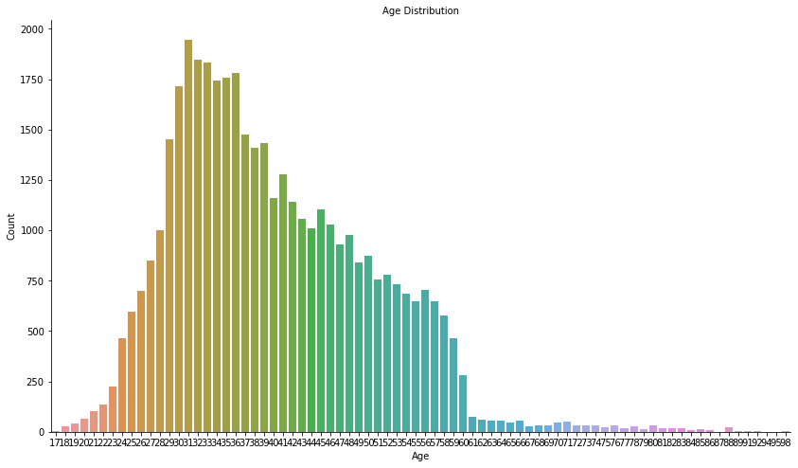
AGE
Clients age ranged from 17-98 yrs.

Slide 17
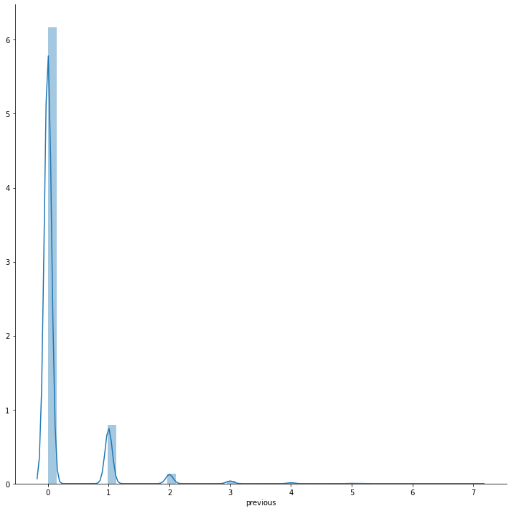
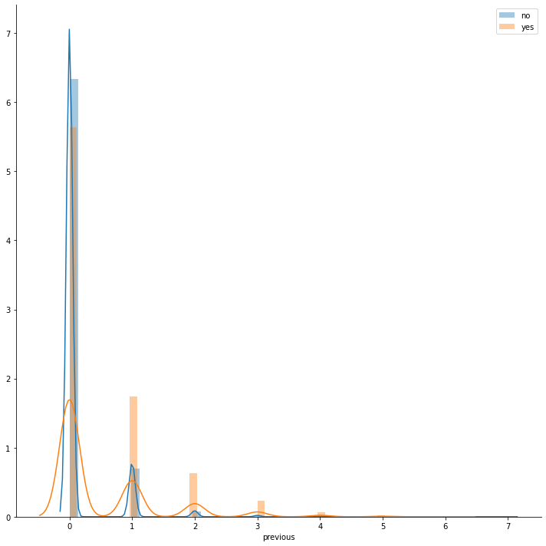
PREVIOUS
From the plot majority of the clients the bank contacted in this campaign had not been contacted in the last campaign.
It is also clear that previous will be very useful in prediction.

Slide 18
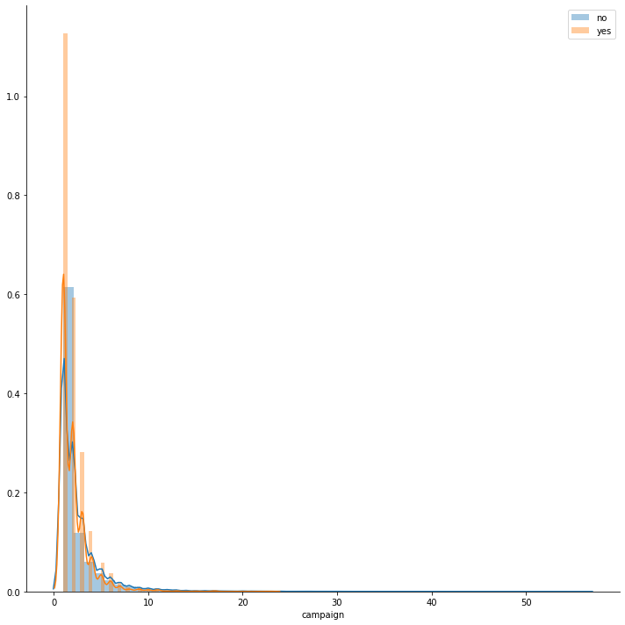
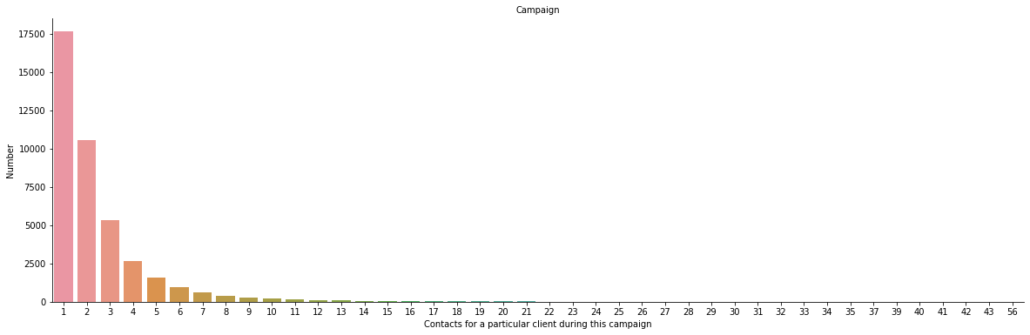
CAMPAIGN
Majority of the clients were only contacted once during this campaign.

Slide 19
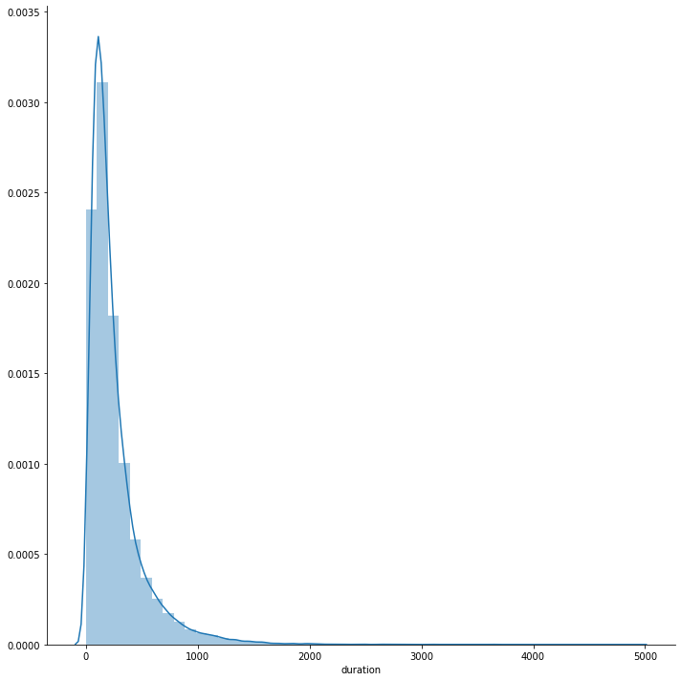
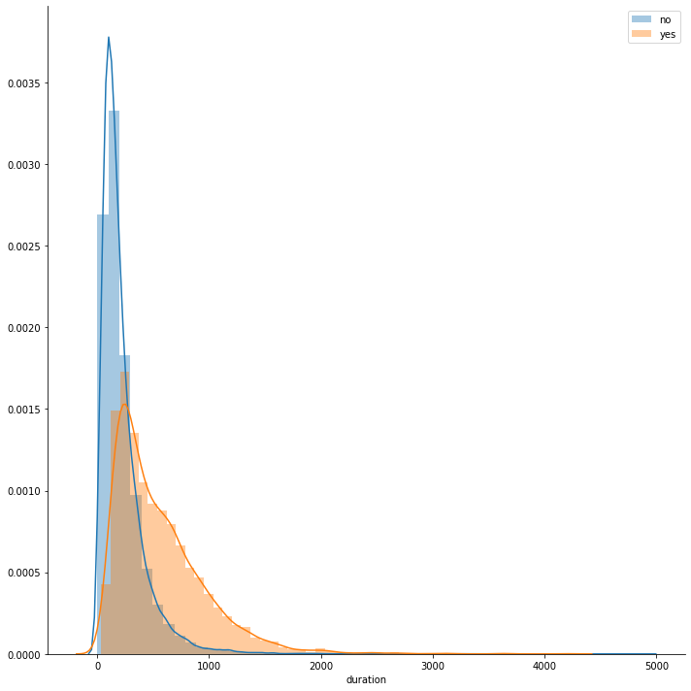
DURATION

Slide 20
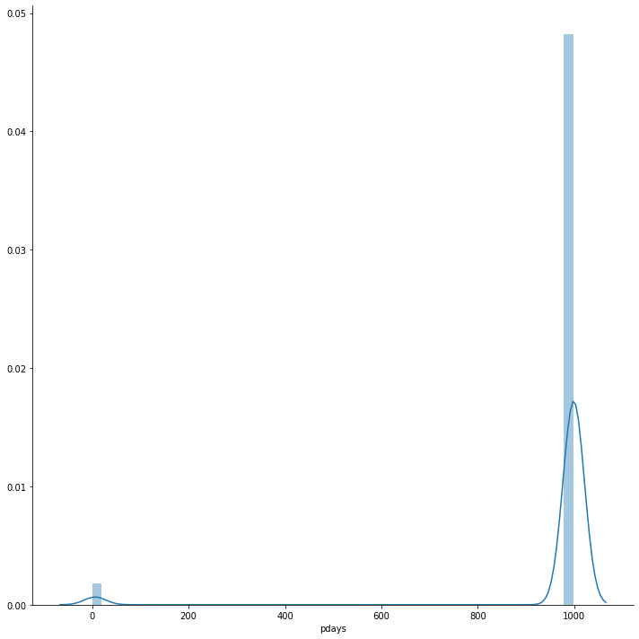
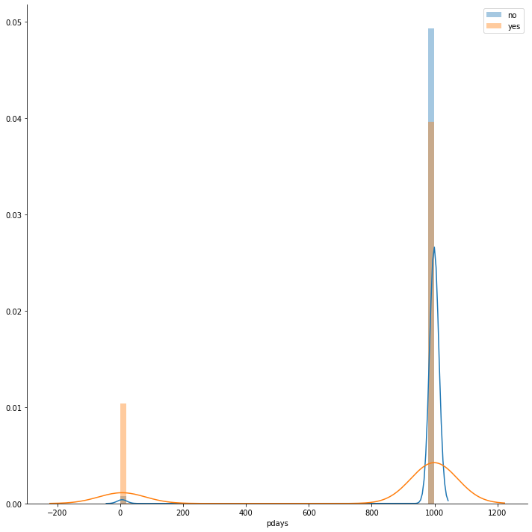
PDAYS

Slide 21
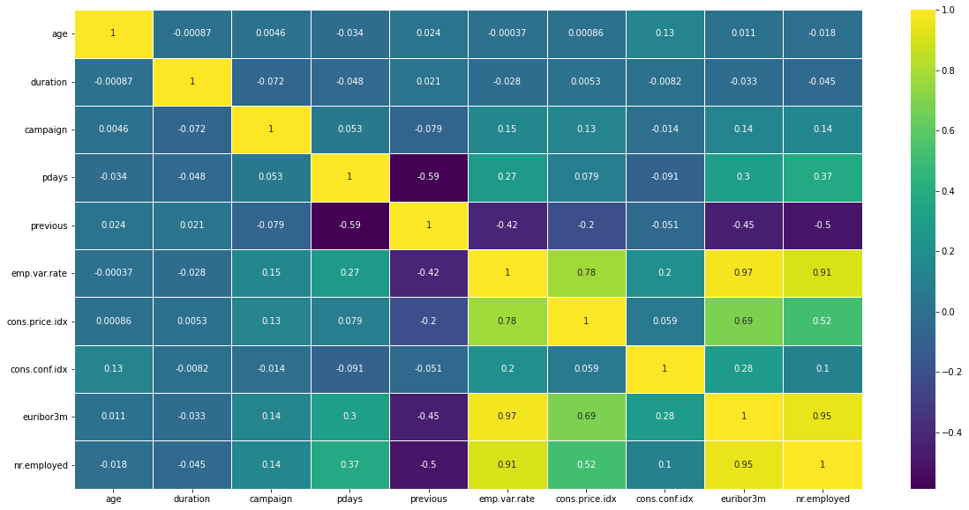
CORRELATION MATRIX
Emp.var. Rate, euribor3m, nr.employed and cons.price.idx have very high correlation

Slide 22
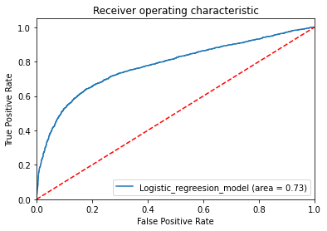

MODELS LOGISTIC REGRESSION

Slide 23
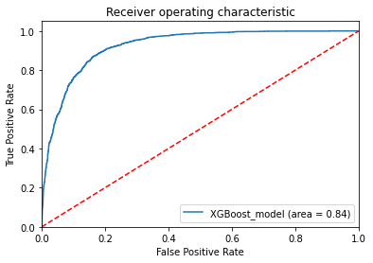
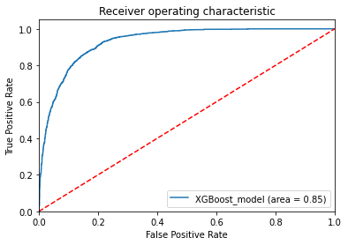
XGBoost Model

Slide 24
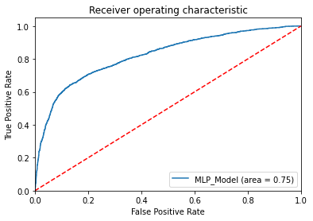

MULTILAYER PERCEPTRON

Slide 25
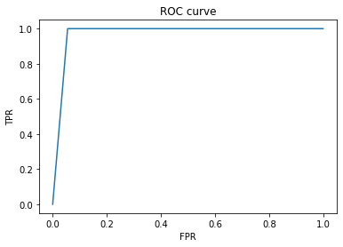
RANDOM FOREST

Slide 26
FINAL RECOMMENDATION
The most influential variables are duration,nr.employed,euribor3m and emp.var.rate
Duration has a positive effect of people saying yes since the longer conversation the more inclined the client will be to the term deposit.
Euribor3m denotes the Euribor 3 month rate which is an indicator of the average interbank interest rates. The higher the interest rates the more a client will be inclined to the term deposit.
Emp.var.rate which is the change of the employment rate has a negative impact of the term deposits since a change in the employment rate will make the clients less likely to subscribe to term deposits.
The bank should target clients above 60years of age.
The bank should also prioritize those who were part of the previous campaigns.

Slide 27
Thank You

