Slide 1

G2M CASE STUDY
27/06/2021

Slide 2

Agenda
Executive Summary
Problem Statement
Approach
EDA
EDA Summary
Recommendations

Slide 3
BACKGROUNG G2M CASE STUDY
XYZ is a private equity firm in the USA. Due to remarkable growth in the cab industry in the last few years and multiple key players in the market it is planning for an investment in the cab industry.
Objective: Provide actionable insights to help XYZ in identifying the right company to invest with.
Cab companies:
Pink Cab
Yellow Cab
The analysis includes :
Data understanding
Data visualization
Finding the most profitable company
Recommendation.

Slide 4
DATA EXPLORATION
There are four datasets:
Cab_Data – This file includes details of transaction for the 2 cab companies.
Customer_ID.csv- This is a mapping table that contains a unique identifier which links the customer demographic details.
Transaction_ID.csv-This is a mapping table that contains transaction to customer mapping and payment mode.
City.csv-This file contains list of US cities ,their population and number of cab users.

Slide 5
EXPLORATORY DATA ANALYSIS

Slide 6
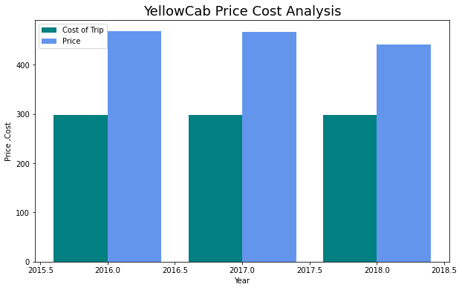
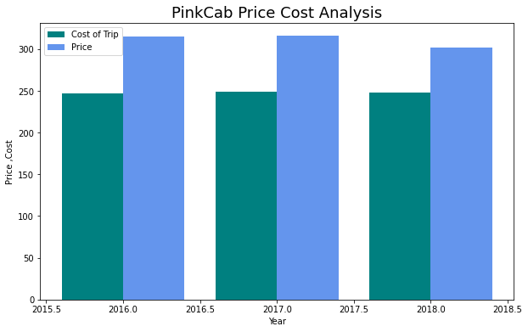
PRICE COST ANALYSIS
From the above it is clear that Yellow cab has higher margins compared to Pink cab.
Yellow cab also charges higher prices than Pink cab

Slide 7
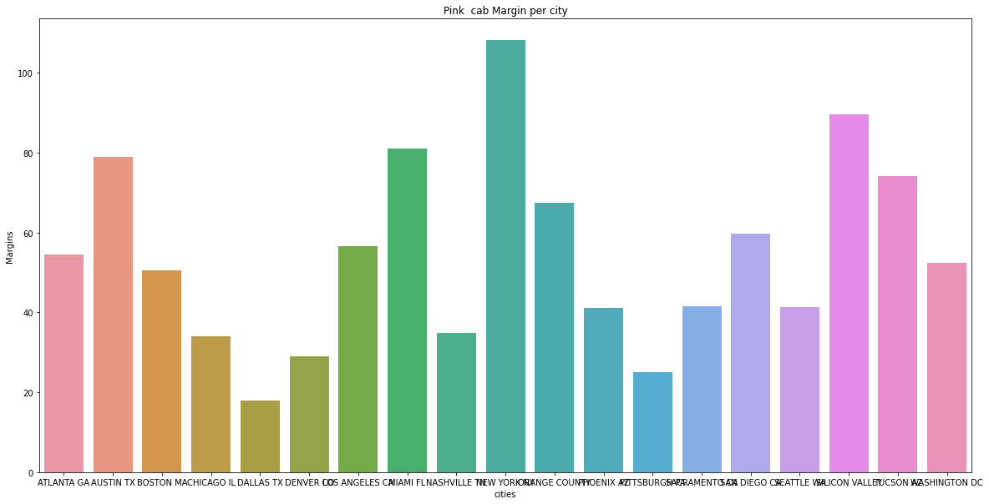
MARGIN PER CITY : PINK CAB

Slide 8
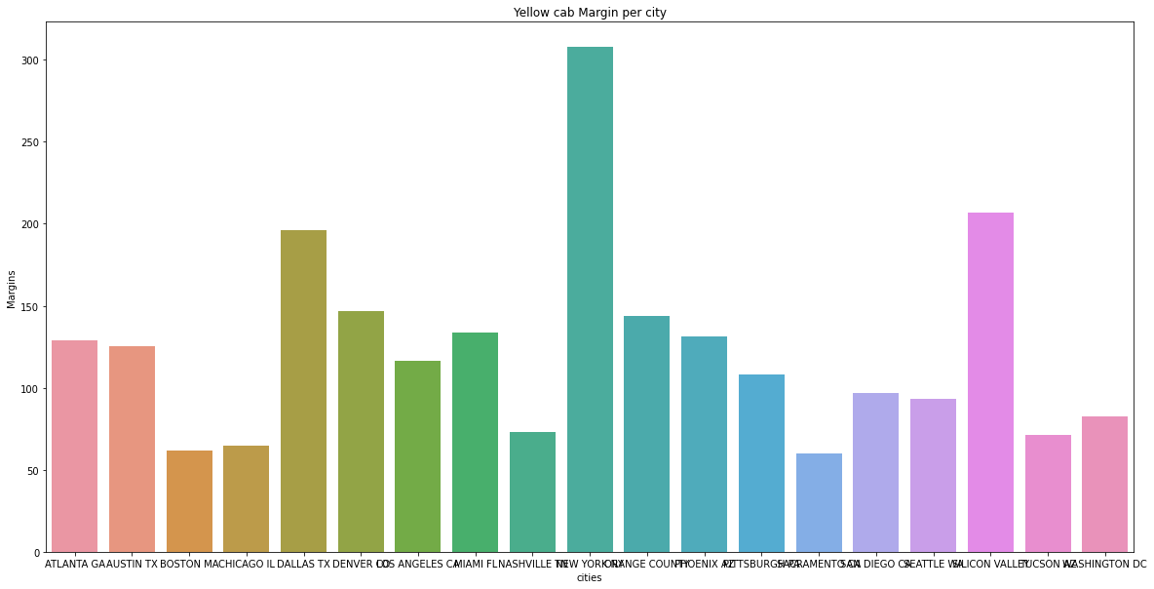
MARGIN PER CITY : YELLOW CAB

Slide 9
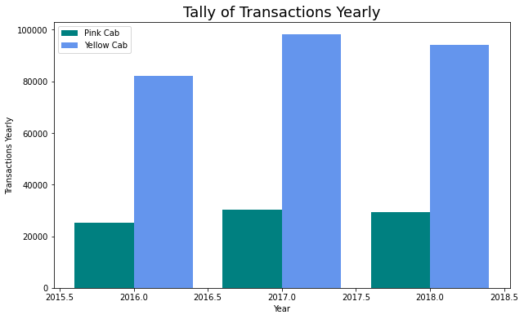
TRANSACTIONS YEARLY
Yellow cab has almost twice as much transactions as Pink cab

Slide 10
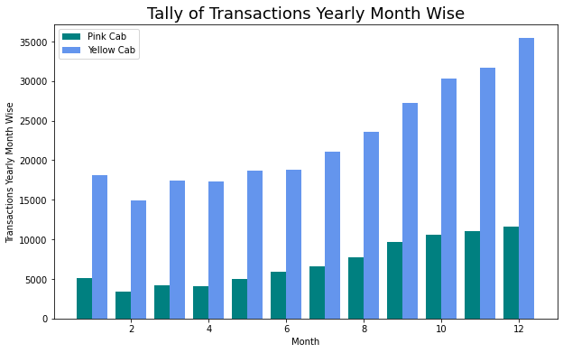
TRANSACTIONS PER MONTH
Transactions peak towards the end of the year and are highest in December which is the holiday season

Slide 11
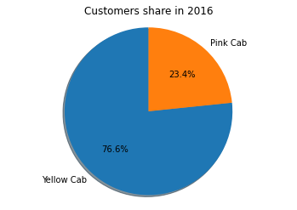


CUSTOMER SHARE
Yellow cab has had three times as much customers from 2016 to 2018 as pink cab

Slide 12
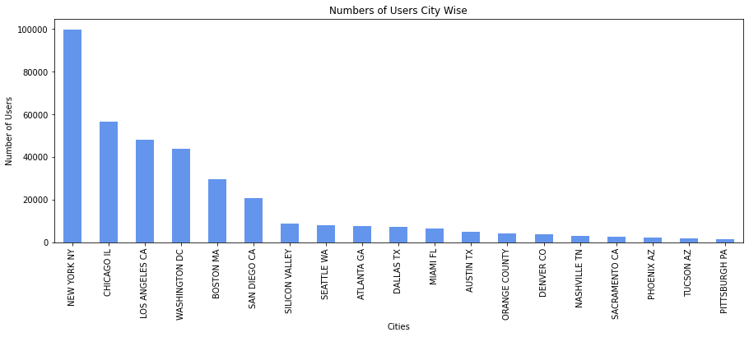
NUMBER OF USERS PER CITY
From the above graph ,New York City has the highest number of cab users

Slide 13
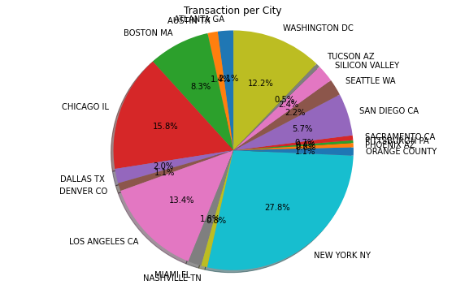
TRANSACTION PER CITY

Slide 14
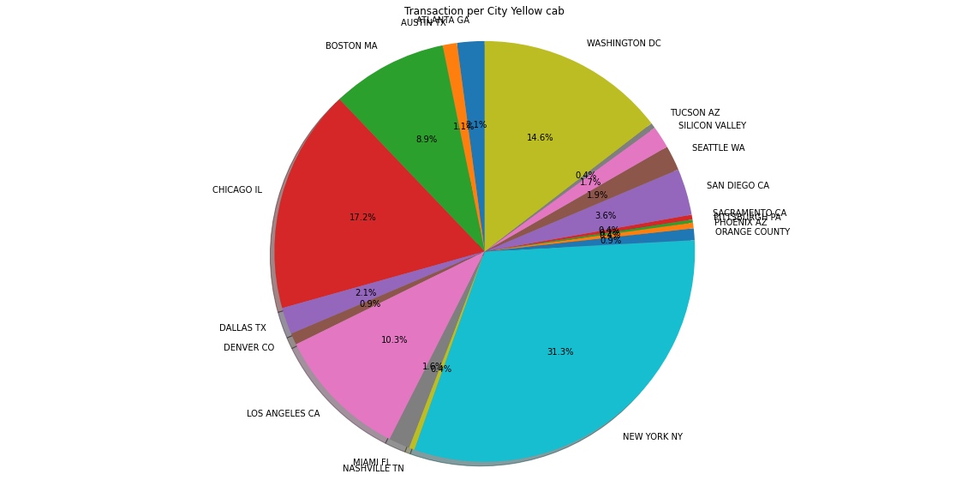
TRANSACTION PER CITY YELLOW CAB
Yellow cab has more transactions in New York city which has the highest number of cab users

Slide 15
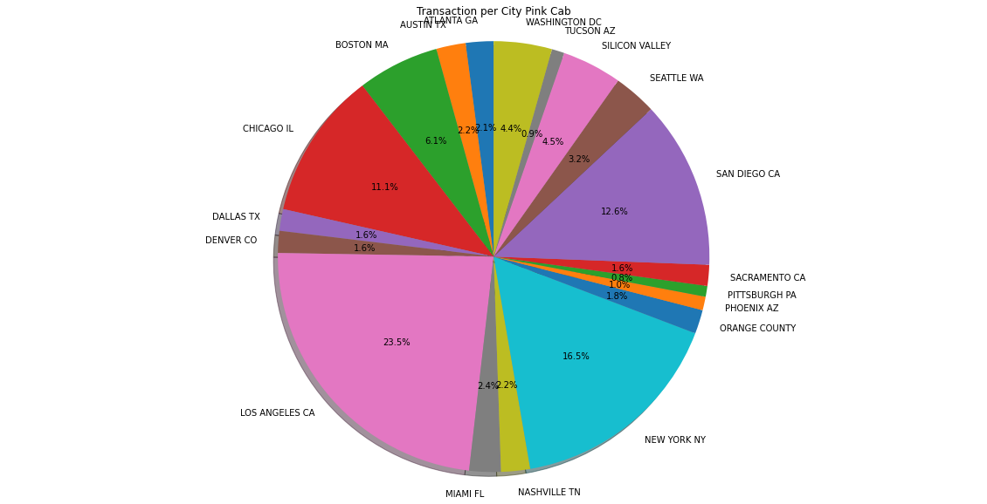
TRANSACTION PER CITY PINK CAB
Pink cab has a higher number of users in Los Angeles at 23.5% compared to New York City which has the highest number of Cab users

Slide 16
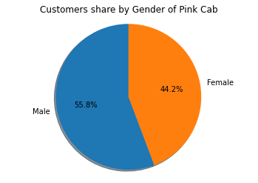
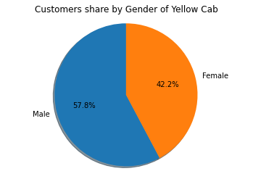
CUSTOMER SHARE

Slide 17
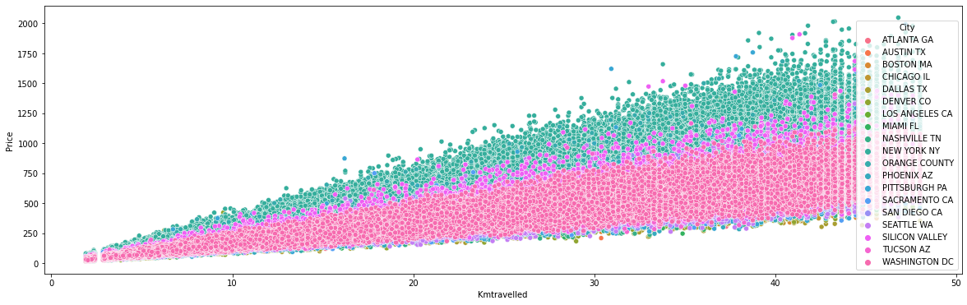
PRICE CHARGED PER KM TRAVELLED
New York City charges the highest prices in comparison with other cities

Slide 18
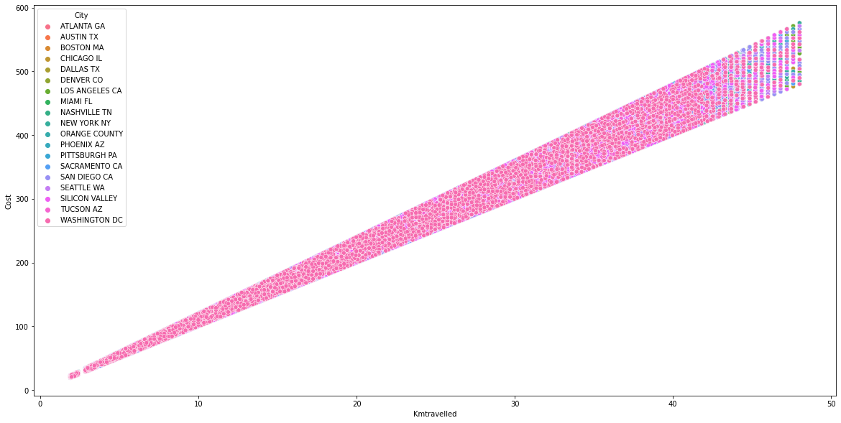
PRICE CHARGED PER KM TRAVELLED PINK CAB
Price charged increases linearly with distance

Slide 19
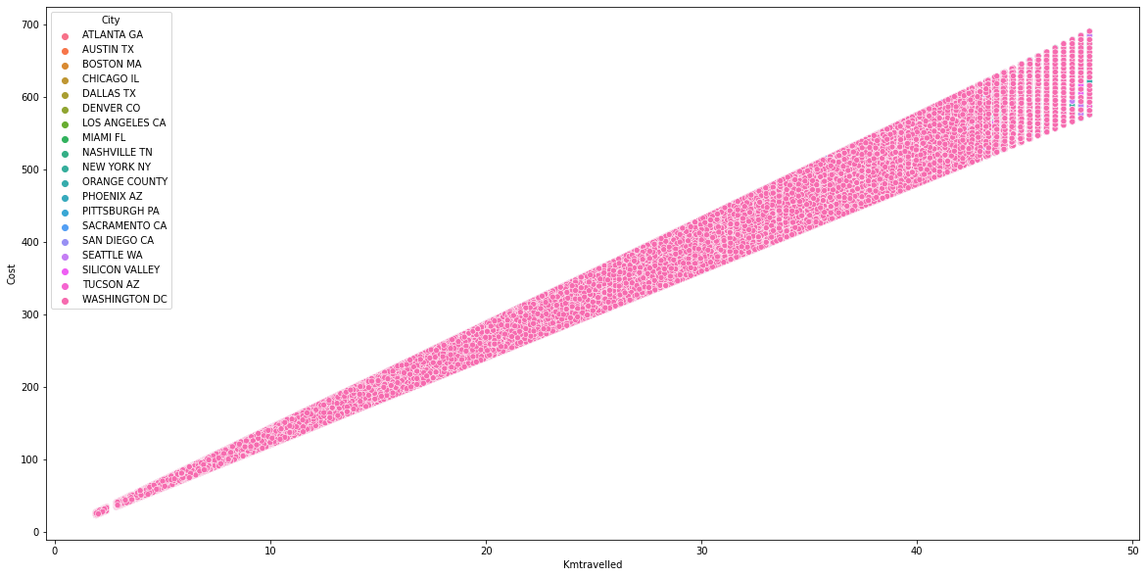
PRICE CHARGED PER KM TRAVELLED YELLOW CAB
Prices charged increases with increase in distance for yellow cab.

Slide 20
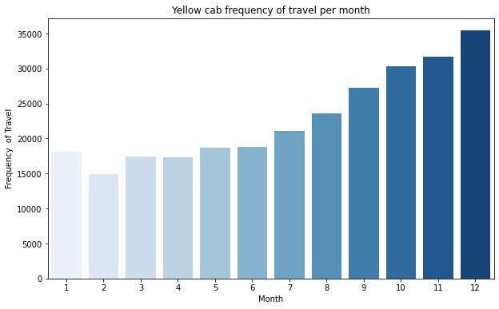

TRAVEL FREQUENCY PER MONTH
There’s a lot of travel in the month of December which is the holiday season.

Slide 21
HYPOTHESIS TESTING

Slide 22


HYPOTHESIS TESTING
HYPOTHESIS 1: There is no difference in margin given the mode of payment.
Yellow Cabs : There is no difference in margin whether paid in cash or card.
Pink Cab: There is no difference in margin given the mode of payment.

Slide 23


HYPOTHESIS : COMPANY MARGIN REMAINS THE SAME FOR ALL GENDER
Yellow Cab: Gender does affect the company margin.
Pink Cab: Gender does not affect the company profit.

Slide 24


HYPOTHESIS: Gender has no effect on distance travelled.
Yellow Cab : There is no difference in distance travelled for both gender.
Pink Cab: There is no difference in distance travelled for both gender.

Slide 25
RECOMMENDATION
Margin: Yellow cab has had higher margins(price charged- cost of trip) compared to pink cab from 2016 to 2018
Transactions : Yellow cab has had almost twice as much transactions as pink cab.
Customer share : Yellow has a higher number of customers from 2016 through to 2018.
Customers of Yellow cab in New York city which has the highest number of cab users is higher than that of pink cab.
On the basis of the above Yellow Cab is recommended for investment.

Slide 26
Thank You

