Slide 1
M&A Strategy Session: Agenda
Thursday, November 13, 2026 · 12:00 to 2:00 pm CT
Two hours on the Walters M&A program: strategy, markets, targets, and the machine that finds and converts them, plus the five key decisions we need to make for 2027.
We walk the dashboards live; the pages behind this one are the reference copy.
Time | Min | Block | Owner | Outcomes Desired
12:00 | 10 | Goals for the session | Charlie | Align on M&A strategy, MSA and target evaluation. Make 5 key decisions.
12:10 | 20 | Strategy Overview | Charlie | Confirm or modify strategy
12:30 | 30 | Markets: where we are focused | Cate | Agree on quantitative and qualitative factors
1:00 | 30 | Venue Targets + Our Machine | Cate, Charlie | Agree on venue targeting logic, validate the tools we’re using, and align on why the middle of the funnel has been limited.
1:30 | 15 | Current Middle of Funnel Initiatives | Cate | Agree on actions and timing
1:45 | 15 | Decisions Required | All | Make all key decisions; determine whether additional decisions are required

Slide 2
M&A Strategy Overview
Enter markets with attractive fundamentals and 5-15+ venue potential · 1 of 2
Goal: Acquire 5 to 15+ venues in every market we enter, so we can deploy our vendor services and centralized services efficiently.
Pick markets where density is possible: strong wedding demand, large venue count, fragmented ownership, sensible land cost
Pursue each market's leading venues and "infill" venues simultaneously; owners sell when they are ready, so we win the best of what comes available.
Enter markets in three ways (buy, lease, manage)
WHAT WE BUY
THREE ACQUISITION MODELS
Traditionally Walters (rural and suburban)
Buy the business and the real estate
Estates, chapels, barns, gardens; 75 to 200 events
Owned real estate priced on earnings
Firefly Lane, Davis & Grey, Caney Creek
Leading venues; land priced on earnings
EPRT sale-leaseback enables capital efficiency
Firefly Lane, Davis & Grey, Caney Creek
Urban
Buy the business; lease the real estate
Industrial, loft, and historic venues
Usually leased
Engine Room, West Midtown, VisionLoft, Wilburn Street
When seller values land too highly, or when performance must ramp substantially
Seek long lease terms and early-year termination ability
Engine Room, Hadden Estate
Platforms
Manage or partner
Multi-venue groups
D'Amico, BTTS, Cescaphe, Spaces in the City
Owner keeps the asset; we run sales, planning, and operations for a fee, plus exclusivity
Little River Farms
WHERE WE'RE FOCUSED
Tier | Markets | Why
Home markets | DFW, Houston, Hill Country, Atlanta, Nashville | Hubs built; every infill adds ancillary on day one
Expansion Tier 1 | Nashville, Atlanta, Chicago, Minneapolis, Indianapolis, Cincinnati, Columbus, Knoxville, Greenville, Phoenix, Cleveland | Leading macro fundamentals, numerous available targets, reasonable initial response rate
Expansion Tier 2 | Memphis, Louisville, Birmingham, Buffalo, Hartford, Pittsburgh | One region most weeks to Jan 18; fragmented supply, cheap to test
Paused | Miami, Salt Lake, Charlotte, Raleigh, Denver, Kansas City, New Orleans, Charleston | Poor fundamentals, strong Wedgewood, low venue count, low response rates
Broker-led | DC, Philadelphia, New Jersey, Baltimore, Virginia Beach | Attractive fundamentals, but outreach fell short

Slide 3
M&A Strategy Overview
The funnel, our activity that drives it, and where we lose deals · 2 of 2
2026 FUNNEL (AS OF NOV 8)
LOIs SENT IN 2026, BY MARKET
Contacted: 1,231
Responded: 657 · 53%
Confirmed interest: 142 · 12%
Shared data: 113 · 9%
Reviewed / offered: 91 · 7%
LOIs sent (2026): 19 · 1.5%
Accepted: 5
Closed: 2
Closed
Signed
Re-engaging
Seller Declined
Died post-LOI
Where we lose deals: valuation, not quality
OF 91 VENUES REVIEWED OR OFFERED
WHY SELLERS DECLINED OUR OFFER
We passed: 60
Seller declined our offer: 26
Accepted: 5
OUR PRICE AS % OF SELLER ASK
RESPONSE RATE BY FOOTPRINT
Seller Declined
Re-engaging
Signed
Closed
Died post-LOI
2027 Goals
LOIs: 20+
Closes: 4 to 6 single venues plus one platform
Density: every market shows a credible path to 5 venues within 18 months, or we stop spending there
New markets: 8 outreach waves by Jan 18; 17 region overviews to Wildcat by Nov 23; 2 to 3 new markets reach a leading-venue conversation by Q2
Middle of funnel: execute on existing plan; drive new ideas

Slide 4
How we pick markets and venue targets
MSA SCORING CRITERIA
VENUE SCORING CRITERIA
Criteria | Weight | What it measures
Weddings per 1,000 residents | 18 | Wedding intensity, including destination pull
Revenue pool | 16 | Annual venue dollars in the market
Growth rate | 16 | Population growth
Walters fit | 16 | Strategic fit with our expansion plans
Competition | 14 | Venues per 100k residents, inverted
Land $ per acre | 8 | Crexi land value; lower is better
Median wedding spend | 6 | The Wedding Report metro median
Population | 6 | Metro size
Criteria | Weight | What it measures
Physical-plant fit | 18 | 150+ seated, rain plan, multi-room
Review rating | 16 | Google, The Knot, WeddingWire, Zola average
Recent reviews, 12 months | 16 | Recency and momentum
Capacity fit | 12 | 150 to 250 seated scores highest
MSA / market score | 12 | From the table at left
Events per year | 8 | Actual throughput where known
Venue-type fit | 8 | Barn, estate, ballroom over restaurant, hotel
Ancillary hub coverage | 6 | Catering, floral, bakery within ~90 min
Lodging nearby | 5 | Guest lodging within 5 miles
Review volume | 4 | Lifetime reviews, log-scaled
Qualitative considerations for MSAs and venue targets
Path to 5+ venues. Fragmented ownership, owners who answer, and several venues of the quality we would own.
A leading venue we could own. One top-15% venue plausibly for sale within 24 months; without it, infill has nothing to infill around.
Hub economics. A catering, floral, and bakery hub reachable within about 90 minutes, or buildable soon.
Who else is at the table. Wedgewood (Phoenix 9, Denver 8, Charlotte 4), PE-backed caterers that manage venues, regional groups buying the same targets.
Operability. Liquor licensing and permitting timelines, labor market, travel from Texas leadership, and whether our lead engine already pulls couples from the metro.
TOP 24 MSAS
# | MSA | Score | Venues | Status
1 | Dallas-Fort Worth | 4.08 | 653 | Home
2 | Houston | 4.04 | 531 | Home
3 | Miami-Ft. Lauderdale | 3.86 | 164 | Paused
4 | Tampa | 3.54 | 134 | Future
5 | Austin | 3.54 | 271 | Home
6 | Orlando | 3.48 | 148 | Focused
7 | Atlanta | 3.39 | 422 | Home
8 | San Antonio | 3.38 | 263 | Home
9 | Nashville | 3.22 | 263 | Home
10 | Salt Lake City | 3.18 | 107 | Paused
11 | Washington DC | 3.16 | 304 | Broker-led
12 | Raleigh | 3.10 | 142 | Paused
# | MSA | Score | Venues | Status
13 | Jacksonville | 3.10 | 99 | Future
14 | Charlotte | 2.99 | 201 | Paused
15 | Charleston | 2.98 | 130 | Paused
16 | Minneapolis | 2.96 | 138 | Focused
17 | Seattle | 2.88 | 129 | Not pursued
18 | Columbus | 2.82 | 110 | Focused
19 | Cleveland | 2.82 | 118 | Focused
20 | New York | 2.80 | 373 | Not pursued
21 | New Jersey | 2.80 | 109 | Broker-led
22 | Indianapolis | 2.78 | 131 | Focused
23 | Virginia Beach | 2.78 | 95 | Broker-led
24 | Greenville | 2.76 | 75 | Focused
Today's hub ranking, the long list. The market reviews due later this month (one per market, Midwest and eastern half of the US, scored 0 to 100 on public data and benchmarked to our four home markets) become the working view and will shift this order. How the method changes is on page 13.

Slide 5
Our Machine: how we identify targets and drive funnel conversion
Stage | YTD (Nov 8) | Tools | Key Actions
1 · Identify and score | 8,748 VENUES SCORED | Venue Prioritization hub; owner enrichment agent; Market Intel agent | Score MSAs on eight criteria (plus qualitative), and every venue on ten criteria. Find and verify each owner's name, phone, and email before any outreach Flag news, listings, and operator moves on the top 1,000 venues every Monday
2 · Contact | 3,842 TOUCHPOINTS YTD | Pipedrive; funnel tracker | Load new regions from Stage 1 into Pipedrive and send the first emails to owners Call first, email second; stop at touch 2 for low-tier venues Log every touchpoint and track which channel gets answered
3 · Engage | 142 CONFIRMED INTEREST | Funnel tracker stages; mid-funnel program; Deal Factors agent | Confirm seller interest, determine valuation expectations, and request data (e.g., financials, events) Try to move “stuck” venues with the trends one-pager, Coffee Chat, seller references, etc. Contact venues that don’t respond every 60-90 days
4 · Evaluate and offer | 19 LOIS SENT IN 2026 | Active Pipeline; LOI dashboard; databooks; Review Intel | Build databook and score target on quality, economics, and fit Set price and structure (buy, lease, manage) from the ledger comparables; compile the public reviews Wildcat reviews LOI, then we send it and negotiate to signature
5 · Diligence and close | 2 UNDER CONTRACT | Deal Command Center; Daily Deal Status email | Run the diligence, legal, and integration workstreams Track milestones, open seller questions, and what is waiting on whom; daily status to the deal team Negotiate purchase agreement and leases, get approvals and licenses, close
6 · Integrate and measure | 2 CLOSED IN 2026 | 120-day tracker; integration dashboard; post-mortem scorecard | Run 120-day integration plan: systems, people, sales, and ancillary launch Measure leads, sales, revenue, and events against underwriting Post-mortem every deal and feed what we learn back into scoring and pricing

Slide 6
M&A Dashboards and Agents Overview
DASHBOARDS
Stage | Dashboards | What the dashboards show
1 · Identify | Venue Prioritization hub; Region overviews and operator intel | 8,748 venues scored and ranked across U.S.; MSA scoring; map with hub rings Owner and operator identification and contact information
2 · Contact | Outreach analytics | Touchpoints by week and market Analysis of which channels drives response
2-3 · Contact, Engage | M&A Pipeline tracker | U.S. and regional funnels Venue lists by stage, map, Wedgewood tracker
4 · Evaluate, Offer | LOI dashboard and Active Pipeline | All LOIs, with terms and outcomes Live targets scored with economics
5 · Diligence, Close | Deal Command Center | Every deal under contract: workstreams, milestones, third parties
All | M&A priorities workplan | All workstreams: LOIs, regions, overviews, conversion ideas, trips
AGENTS
Agent | What it does
Owner enrichment | Finds owner name, phone, and verified email for a target on demand
Market Intel | Every Monday: news and for-sale listings matched to the top 1,000 venue targets; Wedgewood tracker
Daily Deal Status | Every weekday morning: what moved on every deal under contract
Deal Factors | Every Saturday: tests which measurable factors predict a response, an LOI, and an acceptance; scores open targets for the week; grades its own predictions
Pipeline Updates | Every Monday: refreshes the pipeline output, summarizes the week's owner calls, and confirms every deal has a current status and note
New Market Outreach | After each new-market email wave: reconciles the hub list against sent mail and bounces, researches the true owner of each venue, and creates the orgs, contacts, deals, and follow-up tasks in Pipedrive

Slide 7
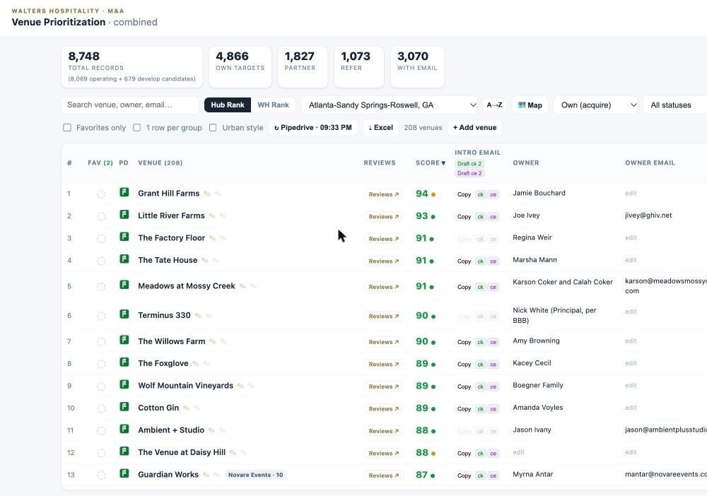
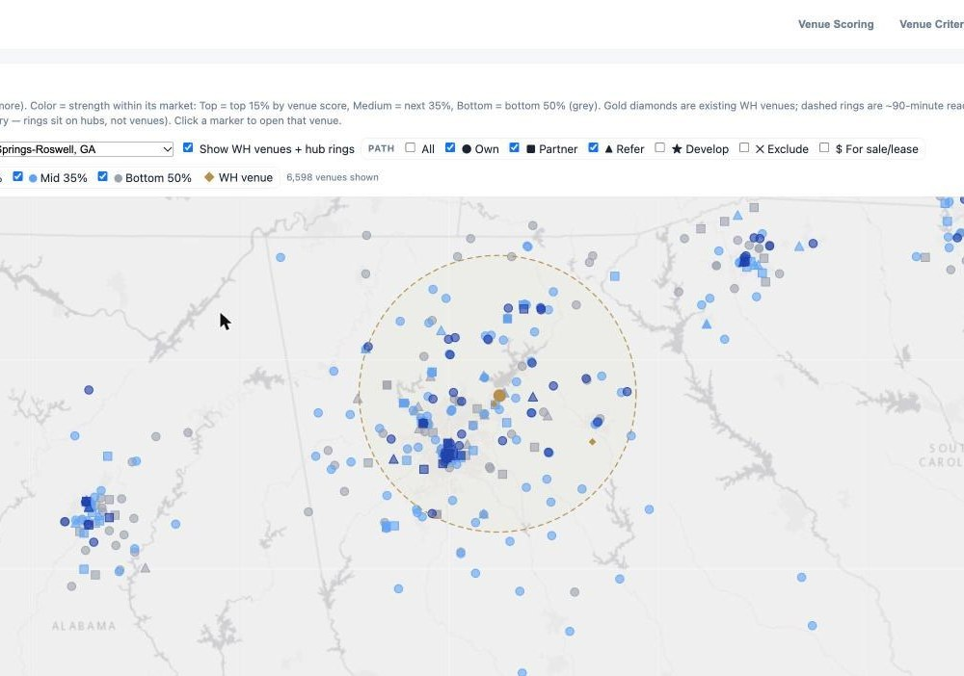
Dashboard 1 · Venue Prioritization hub
Atlanta, sorted by score: the market's leading venues are already in the pipeline.
Atlanta map: our venues (gold), the 90-minute hub ring, every target by strength.
What it is
Why it matters
How we use it
Every venue we could own, partner with, or refer: 8,748 records, 4,866 on the own path, owner email verified on 3,070
Each row: ten-factor score, reviews, capacity, MSA, path, live Pipedrive stage
Tabs for venue criteria (weights editable), MSA scoring, operator census, and the hub-ring map
A Develop lens tags lodges, churches, warehouses, and halls that could become venues
Density is planned here: the ranked list and the hub ring show which venues build a market
Atlanta's leading venues (Grant Hill Farms 94, Little River Farms 93, Meadows 91) are all already in the pipeline
The map shows which of the 208 Atlanta venues sit inside the hub ring
Laura and Karlee work each market's list from the top, drafting intro emails from the row
Before an LOI, the Reviews button compiles every public review
Before a visit, the map and Groups tab set the itinerary

Slide 8
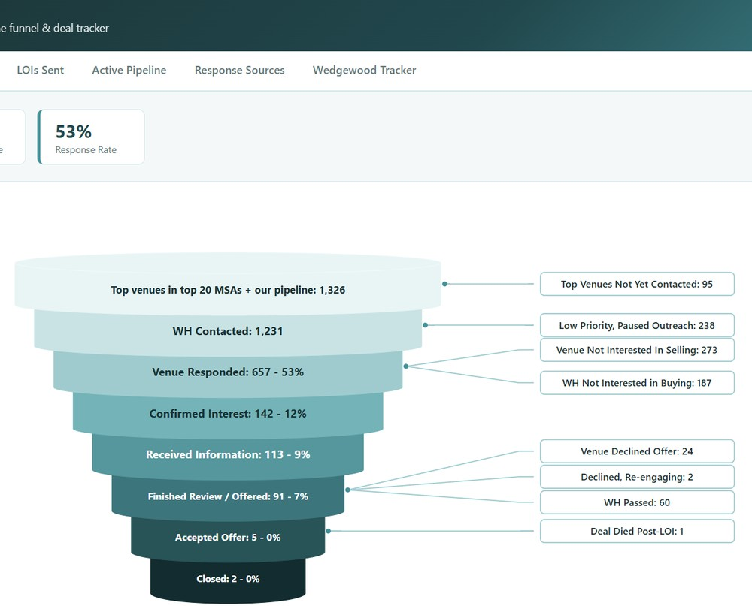
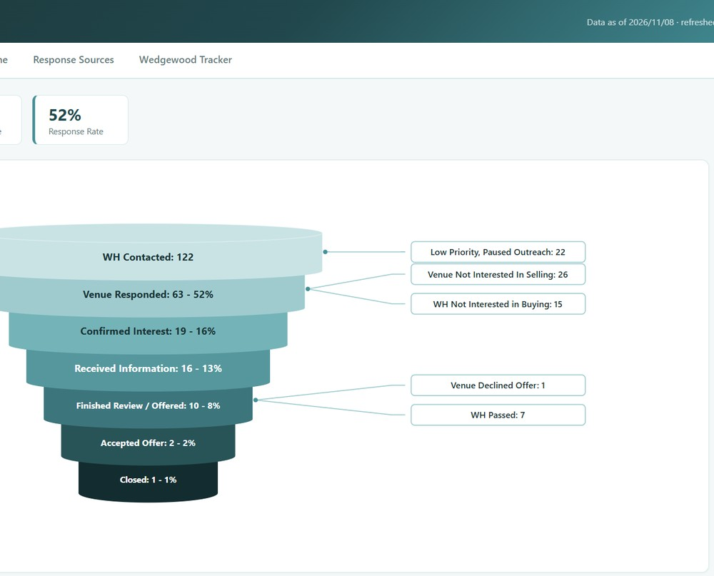
Dashboard 2 · M&A Pipeline tracker
Total funnel with every exit labeled.
Atlanta: 122 contacted, 52% response, 19 confirmed interest.
What it is
Why it matters
How we use it
Live Pipedrive export
Active funnel shows live work only
Regional Funnel cuts the same view for 44 regions, every venue listed under its stage
The scoreboard for the strategy: whether a market produces conversations and where they stall
Anchors the Tuesday M&A Update to Wildcat and the Thursday deal review
The stage lists drive the two-week sweeps of stuck venues

Slide 9
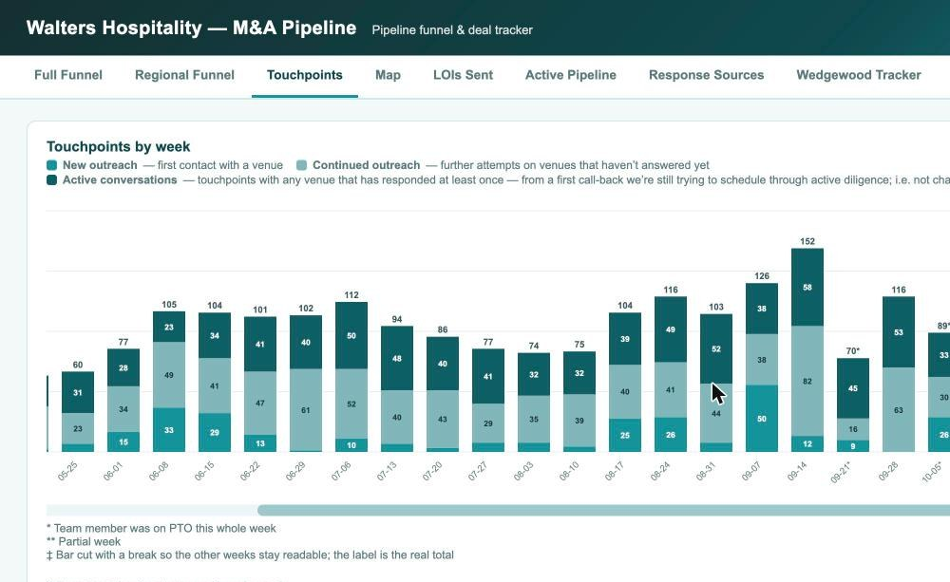
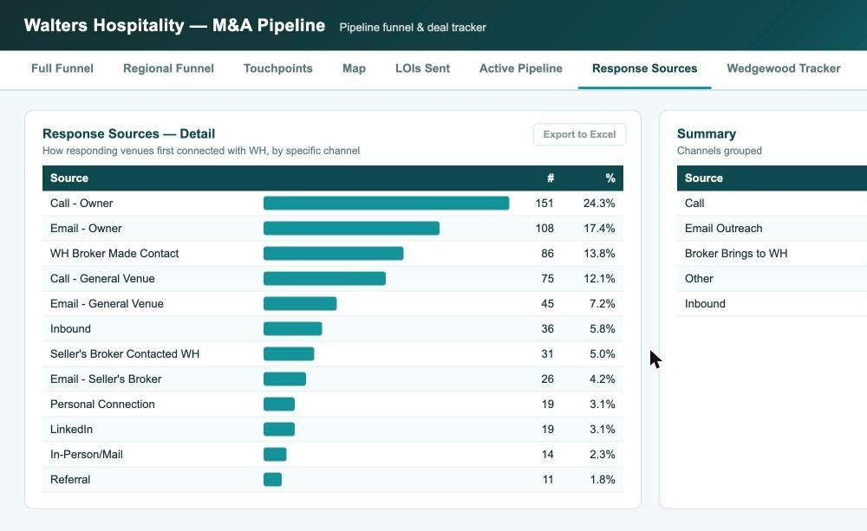
Dashboard 3 · Outreach analytics
Weekly touchpoints by type; YTD 3,842.
First-response channel for 620 responding venues.
What it is
Why it matters
How we use it
Touchpoints by week since May: new outreach, follow-ups on silence, active conversations
Calls are answered 21 times per 100 vs 12 for email; responders answer by the second touch
Drivers of response
Outreach is the input we control; this page proves the machine is running and where to point it
Weekly M&A calls
Monthly check that new-region waves land on schedule
Board meetings

Slide 10
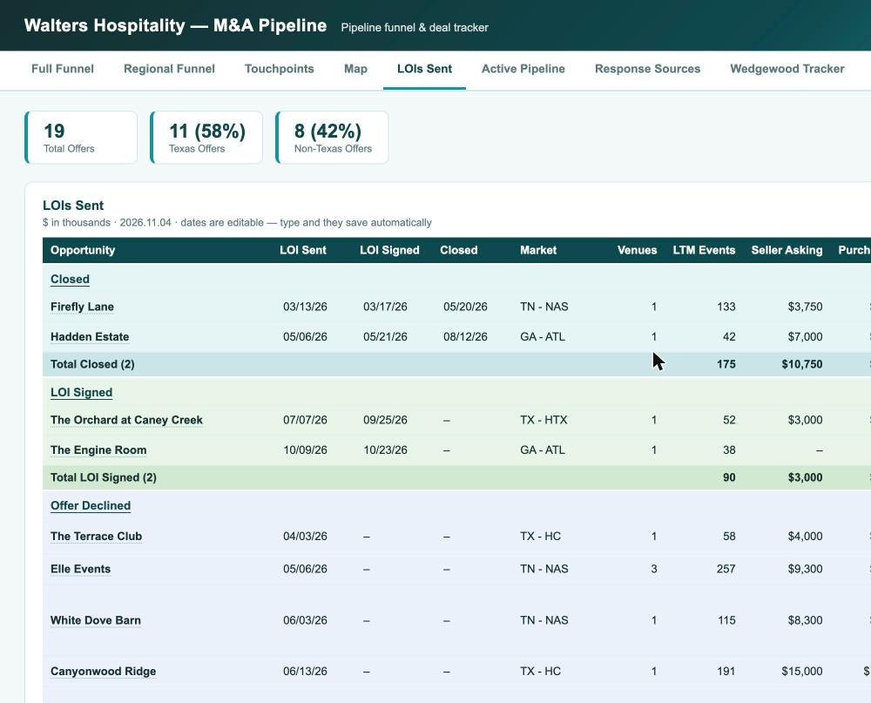
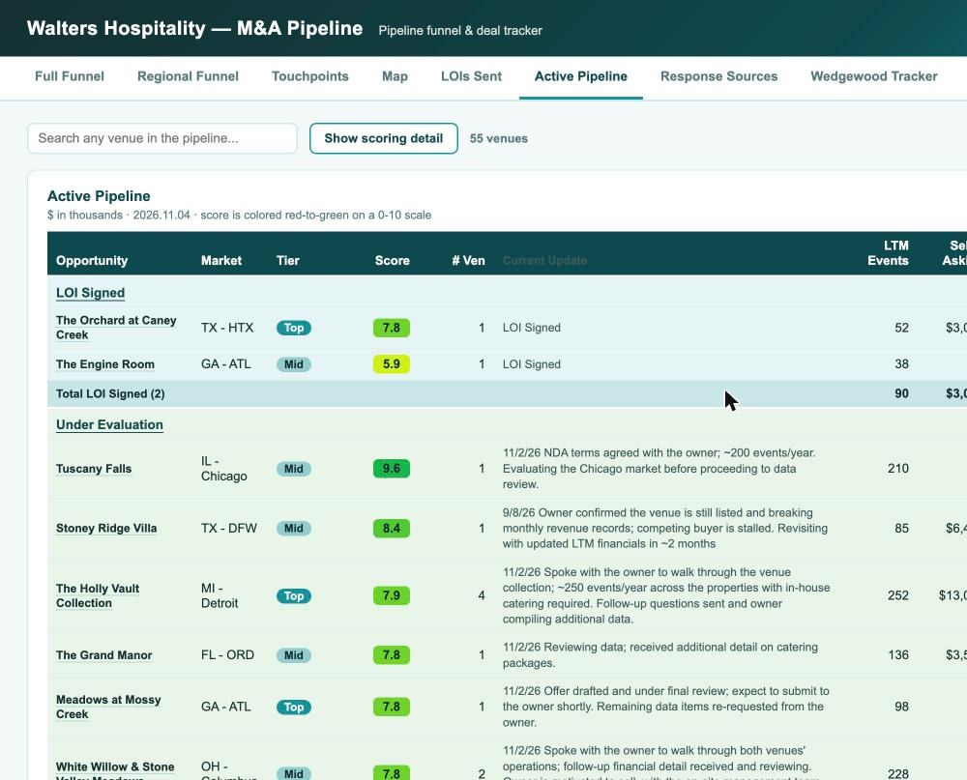
Dashboard 4 · LOI Dashboard and Active Pipeline
All 19 LOIs with terms and outcomes.
55 live targets scored 0 to 10 with economics.
What it is
Why it matters
How we use it
The ledger: all 19 offers with dates, market, LTM events, asking price, our price, rent, EBITDA, and outcome
Outcomes: 2 closed, 2 signed, 2 declined but re-engaging, 12 declined, 1 died after signing; 11 Texas, 8 outside
Active Pipeline: the 55 live targets scored 0 to 10 with LTM and PF-Y2 revenue and EBITDA, future bookings, latest note
This is where valuation discipline shows; the commentary records why deals die
Before every offer, the ledger sets comparables and the pipeline score frames the data book
Feeds the quarterly board slide and the Saturday scorecard (LOIs vs the 20 goal)

Slide 11
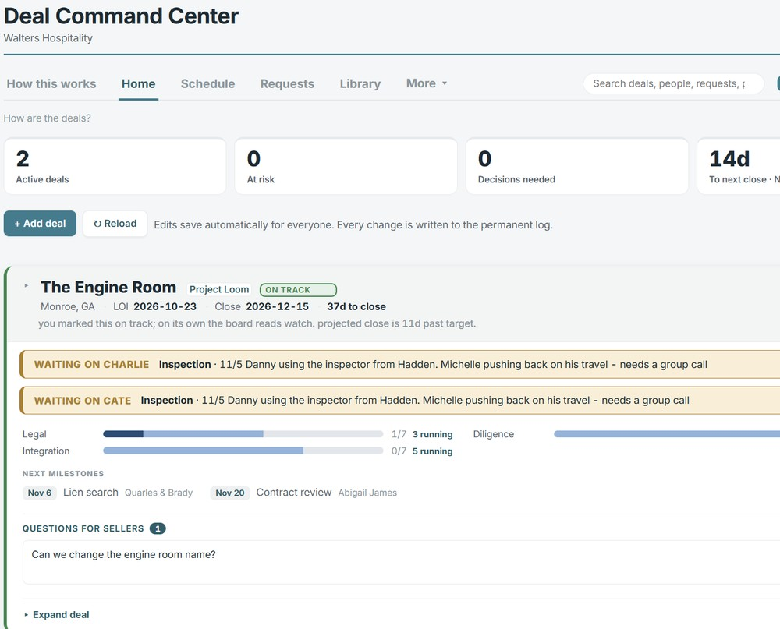
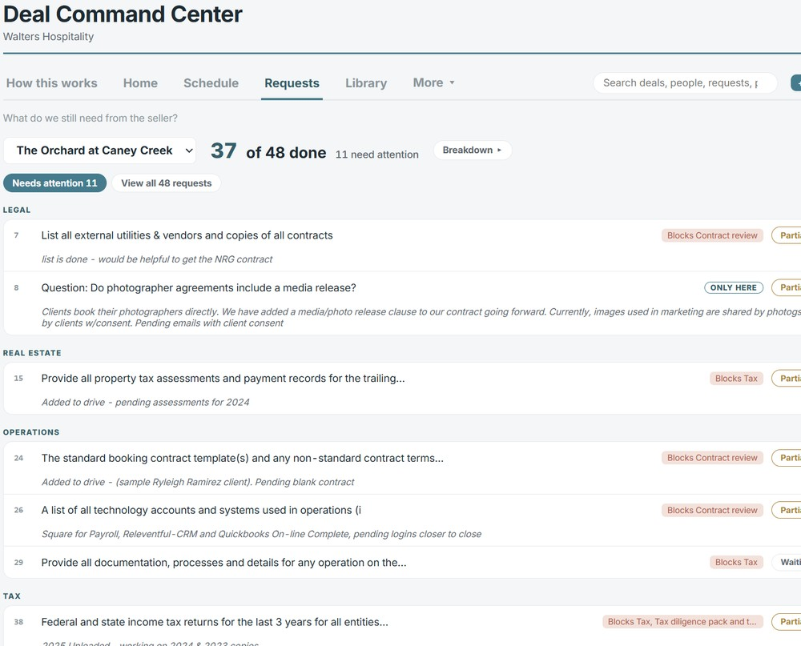
Dashboard 5 · Deal Command Center
Home: 2 active deals, 0 at risk, next close in 14 days (Nov 22).
Per deal: workstreams, milestones, owners, open questions.
What it is
Why it matters
How we use it
Dashboard for every deal under contract: LOI and close dates, days to close, status with the board's own read beside ours
Legal, diligence, and integration workstreams; next milestones with the third party on point; what is waiting on whom
Schedule, Requests, and Library hold the calendar, request lists, and documents; every change is logged
Closing is where strategy becomes venues; integration starts here, not at close
The 7am Daily Deal Status email comes from this log
The counsel all-hands works off the milestones
At close the integration workstream hands to Abigail with the history intact

Slide 12
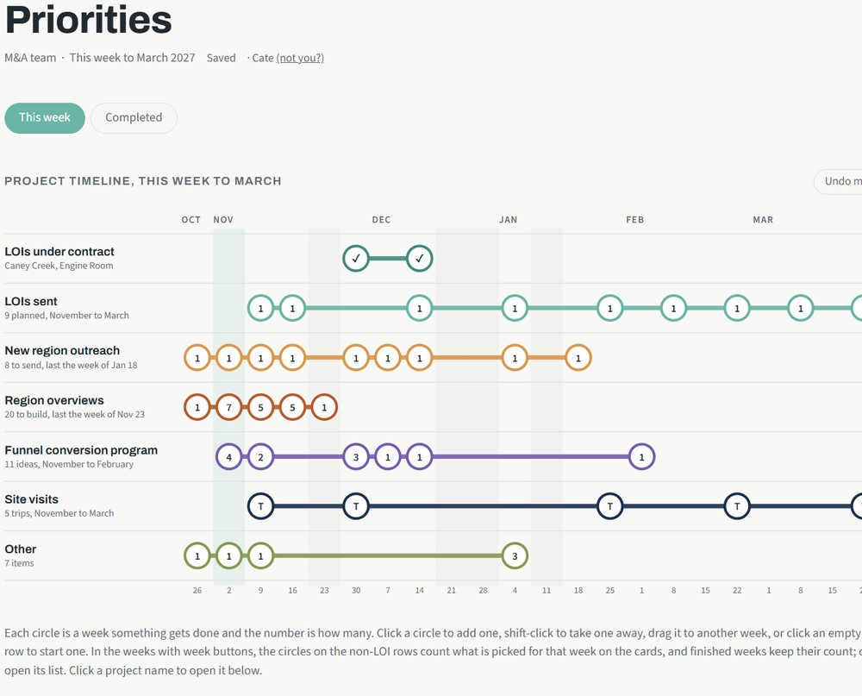
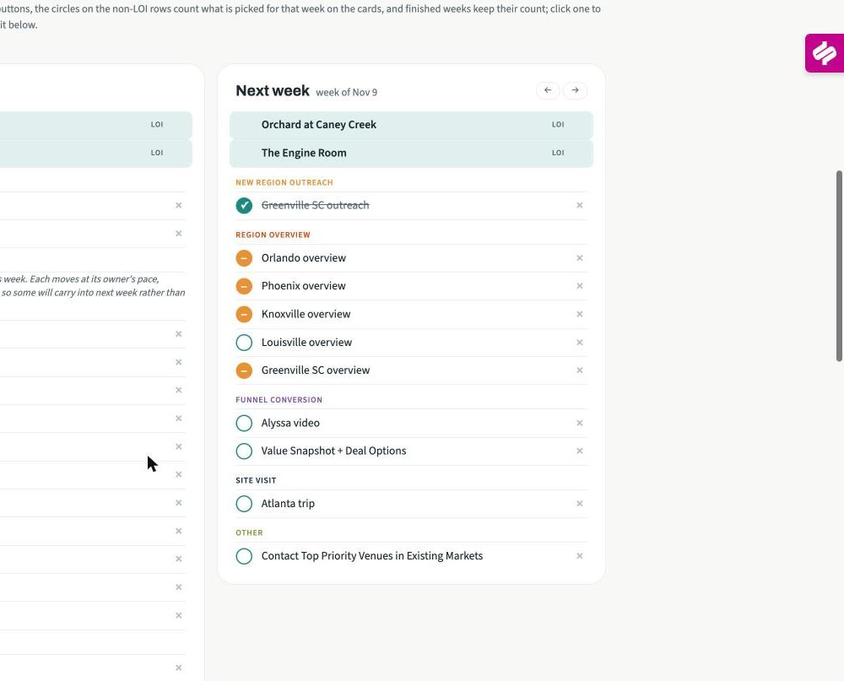
Dashboard 6 · Priorities workplan
Timeline: seven workstreams to March 2027.
This week and next week: venues in play, overviews, conversion steps.
What it is
Why it matters
How we use it
All workstreams on one page
This-week and next-week cards list the venues and tasks
Each deal with a clear status
The strategy with dates on it
Capacity and priority are clearly visible
Daily action management

Slide 13
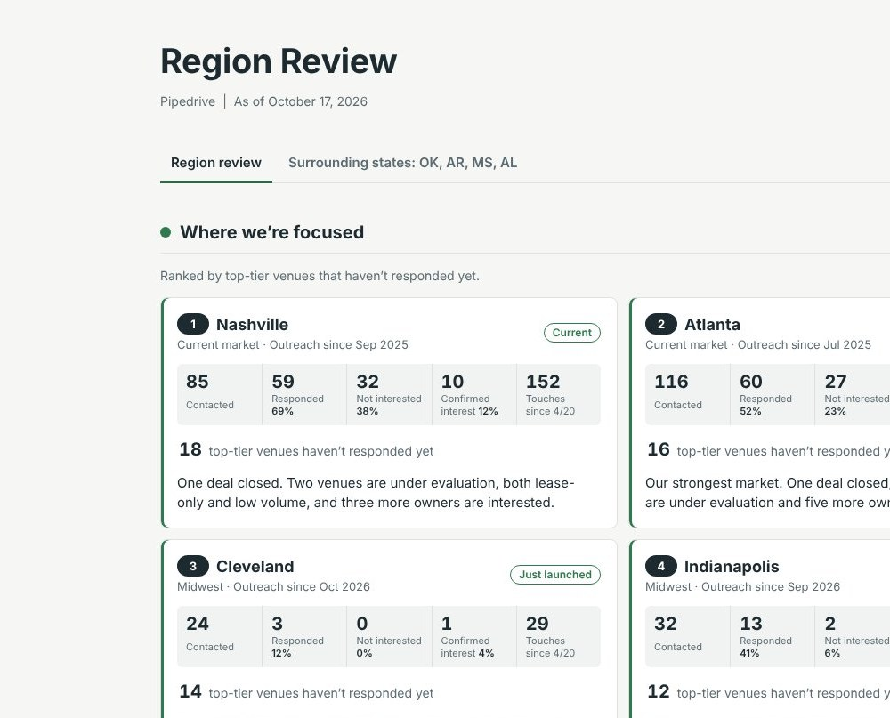
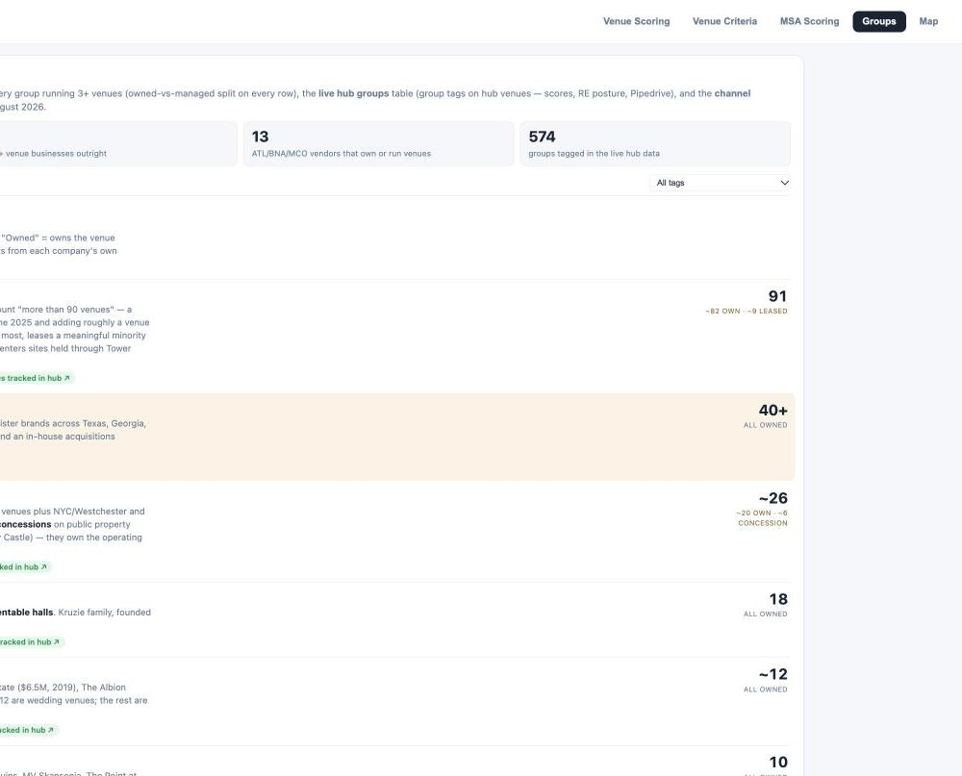
Dashboard 7 · Region overviews and operator intelligence
Region Review: where we're focused, ranked by top-tier venues not yet responding.
Groups census: 67 multi-venue operators, owned vs leased.
What it is
Why it matters
How we use it
Region Review ranks every market by top-tier venues not yet responding, with contacted, responded, confirmed, and touches
A new market reviews dashboard will soon replace this page
Groups tab: census of 67 multi-venue operators
Keeps the market list honest: each market carries its own evidence
The census shows who else is consolidating and which groups are platforms we could buy
MSA screening and review before every market visit
Each focused market gets an overview pack for Wildcat: owner feedback, weddings per 1,000, county map, competitive set
How the market evaluation is being updated
The hub is the screen. 56 MSAs scored 1 to 5 on eight weighted criteria; it sets the long list.
The market reviews are the working view. One per market in or planned for outreach, picked on geography, proximity to our markets, and venues available.
The review score uses public data. Wedding spend, spend per wedding, weddings per resident, growth, income, population, competition, and land cost, weighted; benchmarked to our four home markets.
The reviews add what the hub cannot see. County-level growth and income, drive times, who else is consolidating, owner feedback, and a hand-picked ranked venue list.
Updated as outreach continues.

Slide 14
Current Middle of Funnel initiatives (through March 2027)
MIDDLE-OF-FUNNEL CONVERSION PROGRAM AND EARLY RESULTS
Initiative | What it is | Status and results | Due date
Quarterly Venue Trends one-pager | Key market trends sent to target owners as a reason to talk | Sent to 145 venues in October: 67% open, 6% reply and counting. Next edition Q1. | Running
Coffee Chat email | $10 Starbucks card to top-priority non-responders | 40 top-tier venues over two weeks: 80% open, 3% reply and counting. | Running
Prior seller references | Firefly Lane and Hadden owners as references and intro sources in their markets | Both engaged; Hadden referral program proposed Nov 4 (paid reference and intro calls, success fee on a close). | Running
Acquisition announcements | Hadden to GA venues, Firefly Lane to TN venues, with an offer to speak to the seller | Drafts with marketing now | Week of Nov 30
Updated outreach PDFs | Owner brochure and partner flyer refreshed | v2 built Nov 4; website acquisitions page gains owner quotes. | Complete
Alyssa video | Short CEO message embedded in invites and announcements | Record in December | Set date
Holiday gift A/B test | 25 watercolors or hats, ship by Dec 11, follow-up calls in January | Readout in February | Week of Dec 7
Quarterly owner note | Marketing produces, M&A reviews; January, April, July, October | Draft by mid-December. | Week of Dec 14
CPA and advisor channel | 2 to 3 firms each in Atlanta and Nashville, then Houston and Dallas in March | January. | Week of Jan 4
Association meetings | WIPA pilot in Atlanta and Nashville | February. | Week of Feb 1

Slide 15
Decisions Required by the Group
1. Fewer, better deals, or more market deals? We cannot have both.
 | Fewer, better deals | More market deals
What it means | The market's leading venues at full price: top-15% quality, 100+ events, owned real estate where it makes sense. Two to four closes a year. | Density fast: mid-tier infill, leases, platforms, conversions at earnings value. Six to ten closes a year across several structures.
Density | Slower to 5 per market; each venue pulls the market's lead pool and sets the price ladder. | Faster to 5 per market; hub economics arrive sooner; brand set by the best of a mixed portfolio.
Capital and risk | More capital per deal, more real estate, higher multiples (Firefly Lane 6.3x LTM). Fewer, larger bets. | Less capital per deal, more leases and earnouts, more integration load. More, smaller bets; more can go wrong at once.
The team | Deep work on 20 to 30 named targets; less new-region outreach; Charlie and Cate on every owner call. | Outreach at full pace; standard lease and management terms; integration capacity added before deal capacity.
We stop | Chasing sub-$500k EBITDA venues and most lease-only urban product. | Paying up for anchors when infill is available at earnings value.
2. 2027 target acquisitions and capital availability
More selective than 2026
Same as 2026
Less selective than 2026
3. What makes a target MSA
Macro fundamentals only/primarily
Fundamentals x Target Availability
4. Wildcat involvement and sign-off rules
LOI negotiation?
Purchase agreement negotiation?
5. Alyssa's go-forward involvement
Own the Wildcat M&A relationship
Join market visits and closing calls
Sponsor integration

