Slide 1
EDC Streaming Concept with Policy Monitoring

Slide 2
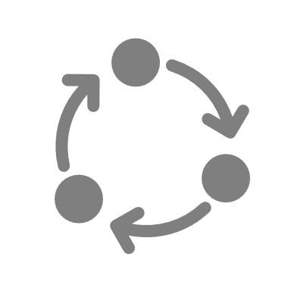



Streaming
1
Contract Negotiation
OEM Control Plane
SP Control Plane
2
Non-finite Transfer Process
3
Policy Monitor
Periodic monitoring
Check policies and suspend/terminate transfer process
OEM
Service Provider
Vehicle
Service Provider Pull
OEM sends special access token to Service Provider to connect to a topic/channel when the transfer process is started
OEM Push
Service provider sends special access token to OEM to send to a topic/channel when the transfer process is requested

Slide 3
Planning
Decide on a streaming implementation, e.g. Kafka
Build the Policy Monitor (upstream EDC)
Responsible for periodic policy checks and suspension/termination of finite transfer processes
Built using the EDC state machine framework
Similar to the ContractNegotiationManager and TransferProcessManager
Extensible – SPI and HTTP callback

