Slide 1

MapAction PowerPoint Maps
Introduction
The aim of this PowerPoint pack to provide you with some simple maps so that you can add your own data and information to them and use in presentations or reports. The maps are saved to the background so that your write or draw over them without touching the map itself. The PowerPoint pack provides all the tools that you would need to produce including symbols, callout boxes, legends and labels. All you need to do is copy and paste.
How to guide
Select the map you want to use.
Add your data
In the Labels and Symbology section there are ready made symbols, labels and callout boxes that can be cut and pasted onto your map. With the callout boxes, double click on them and begin typing your information.

Slide 2
Contents
1. Introduction and How to guide
2. Country Map
3. Admin 1 Maps
4. Other Maps
a. Settlements Map
b. Physical Map
c. Baseline Population
d. Roads
5. Labels and Symbology
6. Logos
7. Weblinks
8. Data Collection
9. MapAction User Guide

Slide 3
Country Map
Showing Country boundary and Department boundaries
There are two types of country map:
Simple Country Reference Map – Copy and paste labels to map
Advance Country Reference Map – Admin boundaries colours can be changed. Select admin area, Right Click>>Format Shape>>Fill
Contents

Slide 4
COUNTRY: Reference Map *Simple Reference Map

Slide 5
COUNTRY : Reference Map *Advance Reference Map

Slide 6
Admin 1 Maps
Showing Department and Arrondissement boundaries
Contents

Slide 7
COUNTRY : ADMIN 1 - Reference Map

Slide 8
Other Maps
Settlements Map
Physical Map
Baseline (Date) Population Map
Roads Map
General Transportation Map
Contents

Slide 9
COUNTRY: Settlements Map

Slide 10
COUNTRY: Physical Map

Slide 11
COUNTRY: Baseline (Date) Population Map

Slide 12
COUNTRY: Roads Map

Slide 13
Labels and Symbology
General Symbols
OCHA Symbols
Callout Boxes
Contents

Slide 14
























































OCHA Symbols
Cluster
 | Agriculture
 | CCCM
 | Coordination
 | Early Recovery
 | Education
 | Emergency Shelter
 | Emergency Telecommunications
 | Food Security
 | Health
 | Logistics
 | Nutrition
 | Protection
 | WASH
Disaster
 | Cold Wave
 | Cyclone Hurricane Typhoon
 | Drought
 | Earthquake
 | Epidemic
 | Fire
 | Flash Flood
 | Flood
 | Heat Wave
 | Insect Infestation
 | Landslide Mudslide
 | Snow Avalanche
 | Storm
 | Storm Surge
 | Tornado
 | Tsunami
 | Volcanic Eruption
Affected Population
 | Affected Population
 | Children
 | Dead
 | Injured
 | Missing
Damage
 | Affected
 | Damage
 | Destroyed
 | Partially Destroyed
Infrastructure
 | Airport
 | Airport Civil
 | Airport Military
 | Bridge
 | Buddhism Temple
 | Church
 | Community Building
 | Food Warehouse Storage
 | Government Office
 | Helipad
 | Hindu Temple
 | Infrastructure
 | Mosque
 | Police Station
 | Road
 | School
 | Seaport
 | Tunnel

Slide 15


































































OCHA Symbols Continue
Health Facilities
 | Clinic
 | Health Facilities
 | Health Post
 | Hospital
 | Psychological Support
Physical Closure
 | Checkpoint
 | Cross Border
 | Earthmound
 | Military Gate
 | Observation Tower
 | Physical Closure
 | Road Barrier
 | Road Block
 | Road Gate
 | Trench
Armed Troop
 | Armed Troop
 | Child Combatant
 | National Army
 | Rebel Army
Mine and UXO Presence
 | Dangerous Areas
 | Mine UXO Presence
 | Mined Areas
 | UXO Spots
Water and Sanitation
 | Borehole
 | Latrine
 | Potable Water Source
 | Spring Water
 | Submersible Pump
 | Tapstand
 | Water Sources
 | Well
Relief Materials
 | Blanket
 | Bottle of Water
 | Bucket Jerry Can
 | Clothing
 | Food
 | Kitchen Sets
 | Matress
 | Medical Supply
 | Medicine
 | Mosquito Net
 | Non Food Item
 | Plastic Sheeting
 | Relief Goods
 | Stove
 | Tarpauline
 | Tent
Telecommunications
 | Fax
 | Internet
 | Mobile Phone
 | Radio
Camp
 | Fixed
 | IDP Refugee Camp
 | Refugee Registration
 | Temporary
 | Transition Sites
Security
 | Arrest Detention Abduction
 | Assault
 | Attack
 | Forced Entry Office Occupation
 | Harassment and Intimidation
 | Hijacking
 | Murder
 | Robbery
 | Security
 | Threat

Slide 16
General Symbols

Slide 17
Labelling
Label
Callout 1
Callout 2
Label in Italics
Label in Bold
Callout 3
Callout 4
LABEL IN CAPITALS
Transparent Label
Callout 5
Callout 6
Transparent Label in Italics
Transparent Label in Bold
Callout 7
Callout 8
TRANSPARENT LABEL IN CAPITALS
Creation Date/ Time:
Map Reference Number:
Glide Number:

Slide 18
Legend Details
Map Title
Map Title Example
Location:
Subject
Date
Haiti:
Department
Reference Map
Map Summary
Map Summary Example
The map summary (also Termed the abstract) is a block of descriptive text that provides a useful guide to a user whether or not they are looking at the map itself, a thumbnail or a non-graphical list of map products.
The map summary (also termed the abstract) is a block of descriptive text that provides a useful guide to a user whether or not they are looking at the map itself, a thumbnail or a non-graphical list of map products.
For example:
The map background shows major settlements and
Department boundaries.
Additional Metadata Tags
Additional Metadata Tags Examples
Creation Date/ Time:
Creation Date/ Time: 2010-10-10/ 1200
Map Reference Number:
Map Reference Number: ABC123
Glide Number:
Glide Number:
Data Sources:
Data Sources:

Slide 19
Specific Legends
Physical Map
Population Map
Transport Map
Settlements Map

Slide 20
Logos
Logos of key organisations
Contents

Slide 21


Logos
Paste your logos here to use in the future

Slide 22
Weblinks
Links to key maps and data sources
Contents

Slide 23
Logos
Map Sources
Data Sources
MapAction - http://www.mapaction.org/
Reliefweb - http://www.reliefweb.int/
Reuters Alertnet - http://www.alertnet.org/
UNOSAT - http://www.unosat.org/
Contents

Slide 24
Data Collection
Waypoint Collection Sheet
Contents

Slide 25
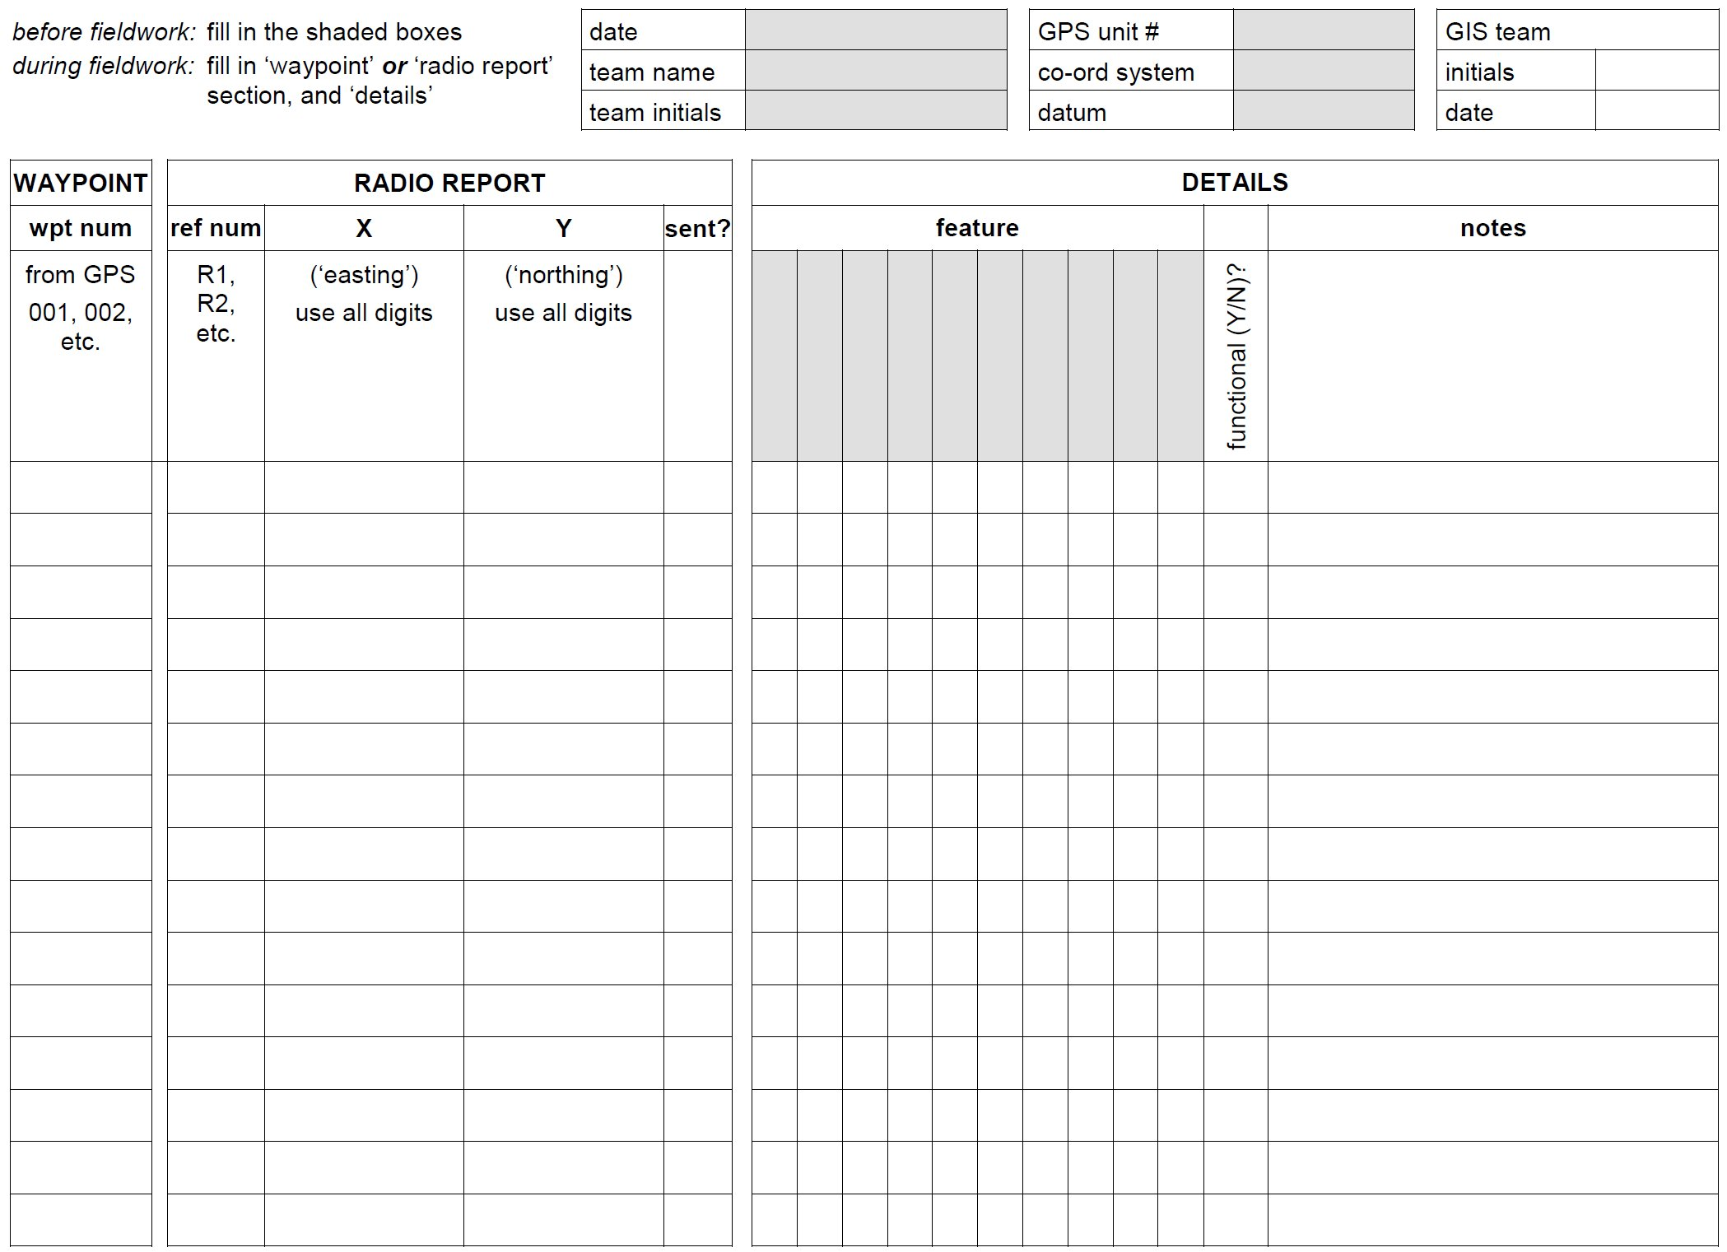

Slide 26
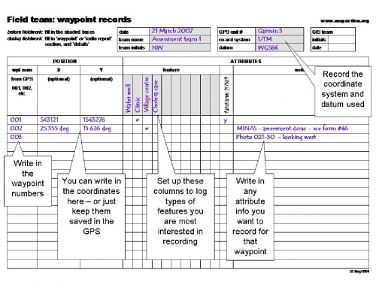
Waypoint Collection Sheet
How to use
Remember that the GPS only records the WP numbers: you must also make a record of what these points represent (these are called the attributes).
Some newer GPS receivers and other GPS-enabled devices such as hand-held computers allow you to enter attribute information by keying it into the device directly when you create a waypoint. By all means experiment with these, but you may find it awkward in a field environment to mess around with tiny keypads to enter information. A paper record as shown below often proves a more practical way to capture various kinds of information.
You can use a notebook to record the attributes of WPs as you go along. Just write down the WP number, and what you want to record at that place. A better way is to use a purpose-designed form.
At Appendix 2A is a copy of MapAction’s blank WP form for you to reproduce and use if you wish. Here is an example showing how the form can be used.
It is not essential that you use a recording sheet exactly like the one above, but whatever you do you must be able to record accurately the attributes for each waypoint you have saved with the GPS.
Contents

Slide 27
MapAction User Guide
PowerPoint Map Creation
Basic Maps
1. Create base map in ArcGIS, using the PowerPoint_Map_Template found in - 2011-mm-dd-destination-BLANKv02\GIS\3_Mapping\37_PowerPoint_Maps_Basic. 2. Ungroup metadata properties and edit the Scale. 3. Regroup metadata properties. Set the frame properties as follows - Border - 1.0 point, Gap - X and Y - 5pt; Background - White, Gap - X and Y - 5pt. 4. Export map as JPEG to - 2011-mm-dd-destination-BLANKv02\GIS\3_Mapping\37_PowerPoint_Maps. 5. Open the PowerPoint Pack Template and locate the relevant slide.
6. Right click slide and select format background.
7. Select Fill>> Picture or texture fill>> Insert from>> File and select map jpeg.
8. Before applying check that the stretch options>> Offsets are all at 0%.
9. Click Close.
10. Save PowerPoint.
Advance Maps
1. Create base map in ArcGIS, using the PowerPoint_Map_Template found in - 2011-mm-dd-destination-BLANKv02\GIS\3_Mapping\37_PowerPoint_Maps_Advance. 2. Export map as EMF to - 2011-mm-dd-destination-BLANKv02\GIS\3_Mapping\37_PowerPoint_Maps.
3. Open the PowerPoint Pack Template and locate the relevant slide.
4. Select Insert>>Picture>>Select EMF File>>Insert. 5. Resize map approximately. 6. Right Click Image>>Group>>Ungroup A dialog box with the following will show: "This is an imported picture, not a group. Do you want to convert it to a Microsoft Office drawing object?“ 7. Select Yes. 8. Make sure the whole map is selected and resize to fit slide. Each part of the map should now be clickable and editable. 9. Save PowerPoint.
Adding a border to the map. 1. Click - Insert>>Shapes>>Rectangle.
2. Draw Rectangle around map 3. Right click rectangle>> Format shape>>Fill>>No Fill 4. In the Shape Format>> Select Line Color - Black or Grey 5. In the Shape Format>> Select Line - Width 2pt 6. Close Shape Format.
Contents

