Slide 1
NBA 2017-2018 Season Stat Analysis
By: Tarek Mohamed, Cate Soane, Sandra Langston and Joe Spiwak

Slide 2
Motivation & Summary
What gives top NBA Organizations their edge (2017-2018 season)?
Do teams with more experienced players win more?
Is Real Plus-Minus (RPM) a good predictive stat for how NBA organizations/players will perform?
Is Player Efficiency Rating (PER) a good predictive stat for how NBA organizations/players will perform?
Is there a particular box score stat that correlates with wins?
Do organizations with more money/higher paid players win more?

Slide 3
Questions & Data
Compiled data from ESPN and other NBA affiliated websites
Data Needed:
Player salary data
Player PER/RPM data
Player bio data (ex: # of years in league, current team, etc..)
Team box score data (rebounding, turnovers, assists, etc.)

Slide 4
Data Cleanup
Data Cleanup:
Different sources had different team abbreviations
No compiled source of players’ years in NBA
Making data mergeable
Rearrange data formats (turn columns into rows)

Slide 5
Team Experience Analysis
Do teams with more experienced players win more?
Calculated average team roster, rotation and starter experience
Calculated r squared and p value
Compared to team 2017-2018 season wins

Slide 6
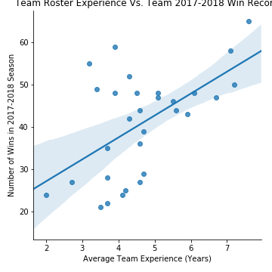
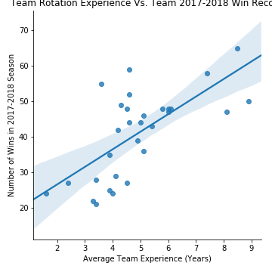
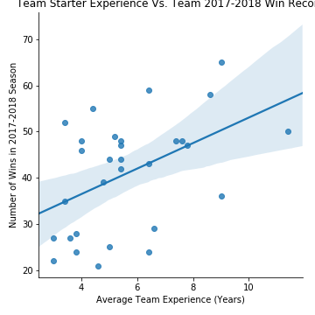
Experience vs. Wins
r_squared = 0.32
p_value = 0.001
r_squared = 0.46
p_value = 3.94e-05
r_squared = 0.22
p_value = 0.009

Slide 7
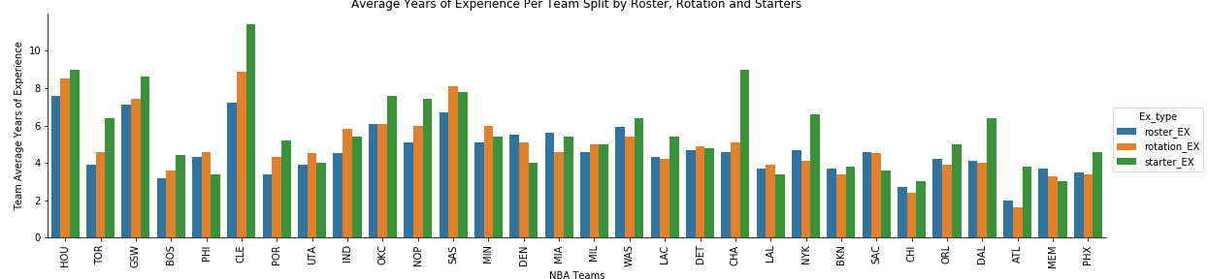
Team Experience Breakdown

Slide 8
Experience Findings
Although the p values are < .05 there is not a strong correlation between a teams average roster, rotation and starter experience and the number of team wins
NBA rotation experience has a slightly stronger correlation to wins
This suggests that a team with more depth on the bench is more likely to be successful

Slide 9
RPM Analysis
Is Real Plus-Minus (RPM) a good predictive stat for how NBA organizations/players will perform?
What is Real Plus Minus (RPM)?
RPM is the player’s average impact in terms of net point differential (pts scored – pts allowed) per 100 offensive and defensive possessions.
Group player info by team
Calculate average team RPM, DRPM and ORPM score
Compare to team season wins
Calculated r squared and p value

Slide 10
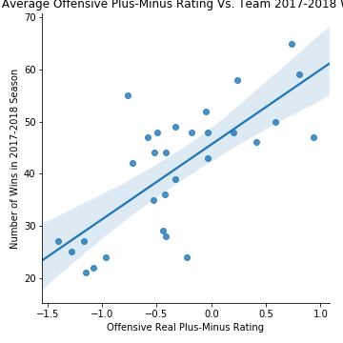
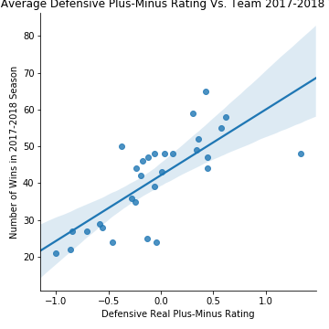
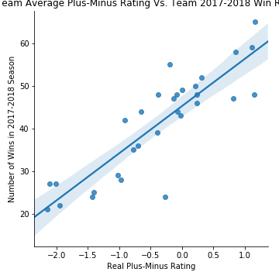
RPM vs. Wins
r_squared = 0.54
p_value = 4.27e-06
r_squared = 0.56
p_value = 2.24e-06
r_squared = 0.76
p_value = 4.30e-10

Slide 11
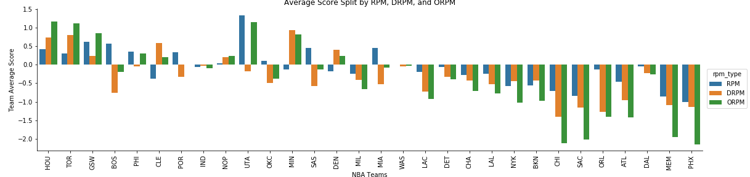
Team RPM Breakdown

Slide 12
RPM Findings
There is a very strong positive correlation between a team’s RPM average score and number of wins
This suggests that RPM is a good predictive stat organizations can use

Slide 13
Box Score Analysis
Is there a particular box score stat that correlates with wins?
Group player box score stats and teams
Calculate average team box score stats
Defensive rebounding (DRR)
Offensive rebounding (ORR)
Rebound Rate (REBR)
Assists (AST)
True Shooting Percentage (TS%)
Compare to team season wins
Calculate r squared and p value

Slide 14
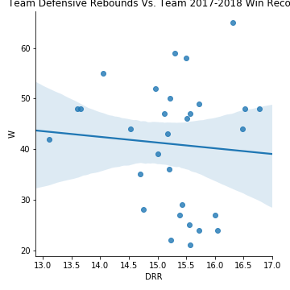
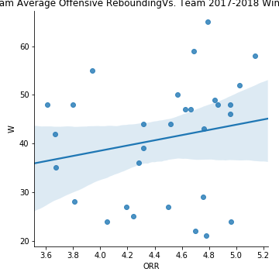
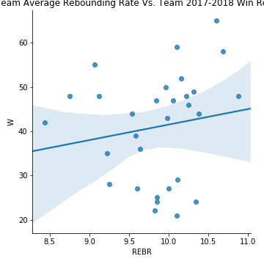
Box Score Stats vs. Wins
r_squared = 0.006
p_value = 0.68
r_squared = 0.04
p_value = 0.30
r_squared = 0.03
p_value = 0.40

Slide 15
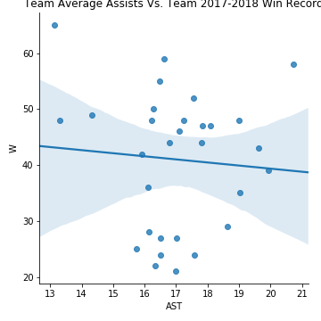
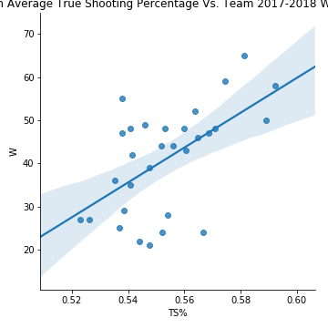
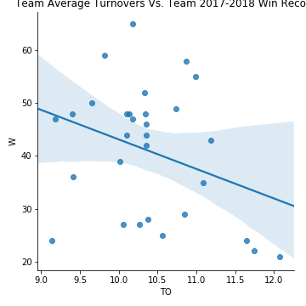
Box Score Stats vs. Wins continued
r_squared = 0.006
p_value = 0.68
r_squared = 0.33
p_value = 0.001
r_squared = 0.12
p_value = 0.08

Slide 16
Box Score Stats Findings
Rebounding, assists and turnovers, are not statistically a significant factor for team wins when standing alone
There is a weak positive correlation between TS% and team wins, however, still not statistically a significant factor for team wins when standing alone
There is NOT one holy grail of box score stats

Slide 17
PER Analysis
Is Player Efficiency Rating (PER) a good predictive stat for how NBA organizations/players will perform?
Convert salary to integer
Merge datasets
Group by team and PER score and calculate average team PER
Calculate r squared and p value
What is Player Efficiency Rating (PER):
PER is a rating of a player's per-minute productivity.
Pros/Cons:
Pros: more detailed and accurate compared to looking at box score stats
Cons:
Lacks consideration for individual/ team defense.
Formula largely measures player offensive performance

Slide 18
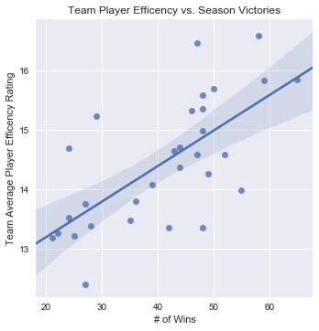
Team PER vs. Wins
r_squared = 0.46
p_value = 0.00004

Slide 19
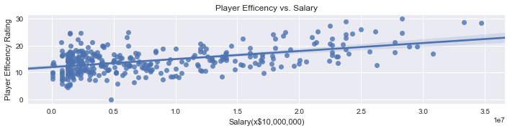
Player PER vs. Salary
r_squared = 0.24
p_value = 6.7e-22

Slide 20
PER Findings
There is a weak positive correlation between a players PER score and their salary. Suggesting that the most efficient players should be getting paid the most however, that is not always the case
There is a moderately positive correlation between a team’s average PER score and wins. However, it is not significantly strong enough to be a good predictor alone

Slide 21
Team Salary Analysis
Do organizations with more money/higher paid players win more?
Converted salary columns to integer
Merge data so it is grouped by teams
Calculate r squared and p value

Slide 22
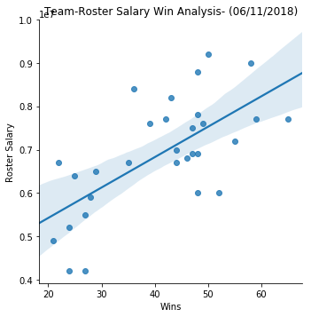
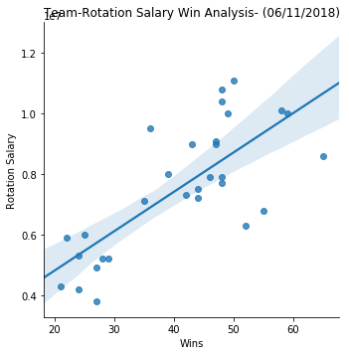
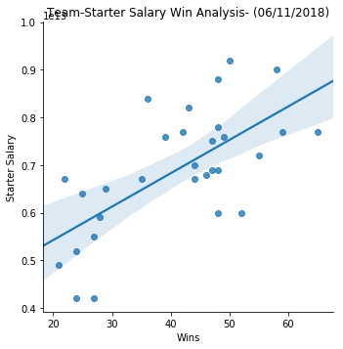
Team Salary vs. Wins
r_squared = 0.44
p_value = 5.99e-05
r-squared = 0.57
p-value = 1.33e-06
r_squared = 0.44
p_value = 5.99e-05

Slide 23
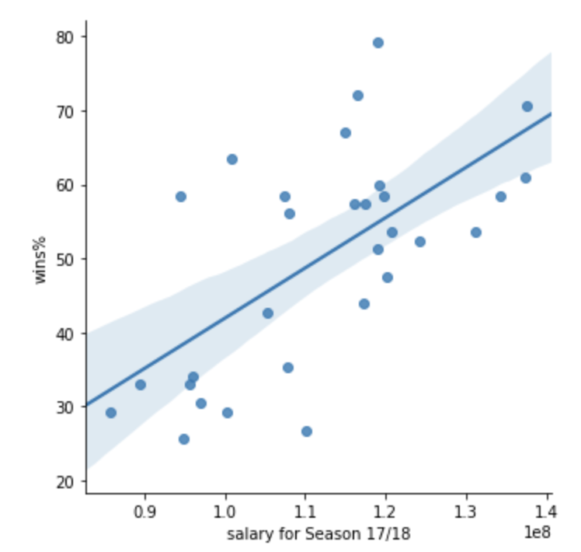
Team Salary vs. Wins continued
r_squared = 0.41
p_value = 0.00015

Slide 24
Salary Findings
Although it looks to be a positive relationship for wins and higher team salary. Salary is NOT statistically a significant factor for team wins.
It is part of the equation but other factors are more significant contributors.

Slide 25
In Conclusion
There is NOT one factor that goes into a team having a winning record
Teams can use PER scores and RPM scores to determine who will be most productive and efficient on the floor, however, you cannot only rely on a select few players to get the job done
Teams need depth on the bench and need to play good fundamental team basketball to win games

Slide 26
Post Mortem
Difficulties:
Data doesn’t account for injuries, trades, etc.
Data doesn’t account for how long player contracts are for
If we had more time:
Based on player’s PER/RPM score, who is being overpaid and underpaid based on their performance?
Does our 2017-2018 data match past years data?
Predict based on our data who will be the top teams next season?
Do fans care more about an organization or individual players?
Compare teams regular season to post season (if they made it)
Do organizations that win more have more fans?
How many fans does an organization have pre/post win (bandwagoning)?

Slide 27
Questions?

