Slide 1
Week 4 Project
Budget App
Started 08Nov2018

Slide 2
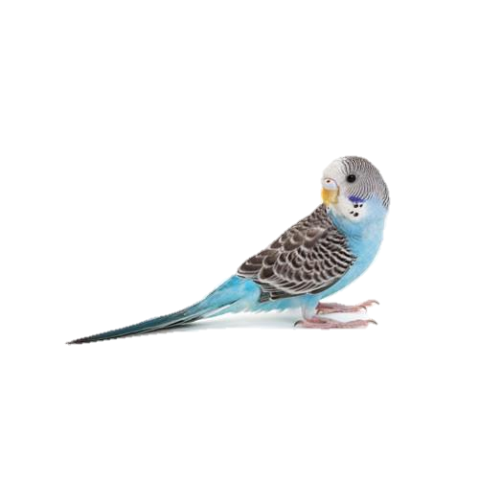
Homepage - Buttons
Home
My Spending
My Merchants
My Buy Tags
New Transaction
Edit Transactions
Budgee
Welcome to Budge-Track
Blah blah this is a spending tracking app, this app will answer your prayers and reveal the purpose of life blah blah blah
My Spending
My Merchants
My Buy Tags
New Transaction
Edit Transactions

Slide 3
My Transactions – Table – Buttons - Fields
Home
My Spending
My Merchants
My Buy Tags
New Transaction
Edit Transactions
Budgee
My Transactions
Blah blah info about this page blah blah blah
My Budget: £500
Amount (£) | Merchant | Buy Tag | Essential? | Time | Day | Month | Total Spend (£) | Budget Remaining (£)
5.00 | Lidl | Groceries | Y | 16:00 | 28th | February | 5.00 | 495.00
60.00 | Sainsburys | Groceries | Y | 10:00 | 1st | March | 65.00 | 435.00
100.00 | Schuh | Clothes | N | 15:20 | 2nd | March | 165.00 | 335.00
35.00 | New Look | Clothes | Y | 16:00 | 2nd | March | 200.00 | 300.00
4.00 | Asda | Entertainment | N | 18:05 | 2nd | March | 204.00 | 296.00
19.99 | Zara | Clothing | N | 12:04 | 3rd | March | 223.99 | 276.01
Filter by Merchant
dropdown
Filter by Buy Tag
dropdown
Filter by Month
dropdown
Set my Budget (£)
text

Slide 4
My Merchants – Table – Buttons - Fields
Home
My Spending
My Merchants
My Buy Tags
New Transaction
Edit Transactions
Budgee
My Merchants
Blah blah info about this page blah blah blah
Existing Merchants
Lidl
Sainsburys
Schuh
New Look
Asda
Zara
Add Merchant
text
Edit Merchant
dropdown
text
Delete Merchant
dropdown

Slide 5
My Buy Tags – Table – Buttons - Fields
Home
My Spending
My Merchants
My Buy Tags
New Transaction
Edit Transactions
Budgee
My Buy Tags
Blah blah info about this page blah blah blah
Existing Buy Tags
Groceries
Clothes
Entertainment
Transport
Add Merchant
text
Edit Buy Tag
dropdown
text
Delete Merchant
dropdown

Slide 6
New Transaction - Form
Home
My Spending
My Merchants
My Buy Tags
New Transaction
Edit Transactions
Budgee
New Transaction
Blah blah info about this page blah blah blah
Amount
text
Merchant
dropdown
Buy Tag
dropdown
Essential?
Dropdown Y/N
Time
Dropdown
Day
Dropdown
Month
Dropdown
Add New Transaction

