Slide 1
Week 4 Project
Budget App
Started 08Nov2018

Slide 2
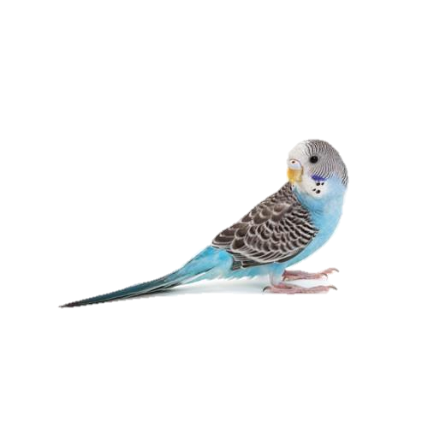
My Transactions – Table – Buttons - Fields
Home
My Spending
My Merchants
My Buy Tags
New Transaction
Edit Transactions
Budgee
My Transactions
Blah blah info about this page blah blah blah
My Budget: £500
Amount (£) | Merchant | Buy Tag | Essential? | Time | Day | Month | Total Spend (£) | Budget Remaining (£)
5.00 | Lidl | Groceries | Y | 16:00 | 28th | February | 5.00 | 495.00
60.00 | Sainsburys | Groceries | Y | 10:00 | 1st | March | 65.00 | 435.00
100.00 | Schuh | Clothes | N | 15:20 | 2nd | March | 165.00 | 335.00
35.00 | New Look | Clothes | Y | 16:00 | 2nd | March | 200.00 | 300.00
4.00 | Asda | Entertainment | N | 18:05 | 2nd | March | 204.00 | 296.00
19.99 | Zara | Clothing | N | 12:04 | 3rd | March | 223.99 | 276.01
Filter by Merchant
dropdown
Filter by Buy Tag
dropdown
Filter by Month
dropdown
Set my Budget (£)
text

Slide 3
My Merchants – Table – Buttons - Fields
Home
My Spending
My Merchants
My Buy Tags
New Transaction
Edit Transactions
Budgee
My Merchants
Blah blah info about this page blah blah blah
Existing Merchants
Lidl
Sainsburys
Schuh
New Look
Asda
Zara
Add Merchant
text
Edit Merchant
dropdown
text
Delete Merchant
dropdown

Slide 4
My Buy Tags – Table – Buttons - Fields
Home
My Spending
My Merchants
My Buy Tags
New Transaction
Edit Transactions
Budgee
My Buy Tags
Blah blah info about this page blah blah blah
Existing Buy Tags
Groceries
Clothes
Entertainment
Transport
Add Merchant
text
Edit Buy Tag
dropdown
text
Delete Merchant
dropdown

Slide 5
New Transaction - Form
Home
My Spending
My Merchants
My Buy Tags
New Transaction
Edit Transactions
Budgee
New Transaction
Blah blah info about this page blah blah blah
Amount
text
Merchant
dropdown
Buy Tag
dropdown
Essential?
Dropdown Y/N
Add New Transaction

Slide 6
Edit/Delete Transaction - Display
Home
My Spending
My Merchants
My Buy Tags
New Transaction
Edit Transactions
Budgee
Edit or Delete Transactions
Select a transaction to edit or delete by clicking on a row:
Amount (£) | Merchant | Buy Tag | Essential? | Time | Day | Month | Total Spend (£) | Budget Remaining (£)
5.00 | Lidl | Groceries | Y | 16:00 | 28th | February | 5.00 | 495.00
60.00 | Sainsburys | Groceries | Y | 10:00 | 1st | March | 65.00 | 435.00
100.00 | Schuh | Clothes | N | 15:20 | 2nd | March | 165.00 | 335.00
35.00 | New Look | Clothes | Y | 16:00 | 2nd | March | 200.00 | 300.00
4.00 | Asda | Entertainment | N | 18:05 | 2nd | March | 204.00 | 296.00
19.99 | Zara | Clothing | N | 12:04 | 3rd | March | 223.99 | 276.01

Slide 7
Edit/Delete Transaction - Form
Home
My Spending
My Merchants
My Buy Tags
New Transaction
Edit Transactions
Budgee
Edit or Delete Transactions
Amount (£) | Merchant | Buy Tag | Essential? | Time | Day | Month | Total Spend (£) | Budget Remaining (£)
100.00 | Schuh | Clothes | N | 15:20 | 2nd | March | 165.00 | 335.00
Amount
text
Amount
text
Merchant
dropdown
Merchant
dropdown
Buy Tag
date
Buy Tag
date
Essential?
Dropdown Y/N
Essential?
Dropdown Y/N
Date
Date
dropdown
Time
dropdown
Time
Day
Day
dropdown
dropdown
dropdown
Month
dropdown
Month
Edit This Transaction
Delete This
Transaction

Slide 8
Tables
Merchants
Id | Merchant Name (VARCHAR)
1 | Sainsburys
2 | Asda
3 | Zara
Tags
Id | Tag Name (VARCHAR)
1 | Groceries
2 | Travel
3 | Clothing
Transactions
Id | Amount(£) (NUMERIC(10,2) | Merchant_id | Tag_id | Essential? (VARCHAR) | Time (NUMERIC(4,2) | Day (INT) | Month (VARCHAR) | Total spend(£) (NUMERIC(10,2) | Remaining Budget(£) (NUMERIC(10,2)
1 | 5.00 | 1 | 1 | Y | 16:00 | 28 | February | 5.00 | 495.00
2 | 10.00 | 1 | 2 | N | 17:15 | 1 | March | 15.00 | 480.00
3 | 19.99 | 2 | 1 | N | 10:00 | 2 | March | 34.99 | 445.01

Slide 9
Classes
Merchant
@id @merchant_name(Str)
Initialize Save (to database) Self find Self all Self map items delete
Tags
@id @tag_name(Str)
Initialize Save (to database) Self find Self all Self map items delete
Transaction
@id @amount(numeric) @merchant_id @tag_id @essential(Str) @time(numeric) @day(Int) @month(Str) @total_spent(numeric) @remaining_budget(numeric)
Initialize Get time/date now Split time/date to time/day/month Calculate total spent Calculate remaining budget Save (to database) Self find Self all Self map items delete
Budget
@id @budget(numeric)
Initialize Edit delete

Slide 10
Homepage - Buttons
Home
My Spending
My Merchants
My Buy Tags
New Transaction
Edit Transactions
Budgee
Welcome to Budgee
Blah blah this is a spending tracking app, this app will answer your prayers and reveal the purpose of life blah blah blah
My Spending
My Merchants
My Buy Tags
New Transaction
Edit Transactions

