Slide 1
PDA Static & Dynamic Testing
16Nov2018

Slide 2
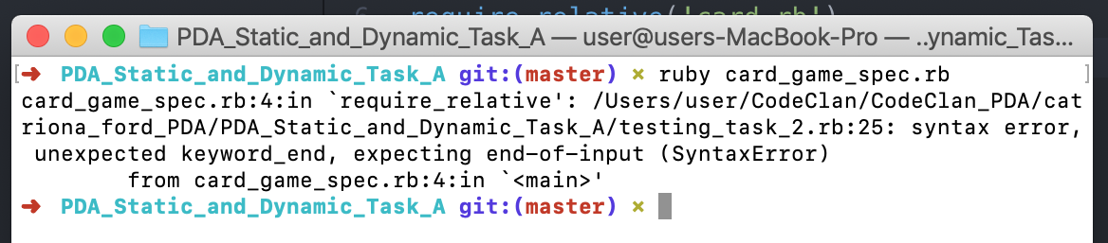
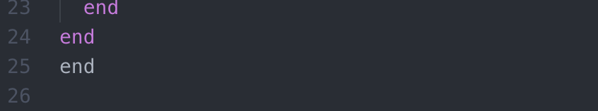
Testing set-up failing – extra end

Slide 3
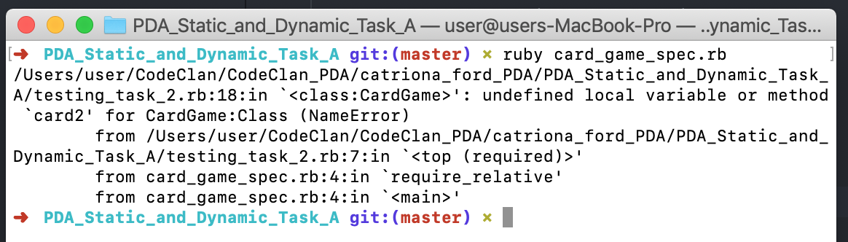

Testing set-up failing – No comma between card1 and card2

Slide 4
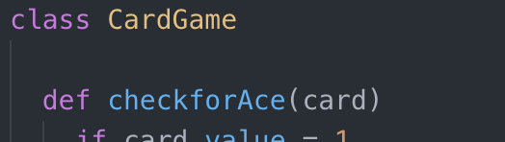
Testing set-up failing – No initialize method for CardGame class

Slide 5
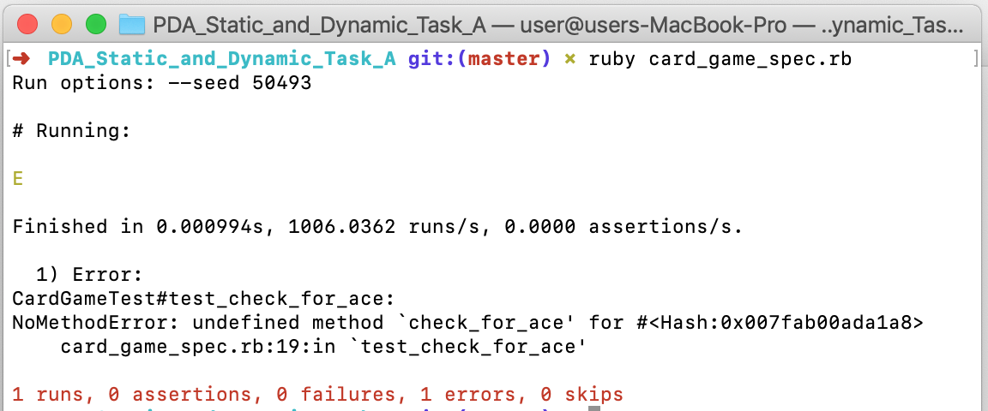
Testing set-up failing – check for ace method in wrong case

Slide 6
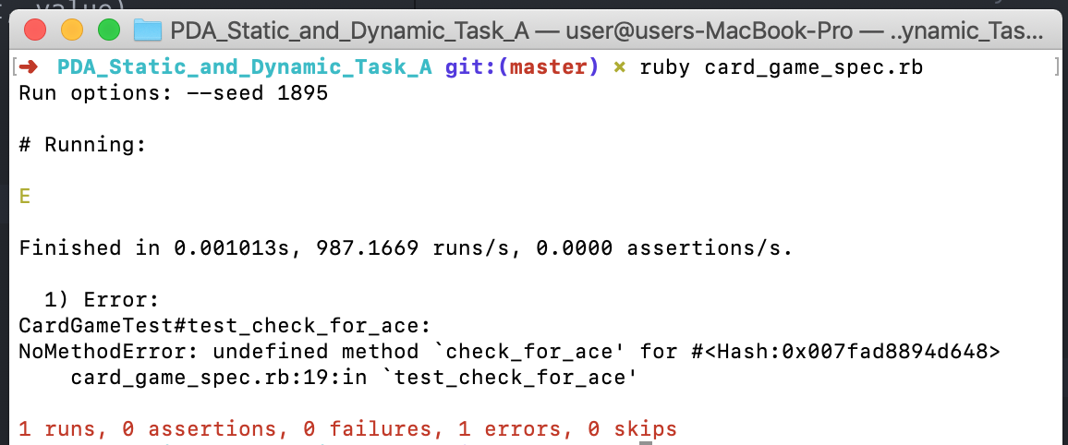
Testing set-up failing – check for ace method in wrong case

Slide 7
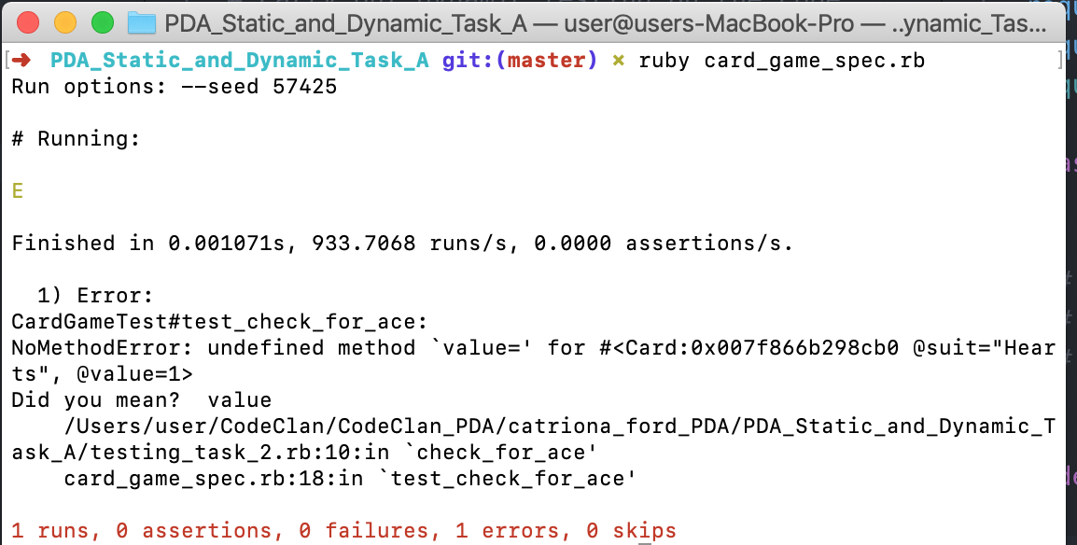

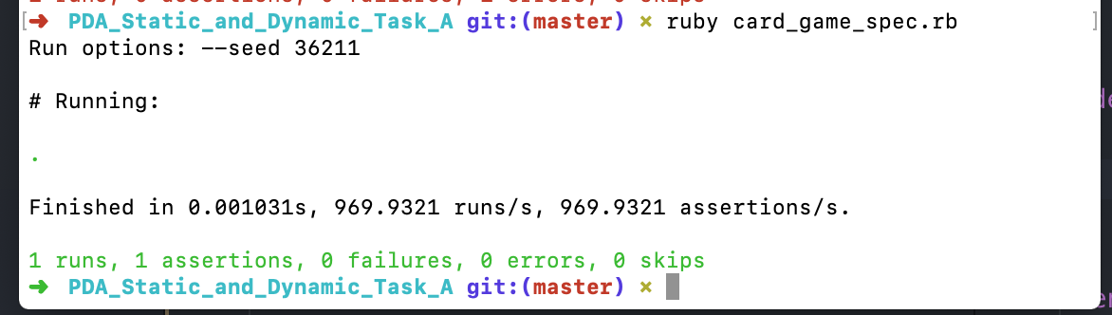
Testing check_for_ace failed
double equals needed

Slide 8
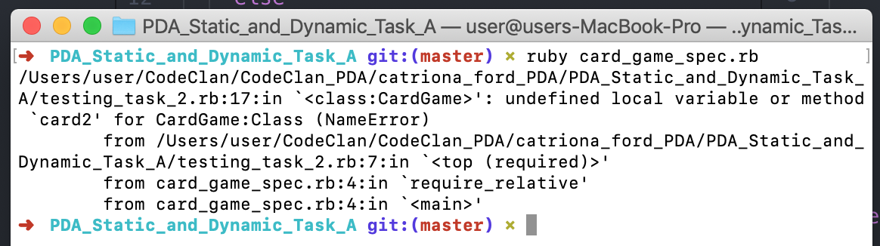
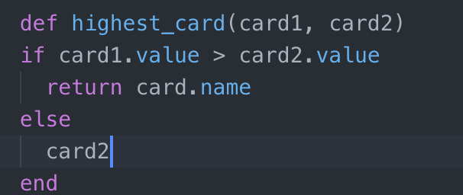
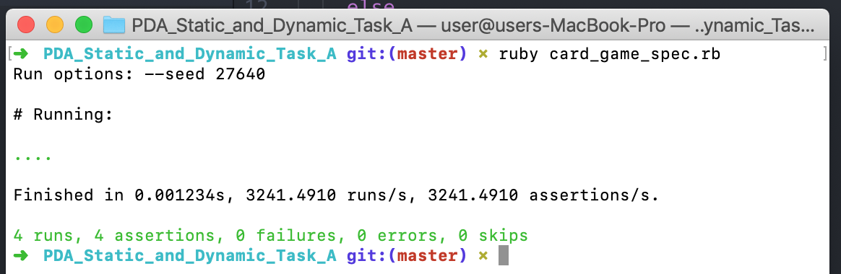
Testing highest_card failed
Comma between card1 and card 2 missing
dif should be def
end missing
card.name should be card1
No contingency if the cards are the same, else if needed

Slide 9
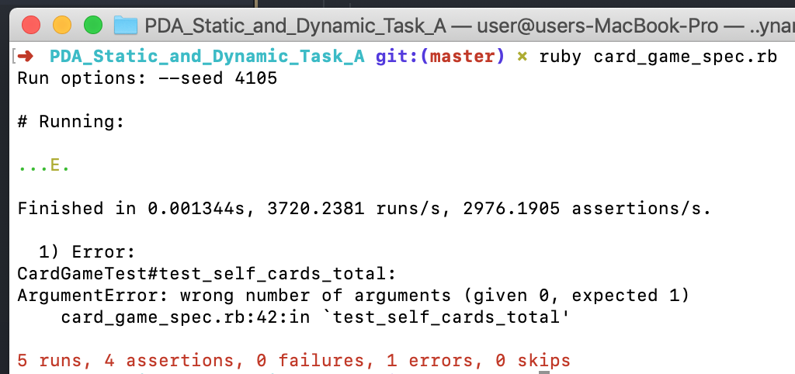
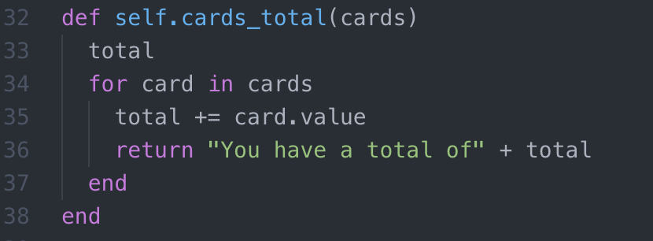
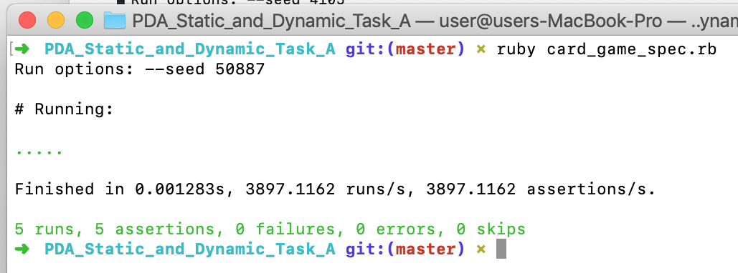
Testing cards total failed
Method outside of class
Shouldn’t be a self method
Total should be equal to zero
+ total in the last line needs a to string method
Needs a space after you have a total of
Return should be outside for loop

