Slide 1

2022 機器學習 課程規定
李宏毅
Hung-yi Lee
Notes:
What is the prerequisite exam?
版本問題助教不處理
本課程不提供運算資源
系學會發運算資源
直接取 30 名
旁聽生請寄信給助教，可以加入 NTU COOL
大助教照片
Kaggle results selected
程式抄襲
去年的 leaderboard 是否關閉
===
助教信箱
助教時間
課程網也

Slide 2
About this course
Time slot: 2:20 p.m. – 6:20 p.m., Friday
Classroom: 博理 112
Live streaming during the lecture time
All lectures will be recorded
You can complete this course online.
submit homework online, no exam
Prerequisite
Math: Calculus (微積分), Linear algebra (線性代數) and Probability (機率)
Programming: You can read and write python code.

Slide 3
About this course
Focus on deep learning
Can be your first machine learning (ML) course.
Little overlap with Hsuan-Tien Lin’s (林軒田) Machine Learning Foundations and Machine Learning Techniques.
Computer Vision
Hsuan-Tien’s
ML
This course
Speech
Natural Language
your first ML course
……

Slide 4
About this course
Focus on deep learning
Can be your first machine learning (ML) course.
Little overlap with Hsuan-Tien Lin’s (林軒田) Machine Learning Foundations and Machine Learning Techniques.
Covering broad aspects
Try to cover most important technology and concepts you need to know (buffet style!)
Not delve into most topics. This is your first ML course, not the last one.
Covering the latest technology
Application oriented

Slide 5


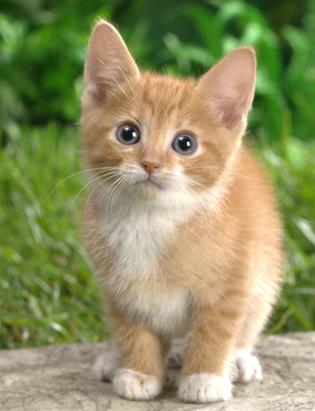




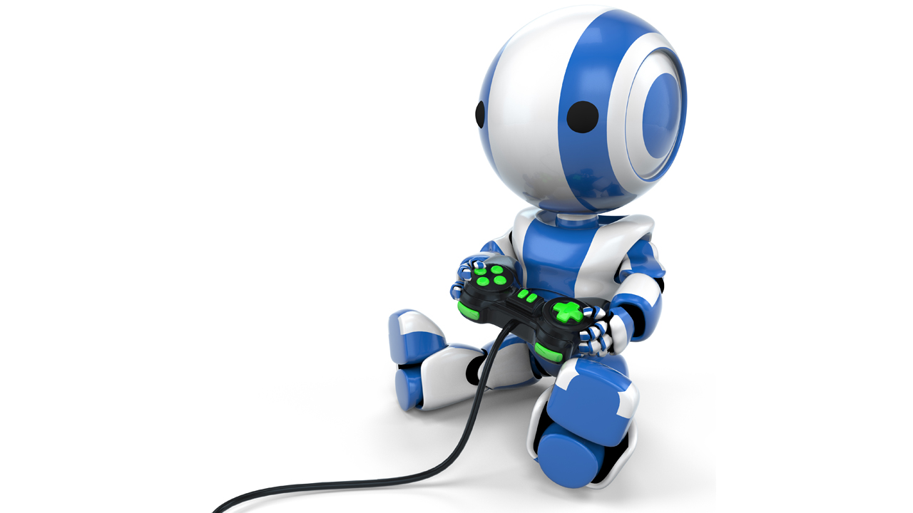
Applications
COVID-19
HW1
Computer Vision
HW 3, 8, 9, 10,11
attack, adaptation, compression, explanation,
anomaly detection
Image
generation
CNN
cat
HW 6
Natural Language Processing
HW 5
HW 7
RL
Speech
Processing
HW 12
HW 2
HW 4

Slide 6
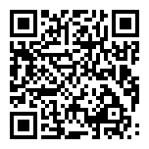
Webpage
All the recording and assignments will be available on the course webpage.
Course webpage: https://speech.ee.ntu.edu.tw/~hylee/ml/2022-spring.php

Slide 7
Assignment

Slide 8
Assignment
Most assignments include report, leaderboard, and code submission.
Report: answer some questions
Leaderboard (排行榜): Kaggle or JudgeBoi (our in-house Kaggle ☺ )
Simple, medium, strong, boss baselines
Submit the related codes of each assignment via NTU COOL.
All assignments can be done by Google Colab. You can pass this course without preparing hardware or install anything.
But usually more computing resources lead to better performance.
Notes:
人生是不公平的

Slide 9
Grading Criterion
分數與等第換算按照學校建議
http://www.bebi.ntu.edu.tw/uploads/root/Regulations.pdf
There are 15 assignments.
Each has 10 points, only count the 10 assignments with the highest points.
You don’t need to do all the assignments. Choose the ones you are interested in.
You are encouraged to complete all 15 assignments!
You decide how much you want to learn.
It’s buffet style.

Slide 10
Disclaimers
This course will NOT teach Python.
This course will NOT teach any Python package, except PyTorch.
Only focus on ML. TAs do not have to answer questions not related to ML or PyTorch.
All TAs’ sample codes can be run on Colab. If you use your own device, TAs have no obligation to solve all problems.
TAs have no obligation to help you pass the baselines.
This course will NOT provide computing resources.
When it comes to network training, your efforts are not always proportional to your performance.
Network training can take a long time.
培養強健
的心理素質
Notes:
Time:

Slide 11
Lecture Schedule

Slide 12
課程網站
https://speech.ee.ntu.edu.tw/~hylee/ml/2022-spring.php
上課前看完
上課補充
額外補充資料
每一個主題都有一個對應的作業

Slide 13
Lecture Schedule
Watch assigned videos before the lecture
During lecture
Teach something new (usually 1 hour) or invited speakers
Not directly related to assignments
Assignment announcement by TA
We will usually finish the lectures before 6:20 p.m.
You can complete this course online.

Slide 14
Kaggle

Slide 15
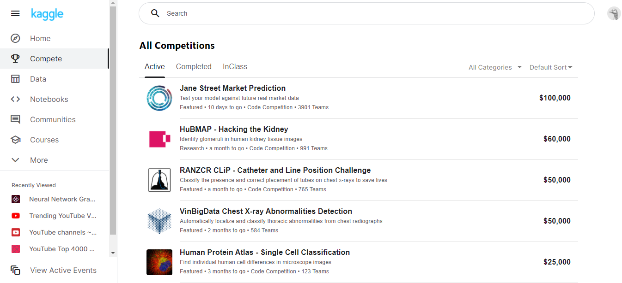
Kaggle (JudgeBoi is similar)
https://www.kaggle.com/
Some assignments are in-class competition on Kaggle.
Register a Kaggle account by yourself.
Notes:
Kaggle 是一個龐大的資料科學社群，上面有各種資料分析的競賽。本 學期的部份作業也會使用到 Kaggle 上的 in-class competition。

Slide 16
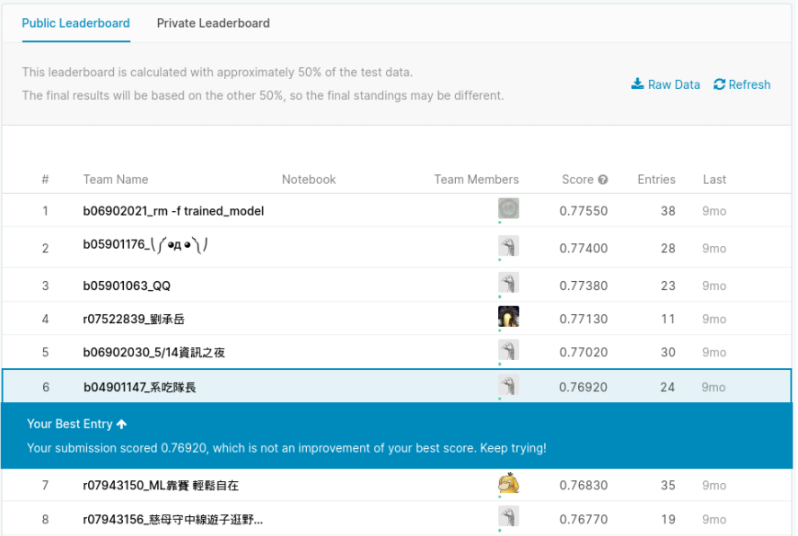
display name
score

Slide 17
Kaggle
The display name should be
Example
<STUDENT ID>_<ANY THING>
b93901106
truly any thing ☺
b93901106_pui pui pui pui pui pui pui pui
b93901106_
b93901106 puipui
We will not find your submission if your format is wrong!

Slide 18
Public score: You can see it right after the submission.
Private score: You can only see the score after the assignment deadline.
display name
score

Slide 19

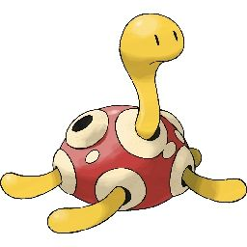




Kaggle – Pokémon & Digimon
Testing Data
Given in the assignment
Ground
truth
poki
poki
digi
poki
digi
digi
on Kaggle (unseen)

Slide 20
Kaggle – Pokémon & Digimon
public
private
Ground
truth
poki
poki
digi
poki
digi
digi
Model
Prediction
poki
digi
digi
digi
poki
digi
Acc = 2/3
Acc = 1/3
What you can see immediately
After the submission deadline

Slide 21
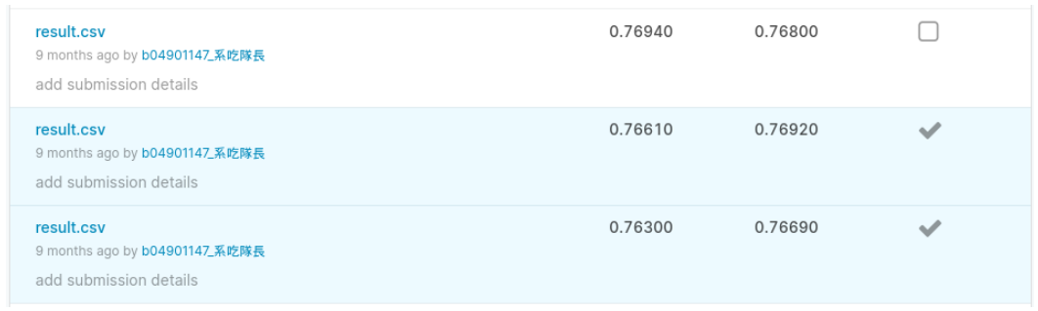
Kaggle
You need to select two results for evaluating on the private set before the assignment deadline.
You only have limited submission times per day.

Slide 22

Rules

Slide 23
Rules – Common Sense
Don’t plagiarize others’ code and don’t submit others’ reports or results.
“Other” means all creatures in the universe
Using the available public toolkits is allowed.
If some of your codes are from others’ repositories, please mention them in your code.
If you discuss your assignments with some classmates/friends, mention them in your code.
TAs and the lecturer decide plagiarization or not.
Notes:
致敬?
====
Lending your codes to others or allowing others to copy your work will be considered as collusion and thus receiving the same punishment as the plagiarist.

Slide 24
Rules – Common Sense
Protect your efforts! Don’t let others see your codes, don’t give others your results.
Lending your codes to others or allowing others to copy your work will be considered as collusion, thus receiving the same punishment as the plagiarist.
Notes:
致敬?
====
Lending your codes to others or allowing others to copy your work will be considered as collusion and thus receiving the same punishment as the plagiarist.

Slide 25
Rules – For Kaggle and JudgeBoi
There is a limited number of submissions to all the leaderboards (Kaggle and JudgeBoi).
Don’t try to have multiple accounts. (It also violates the rules of Kaggle.)
Don’t borrow account from others and don’t give you account to others.
Don’t submit your results to leaderboards of previous courses.
Don’t use any approach to increase the submission numbers
Notes:
請不要抄襲同學的作業和程式碼、 也不會把程式碼和結果借給其他同學看
我們無法分辨無法分辨抄襲和被抄襲，兩份作業都視同抄襲
同學包含這學期和過去修過課的同學
每一個作業都有規定 (不能用)
上述問題，第一次抓到當次作業 0 分，第二次犯就直接當掉 (決不寬容)
其他上述沒有規定的事項，由老師和助教按照公序良俗與公平性來處理 上述問題，第一次抓到當次作業 0 分，第二次犯就直接當掉 (決不寬容)
其他上述沒有規定的事項，由老師和助教按照公序良俗與公平性來處理

Slide 26
Rules – For Kaggle and JudgeBoi
The results submitted to the leaderboards should only come from machines.
Don’t label the testing data by humans (or any other approaches)!
Only use the data provided in each assignment!
Notes:
請不要抄襲同學的作業和程式碼、 也不會把程式碼和結果借給其他同學看
我們無法分辨無法分辨抄襲和被抄襲，兩份作業都視同抄襲
同學包含這學期和過去修過課的同學
每一個作業都有規定 (不能用)
上述問題，第一次抓到當次作業 0 分，第二次犯就直接當掉 (決不寬容)
其他上述沒有規定的事項，由老師和助教按照公序良俗與公平性來處理 上述問題，第一次抓到當次作業 0 分，第二次犯就直接當掉 (決不寬容)
其他上述沒有規定的事項，由老師和助教按照公序良俗與公平性來處理

Slide 27
Rules - Codes
You need to submit codes for each assignment via NTU COOL.
Your codes need to be able to generate the results you submit to the leaderboard.
If not, it would be considered cheating and get punishment.
TAs may not run all the codes, but TAs will check some of them.
TAs and the lecturer decide cheating or not.

Slide 28
Punishment
The first time you violate the rules.
The final score of this semester times 0.9, and you receive zero score for the assignment you violate the rules.
The second time you violate the rules.
Fail the course.

Slide 29

加簽

Slide 30
加簽
*輔系指事前核可的輔系
加簽電資學院(含輔系*、資料科學學程、智慧醫療學程)的學生
請填寫 google 表單 (如果沒有要加簽就不要填、也不要幫其他人填)
等一下大助教會公告表單連結
表單填寫期限到下週三(2/23)午夜，逾時不候
之後會透過 NTU COOL 發授權碼
Notes:
修過智慧醫療程式設計或醫學概論

Slide 31
加簽
非電資學院的學生，依據作業一的 leaderboard 排名加簽 (等一下助教會公告作業一)
也請填寫 google 表單
根據 private leaderboard 排名取前 30 名非電資學院學生獲得加簽資格
不看 public leaderboard
只看排名不看分數
不遞補
之後會透過 NTU COOL 發授權碼
無論是否為電資學院的學生，完成作業一都可以計入期末總分

Slide 32
旁聽
本課程歡迎旁聽
課程內容和作業內容都已經完整公開在課程網頁上，有沒有正式修課對於學習影響不大
旁聽生請寄信給助教，可以加入 NTU COOL
旁聽生可以上傳結果到 Kaggle (但無法上傳到 JudgeBoi)
助教不批改旁聽生的報告
Notes:
衝堂

Slide 33

Questions?

Slide 34
Questions
Option 1: Ask at TA hour
Option 2: Post your questions on NTU COOL
Your questions are also other’s questions.
Option 3: Mail to the following address
E-mail: mlta-2022-spring@googlegroups.com
E-mail title includes “[hwX]” (e.g. [hw3])
Don’t direct message to TAs. The TAs will only answer the questions by the above alternatives.
Notes:
Option 2 is recommended.

Slide 35
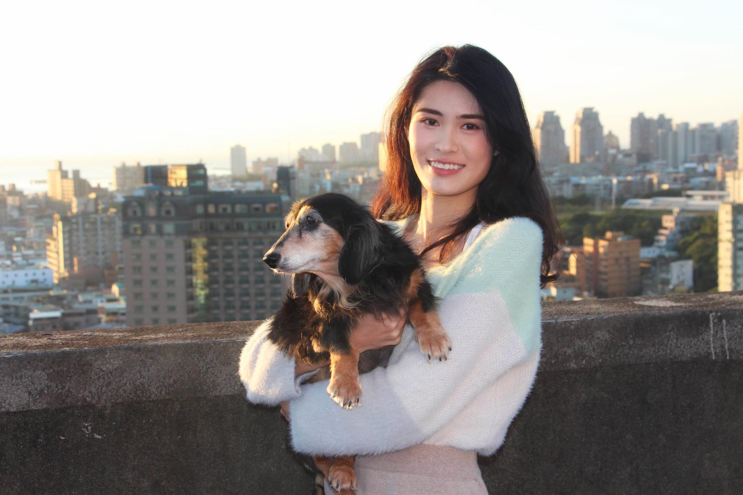
TA head
陳子晴
TA email: mlta-2022-spring@googlegroups.com
Notes:
換助教頭像

