Slide 1

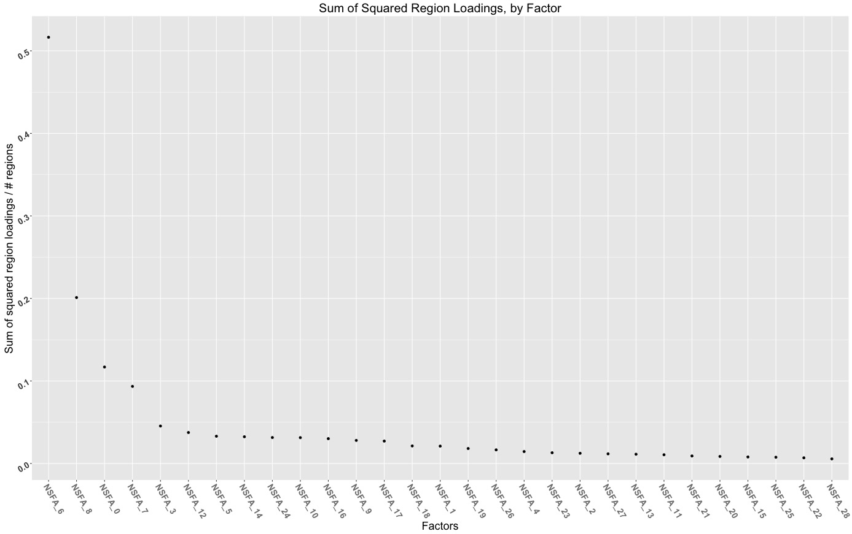
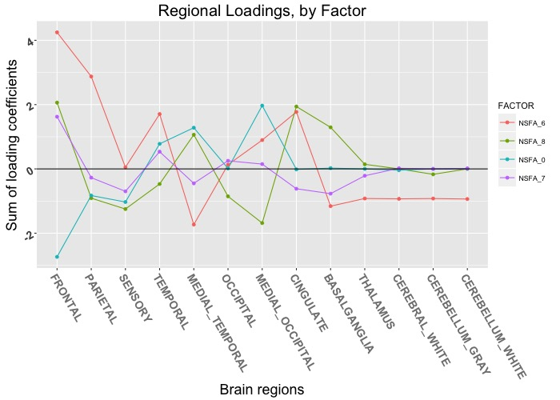
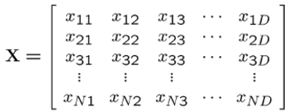
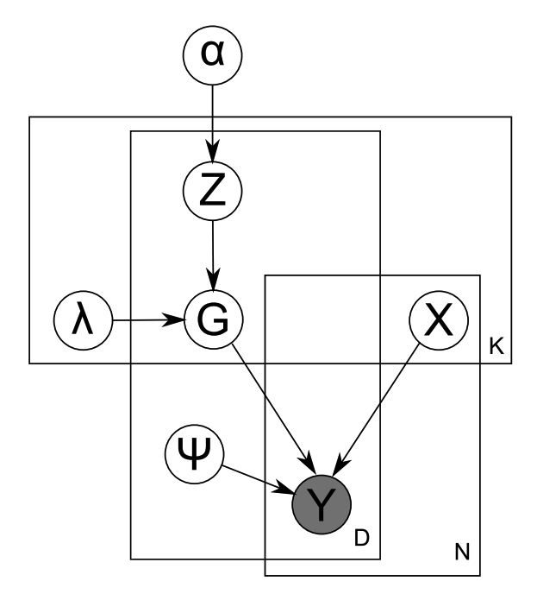
Effects of Baseline Regional Amyloid Deposition Patterns
on Subsequent Accumulation
Andy Horng, William J. Jagust, Susan M. Landau
Helen Wills Neuroscience Institute, University of California at Berkeley, Lawrence Berkeley National Laboratory
Introduction
Methods
Results and Summary
The cortical summary SUVR of ¹⁸F-AV-45 PET scans (frontal/parietal/temporal/cingulate ROI) is a conveniently calculated measure of global ß-Amyloid burden.
Cortical summary SUVR is impaired by:
- noise introduced in choosing a reference region
- ignorance of regional variations within the ROI
- ignorance of regional contrasts (except ROI/ref)
Goals:
Convert regional uptakes of ADNI ¹⁸F-AV-45 and ¹⁸F-AV-1451 PET scans to standardized units via a regionally-unbiased intensity normalization method.
Perform a sparse nonparametric factor analysis of the normalized regional dataset, determining a set of recurring uptake topographies underlying the variance in individual uptake patterns.
Explore the efficacy of topographical factor scores (derived from the factor model) as alternative summary measures of Alzheimer’s disease severity.
Data Normalization
45 bilateral Freesurfer-defined regions
Correction for partial volume effects with the Rousset algorithm (geometry-dependent transfer matrix)
Intensity normalization by Manhattan (L1) norm, mapping each scan (row) onto a regional standard simplex and preserving uptake ratios
Standardize each region (column) to zero mean, unit variance
¹⁸F-AV-45 Factor Loadings (29 Factors)
¹⁸F-AV-1451 Factor Loadings (29 Factors)
Freesurfer Regions
Scans
Nonparametric Sparse Factor Analysis (NSFA)
Sparsity improves interpretability of latent factors and downstream predictive performance.
Nonparametric models remove manual specification of the number of factors.
Potential pitfalls include the assumption of a causal model, and results are only as good as the data.
Subjects
 | AV45 | AV1451
n | 1064 | 55
Age (years) | 73.77 (7.48) | 76.04 (6.98)
Sex (M/F) | 569/494 (1 N/A) | 31/24
Education (years) | 16.21 (2.67) | 16.72 (2.65)
APOE ε4 + | 43.2% | 34.5%
AV45 + | 52.6% | N/A
Normal | 259 (24.3%) | 17 (30.9%)
SMC | 100 (9.4%) | 6 (10.9%)
EMCI | 301 (28.2%) | 11 (20%)
LMCI | 215 (20.2%) | 16 (29.1%)
AD | 189 (17.7%) | 5 (9.1%)
Figure 1. Graphical Model. Adapted from “Nonparametric Bayesian sparse factor models with application to gene expression modeling” by D. Knowles and Z. Ghahramani, 2011
¹⁸F-AV-45 Factor Scores
¹⁸F-AV-1451 Factor Scores
NSFA Output and Analyses
Factor loadings (regional topographies per factor)
- Loadings are regional correlations
- Summary by lobe
- Overlap with de facto ROIs
Factor score estimates (factor representations per scan)
- Correlation with cortical summary SUVR
- Longitudinal behavior
- Penalized linear regression models (LARS) targeting memory
and subsequent accumulation
Notes:
AV45 Factor loadings:
Factor loadings as regional correlations, regional summaries
AV45 comparison to cortical summary SUVR
Brain visualization comparison (NSFA6, NSFA14, NSFA5, cortical summary roi mask)
linear fit against each other
AV45 penalized regression
Of the positive subjects on ADAS-Cog + AVLT
Report R2 shrinkage
AV1451 Factor loadings:
Factor loadings as regional correlations, regional summaries
AV45 comparison with braak regions
Brain visualization (NSFA0, braak masks)
AV1451 penalized regression
- against ADAS-COG + AVLT

