Slide 1



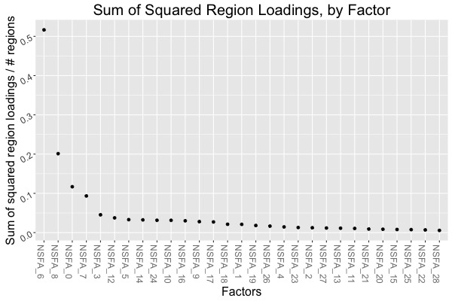
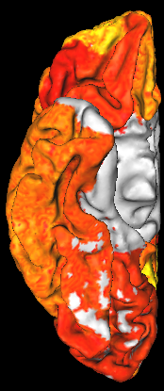
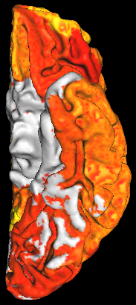
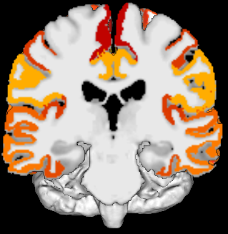
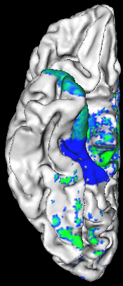
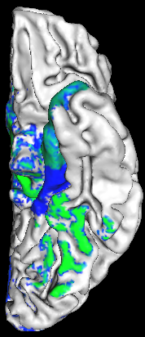

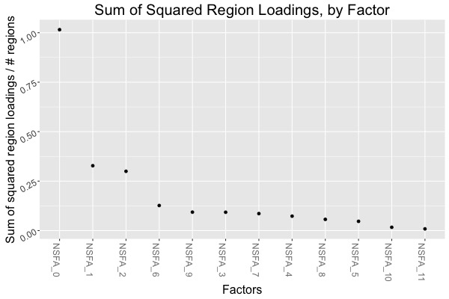





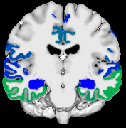
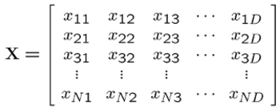
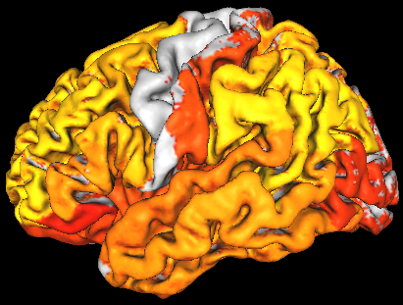
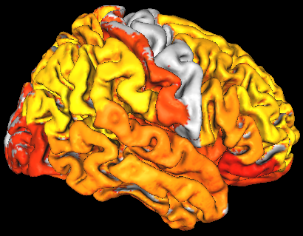
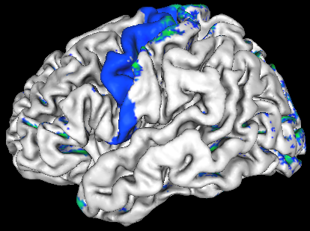
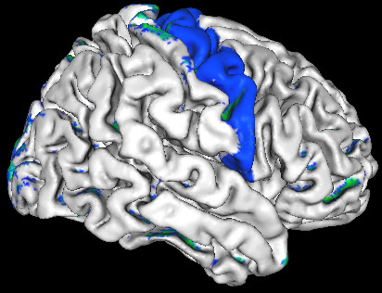
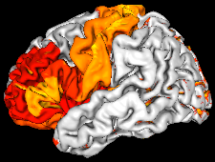
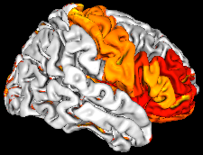
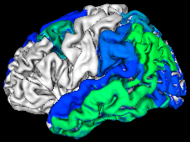
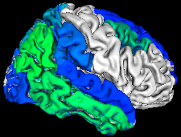
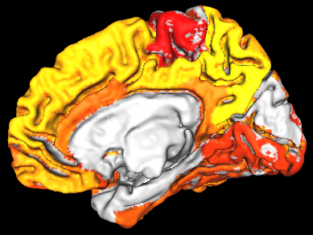
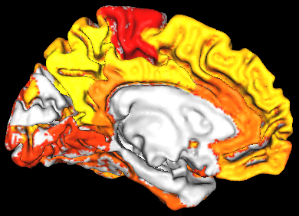
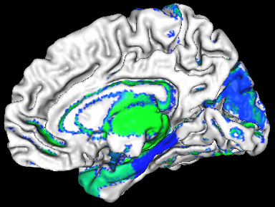
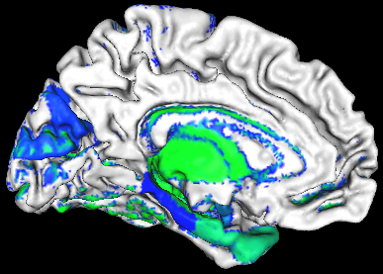
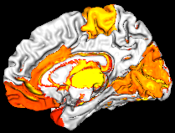
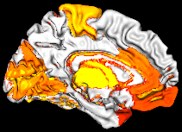
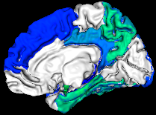
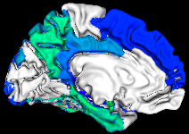
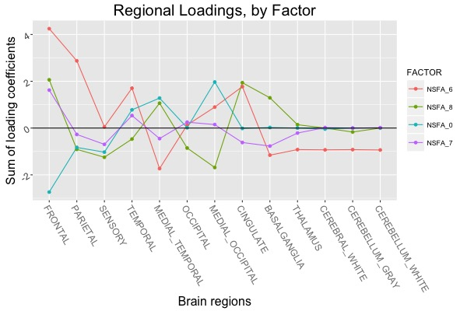
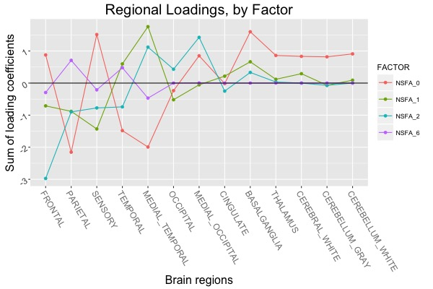
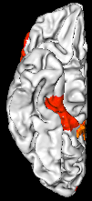
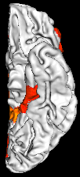
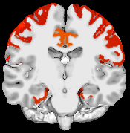

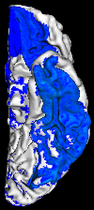

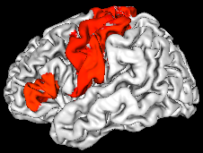
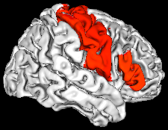
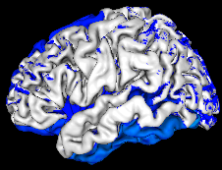
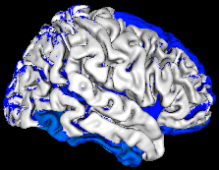
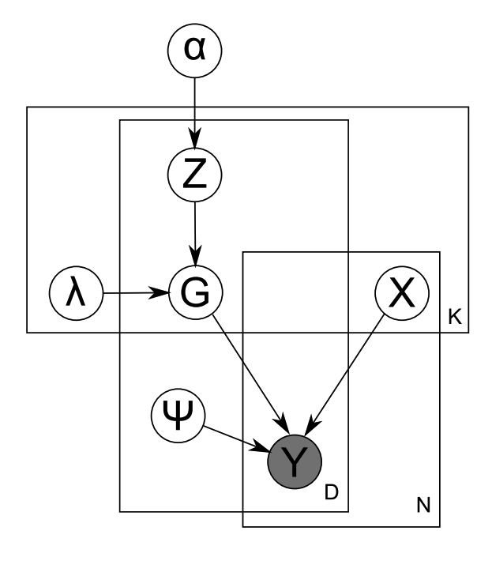
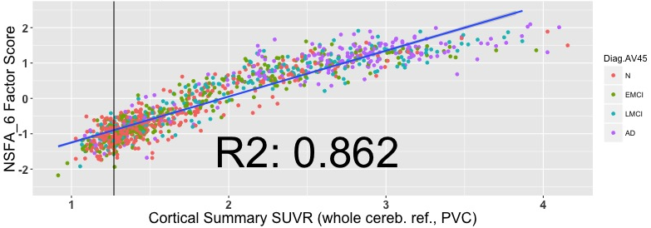
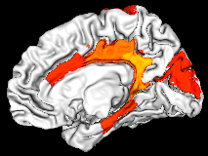
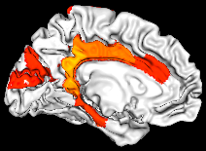
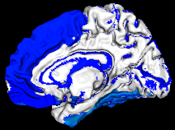
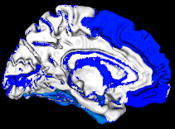
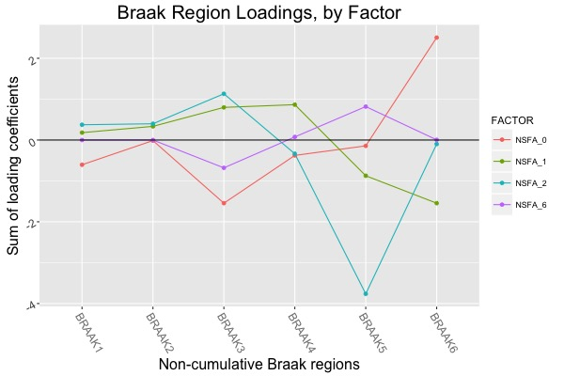
Effects of Baseline Regional Amyloid Deposition Patterns
on Subsequent Accumulation
Andy Horng, William J. Jagust, Susan M. Landau
Helen Wills Neuroscience Institute, University of California at Berkeley, Lawrence Berkeley National Laboratory
Introduction
Methods
Results and Summary
1367.62570846
Overview
The cortical summary (CS) SUVR of ¹⁸F-AV-45 PET scans (frontal/parietal/temporal/cingulate ROI) is a conveniently calculated measure of global ß-Amyloid burden
CS SUVR is impaired by:
- noise introduced via choosing a reference region
- ignorance of regional variations within the ROI
- ignorance of regional contrasts (except ROI/ref)
Goals
Convert regional uptakes of ADNI ¹⁸F-AV-45 and ¹⁸F-AV-1451 PET scans to standardized units via a regionally-unbiased intensity normalization method
Perform a sparse nonparametric factor analysis of the normalized regional dataset, determining a set of recurring uptake topographies underlying the variance in individual uptake patterns
Explore the efficacy of topographical factor scores (derived from the factor model) as an alternative summary measure of Alzheimer’s disease severity
Data Normalization
45 bilateral Freesurfer-defined regions
Correction for partial volume effects with the Rousset algorithm (geometry-dependent transfer matrix)
Intensity normalization by Manhattan (L1) norm maps each scan (row) onto a regional standard simplex and preserves uptake ratios
Standardize each region (column) to zero mean, unit variance
Amyloid Deposition Topography Factors (29 Factors)
Tau Deposition Topography Factors (12 Factors)
Averaged Regional Correlations, by Factor
0.0
1.0
0.0
-1.0
Averaged Regional Correlations, by Factor
0.0
1.0
0.0
-1.0
Freesurfer Regions
Y =
Scans
Factor Loadings,
Summarized by Region
Factor Loadings,
Summarized by Region
Nonparametric Sparse Factor Analysis (NSFA)
Sparsity improves interpretability of latent factors and downstream predictive performance
Nonparametric models remove manual specification of the number of factors
Potential pitfalls include the assumption of a linear causal model, and the results are only as good as the data
G is the matrix of factor loadings
X is the matrix of independent hidden factors
Ψ is Gaussian noise
Factor #6
Factor #0
Penalized Regression: Factors Associated with ADAS-Cog
 | Dependent: ADAS-Cog (n=60)
 | Factors | Braak SUVR
Non-zero predictors | #0: *** β=-4.6, p=6e-11 #9: β=0.92, p=0.3 | Braak V: *** β=29.2, p=8e-4 Braak III: β=-5.5, p=0.47
R² | 0.53 | 0.34
Adj. R² | 0.52 | 0.32
R² Shrinkage | 0.40 | 0.08
Likelihood ratio test | F = 32.4, p<4e-10 *** | F = 14.9, p<6e-6 ***
Subjects
Factor Loadings,
Summarized by Braak Stage
Factor #6 Score vs. CS SUVR
 | ADNI ¹⁸F-AV-45 | ADNI ¹⁸F-AV-1451
n | 1064 | 55
Age (yrs) | 73.77 (7.48) | 76.04 (6.98)
Sex (M/F) | 569/494 (1 N/A) | 31/24
Education (yrs) | 16.21 (2.67) | 16.72 (2.65)
APOE ε4 + | 43.2% | 34.5%
AV45 + | 52.6% | N/A
Normal | 259 (24.3%) | 17 (30.9%)
SMC | 100 (9.4%) | 6 (10.9%)
EMCI | 301 (28.2%) | 11 (20%)
LMCI | 215 (20.2%) | 16 (29.1%)
AD | 189 (17.7%) | 5 (9.1%)
Figure 1. Graphical Model. Adapted from “Nonparametric Bayesian sparse factor models with application to gene expression modeling” by D. Knowles and Z. Ghahramani, 2011
Factor #14
Penalized Regression: Factors Associated with Amyloid Change & ADAS-cog
NSFA Output and Analyses
Factor loadings (regional topographies per factor)
- Loadings as regional correlations
- Summary by lobe
- Overlap with de facto ROIs
Factor score estimates (factor representations per scan)
- Correlation with cortical summary SUVR
- Longitudinal behavior
- Penalized linear regression models (LARS) targeting cognition
and annualized change in global burden
Covariates: Age, Sex, Edu (yrs), APOE ε4 status
Test model performance with 10-fold cross validation
 | Dependent: CS change (n=616) |  | Dependent: ADAS-cog (n=516, AV45+)
 | Factors | CS SUVR | Factors | CS SUVR
Non-zero predictors | #6: ** β=0.016, p=3e-9 | CS SUVR: *** β=0.021, p=3e-4 APOE ε4: *** β=0.015, p=5e-3 | #6: *** β=5.43, p<2e-16 #14: *** β=-1.86, p=3e-7 | CS SUVR: *** β=8.98, p<2e-16
R² | 0.055 | 0.059 | 0.19 | 0.17
Adj. R² | 0.054 | 0.056 | 0.19 | 0.17
R² Shrinkage | 0.048 | 0.045 | 0.18 | 0.16
Likelihood ratio test | F = 35.9, p<3e-9 *** | F = 19.2, p<8e-9 *** | F = 60.1, p<2.2e-16 *** | F = 107.7, p<2.2e-16 ***
Summary
The predominant ¹⁸F-AV-45 factor (#6) recapitulates cortical summary SUVR in regional topography and its relationships to longitudinal amyloid deposition and ADAS-cog amongst florbetapir positive subjects
A ¹⁸F-AV-45 factor (#14) tracks variation between the cingulate and frontal/inferior temporal regions, providing predictive power for ADAS-cog beyond the cortical summary SUVR
A ¹⁸F-AV-1451 factor (#0) outperforms all Braak region SUVRs in relation with ADAS-cog
Results encourage further investigation of inter-modal factor associations, the value of factor scores as longitudinal measures, and a voxel-wise factor analysis

