Slide 1
RTL Implementation of SoC AMBA AHB-APB bridge
CND 111: final project
By
Abeer Tarek | v23009912
Maria George | v23010119
Al-Moemenbellah Allam | v23009973
Supervisor/s
Dr. Khaled Salah
Eng. Muhammed El-Shafeay

Slide 2
INTRODUCTION
The advanced microcontroller bus architecture, AMBA, is an open standard for on-chip communication.
The AMBA has two system busses; the high-performance bus (AHB), which defines interfaces between high-performance components as memory controllers, processors, and a DSP. The second bus system is the advanced peripheral bus (APB) which is designed for low-power, low-complexity, and low-cost interfaces.

Slide 3
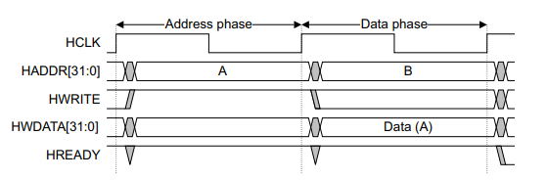
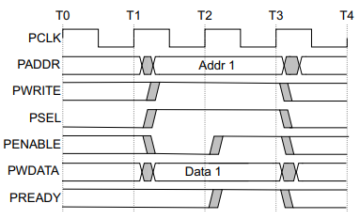
Timing protocols
The AHB has a pipelined architecture were the address and data of a transaction are sent during different clock cycles[1].
The APB is not pipelined, so both the address and the data have to be driven at both clock cycles[2].
Similar protocols are implemented during read transactions.
APB Write Transfer
APB Write Transfer

Slide 4
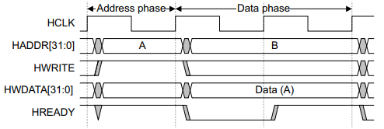
Timing protocols
The APB also has a slower clock period than the AHB.
The bridge has to handle the different protocol problem, and the different clock period problem.
This is done by adding wait states to the AHB using the HREADY signal.
AHB Write transfer with waits

Slide 5
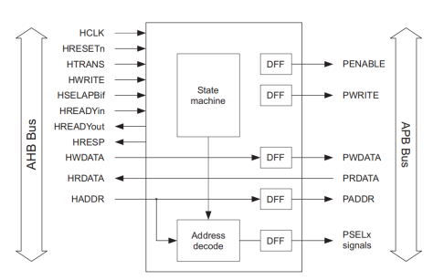
Bridge architecture
The bridge will manage the transactions between the AHB and the APB.
It will contain a state machine to control the transaction outputs and an interface to communicate between the two busses.
The bridge will act as the master of the APB, and can chose specific peripherals on the APB using the PSELx signals
Figure 4. AHB-APB interface block diagram.

Slide 6
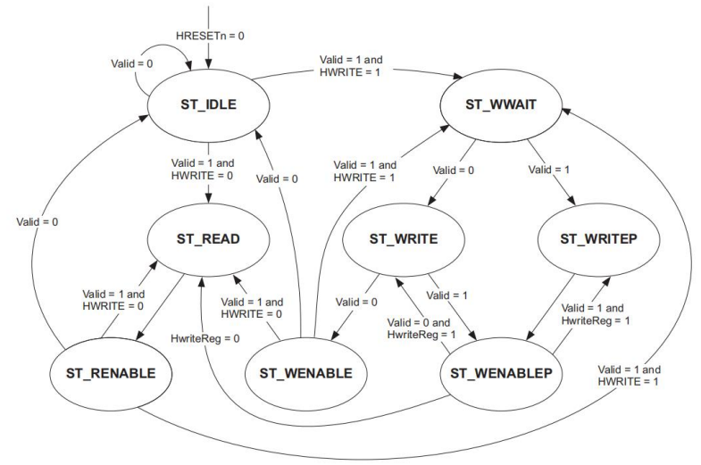
STATE MACHINE
The state machine of the bridge is shown on the right[3].
Every transaction (read/write) will have a setup phase and an enable phase.
Write transactions have an extra wait state at the beginning so that the bridge can obtain both the address and the write data.
The bridge can also support burst write-operations to skip this extra wait state between them.
Figure 13. APB state machine.

Slide 7
Verification
To Bridge was tested by performing 4 operations:
a single write at address 0x002.
8 burst writes from addresses 0x100 to 0x107.
single read at address 0x002.
8 burst reads from addresses 0x100 to 0x107.
The data written during the write operations is the same as the memory address, this is to make sure that the correct data made it to its specific address.

Slide 8
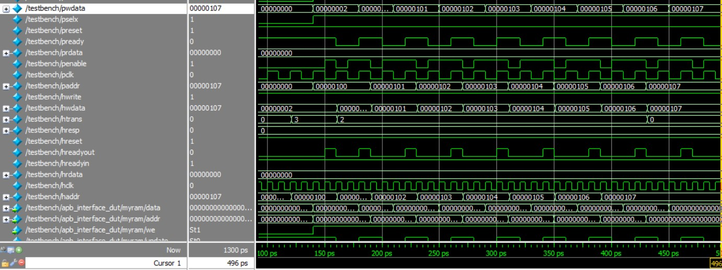
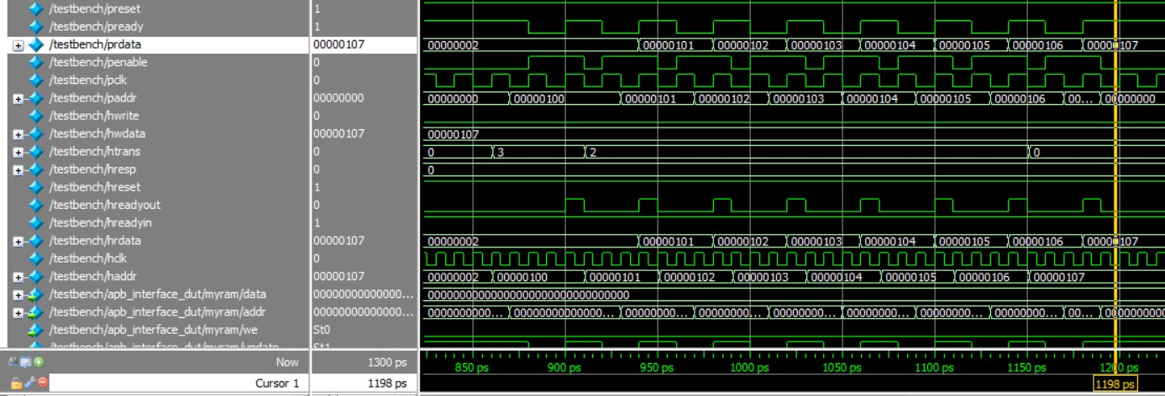
Verification
The two figures below show how the write data appears sequentially on the pwdata signal, and how the data appears again on the prdata signal.

Slide 9
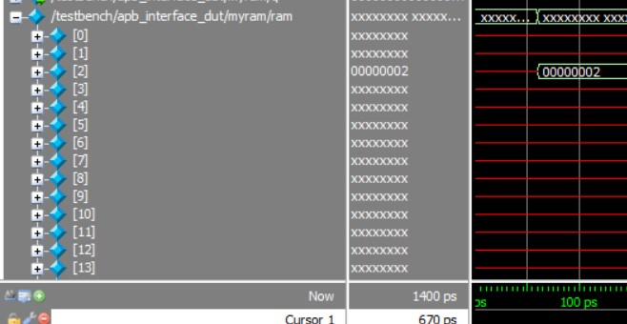
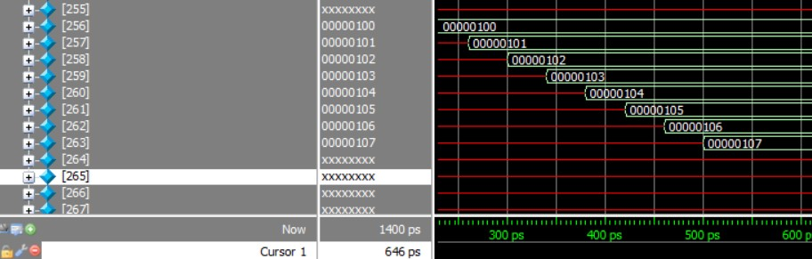
Verification
We ca see below how the data was successfully written into the storage memory of the APB device, note that 0x100 = 0d256.

Slide 10
References:
[1] Amba AHB protocol specification - ARM architecture family, https://documentation-service.arm.com/static/6141bf0d674a052ae36ca811 (accessed Dec. 14, 2023).
[2] “AHB Example AMBA SYstem Technical Reference Manual,” Documentation – arm developer, https://developer.arm.com/documentation/ddi0170/a/AHB-Modules/APB-bridge/System-description (accessed Dec. 14, 2023).
[3] AMBA ® APB Protocol Specification, https://documentation-service.arm.com/static/606dc36485368c4c2b1bf62f%3Ftoken= (accessed Dec. 14, 2023).

