Slide 1
Predicting The Winning Team In A premier league game Data Transformation & Integration
Cathal Hughes & Russell Brady – Group 40

Slide 2
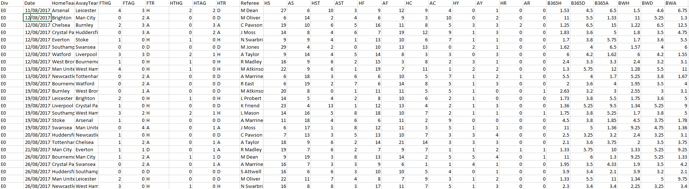
Our Datasets
Premier League Games Datasets – 2000/01 to 2017/18 – from football-data.co.uk – 18 separate datasets
This dataset contains information about every premier league game from this time period.
The number of attributes in these datasets ranged from 28 to 65.
Lots of irrelevant data – in–game stats, bookies odds

Slide 3
Why did we Choose This Workshop?
Our initial dataset had no attributes that we could use directly to make a prediction.
Techniques outlined in this workshop would allow us to create relevant attributes – aggregation/attribute construction
As the data was in raw form – potentially needed to use normalisation
We had 18 datasets – these need to be integrated.

Slide 4
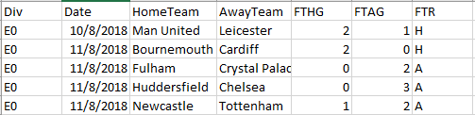
Possible Attributes
We removed attributes that we didn’t want to include in the prediction – in-game stats, bookies odds
We still had no clear attributes to make a prediction with.
Data transformation techniques - generate some attributes.
Aggregation - Date, Full Time Result, Goals Scored etc – Home Team Points, Away Team Points
Attribute Construction – Generate Form

Slide 5
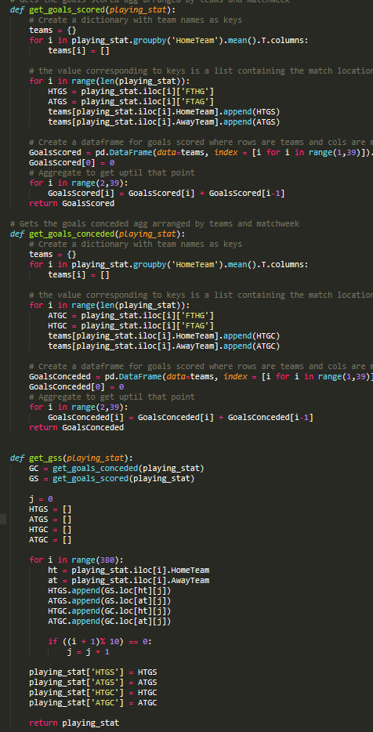
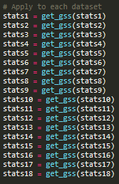
Data transformation - Aggregation
Carry out transformation across all 18 datasets.
Then integrate them.
Easier to create attributes year by year.
Arduous Process – as each attribute needed to abide by the date
HTGD ATGD Code

Slide 6
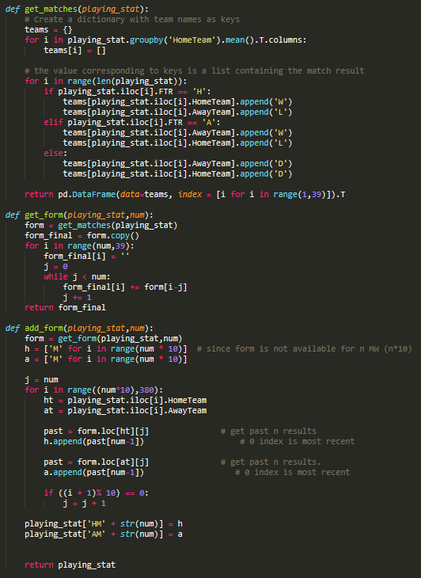
Data Transformation – Attribute Construction
Form generated from FTR
New feature is constructed
Similar to aggregation, but not a summarization

Slide 7
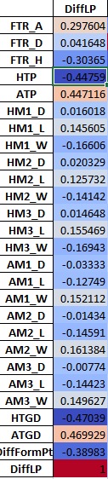
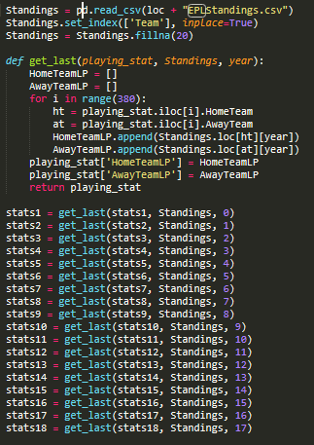
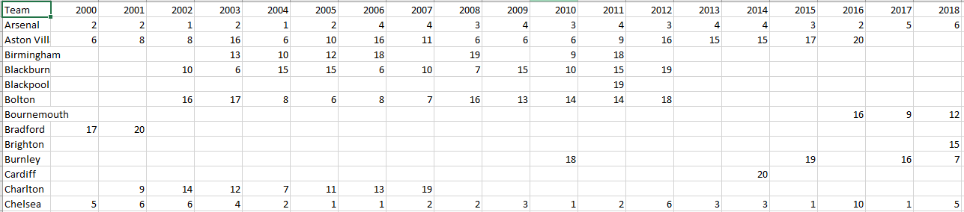
Data Integration – Premier League Standings
Dataset with Premier League Standings for each team in last 18 years.
Difference in league position – previous year
Dealing with Null values
Correlation analysis (Pearson) - ensure we were not introducing a redundancy into our dataset.

Slide 8
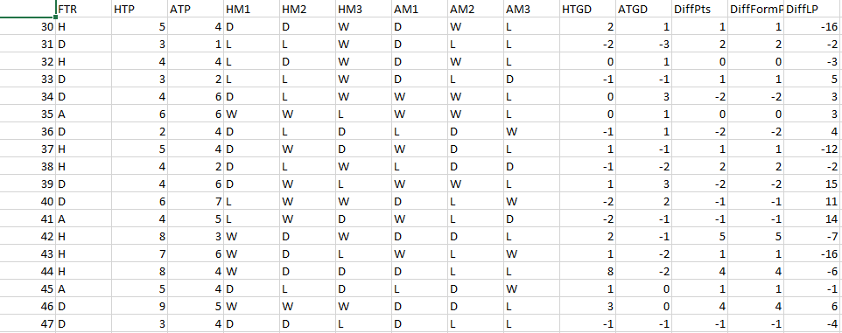
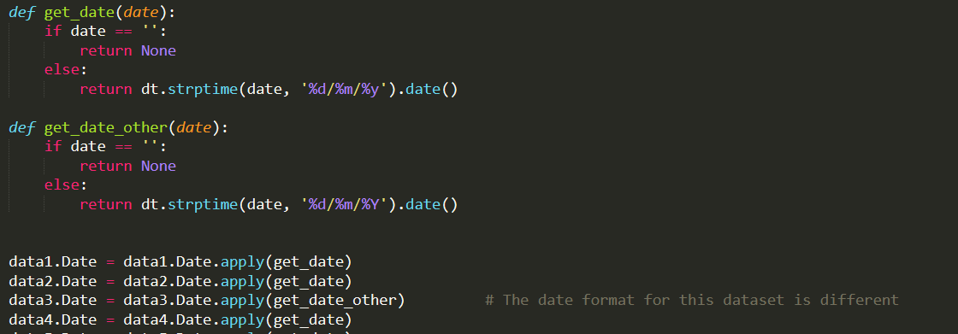
Data Integration – Premier League Results 2000/01 – 2017/18
We need to convert 18 datasets to 1 dataset.
Schema Integration/Object Matching – tricky
Dates in different datasets were formatted differently
Dropped irrelevant columns

Slide 9
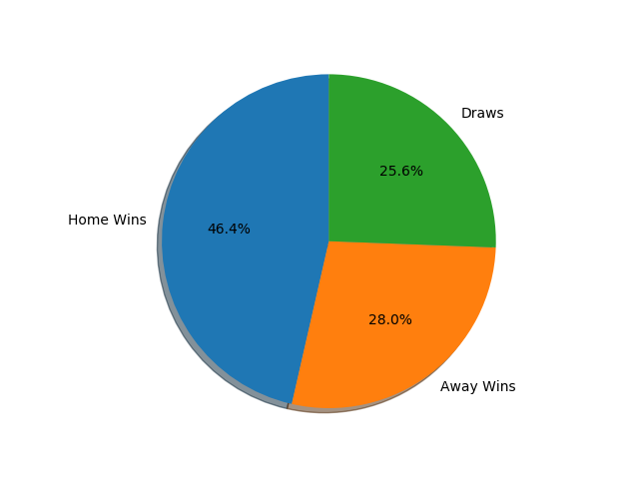
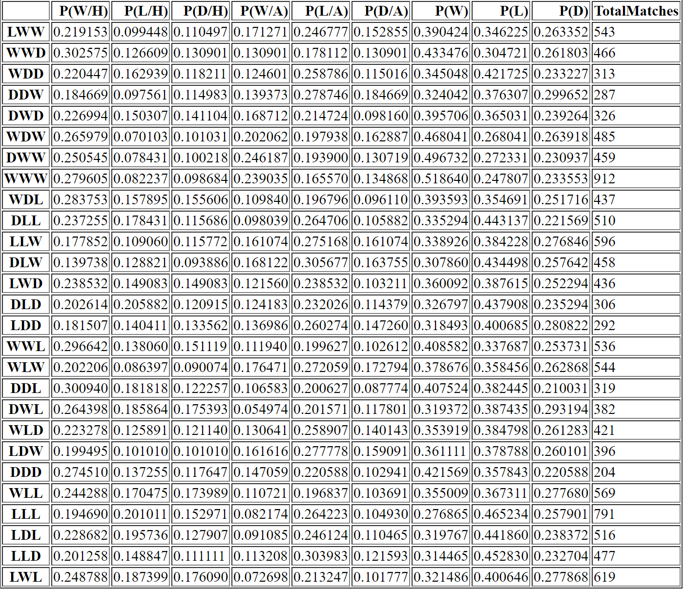
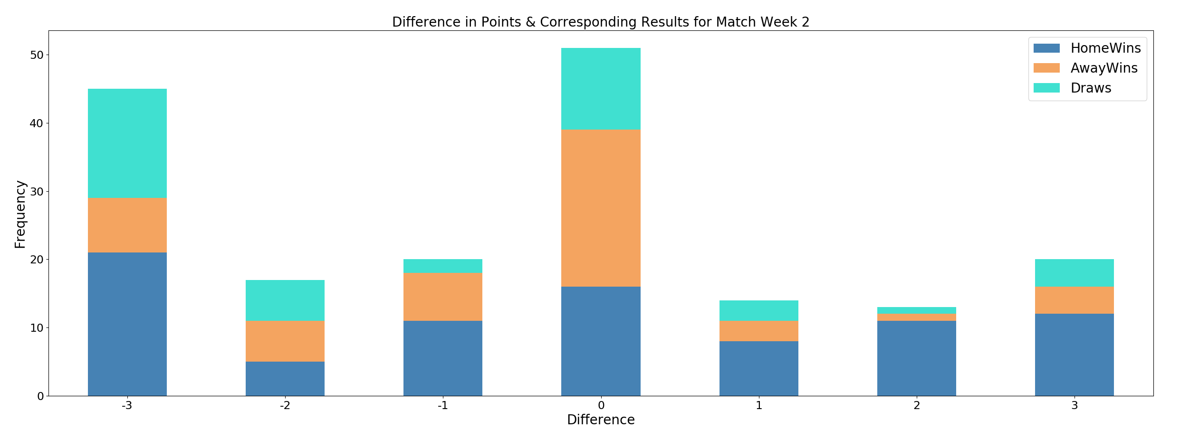
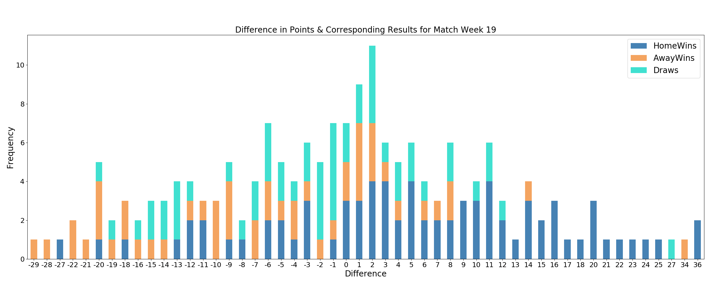
Attribute Analysis

Slide 10
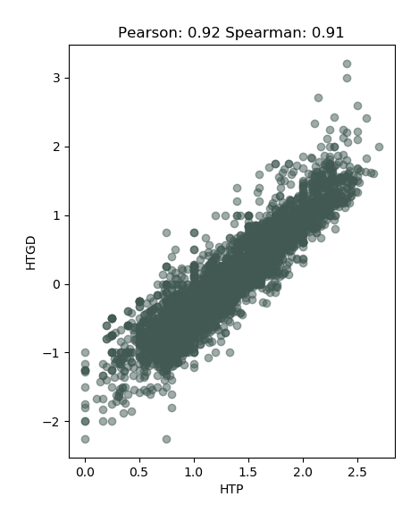
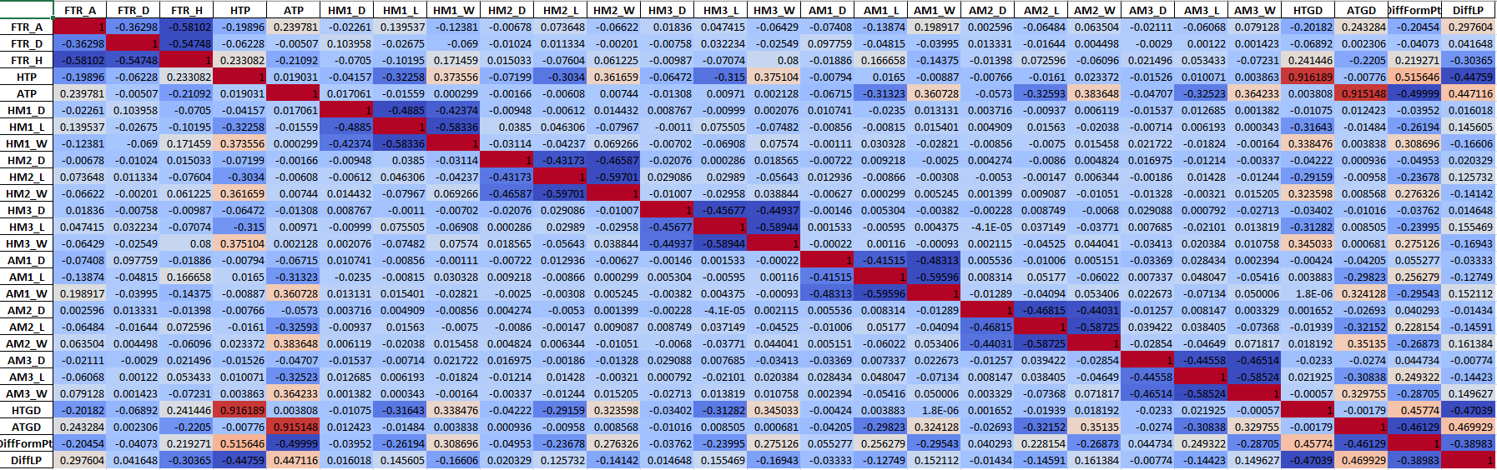
Correlation Coefficient
Analysis of relationship between all attributes after individual attribute analysis
Redundancy detection
Removal of unnecessary attributes

Slide 11
Normalisation ?
We implemented normalisation on continuous data
Attributes of different units – goals, points, league position
If you have outliers in your data set, normalizing your data will certainly scale the “normal” data to a very small interval
Used Decimal Scaling
Should we normalise?

Slide 12
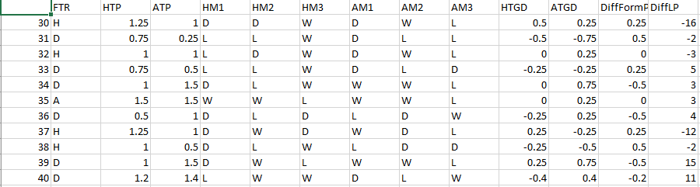
Conclusion
What we learned:
Attributes in dataset may not be relevant on their own
Attribute construction and aggregation reveals relationships and discover missing information
Normalisation may not be the best solution
Attributes may be redundant – Goal Diff and Points
Implementing transformation and integration techniques has completely changed our dataset
Initial Dataset:
Final Dataset:

