Slide 1
Predicting The Winning Team – Data Transformation & Integration
Cathal Hughes & Russell Brady – Group 40

Slide 2
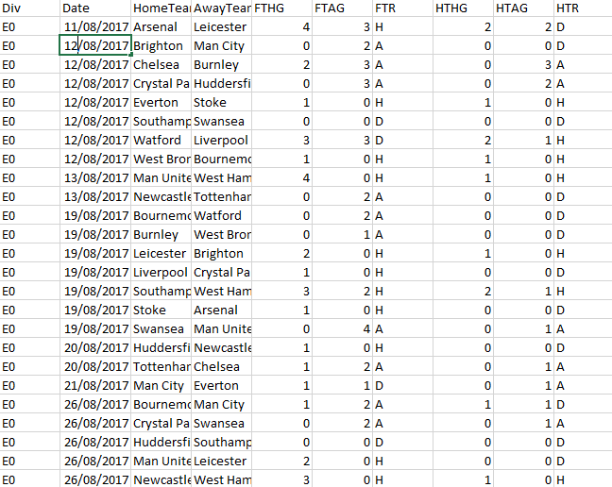
Our Datasets
Premier League Games Datasets – 2000/01 to 2017/18 – from football-data.co.uk
This dataset contains information about every game from this time period.
The number of attributes in these datasets ranged from 28 to 65.

Slide 3
Data Transformation - Aggregation

Slide 4
Data Transformation – Attribute Construction

Slide 5
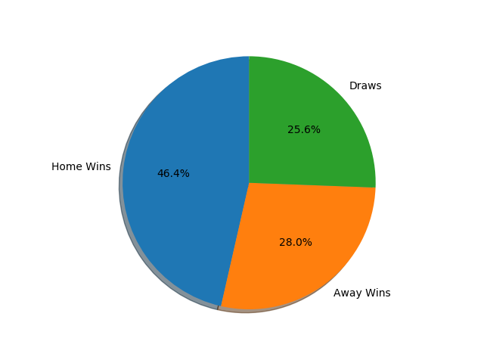
Attribute Analysis – Aggregate win percentage

Slide 6
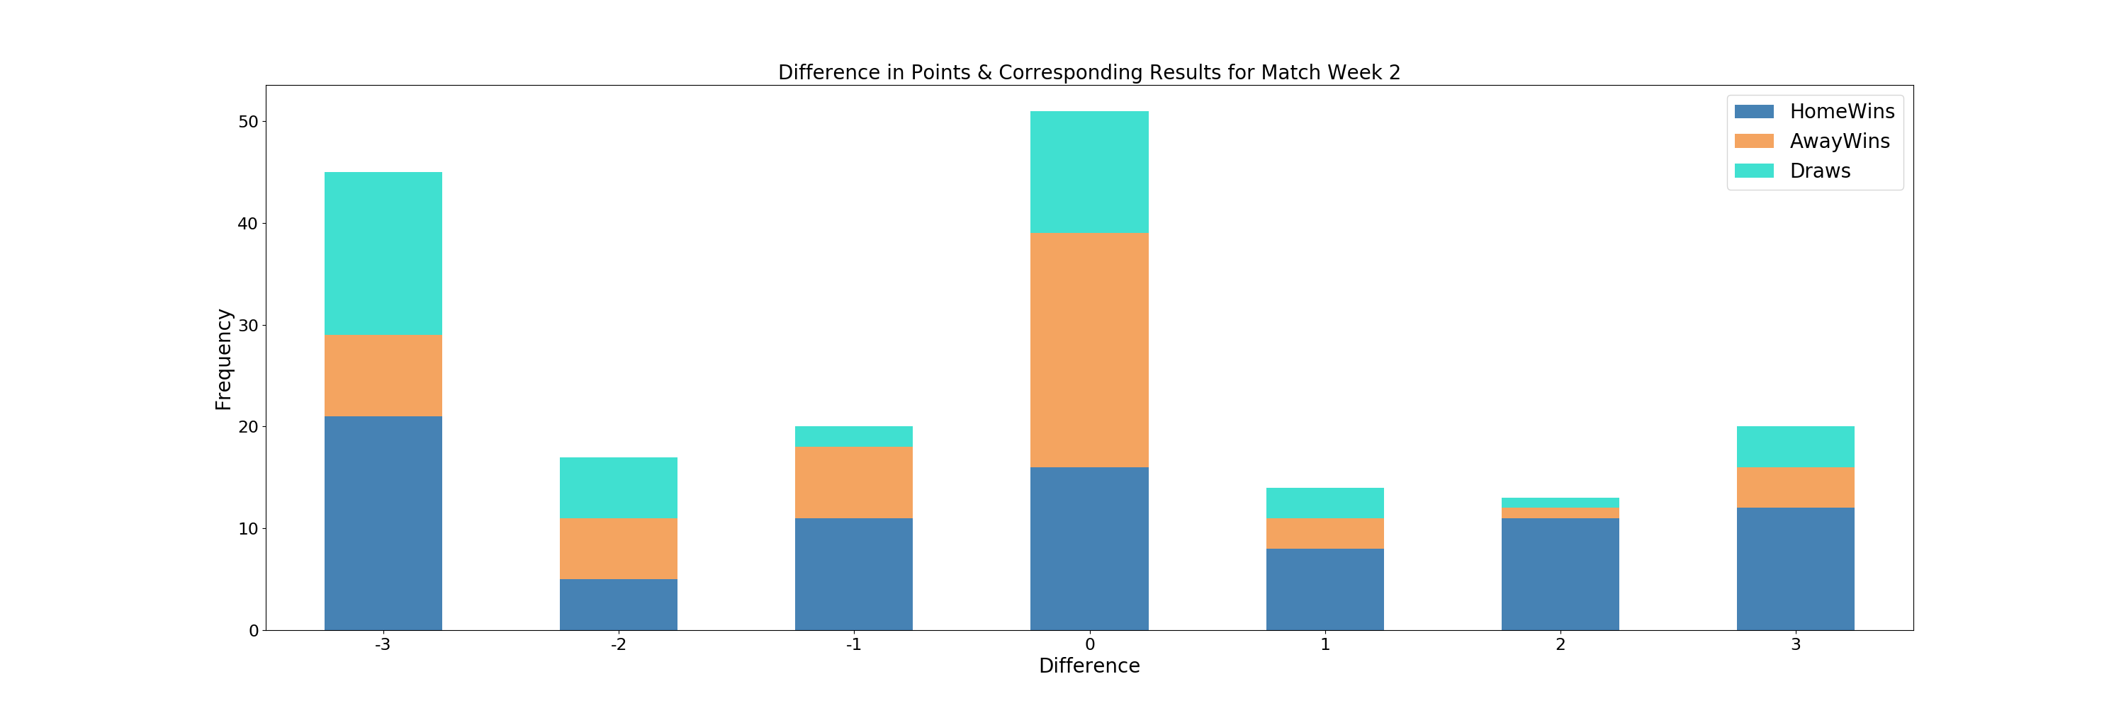
Attribute Analysis – Points Difference

Slide 7
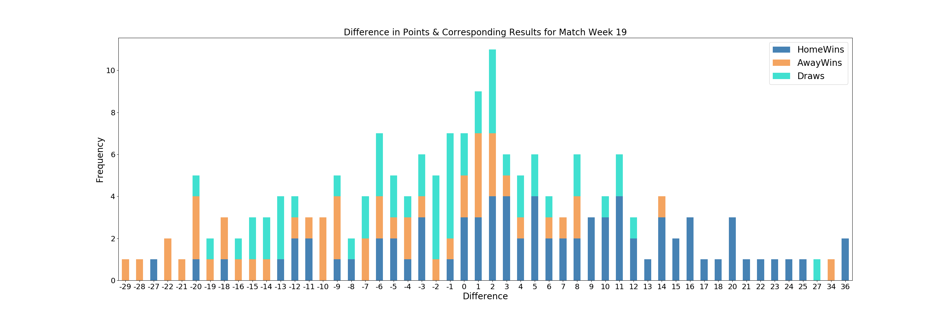
Attribute Analysis – Points Difference

Slide 8
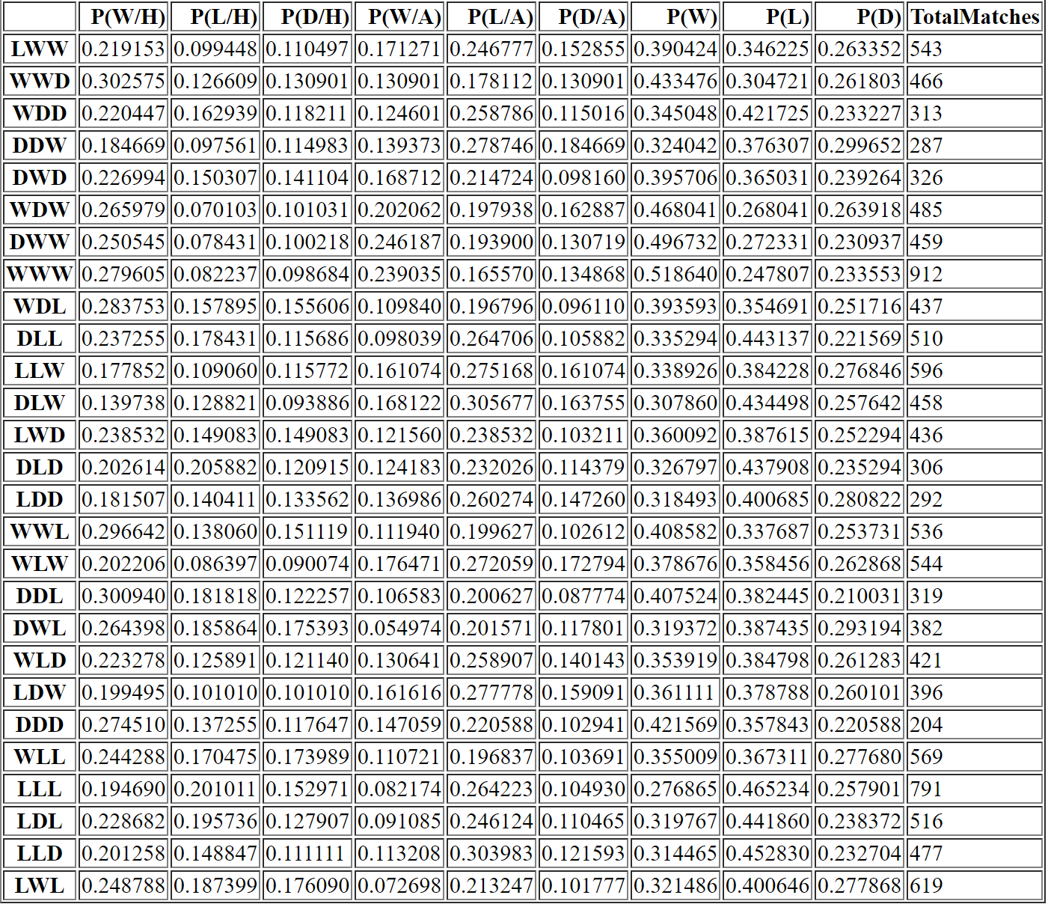
Attribute Analysis - Form

Slide 9
Conclusions
Based on our analysis of the dispersion of some of these metrics, we have identified some key attributes which will be central to our prediction algorithm

