Slide 1
Predicting The Winning Team Data Transformation & Integration
Cathal Hughes & Russell Brady – Group 40

Slide 2
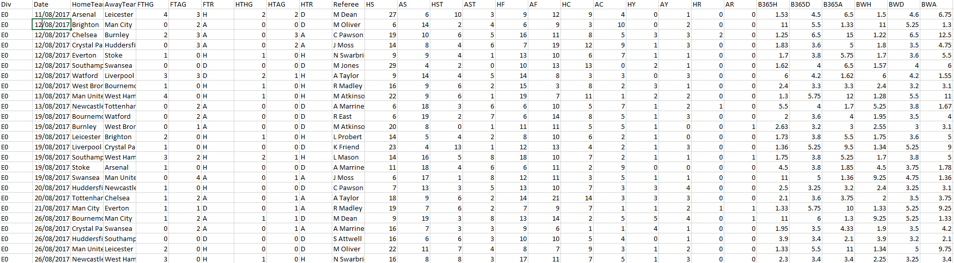
Our Datasets
Premier League Games Datasets – 2000/01 to 2017/18 – from football-data.co.uk – 18 separate datasets
This dataset contains information about every game from this time period.
The number of attributes in these datasets ranged from 28 to 65.
Lots of irrelevant data – in–game stats, bookies odds

Slide 3
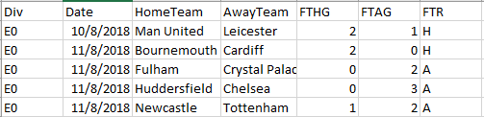
Possible Attributes
When we stripped out all the irrelevant attributes (In-Game Stats, Bookies Odds) we still had no clear attributes to make a prediction with.
We knew we needed to perform some data transformation techniques to generate some attributes.
We looked at what the dataset had to offer (Date, Full Time Result, Goals Scored etc) and thought of how we could utilise these attributes.
Due to the fact we had the date, we knew we could utilise attribute construction and aggregation to generate new attributes.
Some of these attributes included goal difference between teams, team points and team form

Slide 4
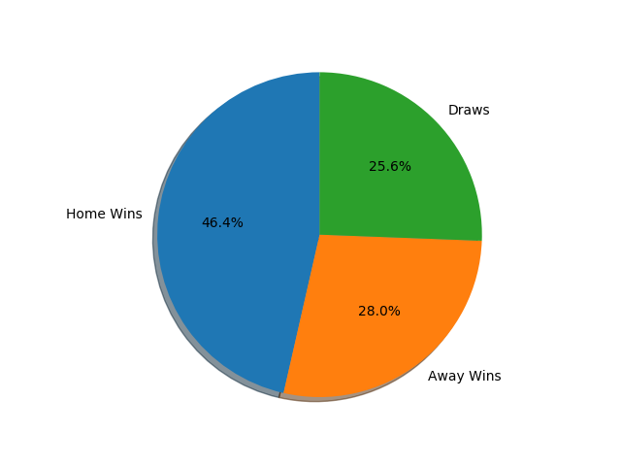
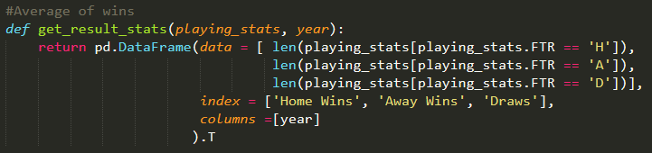
Attribute Analysis – Aggregate win percentage
We overlooked how big a part Home advantage played.
Initial we had only considered a match as a head to head without taking home advantage into consideration
We determined that there should be a bias towards the home team

Slide 5
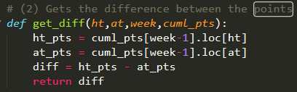
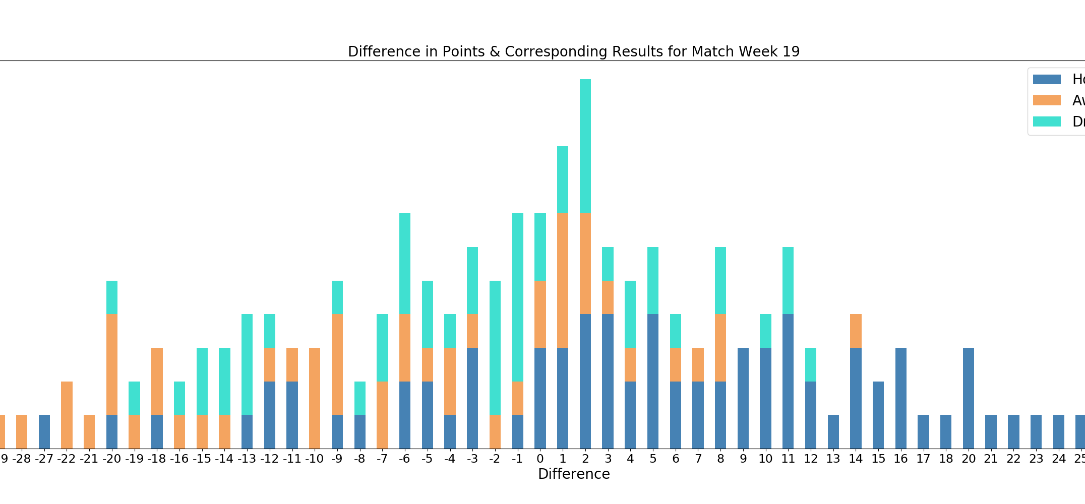
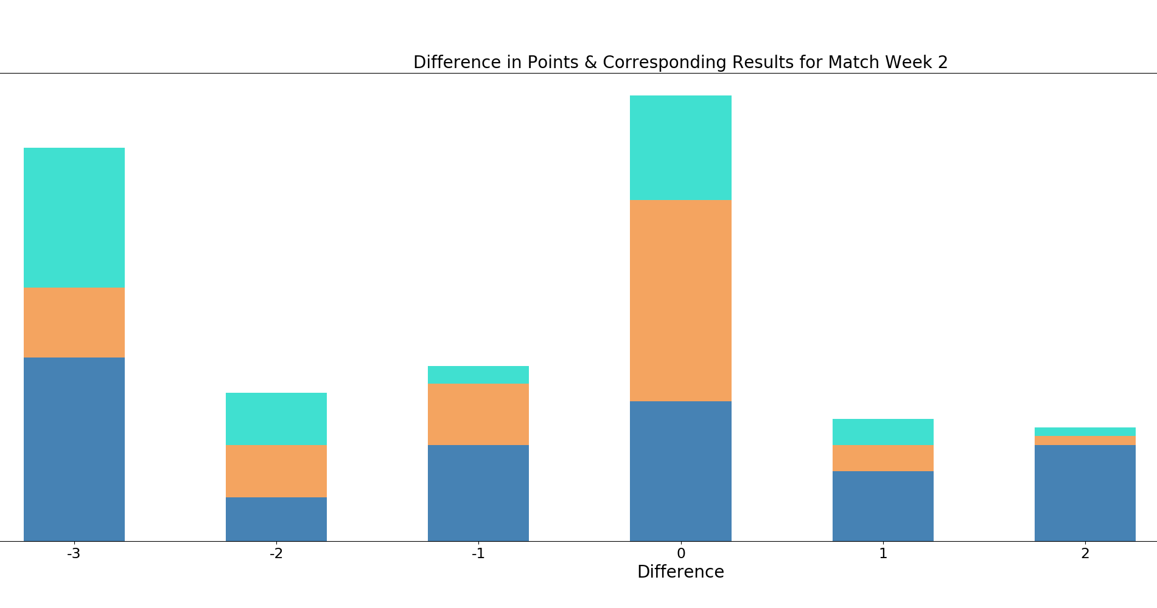
Attribute Analysis – Points Difference
From looking at the original dataset we discovered we could generate both teams points using the date, the team and the full time result for each game.
There are two bar charts shown – Difference in points for Week 2 and Week 19
We contrived from the Week 2 diagram that early on in the season difference in points has little bearing.
At the mid way point of the season we realised how much of an impact difference in points has when the greater the point difference between the teams.

Slide 6
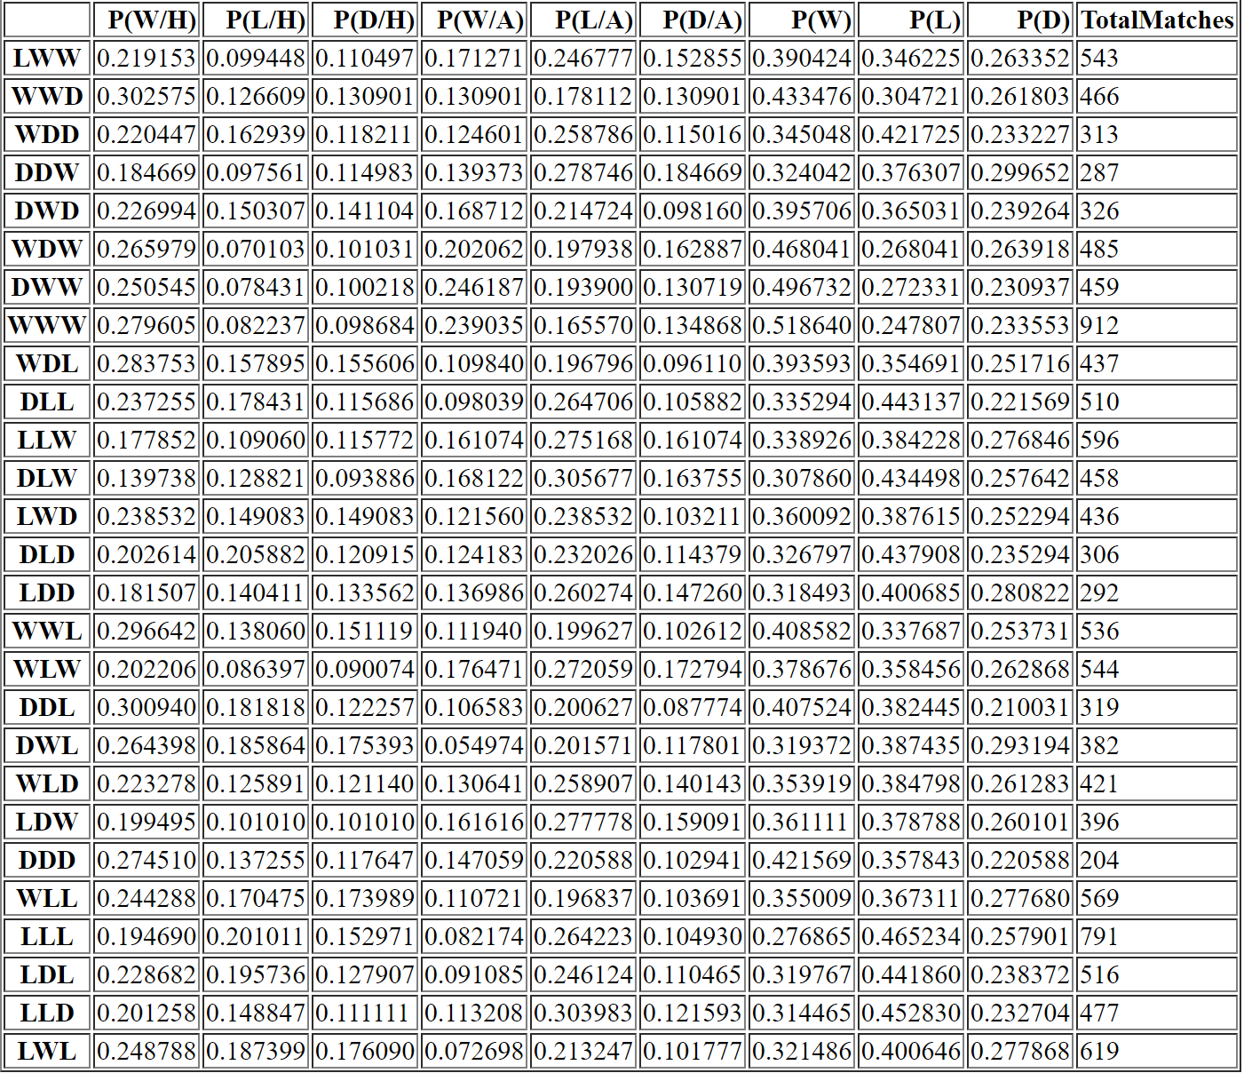
Attribute Analysis - Form
Form is huge in football.
We knew we could generate the form for a team coming into a game.
We investigated whether form could positively impact our prediction.
We generated all the probabilities of all the permutations for a team’s last 3 results.
From these results, we deemed form as a good attribute to use in our prediction.

Slide 7
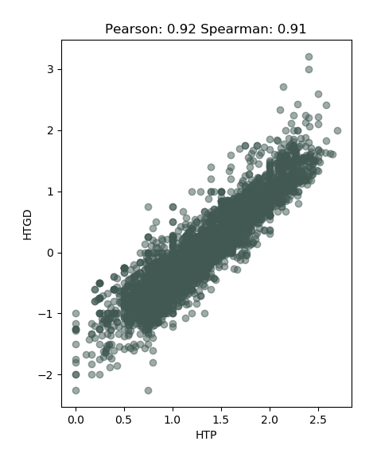
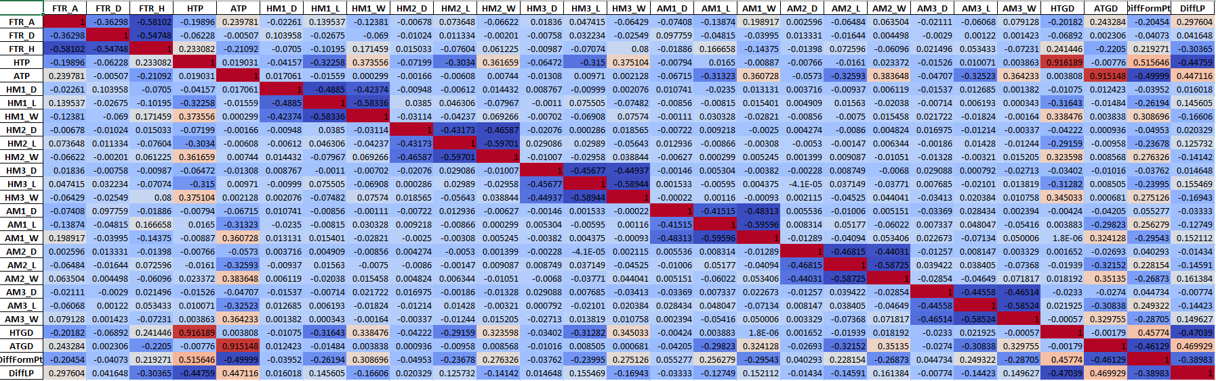
Data Transformation
Based on our analysis we decided to generate the appropriate attributes.
Using Attribute Construction we constructed completely new features from attributes already in the dataset.
Form was an example of this. We used the date to find the teams last 3 games, and generated form based on these games.
We also used aggregation operations to aggregate the teams goal difference.
We also performed a correlation analysis on the transformed dataset to try and single out any redundancies in the dataset.

Slide 8
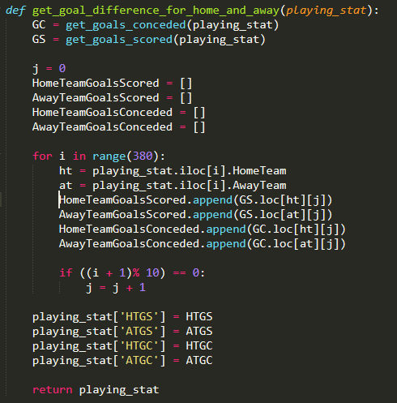
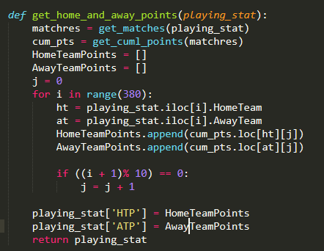
Data Transformation
We used a python script to generate our dataset with the appropriate attributes.
The images displayed show how we generated goal and points difference for the home and away sides.
We used max-min normalisation to perform a linear transformation of our data, both categorical and discrete.
This helped reduce redundancy and allow data to be compared more easily.

Slide 9
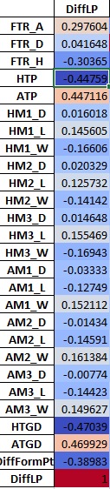
Data Integration – Premier League Standings
Created our own dataset that pertained to Premier League Standings for the relevant years.
Contains data for all 46 teams that participated in that time.
Potential attribute - difference in league position from the previous year as an attribute in our prediction.
Performed correlation analysis (Pearson) to ensure we were not introducing a redundancy into our dataset.
18 datasets

Slide 10
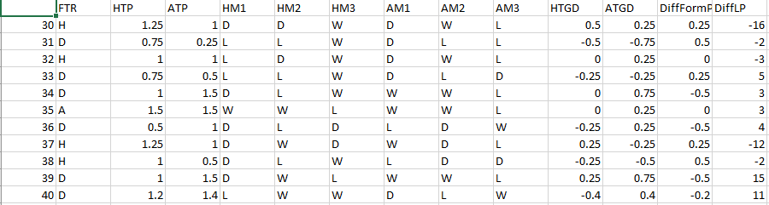
Conclusions
Based on our analysis of the data we generated from transformation and integration, we have identified some key attributes which will be central to our prediction algorithm
We feel we now have a set of attributes that are suitable for a classification algorithm such as K Nearest Neighbour or a Decision Tree.
Our dataset went from this:
To this:

