Slide 1


Robust and actionable forecasting of climate-sensitive IDs
Cathal Mills

Slide 2
1) Intro: Dengue + probabilistic forecasting

Slide 3
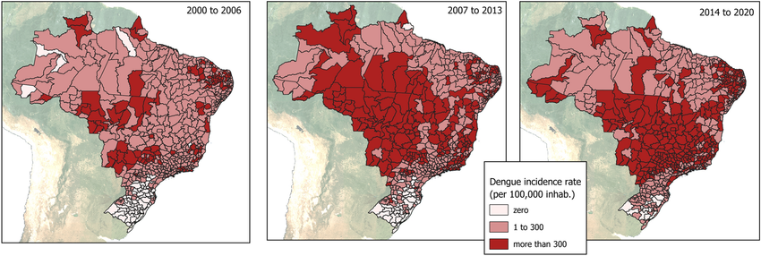
Background
Focus = Dengue
Vector-borne infectious disease (ID)
Climate-sensitive transmission cycle (temperature + precipitation) across mosquito + virus
Climatic effects modulated by local + human factors.
Expanding distribution + increasing incidence (right) globally; i) globalisation, ii) climate change, + iii) urbanisation
Now, world’s most common mosquito-borne disease
Record > 14 million (reported) cases + > 10,000 deaths in 2024.
E.g. Brazil:
Notes:
Insert map

Slide 4
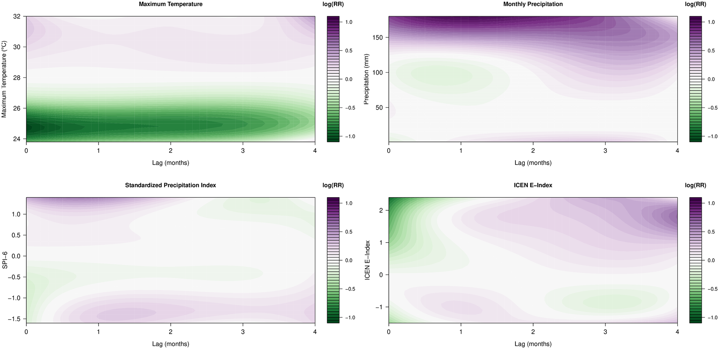
Climatic influences
Past climatic conditions impact current human cases
Model-based quantification of climatic risks while modelling spatial + temporal effects.
> Risk (Purple) for greater temperature, precipitation, drought, + El Nino
Cathal Mills and Christl A. Donnelly. Climate-based modelling and forecasting of dengue in three endemic departments of Peru.
PLOS Neglected Tropical Diseases

Slide 5
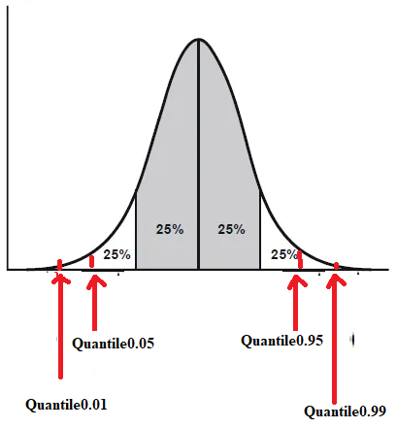
Probabilistic forecasting
Quantity: New (monthly reported) dengue cases -> dengue incidence rate (DIR) per 100,000
Uncertainty: Represent forecast/predictive distribution using samples/quantiles (right)
Uses of forecasts? Outbreak response + resource planning (e.g. vector control, ICU allocation + info campaigns
Focus? Often interested in surges/onsets/hotspots – when + where?
Medium-term forecasts: Peak timing, length of season, invasion, big/small season etc
Idea: Predict future value of epi quantity with uncertainty

Slide 6
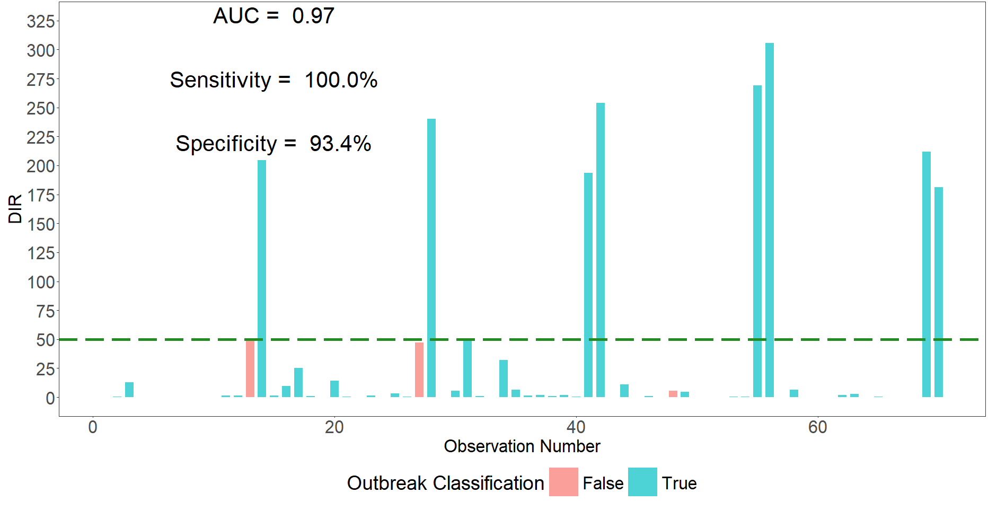
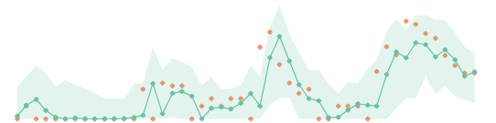

Previous forecasting in Peru
1)
Data
Climate
Disease Case
Demographic
Bayesian hierarchical
TCN
GPT
SARIMA
Baseline
3)
Ensemble forecast
Trained weighting of models
Equal weighting of models
2)
Models
i) Forecasting methods
or
ii) Forecast evaluation methods
“Proper” scoring rules
Measure whole predictive distribution
Public-health oriented metrics
Historically optimised classification of outbreaks
Probabilistic forecast
Predict cases with uncertainty
Cathal Mills, Moritz U.G. Kraemer, and Christl A. Donnelly. Interdisciplinary modelling and forecasting of dengue, October 2024. Preprint (under review)

Slide 7
2) Forecast evaluation

Slide 8
Forecast evaluation Most often = Forecasting reported cases
What we know? Model Performance
Model type: Ensembles outperform + mechanistic often underperform for short-to-medium-term
Scoring rules (e.g. CRPS), not pointwise metrics: Correctly measure whole predictive distribution
Public-health-oriented performance metrics: Focus attention on parts of predictive distribution.
Feature-specific evaluation: Stratify forecast evaluation by region, time, or stage of epidemic
What we don’t know? Link Metric -> Action
How should different users interpret results? Can we decide action from e.g. CRPS?
Do model rankings + users’ decisions vary with different user preferences?
Can we anticipate likely reliability of future forecasts?

Slide 9
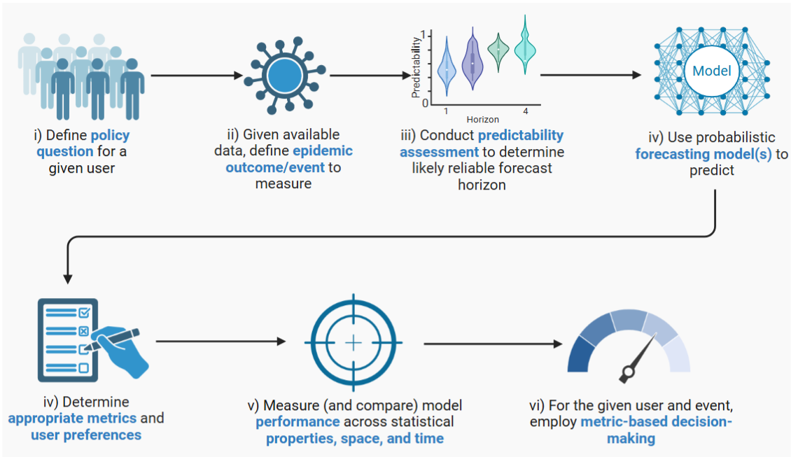
So…
A new evaluation framework for forecasters and forecast evaluators

Slide 10
3) Forecasting challenge
Mosqlimate, brazil

Slide 11
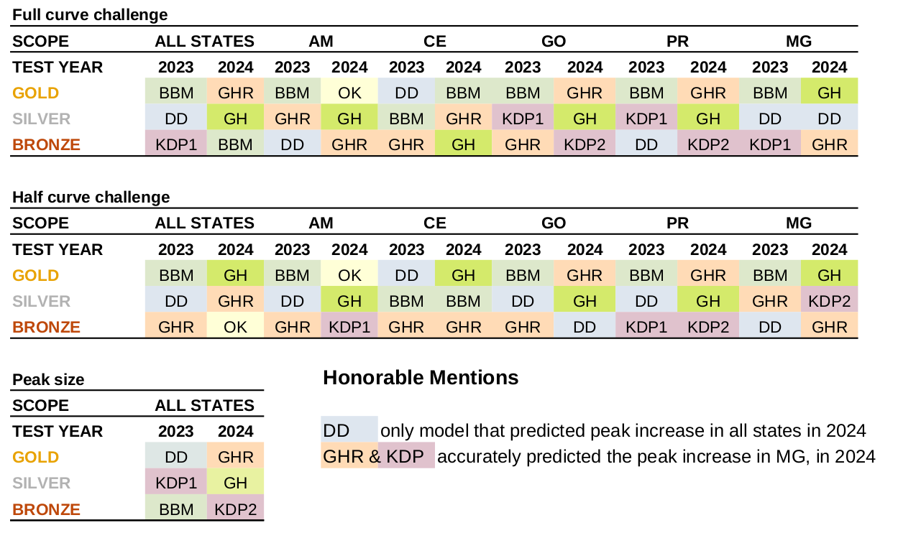
Comments: InfoDengue Sprint Results (https://github.com/Mosqlimate-project/sprint-template/blob/main/scores/scores.md)
Medium-term forecasting challenge i.e. season, where goal was to have individual models inform future ensemble
Predictions @ coarse spatial resolution (state-level)
Training: All data up to 2022 inclusive
Testing: 2023 + 2024 seasons
Results
Baseline random effects model (BBM) outperformed almost always in 2023 (DENV-3)
Overall: Pretty bad?

Slide 12
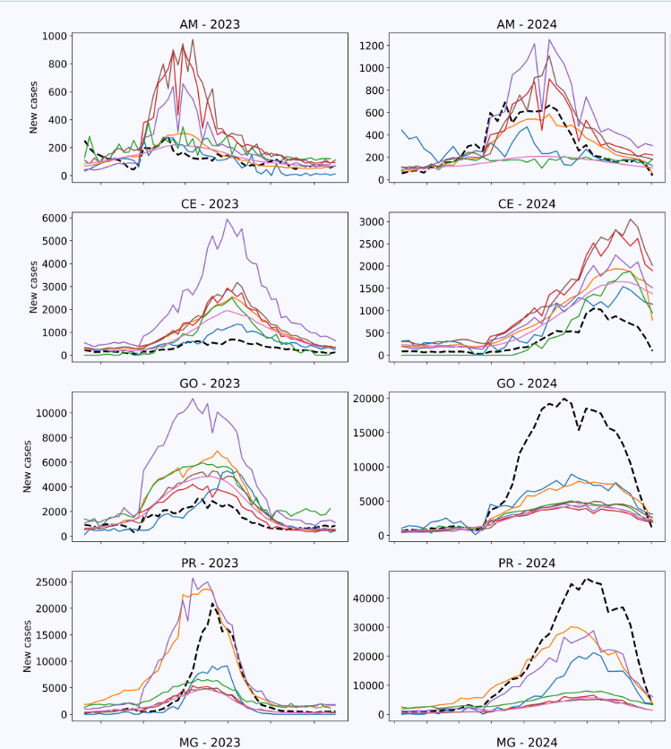
Comments: InfoDengue Sprint Results (https://github.com/Mosqlimate-project/sprint-template/blob/main/scores/scores.md)
E.g. Forecasting full epidemic curve
Black line = Observed cases
Coloured lines = Model predictions
Overall:
Pretty poor? At state level
Particularly 2024 (big dengue season)
Note different y-axes.
Can we (or you) do better?

Slide 13
Example forecasting
Data processing (me)
Exploratory analyses + feature selection
Cross-correlation, wavelets, time series analysis, risk mapping plotting!
Feature importance, forward/backward selection, PCA, + automated feature engineering
Causal techniques (SCM, Granger’s, CCM etc)
Models
Semi-mechanistic methods: Bayesian hierarchical (e.g. INLA, Stan, Numpyro, get started here)
Python Darts library (lots of off-the-shelf methods, get started here) including time series + deep learning methods
Foundational time series models: TimeGPT (with tutorial here)
Forecast evaluations (me!)

Slide 14

Now, over to you….
Data
Single csv of municipality-level case, climate, and demographic data
Data dictionary pdf describes variables *
* I have combined most of the separate data streams for you!
Task (Pair up!)
Forecast weekly cases for 2023 + 2024 dengue seasons…
How? You decide….
Only use up to end week of train_1 (for 2023) and end week of train_2 (for 2024)
Submit forecasts of cases at state/uf level
Requirements for submitting probabilistic forecast
Use either posterior samples or predictive quantiles
Samples:
Quantiles:
predicted | sample_id | location | forecast_date | target_end_date
predicted | quantile_level | location | forecast_date | target_end_date

