Slide 1

Uathcruthú

Slide 2

Introduction
Cathal Henchy
20091405
Final Year Project
H.Dip.Sci. Computer Science
WIT

Slide 3
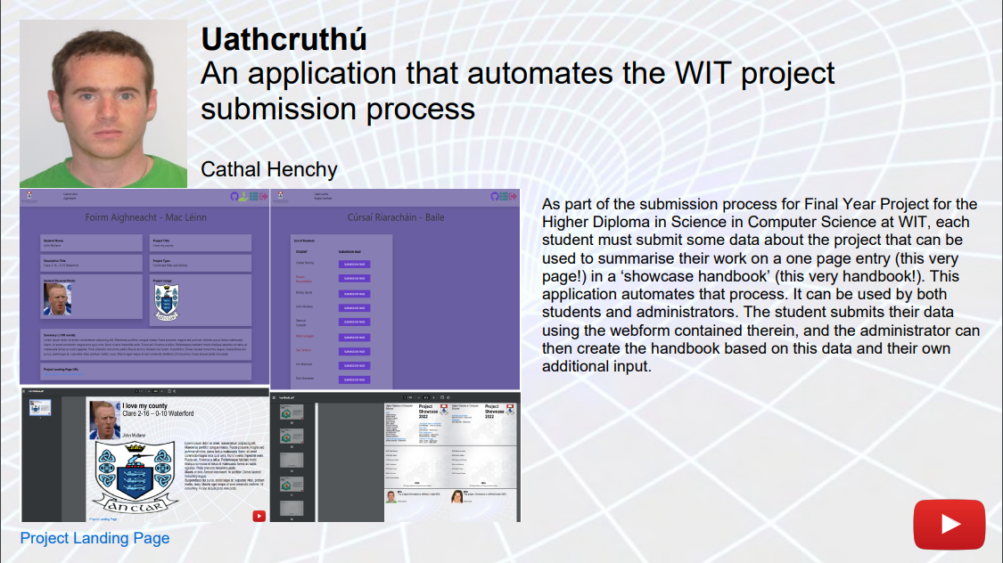
Problem
FYP Handbook
Submission via Moodle:
Multiple files
Subject to erroneous data entries
PDF is Created Manually:
Laborious
Repetitive
Subject to erroneous data entries
May require rework

Slide 4

Solution
Uathcruthú
Web Application
Node.js
Handlebars
External Modules:
Cloudinary
jsPDF
pdf-merger-js
image-data-uri

Slide 5
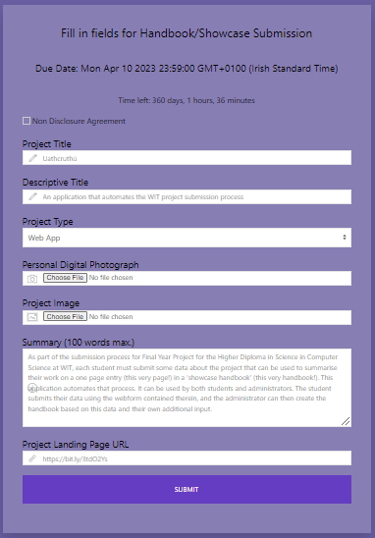
Student Interface
Student submission via Uathcruthú:
Web-form with data specific fields
Validation – reduction of rework
Accepts NDA submissions
Saves student’s work as draft
Submission can be reviewed

Slide 6
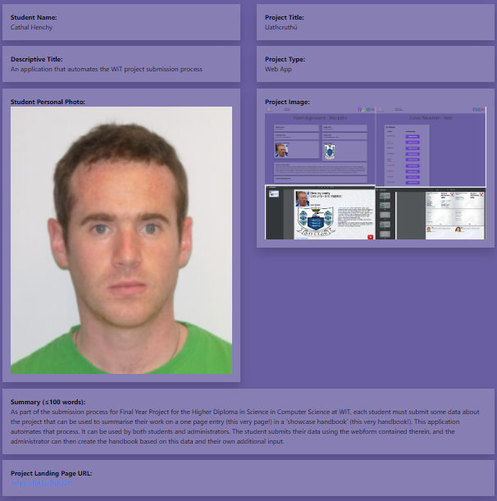
Student Interface: Review of Submission

Slide 7
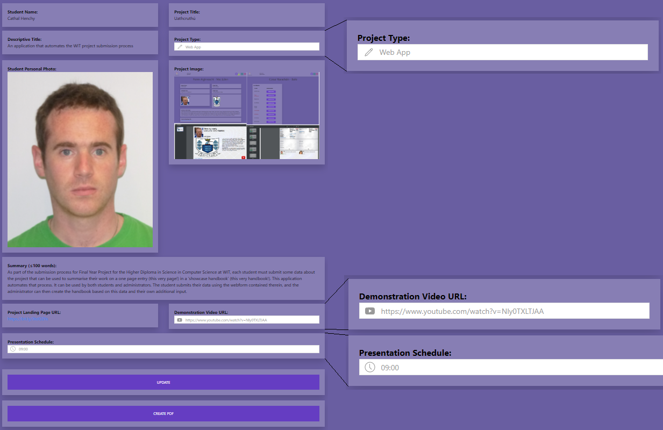
Administrator Interface
Edits student submission:
If ‘Other’ Project Type
Updates student submission:
Demonstration Video URL
Presentation Schedule
Creation of student PDF

Slide 8
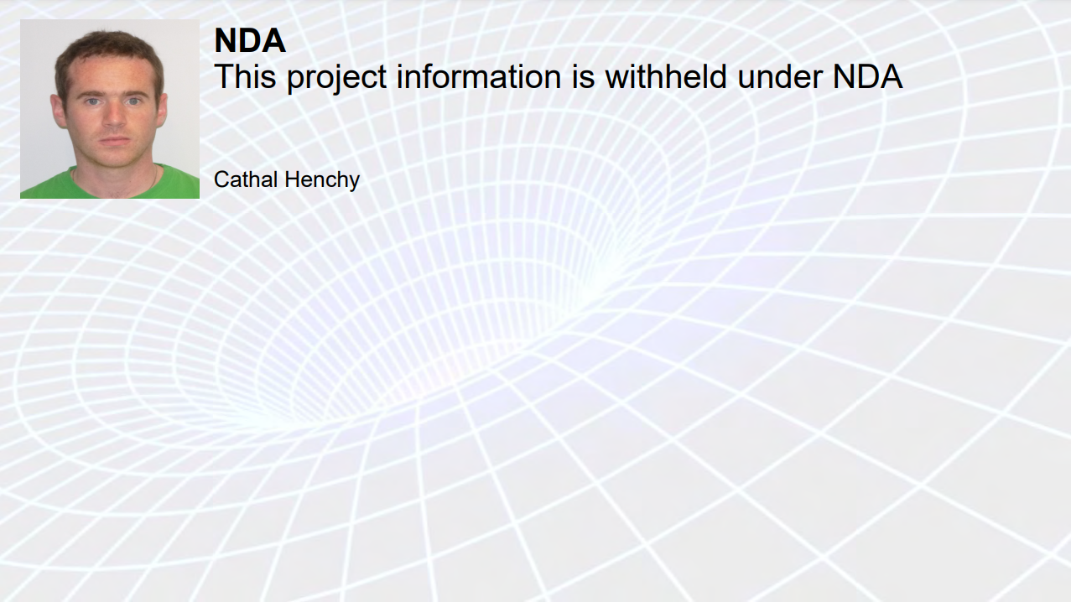
Administrator Interface: Student PDF

Slide 9
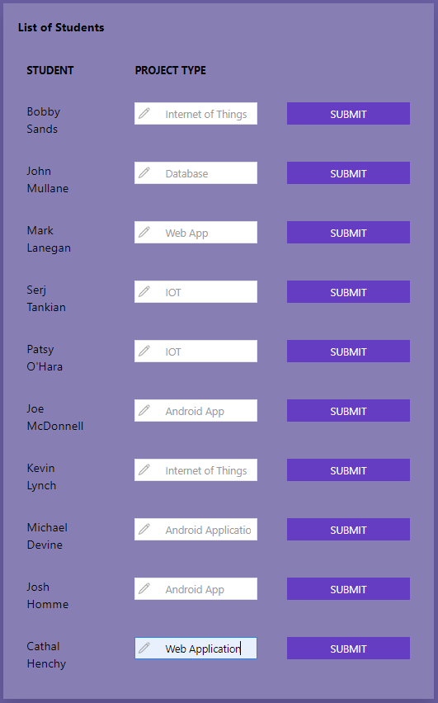
Administrator Interface
Project Type ‘Other’ Form
Alternative location for making these edits
Can view all ‘Other’ project types together
Necessary for categorising and grouping submissions in handbook

Slide 10
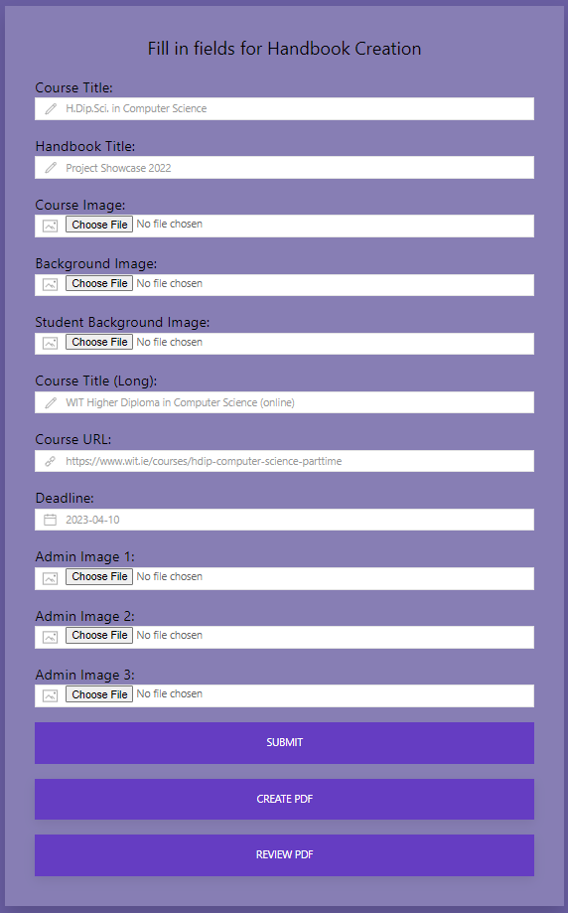
Administrator Interface
Admin submission form:
Web-form with data specific fields
Saves administrator’s work as draft
Submission can be reviewed
Sets Deadline for student submission
If set, student access is revoked after deadline has passed
Creation of admin PDF
Review of admin PDF

Slide 11
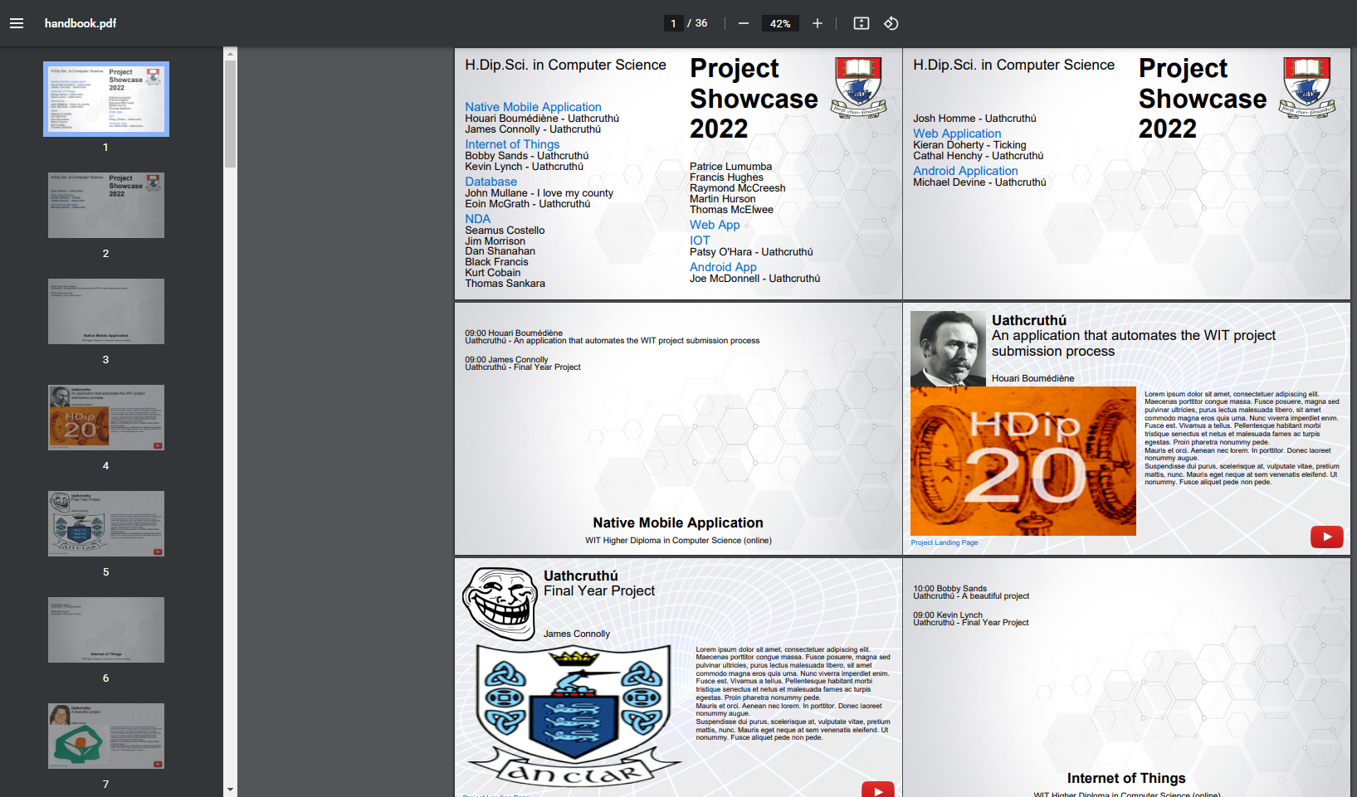
Administrator Interface
Creation of Handbook
Loops through all existing completed submissions and merges them into the one file

Slide 12
Administrator Interface
Creation of Handbook
Excerpt of Loop that sets list of submissions at beginning of file

Slide 13
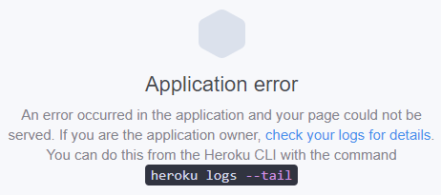
Future Releases
Timeout
PDF File Access
Security, Session & Cookies
UI

Slide 14
Learnings
Priorities
Definition of ‘Bug/Glitch’

Slide 15
Questions?
Insert Boiler-plate Question mark image here...

