Slide 1
Blog Report Generation App

Slide 2
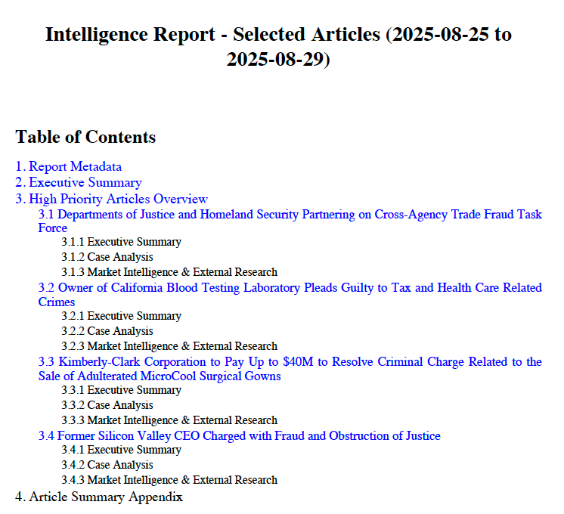
Goal
Automate article collection
Parse key facts + generate insights from article to aid with blog writing
Combine into collective pdf report to be distributed
Example report of highlighted article on the next page

Slide 3
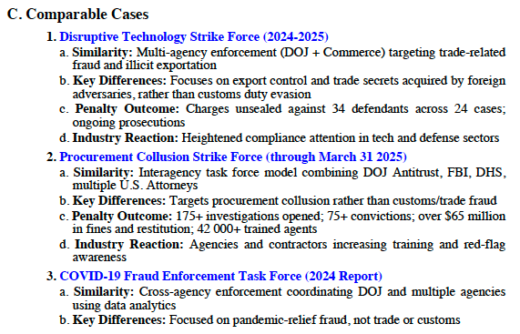
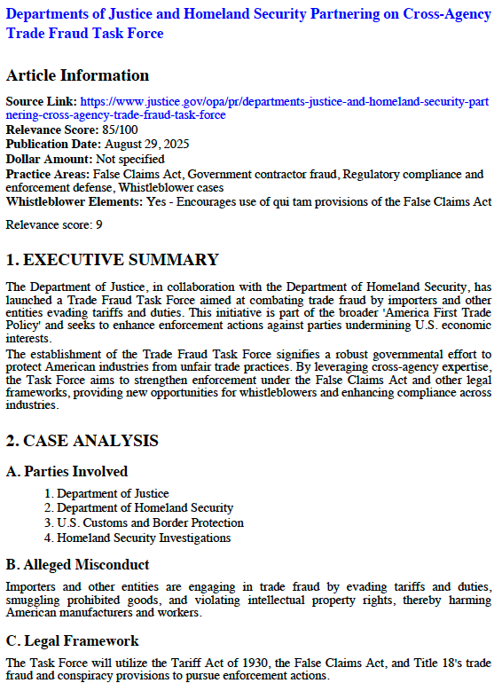
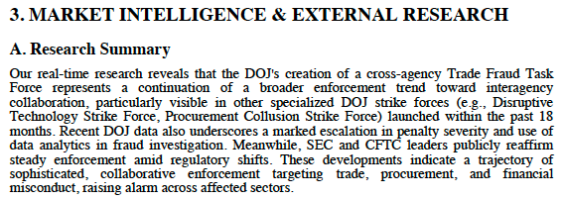
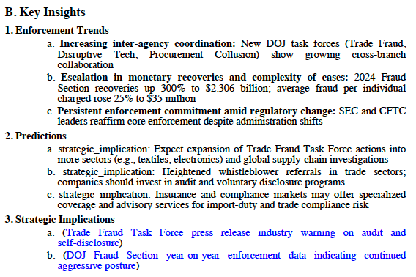
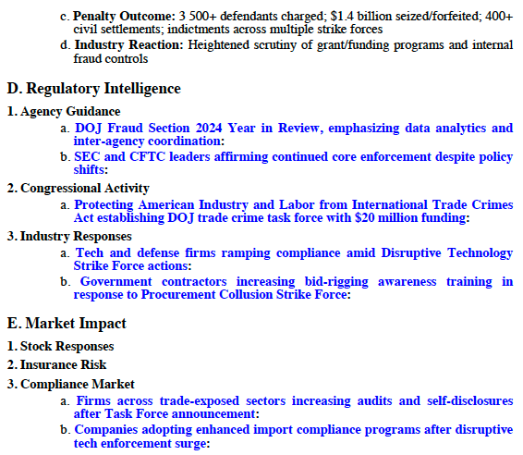
Report Example

Slide 4




Process Overview
Gather news from various sources
Analyze with App
DOJ press releases
Create blog
Summarize facts
Draw insights
Connect back to whistleblower practice
Ensure facts are relevant, tone is precise
Generate report & outline
SEC Whistleblower Office
CFTC Whistleblower Office
.
.
.

Slide 5
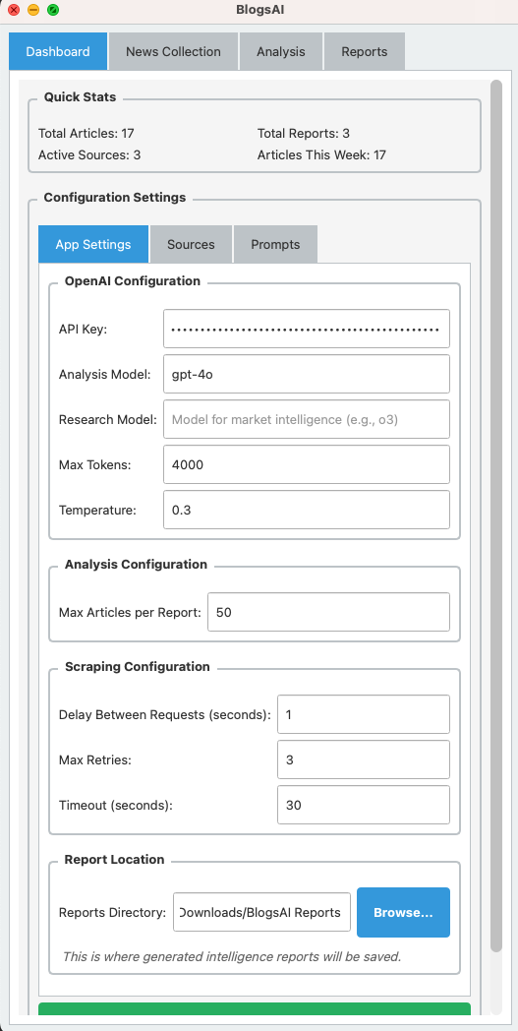
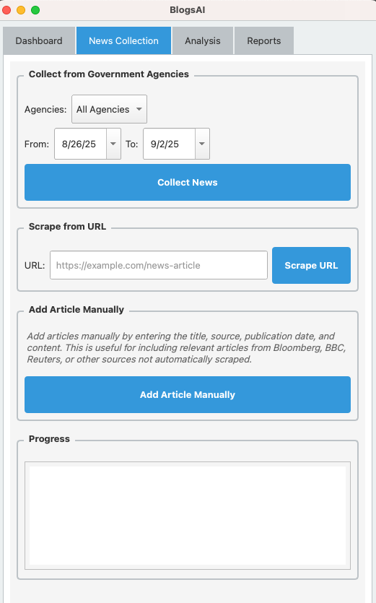
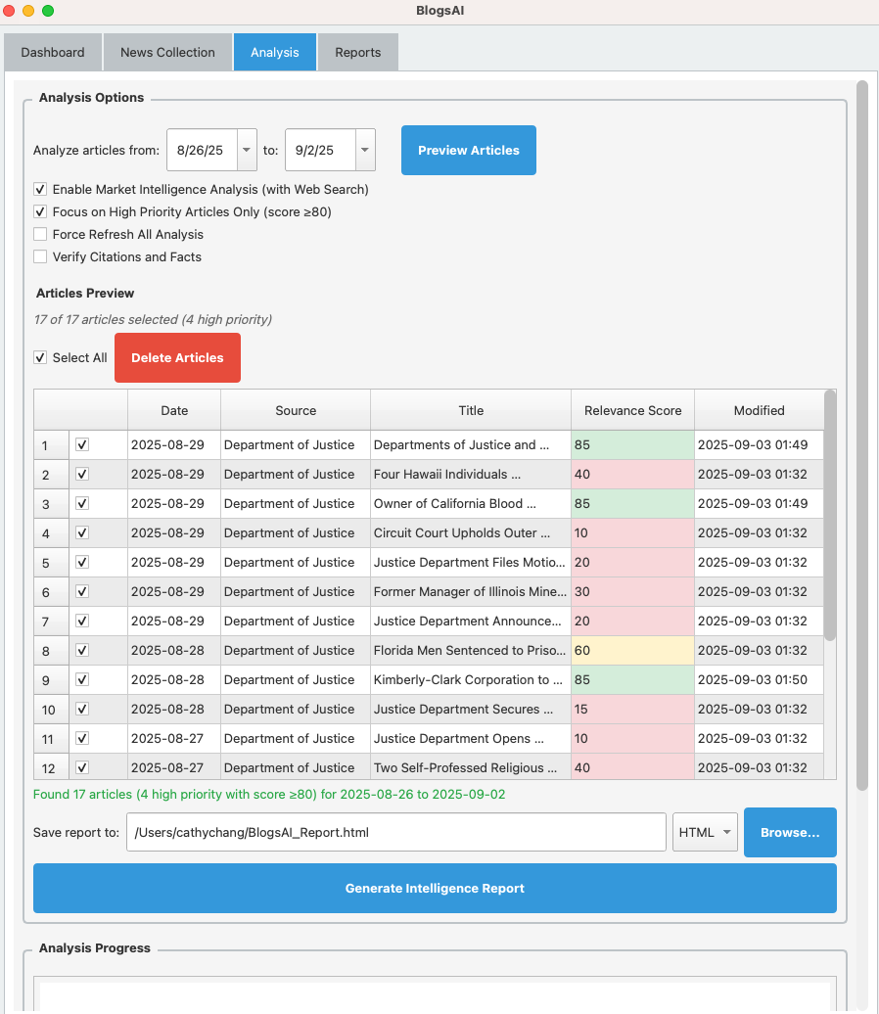
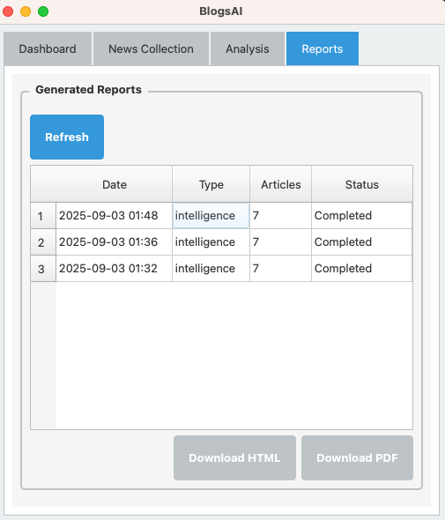
App Overview
1. Configure app & prompts
2. Collect articles from various sources
3. Generate report based on select articles
4. Access & download reports

Slide 6
Walkthrough

Slide 7
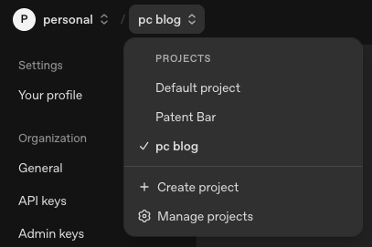
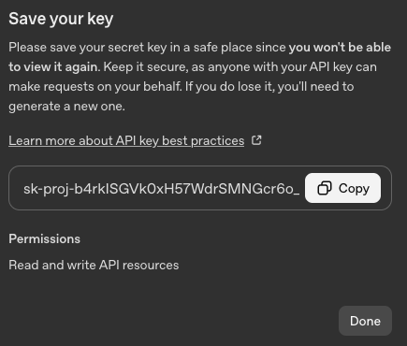

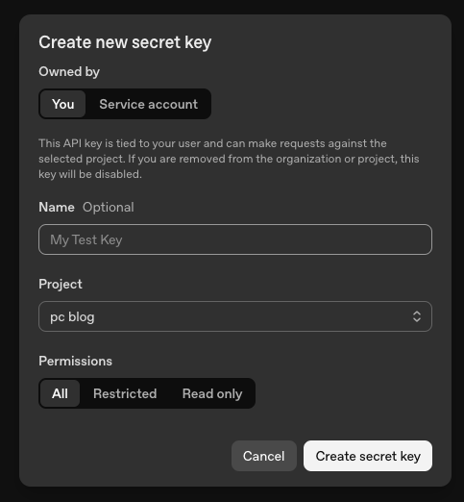
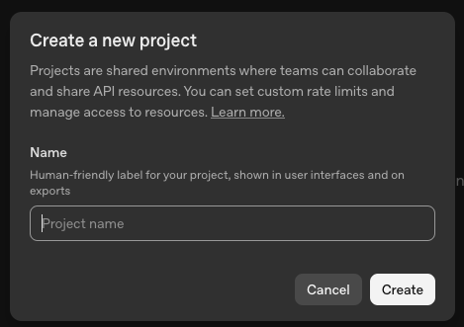
1. Initial Setup – obtain API key
Register for OpenAI firm account here
Create a project
Obtain API key by navigating here and following the steps to create a new secret key
Copy key to input into the app settings later

Slide 8
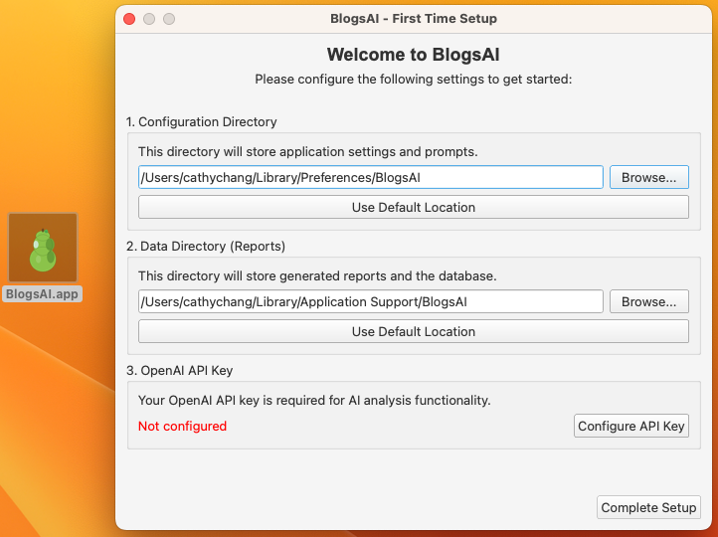
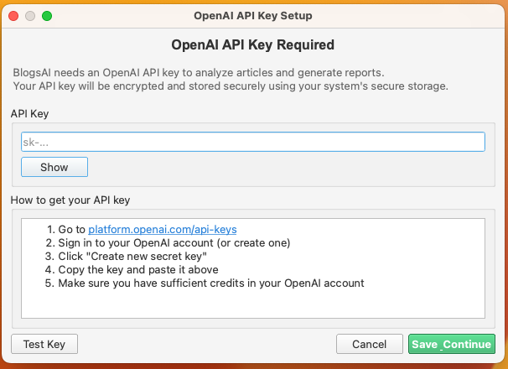
2. Go through app setup dialogue
Select a different directory for steps 1 & 2 if you’d like to store your app configuration files or generated reports in a different directory.
Input your API key obtained from OpenAI into the app
Complete setup. Settings can be revised at any point in the Dashboard.

Slide 9
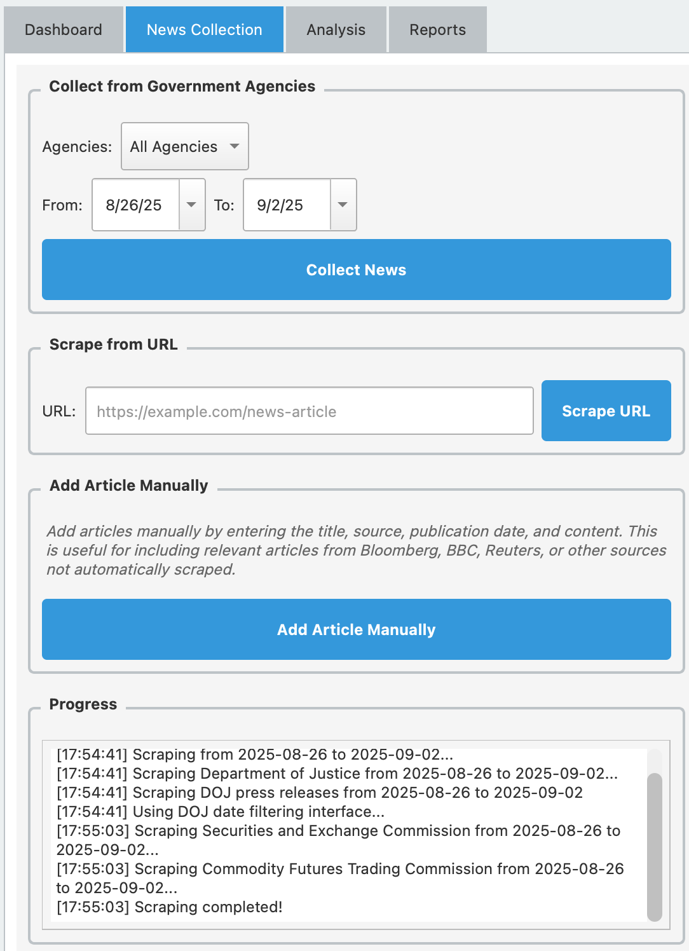
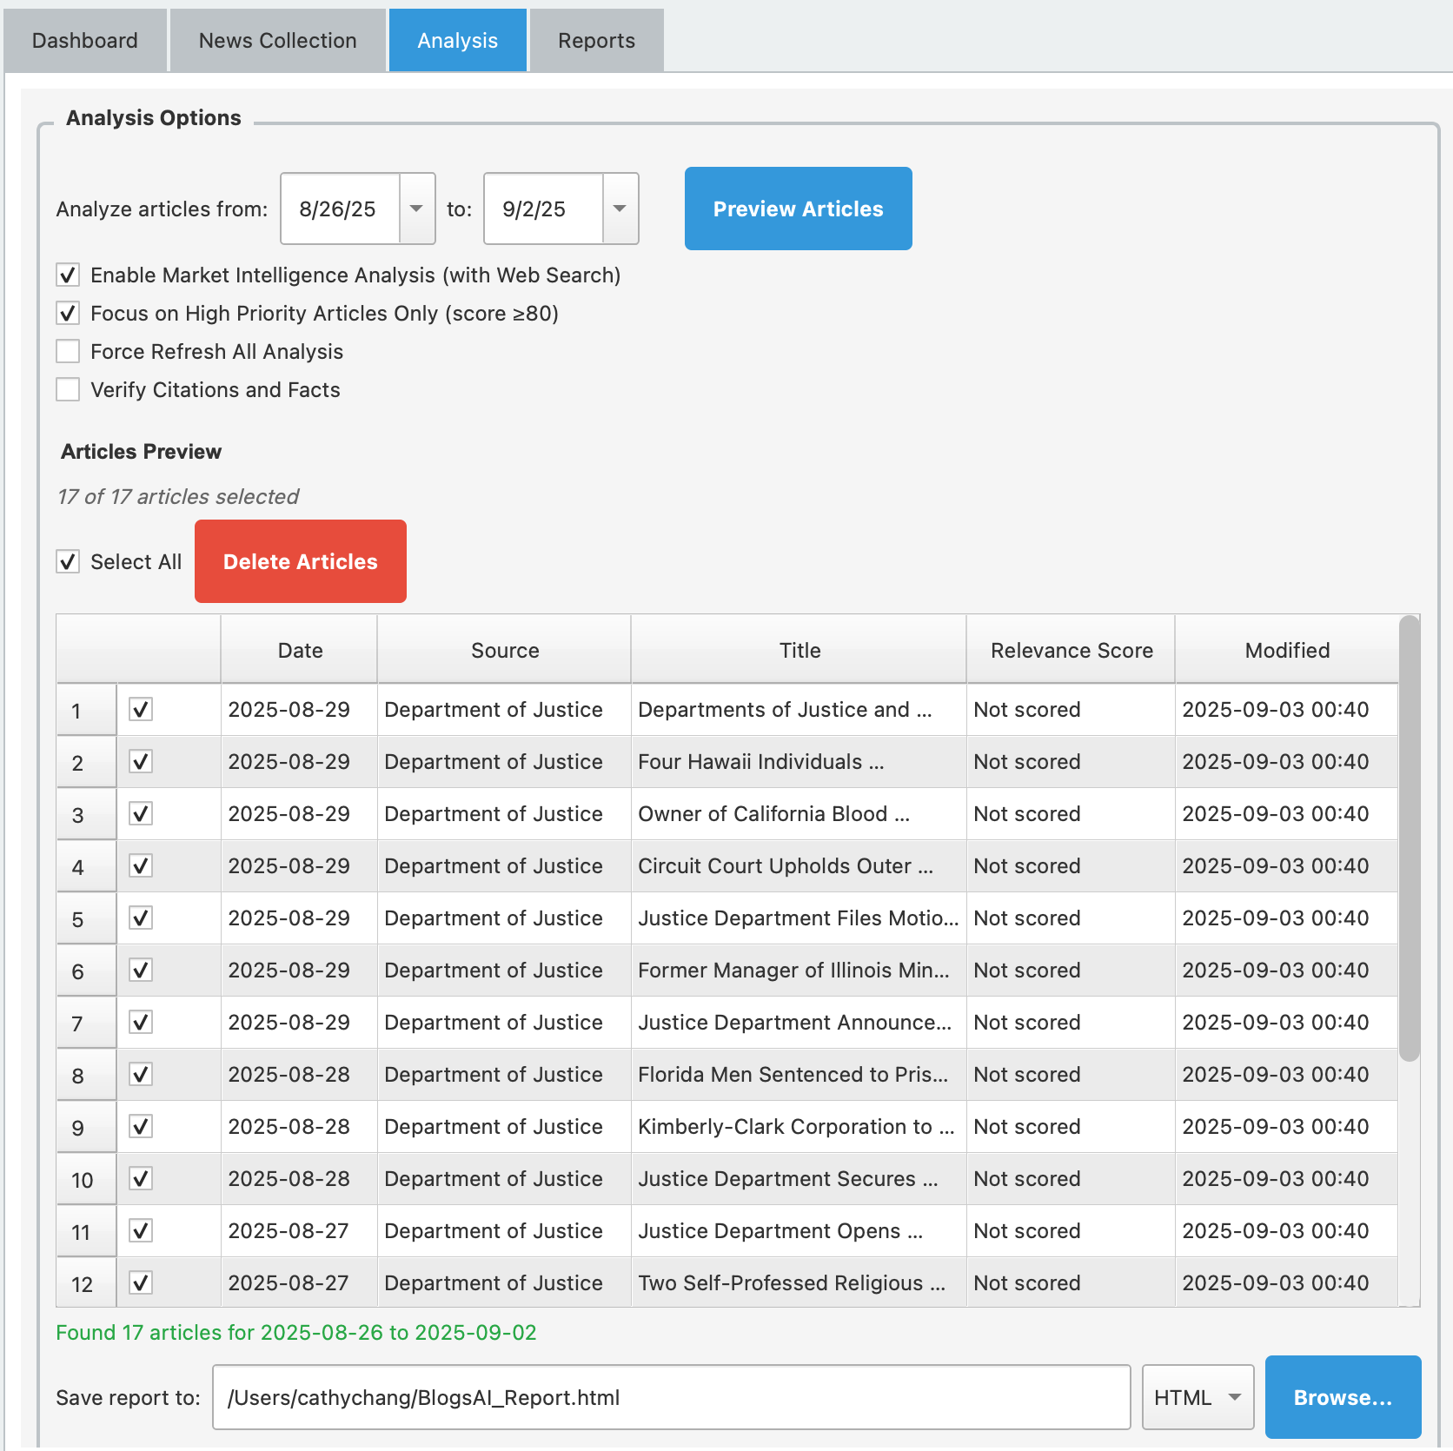
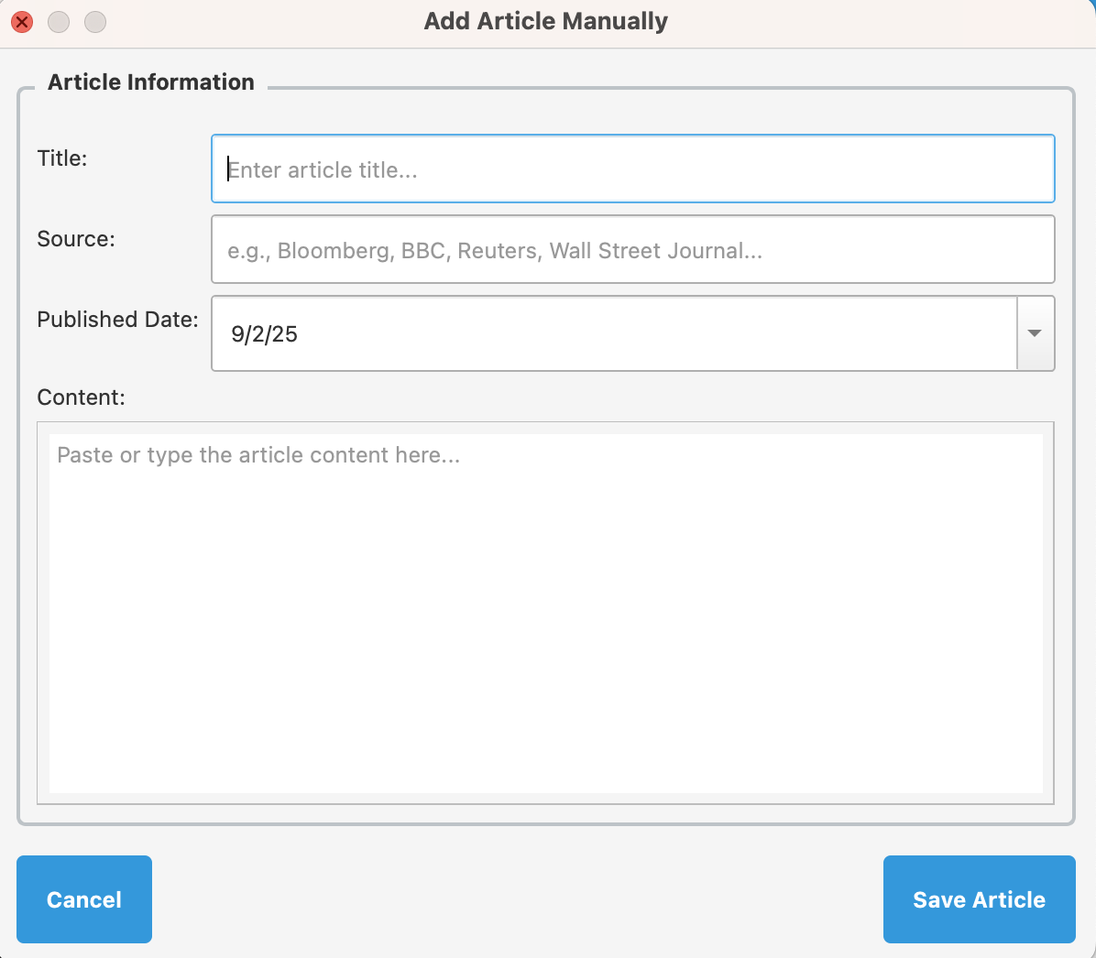

3. Collect Articles
There are 3 ways to collect the article content:
Built-in scraper (DOJ, SEC, CFTC)
Inputting an article link
Adding article manually (useful if article is only accessible behind a paywall)
Articles collected will show up in the analysis tab when you filter for the article published date.

Slide 10
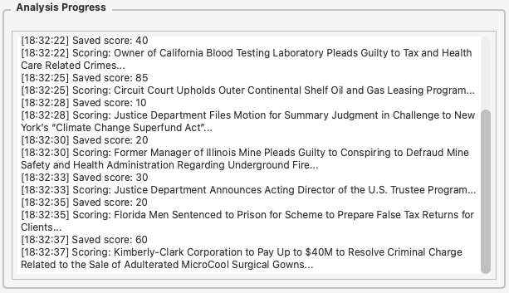
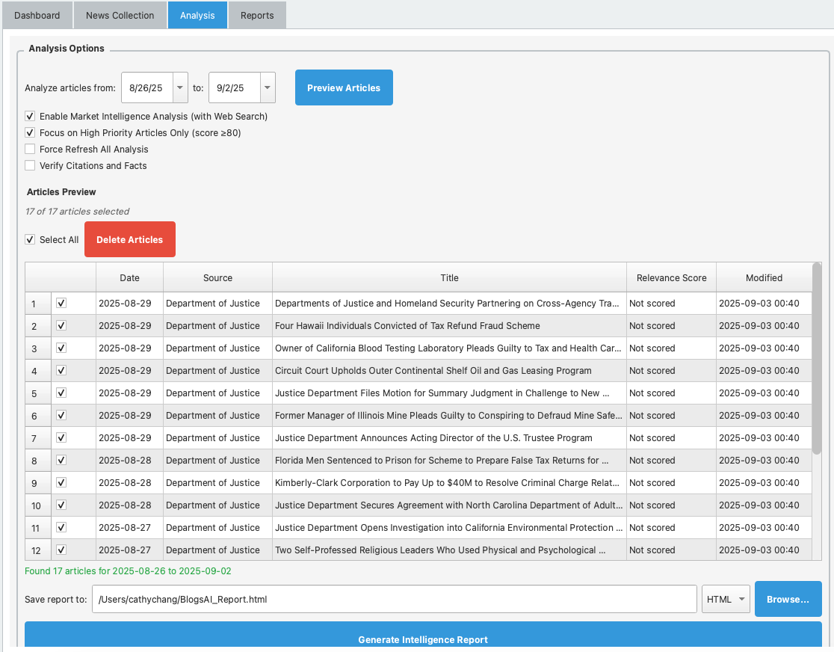

4. Generate Report
Setting options walkthrough
Market intelligence analysis:
Instead of just extracting key facts, system will do extra research on key insights, how the market reacted, and other similar cases.
High priority articles only:
To be token efficient, the system first scores how relevant the article is to whistleblower practice (prompt for scoring can be found and altered in dashboard → relevance_scorer.txt). If this box is unchecked, system will do an in-depth analysis on all articles rather a select few high priority ones.
Force refresh all analysis:
Under normal circumstances, if a relevance score already exists or analysis already exists, system will just use that cache. However, the results may be stale. Checking this option will ensure system refreshes the analysis by calling openai again.
Verify citation and facts:
Prompts for verifying facts and citations can be found and altered in dashboard → prompts → citation_verifier.txt and citation_corrector.txt. This is helpful for filtering out hallucinated content.
Generate report (file format options are html/pdf). This process usually takes ~2-5 minutes depending on how many articles it’s analyzing. Progress is shown on the analysis progress logging.

Slide 11
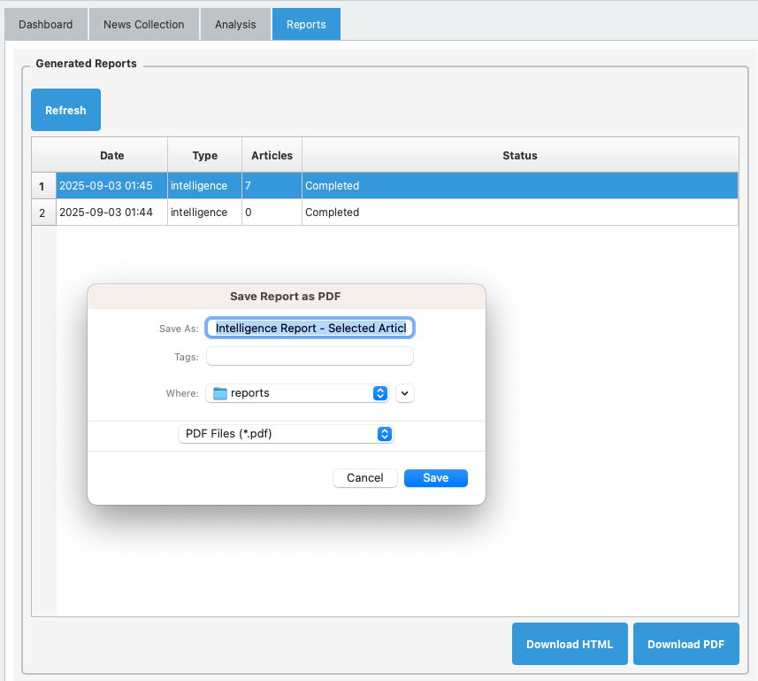
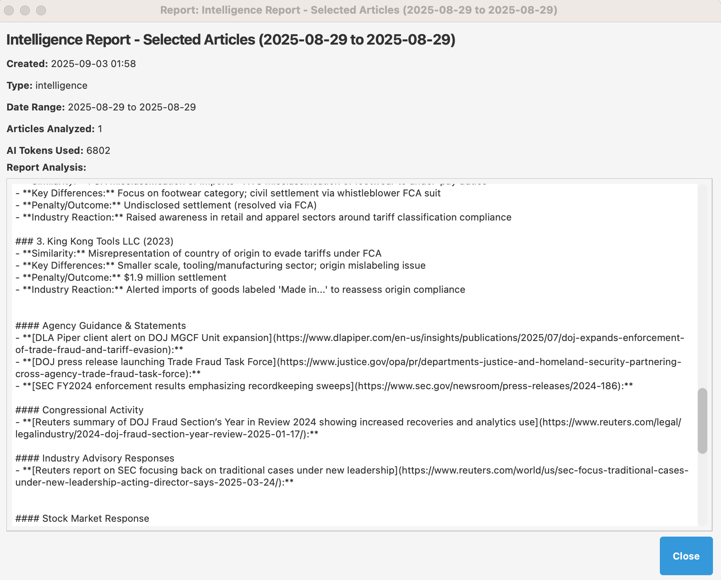
Access previous reports
Click on report and download as pdf
Double click to get markdown version stored in database

Slide 12
Other Notes

Slide 13
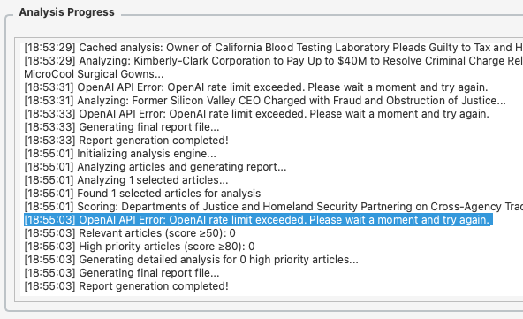
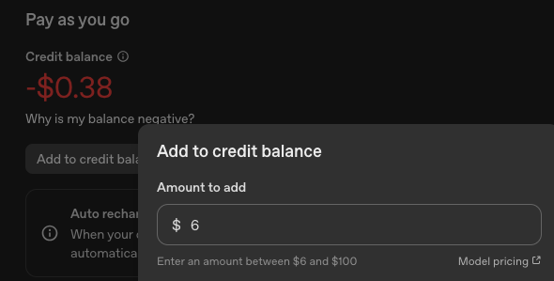
openAI error may mean there aren’t enough credits – go to openai billing to recharge

