Slide 1
MapReduce
DS Team

Slide 2
誰有問題關於MR？

Slide 3
誰跟誰互為好友
AAAA BBBB,CCCC,DDDD,EEEE,XXXX,ZZZZ
BBBB CCCC,DDDD
DDDD SSSS,XXXX,AAAA,ZZZZ
EEEE CCCC,FFFF,ZZZZ
XXXX AAAA
ZZZZ EEEE,CCCC
**AAAA 的朋友有 BBBB, CCCC, DDDD, EEEE, XXXX, ZZZZ
** BBBB 的朋友有 CCCC, DDDD

Slide 4
import re
rows = {}
with open("friend.txt", "rb") as in_file:
for line in in_file:
me, friends = re.split("\s+", line.strip())
rows.setdefault(me, set())
for friend in friends.split(","):
rows[me].add(friend)
for me, friends in rows.items():
for friend in friends:
if friend in rows and me in rows[friend]:
print("{} and {} are friends".format(me, friend))
標準做法

Slide 5
MR做法
AAAA-BBBB 1
AAAA-CCCC 1
AAAA-DDDD 1
AAAA-EEEE 1
AAAA-XXXX 1
AAAA-ZZZZ 1
BBBB-CCCC 1
BBBB-DDDD 1
…
…
AAAA BBBB,CCCC,DDDD,EEEE,XXXX,ZZZZ
BBBB CCCC,DDDD
DDDD SSSS,XXXX,AAAA,ZZZZ
EEEE CCCC,FFFF,ZZZZ
XXXX AAAA
ZZZZ EEEE,CCCC
1
2
('AAAA-XXXX', 2)
('EEEE-ZZZZ', 2)
('AAAA-DDDD', 2)

Slide 6
MR做法
rows = sc.textFile(“…./friend.txt”)
def make_relation(x):
me, friends = re.split("\s+", x.strip())
return (me, friends.split(","))
def make_tuple(x):
one, two = x[0], x[1]
if one < two:
return ("{}-{}".format(one, two), 1)
else:
return ("{}-{}".format(two, one), 1)
relations = rows.map(make_relation).flatMapValues(lambda x: x)
many_relations = relations.map(make_tuple).reduceByKey(lambda x,y: x+y)
both_relation = many_relations.filter(lambda x: x[1] > 1)
for relation in both_relation.collect():
print relation

Slide 7
標
準
做
法
MR
做
法
大數據演算法工程師

Slide 8
表格轉置
A B C D
foo one small 1
foo one large 2
foo one large 2
foo two small 3
foo two small 3
bar one large 4
bar one small 5
bar two small 6
bar two large 7
large small
foo two 0 6
bar two 7 6
foo one 4 1
bar one 4 5

Slide 9
標準做法
#!/usr/bin/python
import numpy as np
import pandas as pd
df = pd.read_csv("table.tsv", sep=" ")
pivot = pd.pivot_table(df, index=["A", "B"], values="D", columns=["C"], aggfunc=np.sum)
C large small
====================
A B
bar one 4 5
two 7 6
foo one 4 1
two NaN 6

Slide 10
MR做法（1）
((u'foo', u'one'), (1, 0))
((u'foo', u'one'), (0, 2))
((u'foo', u'one'), (0, 2))
((u'foo', u'two'), (3, 0))
((u'foo', u'two'), (3, 0))
((u'bar', u'one'), (0, 4))
((u'bar', u'one'), (5, 0))
((u'bar', u'two'), (6, 0))
((u'bar', u'two'), (0, 7))
[u'foo', u'one', u'small', u'1']
[u'foo', u'one', u'large', u'2']
[u'foo', u'one', u'large', u'2']
[u'foo', u'two', u'small', u'3']
[u'foo', u'two', u'small', u'3']
[u'bar', u'one', u'large', u'4']
[u'bar', u'one', u'small', u'5']
[u'bar', u'two', u'small', u'6']
[u'bar', u'two', u'large', u'7']
1
2
(u'foo', u'one') [1, 4]
(u'foo', u'two') [6, 0]
(u'bar', u'two') [6, 7]
(u'bar', u'one') [5, 4]

Slide 11
MR做法（1）
import re
filepath = ….
table = sc.textFile(filepath).map(lambda x: re.split("\s+", x)).filter(lambda x: x[3].isdigit())
c = table.map(lambda x: x[2]).distinct().collect()
brc = sc.broadcast(c)
def reshape(t):
out = [t[0], t[1]]
for v in brc.value:
if v == t[2]:
out.append(t[3])
else:
out.append(0)
return (out[0], out[1]), (int(out[2]), int(out[3]))
reshaped = table.map(reshape)
for row in reshaped.groupByKey().collect():
values = [0, 0]
for v in row[1]:
for idx, sub_v in enumerate(v):
values[idx] += sub_v
print row[0], values

Slide 12
def add(t1,t2):
j=()
for idx, v in enumerate(t1):
j += (t1[idx]+t2[idx],)
return j
def seq(current, next):
return addtup(current, next)
def comb(p, f):
return addtup(p, f)
MR做法（2）
reshaped = table.map(reshape)
pivot = reshaped.aggregateByKey([0 for i in c], seq, comb, 1, seq, comb, 1)
for i in pivot.collect():
print i

Slide 13
Entropy

Slide 14
Entropy
Information
Gain

Slide 15
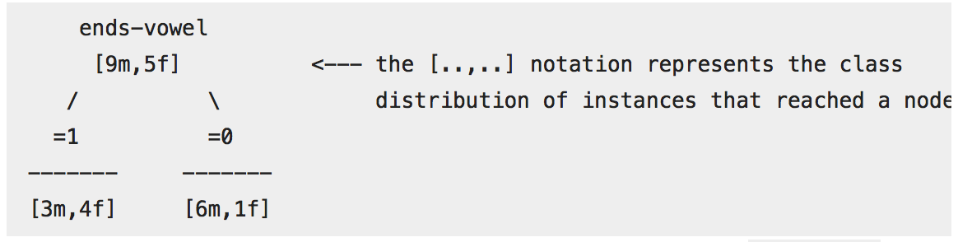
Entropy
1
2
Information
Gain
3
4

Slide 16
ends-vowel gender
1 m
1 m
1 m
1 m
1 m
1 m
1 m
1 m
1 m
0 f
0 f
0 f
0 f
0 f
MR
做
法

