Slide 1
Ad Campaign A/B Analysis
Automated KPI, stats tests, and insights

Slide 2
Ad Campaign A/B Analysis
Auto-generated on pipeline run
Dataset: campaign_data.csv

Slide 3
Executive Summary
Group B conversion rate: 0.974%; Group A: 0.588%
ROI — B: 9.17, A: 10.34 (diff -1.18)
Recommendation will be based on statistical significance and ROI.

Slide 4
Background & Hypothesis
Hypothesis: Test (B) improves conversion rate and ROI vs Control (A).
Goal: Decide whether to scale variant B based on evidence.

Slide 5
Data & Methods
Source: uploaded CSV (campaign_data.csv).
Cleaning: normalized columns, parsed dates, removed zero reach rows.
KPIs: Conversion Rate, Revenue per User, ROI, Cost per Purchase.
Tests: proportion z-test (CR), Welch t-test (RPU).

Slide 6
Key Metrics & Findings
Group A: CR=0.588%, ROI=10.34
Group B: CR=0.974%, ROI=9.17

Slide 7
Statistical Significance
RPU t-test p-value: 0.004; mean diff: 0.0078

Slide 8
Blockers & Assumptions
Revenue column missing; used avg_order_value fallback.
Assumed independent users and comparable traffic.
Small sample sizes / unequal variance may affect t-test.
Using pre-rendered PNG charts from reports/charts.

Slide 9
Recommendations
No statistically significant lift; keep A and refine B.

Slide 10
Appendix: Charts
Conversion Rate by Group: reports/charts/conversion_rate_by_group.png
Revenue Distribution: reports/charts/revenue_distribution.png
Return of Investment : reports/charts/roi_comparison.png
Purchases Over Time: reports/charts/ts_purchases_by_group.png
Impressions Over Time: reports/charts/ts_impressions_by_group.png
Spend Over Time: reports/charts/ts_spend_by_group.png
Website Clicks Over Time: reports/charts/ts_clicks_by_group.png
Conversion Funnel — Group A: reports/charts/funnel_group_A.png
Conversion Funnel — Group B: reports/charts/funnel_group_B.png
Spend vs Purchases — Group A: reports/charts/pie_spend_vs_purchases_group_A.png
Spend vs Purchases — Group B: reports/charts/pie_spend_vs_purchases_group_B.png

Slide 11
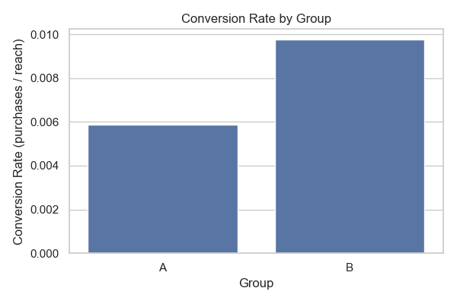
Conversion Rate by Group

Slide 12
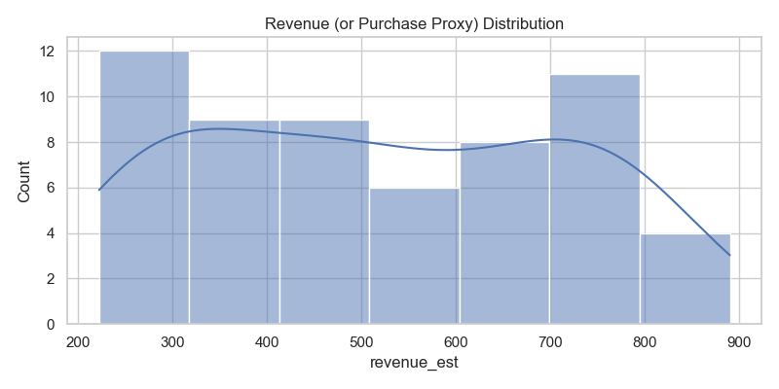
Revenue Distribution

Slide 13
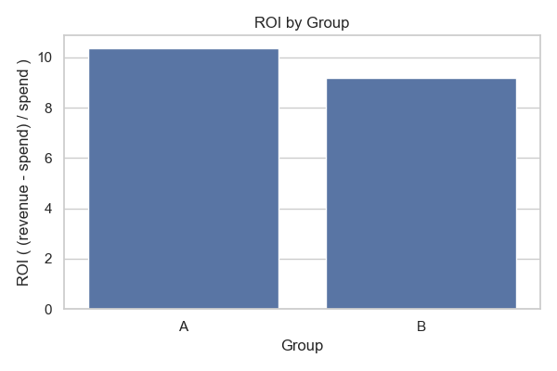
Return of Investment

Slide 14
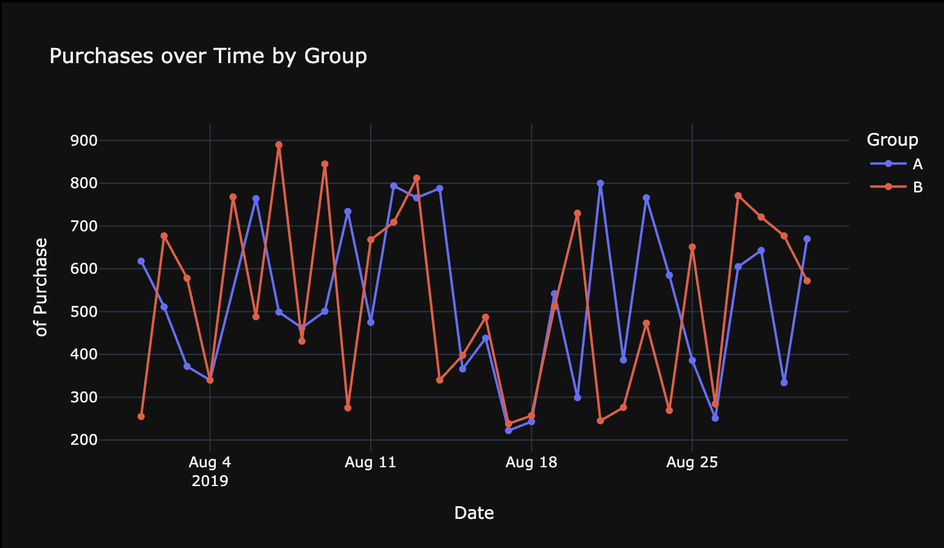
Purchases Over Time

Slide 15
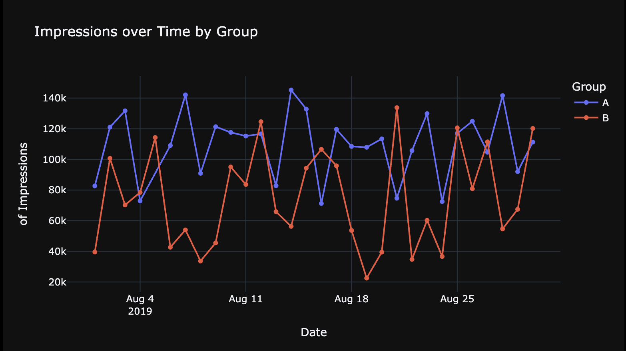
Impressions Over Time

Slide 16
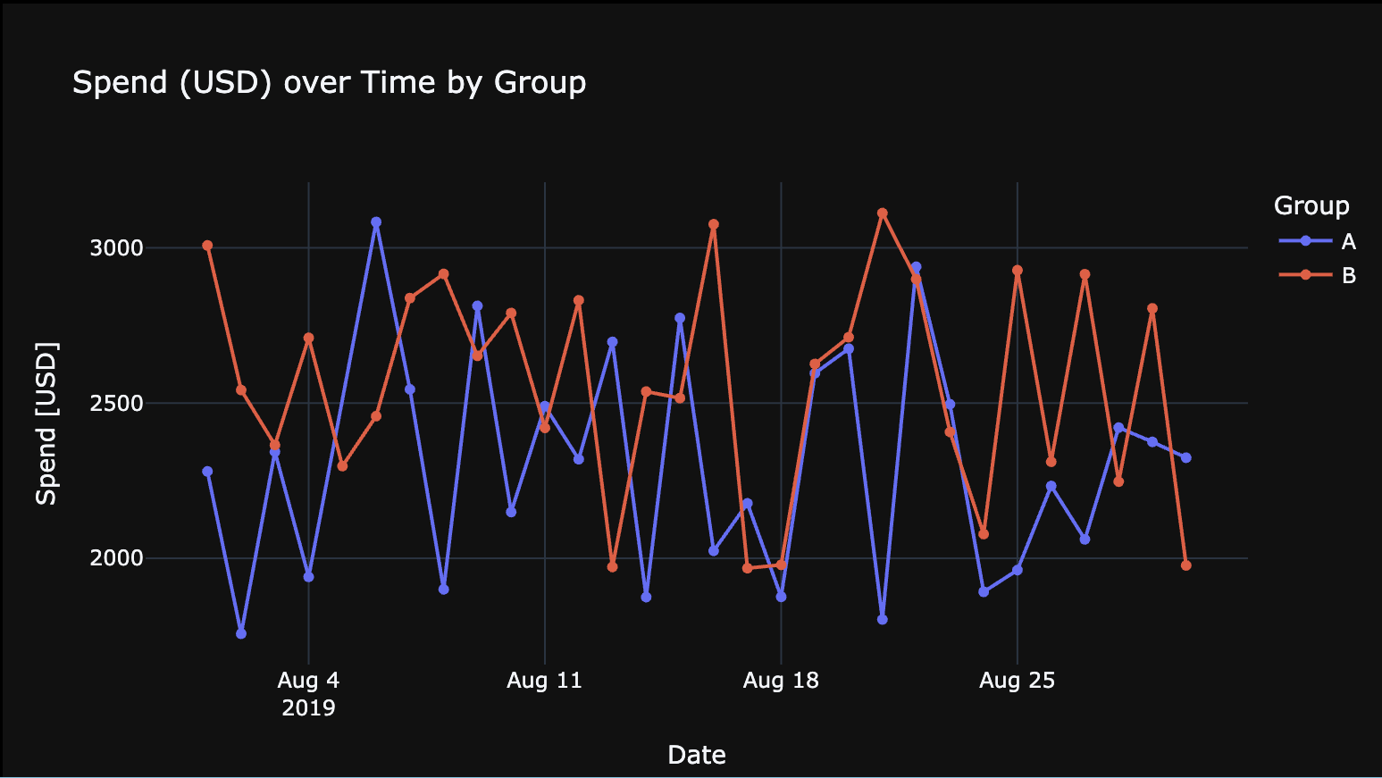
Spend Over Time

Slide 17
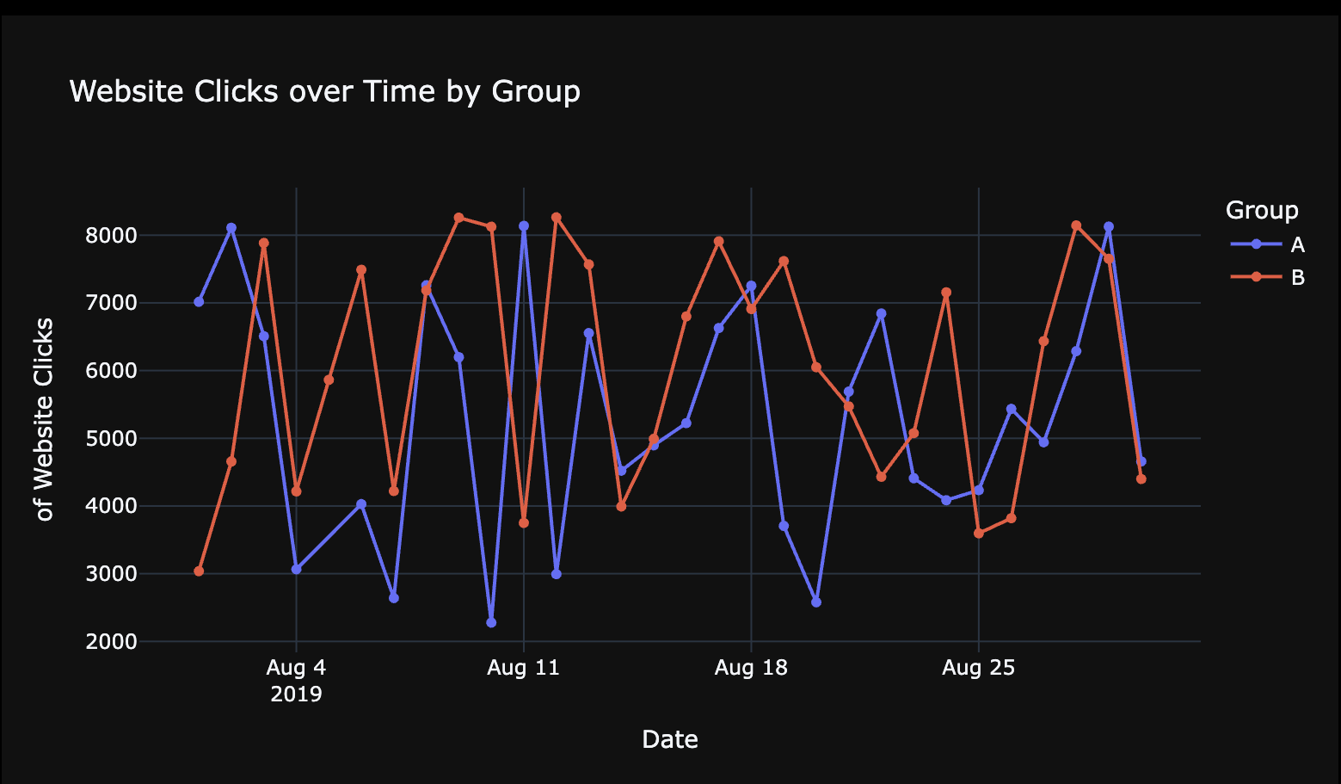
Website Clicks Over Time

Slide 18
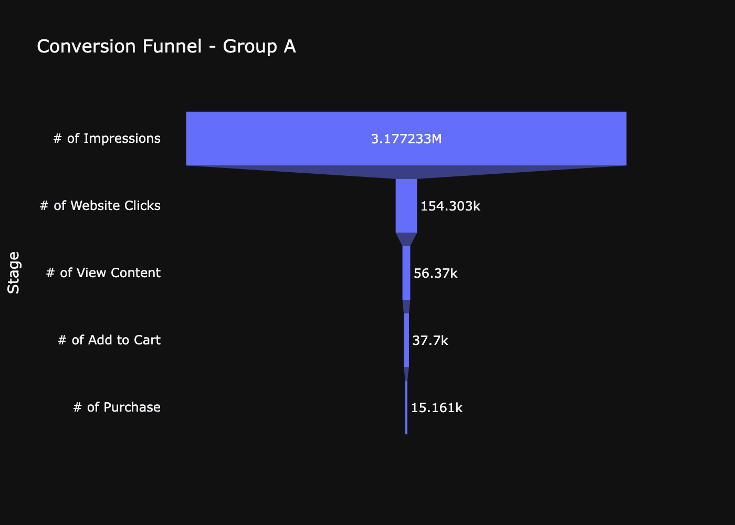
Conversion Funnel — Group A

Slide 19
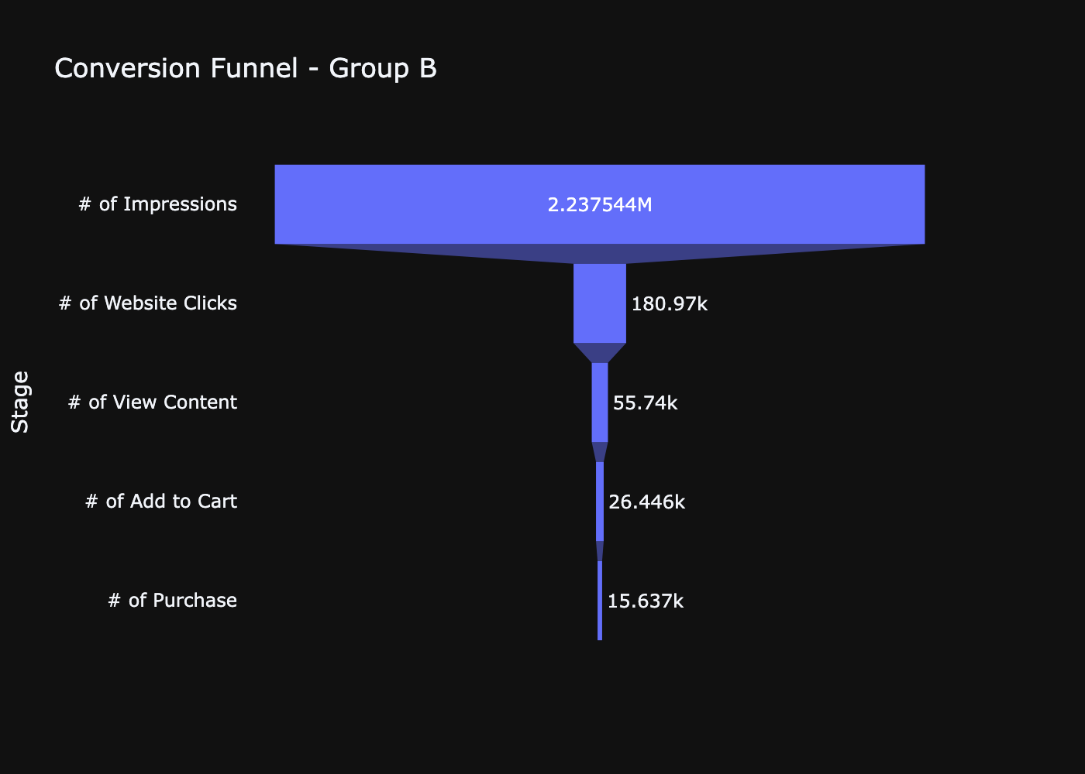
Conversion Funnel — Group B

Slide 20
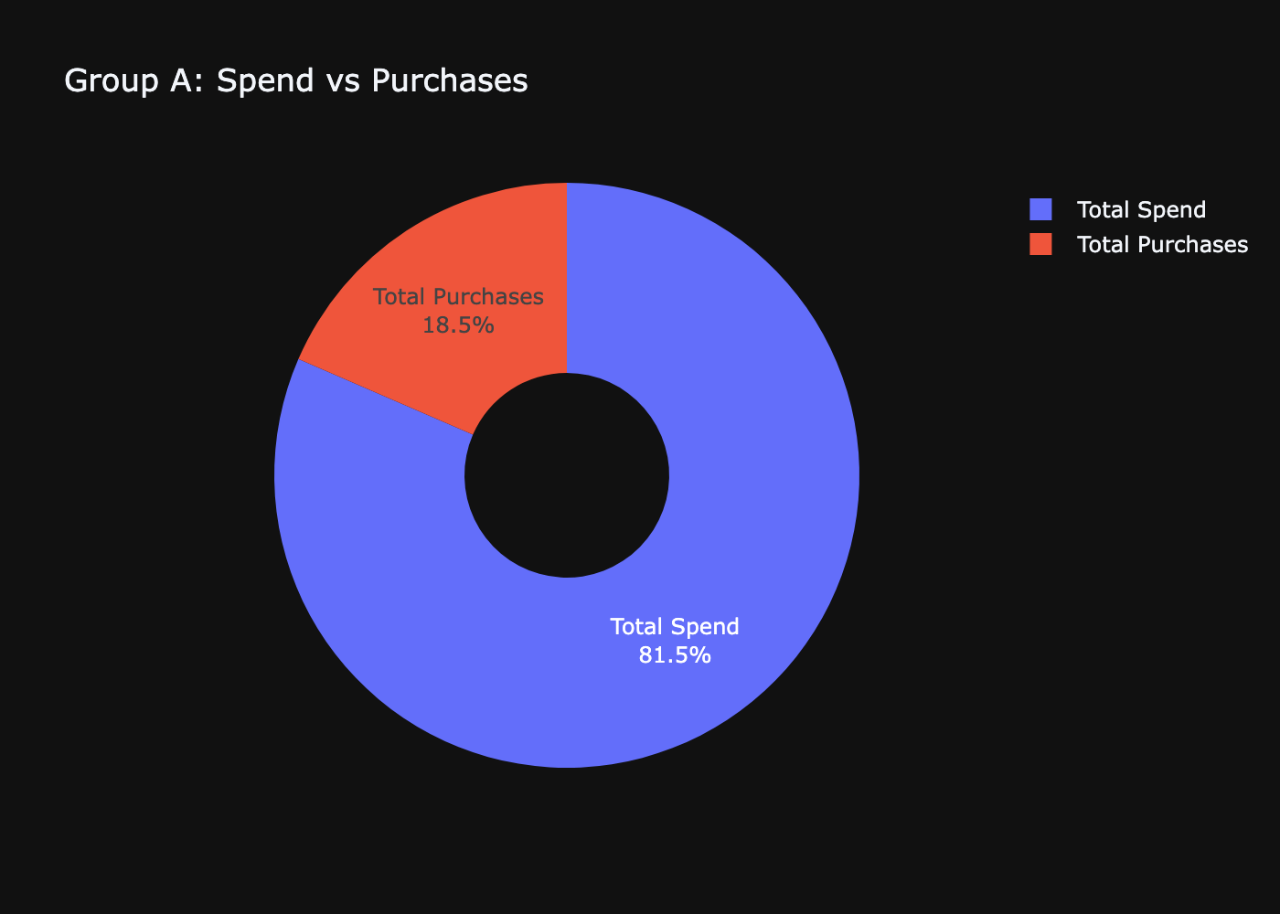
Spend vs Purchases — Group A

Slide 21
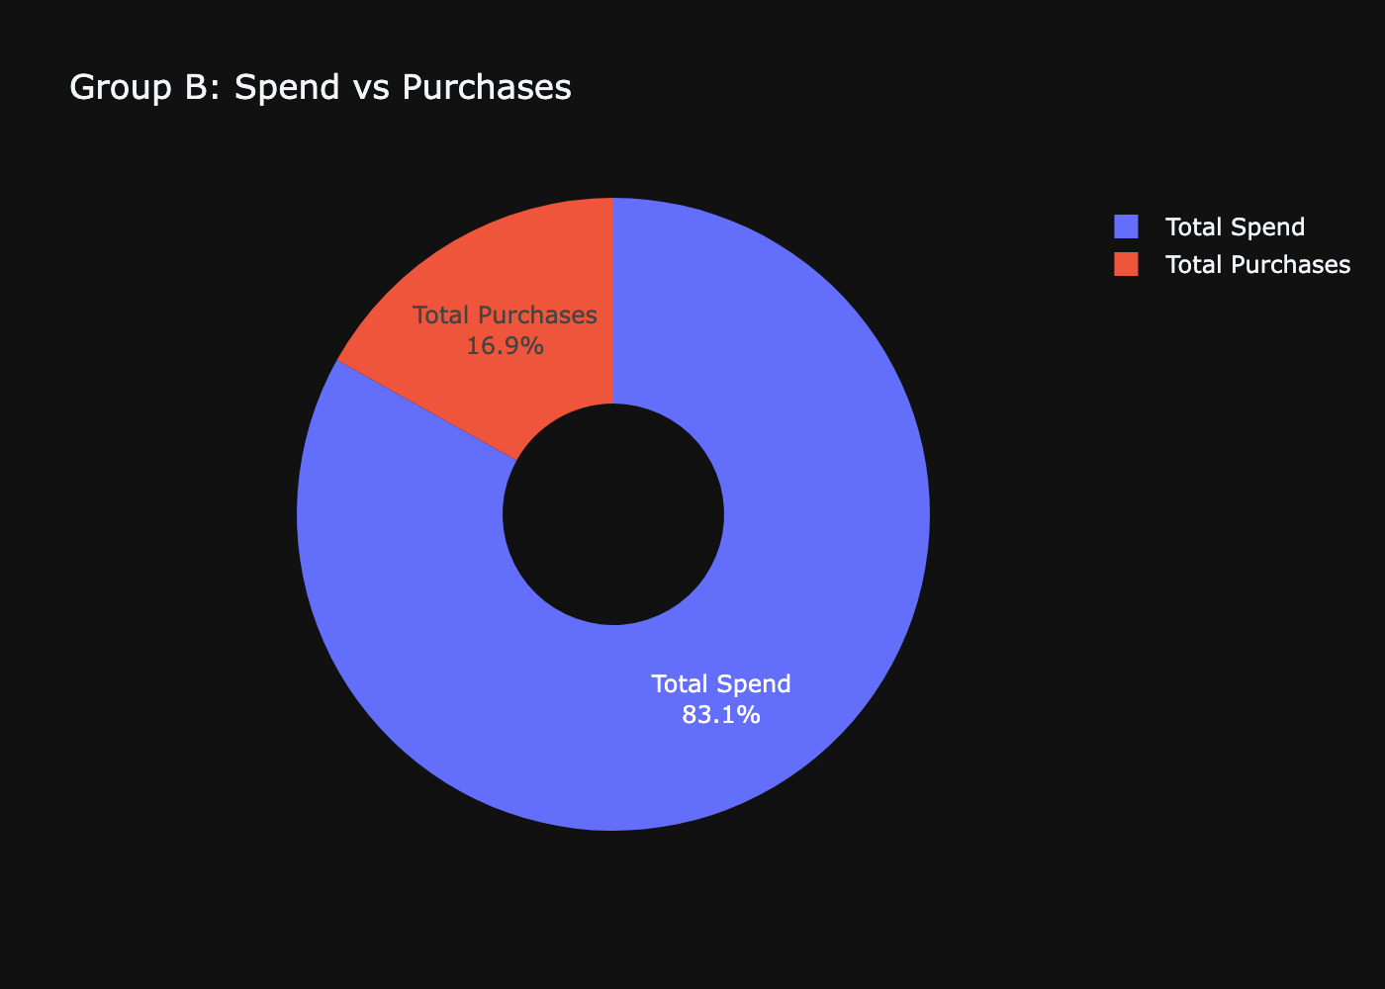
Spend vs Purchases — Group B

