Slide 1
Project Title: Conversion Rate Analysis
Analyzed conversion rates between two marketing groups to optimize ROI.

Slide 2
Executive Summary
Group B outperformed Group A with a conversion rate of 0.0097.
ROI for Group A is higher at 10.34 compared to 9.17 for Group B.
Consider scaling Group B's approach to maximize revenue.
Further testing recommended to explore additional optimizations.

Slide 3
Background & Hypothesis
Hypothesis: Different marketing strategies impact conversion rates.
Objective: Identify the more effective strategy based on metrics.

Slide 4
Data & Methods
Data cleaned for accuracy; metrics defined for clarity.
Key metrics: Conversion Rate (CR), ROI, Revenue per User (RPU).
Statistical tests: T-tests for CR and RPU comparisons.

Slide 5
Key Metrics & Findings
Group A: CR = 0.0059, ROI = 10.34, Revenue/User = $0.29.
Group B: CR = 0.0097, ROI = 9.17, Revenue/User = $0.49.
Absolute CR lift of 0.0039 (65.6% relative increase).

Slide 6
Statistical Significance
P-value for CR test is 0.00, indicating strong significance.
95% CI for CR lift: [0.0037, 0.0040].
RPU test p-value is 0.004, confirming significant differences.

Slide 7
Blockers & Assumptions
Assumed average order value consistent across groups.
Limited reach for Group B may affect long-term results.
Potential external factors influencing user behavior.

Slide 8
Recommendations
Scale Group B's strategy to enhance overall performance.
Continue testing to refine marketing approaches.
Investigate factors affecting Group A's lower performance.

Slide 9
Appendix
reports/charts/conversion_rate_by_group.png
reports/charts/roi_comparison.png
reports/charts/revenue_distribution.png

Slide 10
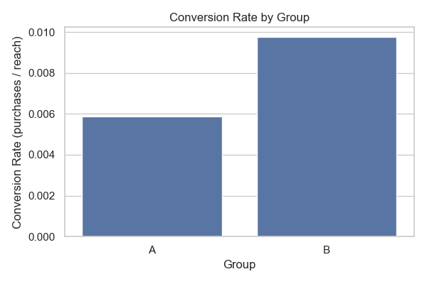
conversion_rate

Slide 11
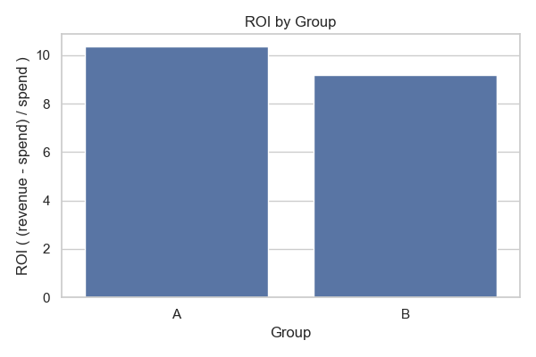
roi_comparison

Slide 12
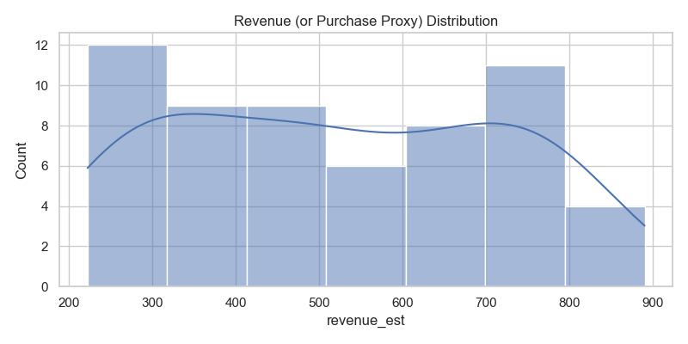
revenue_distribution

