Slide 1
2×2 NETWORK-ON-CHIP
DESIGN // IMPLEMENTATION // SIMULATION
ASHRITH (23011P0415) | PRANJAL (23011P0430) | CHATHERINA (23011P0445) | CHARANDEEP (23011P0446)
GUIDE: DR. KARUNAKAR REDDY SIR, PROFESSOR ECE, JNTUH
PRESENTER: ASHRITH

Slide 2
01
// THE PROBLEM — SHARED BUS BOTTLENECK
CRITICAL LIMITATIONS OF LEGACY SOC DESIGNS
>> Traditional SoC designs rely on ONE monolithic bus for all core-to-core communication.
>> Causes severe data traffic jams. Only ONE core can transmit at any given nanosecond.
>> Does NOT scale. As core count scales past 4 to 8, 16, or 64 cores, the bus chokes.
>> Power consumption per data transfer increases due to long, highly capacitive wires.
>> A single faulty link or congested pathway halts the entire processor subsystem.
PRESENTER: ASHRITH

Slide 3
02
// THE SOLUTION — NETWORK-ON-CHIP (NOC) PARADIGM
NOC ADVANTAGES
PROJECT AIM
>> Replaces the shared bus with an Internet-like packet-switched grid directly on silicon.
>> Data is fragmented into small packets with embedded destination coordinates.
>> Supports true parallelism — multiple packets travel simultaneously on independent links.
>> Scales gracefully: a 2×2 mesh acts as a building block for 4×4 or 8×8 arrays.
>> Design and implement a complete 2×2 Mesh NoC in Verilog-2001.
>> Utilize deterministic XY Routing logic and Valid-Ready flow control.
>> Verify functionality via behavioral simulation in AMD Vivado 2023.2.
>> Quantify network limits (throughput, latency, saturation) using MATLAB.
PRESENTER: ASHRITH

Slide 4
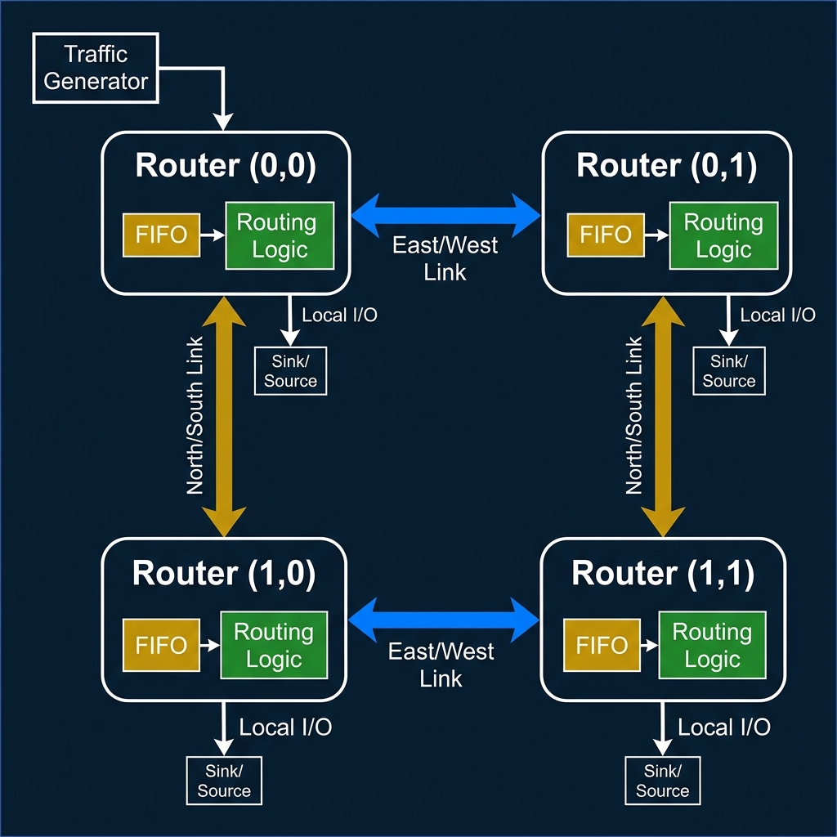
03
// SYSTEM ARCHITECTURE — 2×2 MESH TOPOLOGY
PRESENTER: ASHRITH

Slide 5
04
// HARDWARE DESIGN OBJECTIVES
fifo.v
routing_logic.v
01
Circular FIFO buffer — Depth=4, Width=8 bits. FWFT design. full / empty flag generation.
02
XY routing algorithm. Decode packet[7:6] as dest. Compare against node X,Y params.
router.v
noc_top.v
03
Integrate FIFO + Routing Logic. Implement in_ready = !full, out_valid = !empty.
04
Wire 4 router instances into 2×2 mesh. Connect E↔W, N↔S links.
PRESENTER: PRANJAL

Slide 6
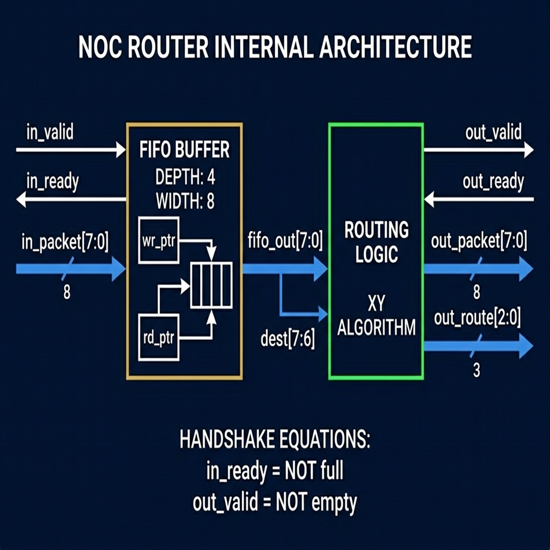
05
// ROUTER NODE — INTERNAL ARCHITECTURE (ROUTER.V)
INSTANTIATION
>> fifo_inst #(DEPTH=4, WIDTH=8)
>> routing_logic_inst #(X_ADDR, Y_ADDR)
>> X_ADDR, Y_ADDR are top-level params.
SIGNAL ROUTING
>> out_packet = fifo_out[7:0]
>> out_route = routing_logic output (3 bits)
>> local_hit = packet delivered to this node
PRESENTER: PRANJAL

Slide 7
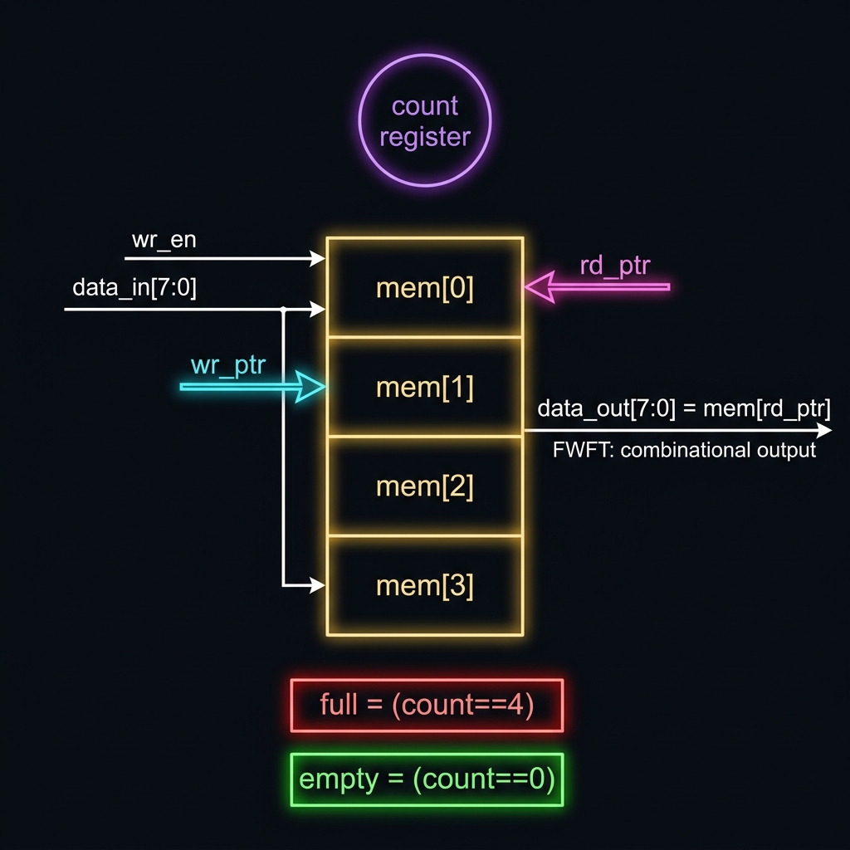
06
// FIFO BUFFER — DEEP DIVE (FIFO.V)
CIRCULAR BUFFER
>> Depth = 4. Width = 8 bits.
>> wr_ptr and rd_ptr (2-bit) wrap mod 4.
>> do_write = wr_en AND (NOT full OR do_read)
FIRST-WORD FALL-THROUGH (FWFT)
>> data_out = mem[rd_ptr] — COMBINATIONAL.
>> No extra clock edge needed to see output data.
>> empty = (count == 0). full = (count == 4).
PRESENTER: PRANJAL

Slide 8
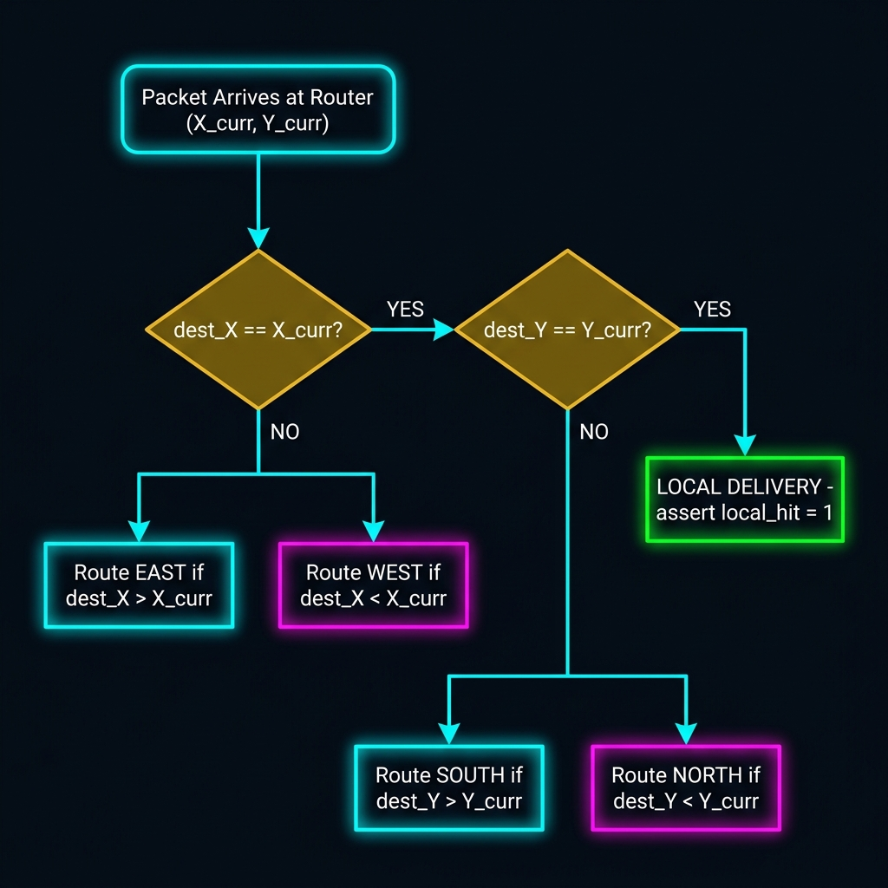
07
// XY ROUTING ALGORITHM — DECISION LOGIC
DETERMINISTIC ALGORITHM
>> Step 1: Compare destination X vs current X.
>> Step 2: If X matches, compare destination Y.
>> Step 3: If both match → LOCAL delivery.
>> Always routes East/West first, then North/South.
ROUTE ENCODING (3-BIT)
>> 000 = Idle
>> 001 = Local (Hit)
>> 010 = East
>> 011 = West
>> 100 = South
>> 101 = North
PRESENTER: PRANJAL

Slide 9
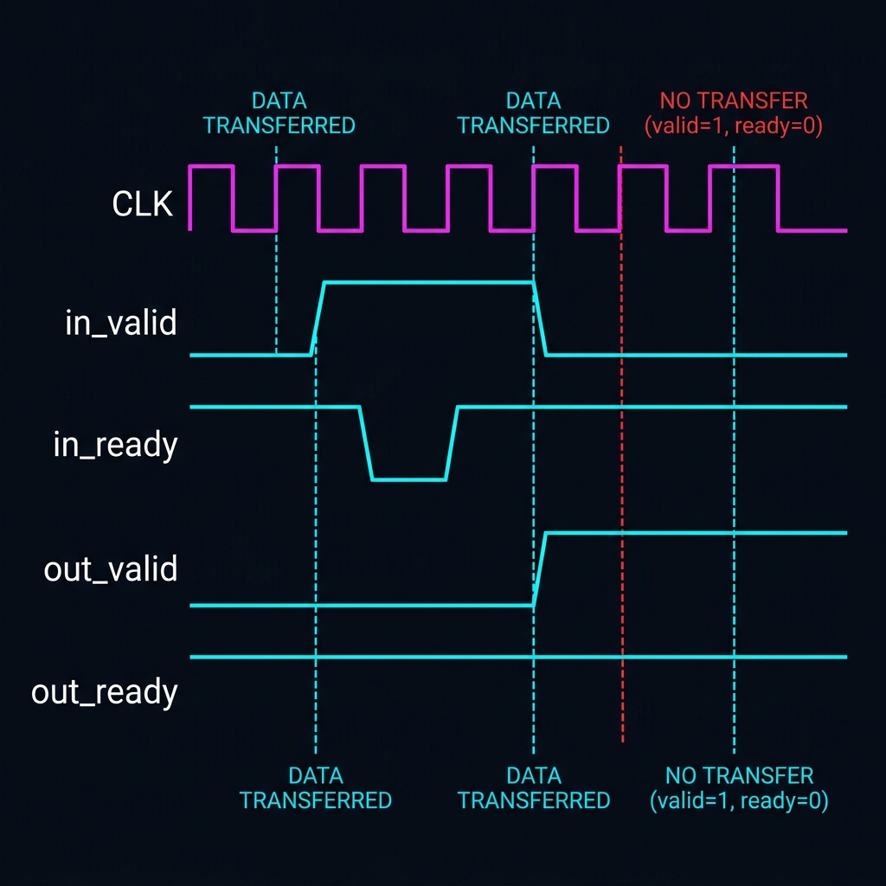
08
// FLOW CONTROL — VALID-READY HANDSHAKE PROTOCOL
TRANSFER RULE
>> Data transfers ONLY when:
>> valid == 1 AND ready == 1
>> Both HIGH on the SAME clock edge.
BACKPRESSURE
>> When FIFO fills (full=1): in_ready=0.
>> Upstream router stalls transmission.
>> Zero packet loss during heavy load.
PRESENTER: CHATHERINA

Slide 10
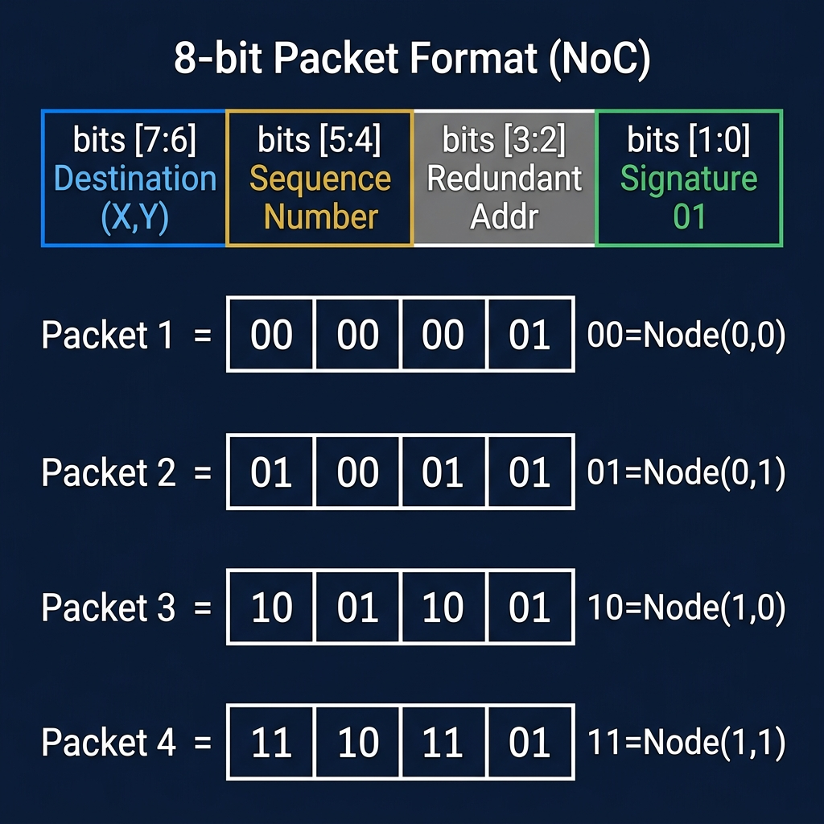
09
// PACKET FORMAT & ADDRESS SPACE
BIT MAPPING
>> Bits [7:6]: 2-bit Destination Address (00=Top-Left, 01=Top-Right, 10=Bottom-Left, 11=Bottom-Right)
>> Bits [5:2]: Payload / Sequence Number
>> Bits [1:0]: Fixed signature '01' used by testbench for validation.
PRESENTER: CHATHERINA

Slide 11
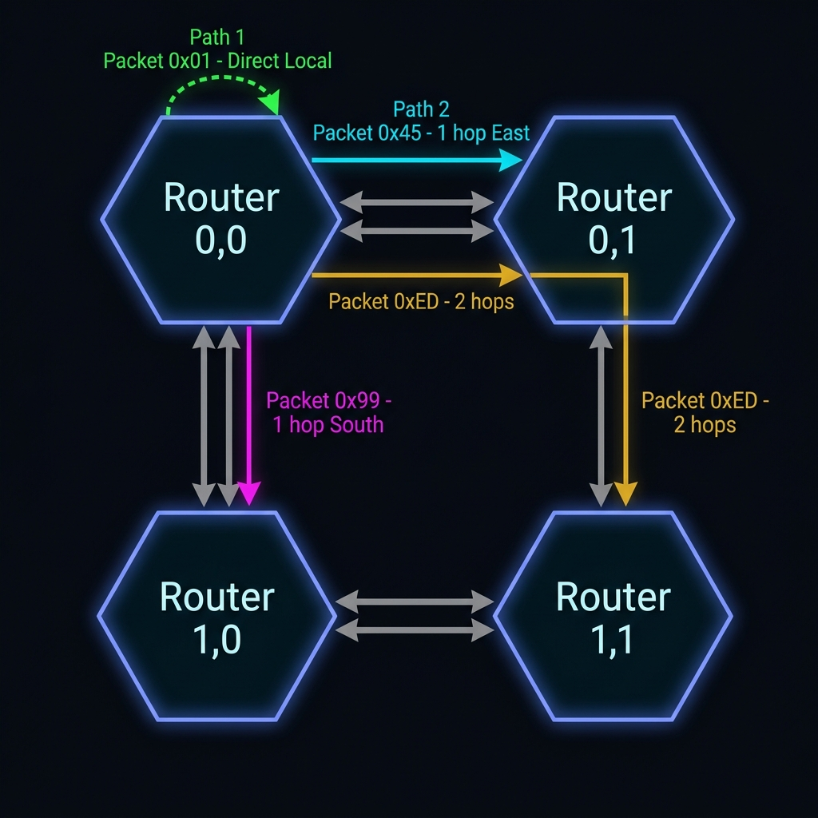
10
// ROUTING PATHS — HOP ANALYSIS
HEX
BINARY
DEST
PATH
HOPS
0x01
00 00 00 01
Node(0,0)
Local (Self)
0
0x45
01 00 01 01
Node(0,1)
East
1
0x99
10 01 10 01
Node(1,0)
South
1
0xED
11 10 11 01
Node(1,1)
East → South
2
PRESENTER: CHATHERINA

Slide 12
11
// TESTBENCH ARCHITECTURE & METHODOLOGY (NOC_TOP_TB.V)
TESTBENCH STRUCTURE
INJECTION TIMELINE
>> CLOCK GEN: 10 ns period (100 MHz clock frequency).
>> RESET: Held high for first 20 ns to flush all FIFOs.
>> INJECTION: custom task inject_packet() pushes traffic via tg_valid.
>> MONITORING: 4 sink modules independently poll sink_valid[3:0].
>> LOGGING: task record_delivery() writes cycle timestamps to CSV.
>> TIMEOUT: 1000 ns watchdog prevents infinite loops.
>> Cycle 0: RESET asserted.
>> Cycle 2: Packet 0x01 injected (Node 0,0)
>> Cycle 3: Packet 0x45 injected (Node 0,1)
>> Cycle 4: Packet 0x99 injected (Node 1,0)
>> Cycle 5: Packet 0xED injected (Node 1,1)
>> Cycle 7: test_done asserts HIGH. All deliveries confirmed.
PRESENTER: CHATHERINA

Slide 13
12
// VIVADO BEHAVIORAL SIMULATION — WAVEFORM ANALYSIS
[ PASTE VIVADO WAVEFORM SCREENSHOT HERE ]
WAVEFORM OBSERVATIONS
>> tg_packet transitions: 01 → 45 → 99 → ED sequentially.
>> sink_packet[31:0] final value = ED994501. All 4 packets safely stored at destinations.
>> test_done asserts at cycle 7. injected = delivered = 4 (100% success rate).
PRESENTER: CHARANDEEP

Slide 14
13
// MATLAB PERFORMANCE ANALYTICS
[ PASTE MATLAB 4-PANEL PERFORMANCE PLOT HERE ]
PERFORMANCE METRICS SUMMARY
>> Latency: Scales from 4.2 → 8.8 cycles as offered traffic load increases from 10% → 40%.
>> Packet Loss: Zero loss at ≤ 20% traffic. Sharp exponential rise after 30%.
>> Saturation: System saturates near 30% load due to FIFO depth (4) filling up.
PRESENTER: CHARANDEEP

Slide 15
14
// LIMITATIONS & FUTURE SCOPE
CURRENT LIMITATIONS
FUTURE UPGRADES
>> FIXED XY ROUTING — No alternate paths. Congested links block all traffic needing that route.
>> SHALLOW BUFFERS — FIFO depth of 4 triggers rapid packet drops past 30% load.
>> SINGLE TRAFFIC SOURCE — Testbench relies on 1 traffic generator; lacks heavy cross-traffic collision testing.
>> ADAPTIVE ROUTING — Query adjacent FIFO fullness to detour packets around congestion.
>> VIRTUAL CHANNELS — Multiple logical queues per physical link to prevent Head-of-Line blocking.
>> SILICON PROTOTYPING — Synthesize onto Xilinx Artix-7 FPGA to validate physical timing slack and max MHz.
>> SCALE OUT — Parameterized architecture easily scales to an 8×8 (64-node) mesh.
PRESENTER: CHARANDEEP

Slide 16
CONCLUSION
[+] COMPLETE RTL DESIGN:
5 full Verilog-2001 modules built and tested from scratch.
[+] ZERO PACKET LOSS:
Valid-Ready handshake successfully prevented data collisions under normal load.
[+] SCALABLE ARCHITECTURE:
Modular node design provides a highly scalable foundation for advanced NoCs.
PRESENTER: CHARANDEEP
THANK YOU // QUESTIONS?

