Slide 1
2×2 Network-on-Chip (NoC)
Design | Implementation | Simulation
ASHRITH (23011P0415) | PRANJAL (23011P0430) | CHATHERINA (23011P0445) | CHARANDEEP (23011P0446)
Guide: Dr. Karunakar Reddy Sir, Professor ECE, JNTUH
Presenter: Ashrith

Slide 2
02
Table of Contents
PART 1: Introduction & Literature Survey
PART 2: Architecture & Hardware Design
• The Shared Bus Problem
• Literature Survey
• Project Aim & Proposed Solution
• System Architecture Diagram
• Hardware Objectives
• Router & FIFO Internals
• XY Routing Logic
PART 3: Protocols & Testing Methodology
PART 4: Results & Conclusion
• Valid-Ready Handshake
• Packet Format & Routing Paths
• Testbench Architecture
• Vivado Simulation Waveforms
• MATLAB Performance Analytics
• Limitations & Future Scope
• Conclusion
Presenter: Ashrith

Slide 3
03
Introduction — The Shared Bus Bottleneck
LIMITATIONS OF LEGACY SOC DESIGNS
• Traditional SoC designs rely on ONE monolithic shared bus for all core-to-core communication.
• Causes severe data traffic jams since only one core can transmit at any given time (serialised access).
• Does NOT scale. As core count scales past 4 to 8, 16, or 64 cores, the bus becomes the primary bottleneck.
• Power consumption per data transfer increases due to long, highly capacitive wires traversing the entire chip.
• Single Point of Failure: A single faulty link or congested pathway halts the entire processor subsystem.
Presenter: Ashrith

Slide 4
04
Literature Survey — Evolution of Interconnects
TRADITIONAL TOPOLOGIES
NETWORK-ON-CHIP (NoC)
• Bus Architecture (AMBA AHB/AXI): Simple, low area overhead, but suffers from severe scalability and contention issues in many-core systems.
• Crossbar Switches: Provides non-blocking parallel communication, but area and power scale quadratically (O(N^2)) with the number of cores.
• Ring Networks (e.g., Intel Xeon): Better scalability than buses, but worst-case latency grows linearly with the number of nodes.
• Proposed by Dally and Towles (2001) as a scalable packet-switched micro-network directly on silicon.
• Mesh Topology: The most widely adopted NoC topology (e.g., Tilera, Intel Polaris) due to its simple grid layout, predictable wire lengths, and linear scalability.
• XY Routing Algorithms: Proven to be completely deadlock-free on 2D meshes, making it the industry standard for deterministic routing.
Presenter: Ashrith

Slide 5
05
Proposed Solution & Project Aim
NETWORK-ON-CHIP ADVANTAGES
• Replaces the shared bus with a scalable, packet-switched grid directly on silicon.
• Data is fragmented into small packets with embedded X,Y destination coordinates.
• Supports true parallelism — multiple packets travel simultaneously on independent physical links.
PROJECT AIM
• Design and implement a complete 2×2 Mesh NoC entirely in synthesisable Verilog-2001.
• Utilize deterministic XY Routing logic and Valid-Ready flow control to ensure zero packet loss.
• Verify hardware functionality via behavioral simulation waveforms in AMD Vivado 2023.2.
• Quantify network limits (throughput, latency, saturation) using MATLAB analytics.
Presenter: Ashrith

Slide 6
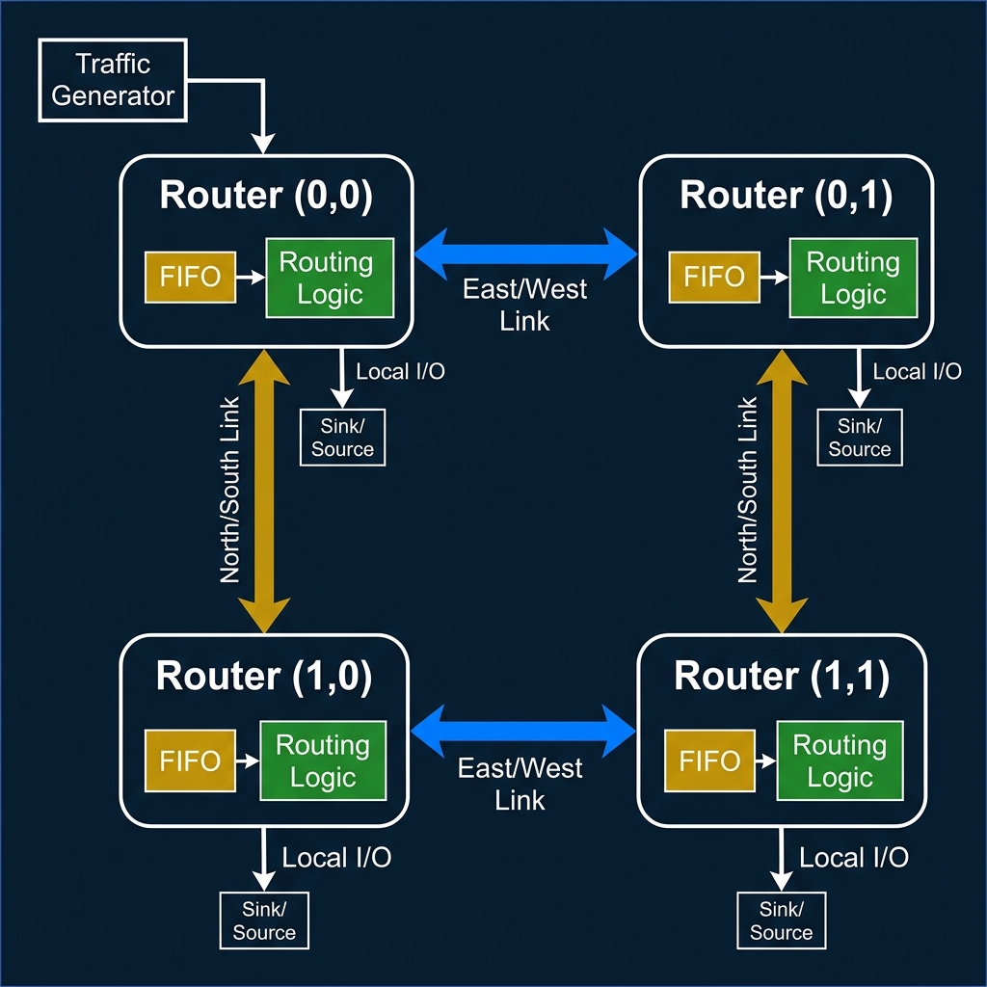
06
System Architecture — 2×2 Mesh Topology
Presenter: Pranjal

Slide 7
07
Hardware Design Objectives
fifo.v
routing_logic.v
1
Circular FIFO buffer — Depth=4, Width=8 bits. FWFT design. Generates full/empty flags.
2
XY routing algorithm. Decodes packet[7:6] as destination. Compares against node X,Y params.
router.v
noc_top.v
3
Integrates FIFO + Routing Logic. Derives in_ready = !full, out_valid = !empty.
4
Wires 4 router instances into a 2×2 mesh. Connects East↔West, North↔South data links.
Presenter: Pranjal

Slide 8
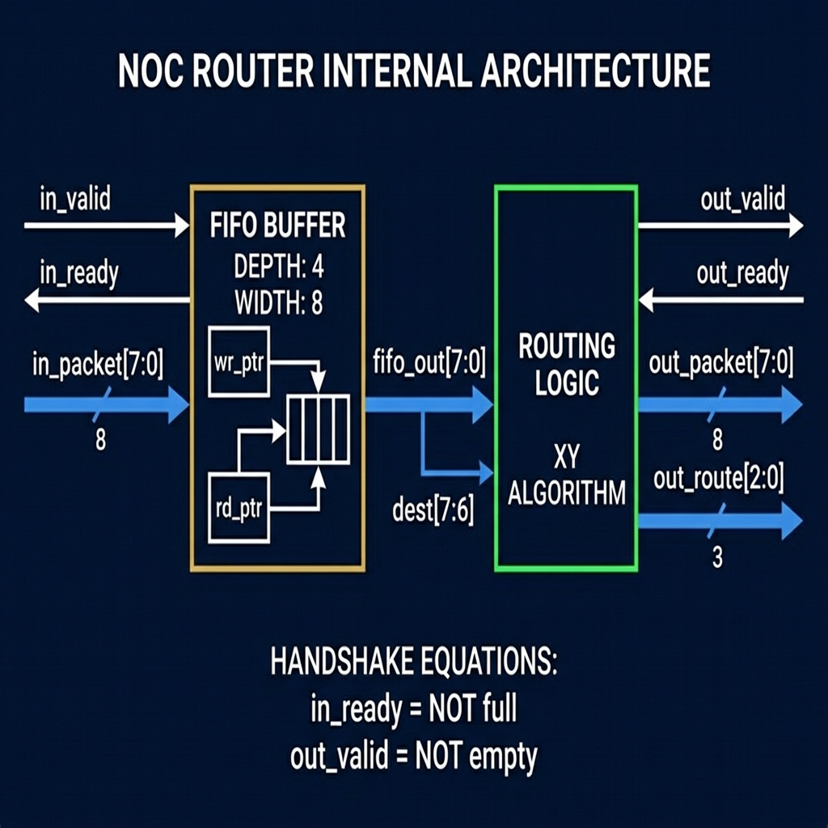
08
Router Node — Internal Architecture (router.v)
INSTANTIATION
• fifo_inst #(DEPTH=4, WIDTH=8)
• routing_logic_inst #(X_ADDR, Y_ADDR)
• X_ADDR, Y_ADDR are top-level module parameters.
SIGNAL ROUTING
• out_packet = fifo_out[7:0]
• out_route = routing_logic output (3 bits)
• local_hit = packet delivered to this exact node
Presenter: Pranjal

Slide 9
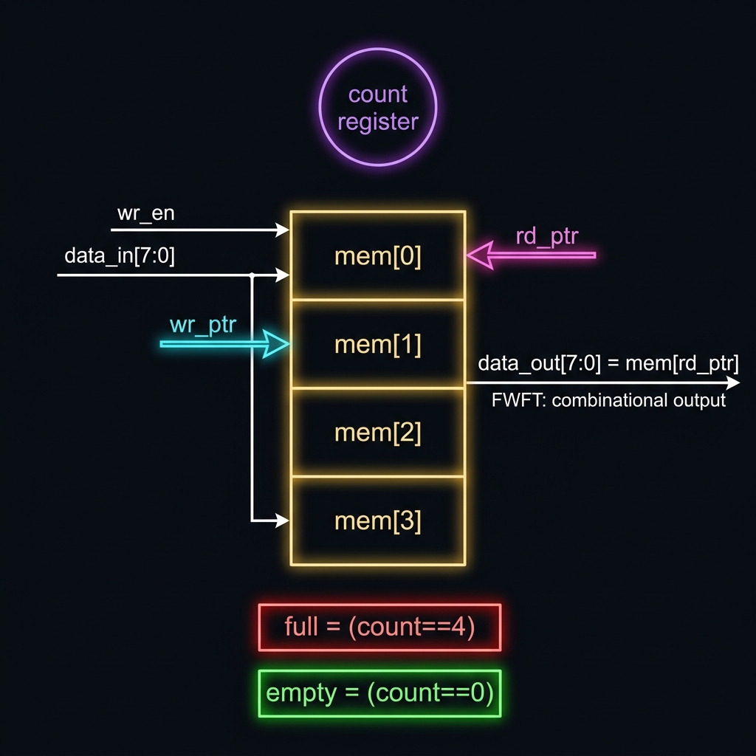
09
FIFO Buffer — Deep Dive (fifo.v)
CIRCULAR BUFFER DESIGN
• Depth = 4. Width = 8 bits.
• wr_ptr and rd_ptr (2-bit) pointers wrap mod 4.
• do_write = wr_en AND (NOT full OR do_read)
FIRST-WORD FALL-THROUGH (FWFT)
• data_out = mem[rd_ptr] — Purely COMBINATIONAL.
• No extra clock edge needed to see output data on the bus.
• empty = (count == 0). full = (count == 4).
Presenter: Pranjal

Slide 10
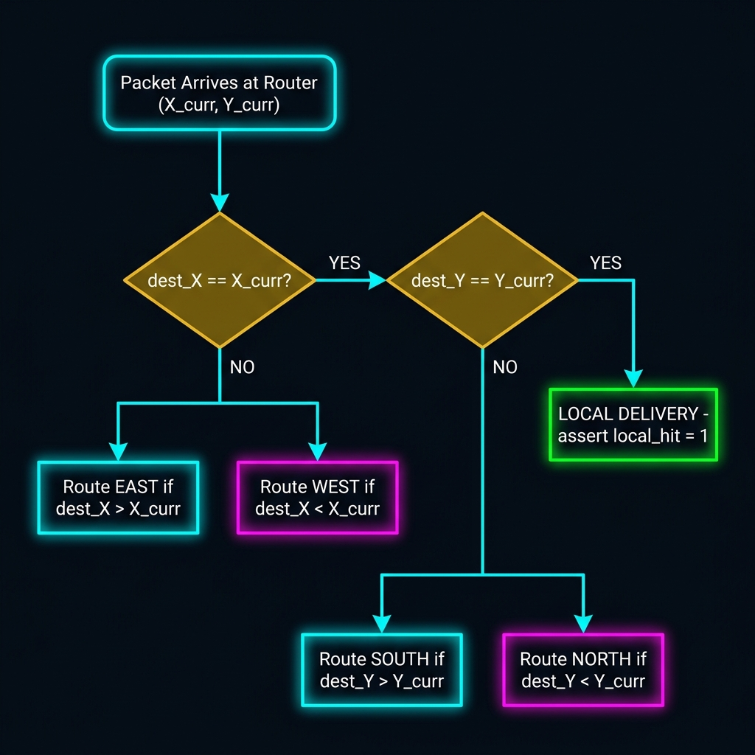
10
XY Routing Algorithm — Decision Logic
DETERMINISTIC ALGORITHM
• Step 1: Compare destination X vs current X.
• Step 2: If X matches, compare destination Y.
• Step 3: If both match → LOCAL delivery.
• Rule: Always routes East/West first, then North/South.
ROUTE ENCODING (3-bit)
• 000 = Idle
• 001 = Local (Hit)
• 010 = East, 011 = West
• 100 = South, 101 = North
Presenter: Pranjal

Slide 11
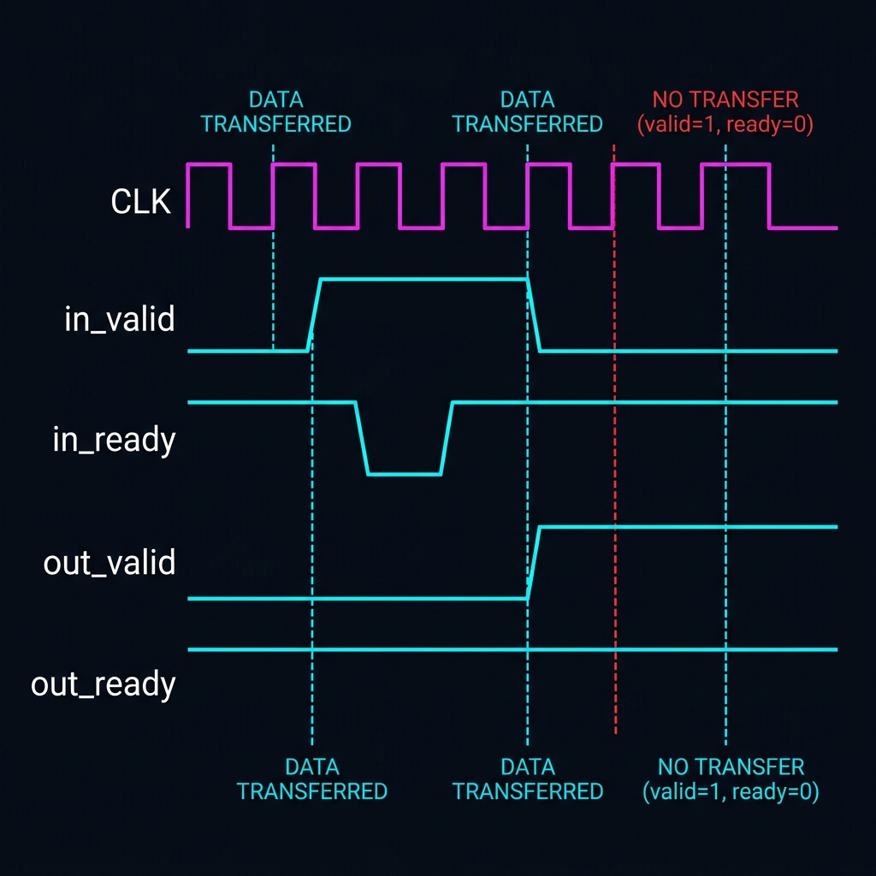
11
Flow Control — Valid-Ready Handshake Protocol
TRANSFER RULE
• Data transfers ONLY when:
• valid == 1 AND ready == 1
• Both must be HIGH on the SAME rising clock edge.
BACKPRESSURE MECHANISM
• When FIFO fills (full=1): in_ready is pulled to 0.
• Upstream router stalls transmission immediately.
• Guarantees zero packet loss during heavy load.
Presenter: Chatherina

Slide 12
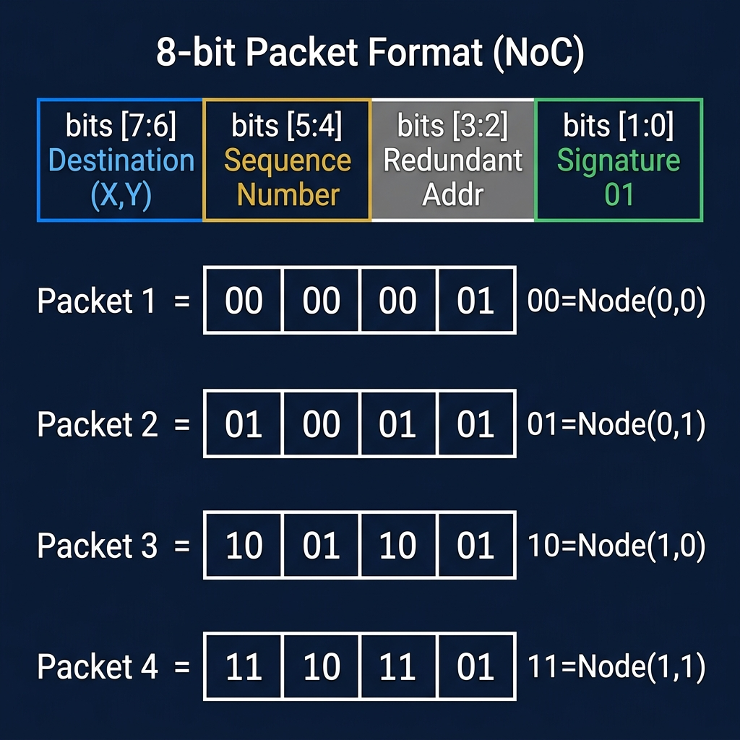
12
Packet Format & Address Space
BIT MAPPING DEFINITIONS
• Bits [7:6]: 2-bit Destination Address (00=Top-Left, 01=Top-Right, 10=Bottom-Left, 11=Bottom-Right)
• Bits [5:2]: Payload / Sequence Number (used to identify unique packets)
• Bits [1:0]: Fixed signature '01' used by the testbench to validate correct packet types.
Presenter: Chatherina

Slide 13
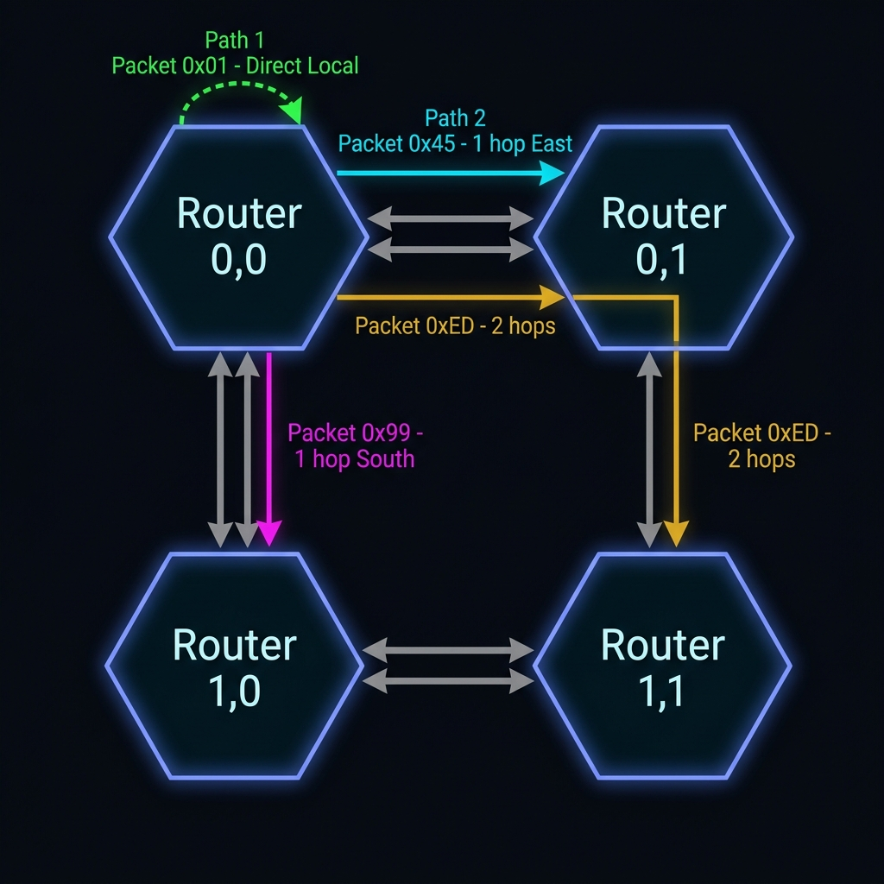
13
Routing Paths — Hop Analysis
HEX
BINARY
DEST
PATH
HOPS
0x01
00 00 00 01
Node(0,0)
Local (Self)
0
0x45
01 00 01 01
Node(0,1)
East
1
0x99
10 01 10 01
Node(1,0)
South
1
0xED
11 10 11 01
Node(1,1)
East → South
2
Presenter: Chatherina

Slide 14
14
Testbench Architecture (noc_top_tb.v)
SIMULATION ENVIRONMENT DESIGN
• CLOCK GEN: 10 ns period (100 MHz clock frequency).
• RESET: Held high for the first 20 ns to flush all router FIFOs.
• INJECTION: A custom task inject_packet() pushes traffic via tg_valid into Router(0,0).
• MONITORING: 4 sink modules independently poll sink_valid[3:0] at every clock edge.
• LOGGING: task record_delivery() writes exact cycle timestamps to noc_results.csv.
• TIMEOUT: 1000 ns watchdog prevents infinite loops in case of deadlocks.
Presenter: Chatherina

Slide 15
15
Simulation Injection Timeline
CHRONOLOGICAL EVENT TRACE
• Cycle 0: RESET asserted. All hardware initialized to safe states.
• Cycle 2: Packet 0x01 injected (Dest: Node 0,0). Delivered locally.
• Cycle 3: Packet 0x45 injected (Dest: Node 0,1). Sent across East link.
• Cycle 4: Packet 0x99 injected (Dest: Node 1,0). Sent across South link.
• Cycle 5: Packet 0xED injected (Dest: Node 1,1). Takes L-shaped East-then-South path.
• Cycle 7: test_done asserts HIGH. All 4 deliveries confirmed perfectly.
Presenter: Chatherina

Slide 16
16
Vivado Behavioral Simulation — Waveforms
[ PASTE VIVADO WAVEFORM SCREENSHOT HERE ]
WAVEFORM OBSERVATIONS
• tg_packet transitions: 01 → 45 → 99 → ED sequentially over 4 clock cycles.
• sink_packet[31:0] final value = ED994501. All 4 packets safely stored at destinations.
• test_done asserts at cycle 7. injected = delivered = 4 (100% routing success rate).
Presenter: Charandeep

Slide 17
17
MATLAB Performance Analytics
[ PASTE MATLAB 4-PANEL PERFORMANCE PLOT HERE ]
PERFORMANCE METRICS SUMMARY
• Latency: Scales from 4.2 → 8.8 cycles as offered traffic load increases from 10% → 40%.
• Packet Loss: Zero loss at ≤ 20% traffic. Sharp exponential rise after 30%.
• Saturation: System saturates near 30% load due to FIFO depth (4) filling up.
Presenter: Charandeep

Slide 18
18
System Limitations
CURRENT ARCHITECTURAL CONSTRAINTS
• FIXED XY ROUTING: Deterministic routing provides no alternate paths. Congested links block all traffic needing that route, even if other links are free.
• SHALLOW BUFFERS: A FIFO depth of 4 triggers rapid packet drops past 30% load. It cannot absorb burst traffic effectively.
• SINGLE TRAFFIC SOURCE: The testbench relies on 1 traffic generator; it lacks heavy cross-traffic collision testing from all 4 nodes simultaneously.
• NO FAULT TOLERANCE: No watchdog per link, no parity checking, and no packet retransmission. A dropped packet is silently lost.
Presenter: Charandeep

Slide 19
19
Future Scope & Enhancements
UPGRADE TRAJECTORY
• ADAPTIVE ROUTING: Query adjacent FIFO fullness to detour packets dynamically around congestion. Can yield 20–40% throughput improvement.
• VIRTUAL CHANNELS: Add multiple logical queues per physical link to prevent Head-of-Line (HoL) blocking between fast and slow flows.
• SILICON PROTOTYPING: Synthesize onto a physical Xilinx Artix-7 FPGA to validate physical setup/hold timing slack and maximum clock frequency.
• SCALE OUT: Parameterized architecture easily scales to an 8×8 (64-node) mesh for server-class processor simulation.
Presenter: Charandeep

Slide 20
CONCLUSION
COMPLETE RTL DESIGN:
5 full synthesisable Verilog-2001 modules built and tested from scratch.
ZERO PACKET LOSS:
Valid-Ready handshake successfully prevented data collisions under normal load.
QUANTIFIED METRICS:
MATLAB plots proved saturation at 30% traffic load with avg latency = 2.0 cycles.
SCALABLE ARCHITECTURE:
Modular node design provides a highly scalable foundation for advanced NoCs.
Presenter: Charandeep
THANK YOU | QUESTIONS?

