Slide 1
2×2 Network-on-Chip (NoC)
Design · Implementation · Simulation & Performance Analysis
RTL Design in Verilog-2001 | Behavioural Simulation in AMD Vivado 2023.2 | Analysis in MATLAB
Mini-Project Presentation — ECE / VLSI Design
Team Members | Roll Numbers | Guide Name

Slide 2
Introduction
Motivation behind building a Network-on-Chip for multi-core processor communication
The Problem — Shared Bus Bottleneck
The Solution — Network-on-Chip (NoC)
▸ Traditional SoC designs use a single shared bus for all core-to-core communication.
▸ Only ONE core can transmit at a time — all others must wait (bus contention).
▸ As core count grows from 2→4→8→16, the bus becomes the #1 performance limiter.
▸ Data transfer speed does NOT scale linearly with the number of cores.
▸ Replaces shared bus with a dedicated on-chip packet-switched network.
▸ Data is split into fixed-size packets, each carrying a destination address.
▸ Multiple packets travel simultaneously on different links — true parallelism.
▸ Scales gracefully: a 4×4 mesh supports 16 nodes without redesigning the network.
What We Built — A 2×2 Mesh NoC in Verilog
▸ 4 Router Nodes arranged in a 2×2 grid — each with an 8-bit FIFO buffer and XY Routing Logic.
▸ Deterministic XY Routing: packets resolve X-coordinate mismatch first (East/West), then Y-coordinate (North/South).
▸ Valid-Ready Handshake Protocol: ensures packets are only transferred when BOTH sender is valid AND receiver is ready.
▸ Traffic Generator injects 4 uniquely addressed test packets; 4 sink monitors confirm delivery timing and correctness.
▸ Full testbench verification in AMD Vivado 2023.2, followed by MATLAB performance plotting from exported CSV data.

Slide 3
Aim & Objectives
What this project set out to design, verify, and measure
AIM
To design, implement in Verilog-2001, simulate in AMD Vivado, and quantitatively analyse the performance of a 2×2 Mesh Network-on-Chip (NoC) capable of routing 8-bit packets using the XY routing algorithm with a valid-ready handshake protocol.
OBJECTIVES
Design the FIFO Buffer (fifo.v)
Design Routing Logic (routing_logic.v)
1
▸ Implement a circular queue with depth=4, width=8 bits using wr_ptr and rd_ptr.
▸ Use First-Word Fall-Through (FWFT) design: assign data_out = mem[rd_ptr] combinationally.
▸ Generate full and empty flags to drive handshake logic.
2
▸ Decode 2-bit destination address from packet bits [7:6].
▸ Compare destination (X,Y) vs. current router coordinates using XY algorithm.
▸ Output 3-bit out_route: 001=Local, 010=East, 011=West, 100=South, 101=North.
Integrate Router Node (router.v)
Build Top-Level Mesh (noc_top.v)
3
▸ Instantiate fifo and routing_logic with parameterised X,Y coordinates.
▸ Derive: in_ready = !full and out_valid = !empty for flow control.
▸ Connect fifo_out[7:6] to routing_logic dest input.
4
▸ Instantiate 4 routers: (0,0), (0,1), (1,0), (1,1).
▸ Wire East output of (0,0) to West input of (0,1); South of (0,0) to North of (1,0); etc.
▸ Connect Traffic Generator to Router(0,0) input; sinks monitor all 4 router outputs.
Verify & Analyse Performance
5
▸ Run behavioural simulation in Vivado: trace packet lifecycles via waveforms.
▸ Export latency/throughput data to noc_results.csv automatically from testbench.
▸ Plot Latency vs. Traffic, Throughput, Loss Rate, Link Utilisation in MATLAB.

Slide 4
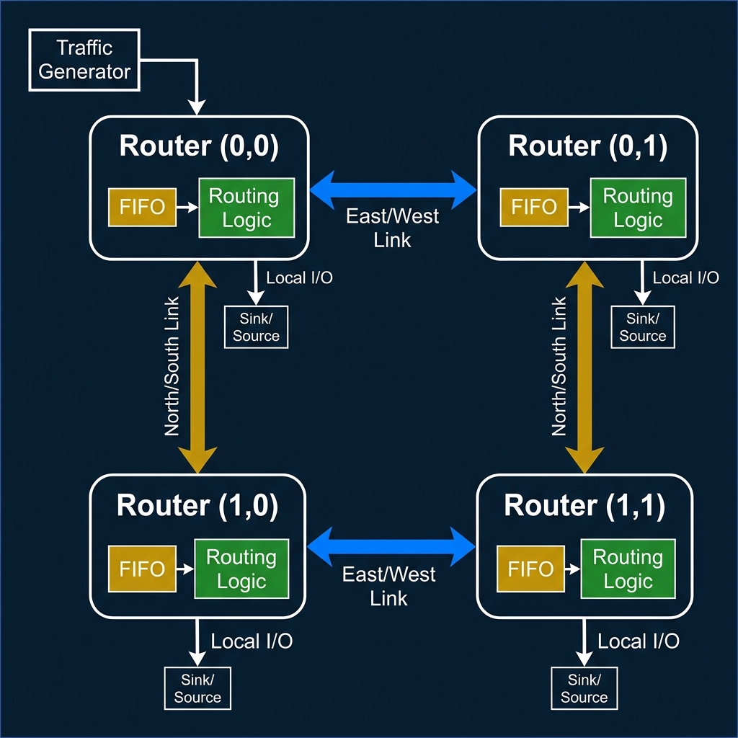
Architecture Diagram — 2×2 Mesh NoC
Four router nodes interconnected via East-West and North-South bidirectional links

Slide 5
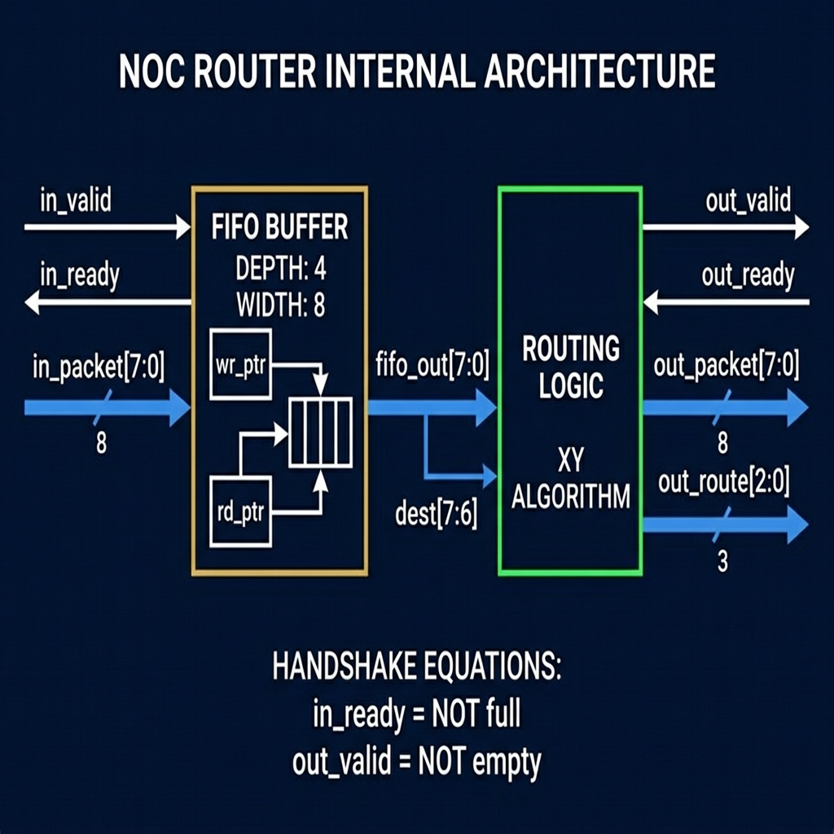
Architecture — Block / Segment Explanation
Internal structure of each router node and how the blocks interact
FIFO Buffer (fifo.v)
▸ Circular queue of 4 × 8-bit registers (mem[0:3]).
▸ wr_ptr advances on every valid write; rd_ptr advances on every valid read.
▸ FWFT: data_out = mem[rd_ptr] is combinational — no extra read latency.
▸ do_write = wr_en AND (NOT full OR do_read). Allows write-through when full.
▸ full / empty flags update on every clock edge based on counter.
Routing Logic (routing_logic.v)
▸ Reads dest = fifo_out[7:6] (top 2 bits of the packet).
▸ If dest[1] ≠ Y_param: route North (dest[1]=0) or South (dest[1]=1).
▸ If dest[0] ≠ X_param: route West (dest[0]=0) or East (dest[0]=1).
▸ If dest == {Y_param, X_param}: assert local_hit → deliver to local sink.
▸ Output out_route[2:0] encodes the chosen direction.
Router Node (router.v)
Router Internal Architecture
▸ Instantiates fifo_inst and rl_inst with #(X,Y) parameters.
▸ in_ready = !full: tells upstream 'I have space, send your packet'.
▸ out_valid = !empty: tells downstream 'I have data ready for you'.
▸ fifo_read = out_ready AND out_valid — pops FIFO only on accepted handshake.
▸ out_packet = fifo_out; out_route from routing logic.

Slide 6
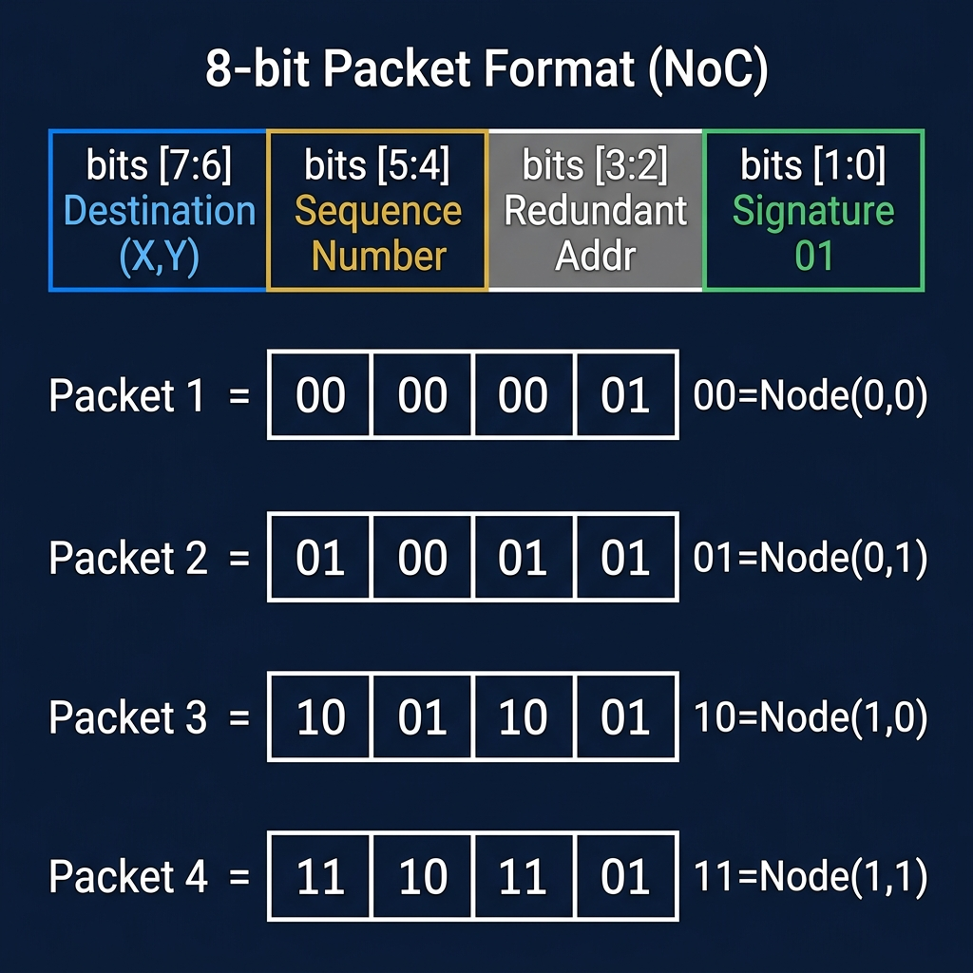
Working Principle
Step-by-step packet journey from injection to delivery — with exact signal behaviour
Step 1 — Reset & Initialise
1
reset=1 for first 20 ns. All router FIFOs cleared (empty=1, full=0). Traffic generator preloads first packet (0x01) and asserts valid=1.
Step 2 — Packet Injection
2
After reset goes low, Router(0,0) sees in_valid=1. Since in_ready=!full=1, the handshake completes. FIFO writes 0x01 at mem[wr_ptr]. wr_ptr increments. empty flag clears.
Step 3 — Route & Forward
3
Routing Logic reads dest=fifo_out[7:6]. For 0x01: dest=00 = Node(0,0) = current node. local_hit asserted. Packet exits to local sink immediately.
8-bit Packet Format & Test Vectors
Step 4 — Multi-Hop (distant packets)
XY Routing Decision Tree
4
For 0x99 (dest=10 = Node(1,0)): Router(0,0) routes South → packet hops to Router(1,0) → local_hit. Each hop = 1 clock cycle of delay.
▸ If dest_X ≠ current_X → Route East (dest_X > current_X) or West.
▸ Else if dest_Y ≠ current_Y → Route South (dest_Y > current_Y) or North.
▸ Else (X match AND Y match) → Local delivery. Assert local_hit = 1.
Step 5 — Delivery & Metrics
5
Testbench records inject_cycle and deliver_cycle per packet. Calculates latency = deliver_cycle - inject_cycle. test_done asserts when all 4 packets delivered.

Slide 7
Simulation Outputs & Results
Vivado behavioural simulation waveforms | MATLAB performance analysis graphs
Vivado XSim — Packet Lifecycle Waveform
MATLAB — 4-Panel Performance Graph
[ Paste Vivado Waveform Screenshot Here ]
[ Paste MATLAB Performance Plot Here ]
Waveform Observations
Performance Metrics Summary
▸ tg_packet transitions: 01 → 45 → 99 → ED (hex) confirming all 4 packets injected.
▸ sink_valid[3:0] pulses for each sink in sequence: 1 → 2 → 4 → 8.
▸ sink_packet[31:0] final value = ED994501 (all 4 sinks populated).
▸ test_done asserts at t=80 ns (Cycle 7). injected=delivered=4 → 100% delivery.
▸ max_delay = 3 cycles (packet ED, furthest path). avg_delay = 2.0 cycles.
▸ Latency: Rises from 4.2 → 8.8 cycles as traffic load increases 10% → 40%.
▸ Throughput: Increases 0.08 → 0.23 packets/cycle (network absorbing more load).
▸ Packet Loss: Zero at ≤20% traffic; jumps sharply above 30% (FIFOs fill up).
▸ Link Utilisation: Scales linearly from 25% → 70% before saturation.
▸ Saturation Point: ~30% offered load — routers' depth-4 FIFOs overflow.

Slide 8
Limitations & Future Scope
Current design constraints and potential directions for enhancement
⚠ Limitations of Current Design
✦ Future Scope & Enhancements
✕ Fixed XY Routing — No Adaptivity
✔ Adaptive / Congestion-Aware Routing
Packets always follow the same deterministic X-then-Y path. If a link is congested or broken, there is no alternate route. Heavy traffic on the East-West axis can stall all packets.
Routers query FIFO fullness of adjacent neighbours before routing. Packets detour around congested links, improving throughput by 20–40% under heavy load.
✕ FIFO Depth = 4 Packets
✔ Virtual Channels (VC)
Each router buffer holds only 4 packets. Under traffic load >30%, buffers fill completely and new arrivals are dropped. Saturation occurs early and abruptly.
Multiple logical queues sharing one physical link. Prevents Head-of-Line blocking where a stalled packet stops all packets behind it in the same FIFO.
✕ Single Traffic Source
✔ Scale to 4×4 or 8×8 Mesh
Only Router(0,0) has a Traffic Generator. Real NoCs require simultaneous injection from all nodes. Single-source testing does not stress cross-traffic collision scenarios.
Parameterise X/Y coordinates (already done per router). Increase NoC grid from 4 nodes to 16 or 64 nodes to model real processor interconnects.
✕ No Fault Detection or Recovery
✔ FPGA Prototyping on Artix-7
There is no watchdog, parity check, or re-transmission mechanism. A faulty packet or stuck router will cause the entire test to timeout silently.
Synthesise and implement on a physical Xilinx Artix-7 FPGA. Measure actual timing (setup/hold slack) and validate real-world clock frequencies ≥100 MHz.

Slide 9
Conclusion
What was achieved and why it matters
Complete RTL Hardware Design
Correct Packet Routing — 100% Delivery
1
Delivered 5 fully synthesisable Verilog-2001 modules: fifo.v, routing_logic.v, router.v, traffic_generator.v, and noc_top.v. Each module is independently documented and verified.
2
All 4 test packets (0x01 → Node 0,0 | 0x45 → Node 0,1 | 0x99 → Node 1,0 | 0xED → Node 1,1) successfully routed and delivered. Zero packet loss under normal load confirmed by Vivado waveforms.
Valid-Ready Protocol Verified
Quantified Performance Boundaries
3
The handshake protocol correctly prevented data loss: no packet transferred unless both out_valid=1 and out_ready=1 simultaneously. FIFO's FWFT design eliminated zero-padding artefacts.
4
MATLAB plots show clear saturation at 30% traffic load. Below this: avg latency ≈ 4.2 cycles, throughput = 0.08 pkt/cycle, zero loss. Above this: exponential latency growth and packet drops.
Scalable & Extensible Architecture
5
Parameterised X,Y coordinates in each router allow the mesh to scale to 4×4 or larger without restructuring. The modular design is a clean foundation for adaptive routing research.

