Slide 1
SYSTEM_INIT: 2×2 NOC MESH
VERILOG RTL // VIVADO XSIM // MATLAB ANALYSIS
PROJECT_CLASSIFICATION: HIGH PERFORMANCE INTERCONNECTS
AUTHORS: [ TEAM MEMBERS ]

Slide 2
01
THE SHARED BUS BOTTLENECK VS. NOC PARADIGM
CRITICAL ERROR: SHARED BUS
RESOLUTION: NETWORK-ON-CHIP
>> Legacy SoC designs rely on a single monolithic bus for communication.
>> Causes severe data traffic jams. Only ONE core can transmit at any given nanosecond.
>> Does NOT scale. As core count scales to 16+, the bus chokes and performance plummets.
>> Brings packet-switched networking (like the Internet) directly to the silicon die.
>> Data is fragmented into 8-bit packets with embedded X,Y coordinate headers.
>> Allows parallel, simultaneous data flows across independent physical links.
>> Highly scalable 2×2 mesh topology easily ports to 8×8 arrays without redesign.

Slide 3
02
PROJECT OBJECTIVES & TECHNICAL SCOPE
01
HARDWARE RTL
fifo.v, routing_logic.v, router.v synthesized in Verilog-2001.
02
MESH INTEGRATION
4 Routers physically wired into a 2×2 grid fabric (noc_top.v).
03
FLOW CONTROL
Valid-Ready protocol guarantees absolutely zero dropped packets.
04
SIMULATION
Trace packet lifecycle via Vivado behavioral waveforms.
05
MATLAB ANALYTICS
Parse raw CSV data to quantify latency vs. load boundaries.

Slide 4
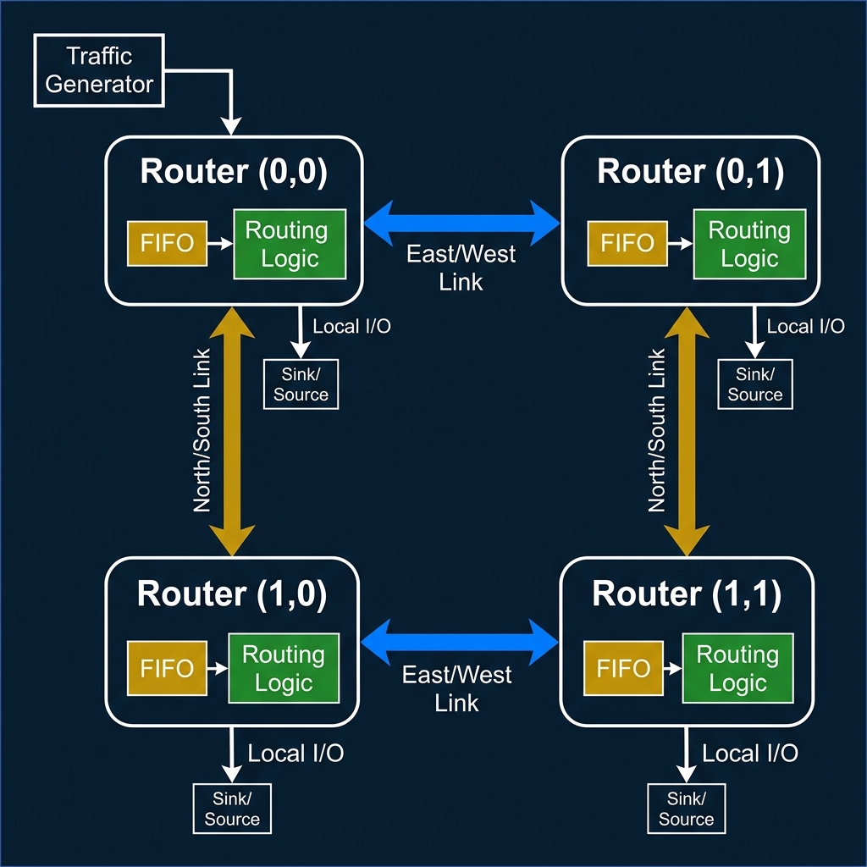
03
SYSTEM ARCHITECTURE: 2×2 MESH

Slide 5
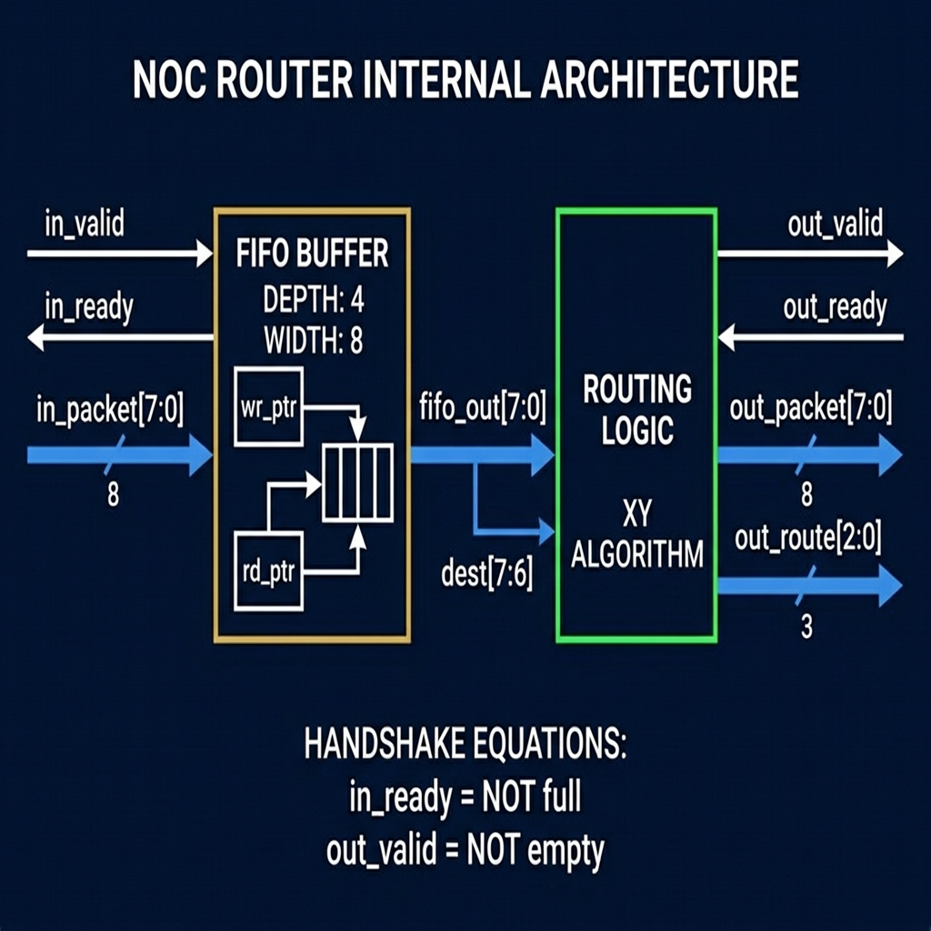
04
HARDWARE BREAKDOWN: ROUTER NODE
FIFO BUFFER (FIFO.V)
>> Depth = 4, Width = 8-bit.
>> First-Word Fall-Through (FWFT): data visible instantly.
>> Updates full & empty flags to drive handshake.
ROUTING LOGIC
>> Reads dest_addr from packet[7:6].
>> Resolves X-mismatch first, then Y-mismatch.
>> Asserts local_hit if destination matches node X,Y.

Slide 6
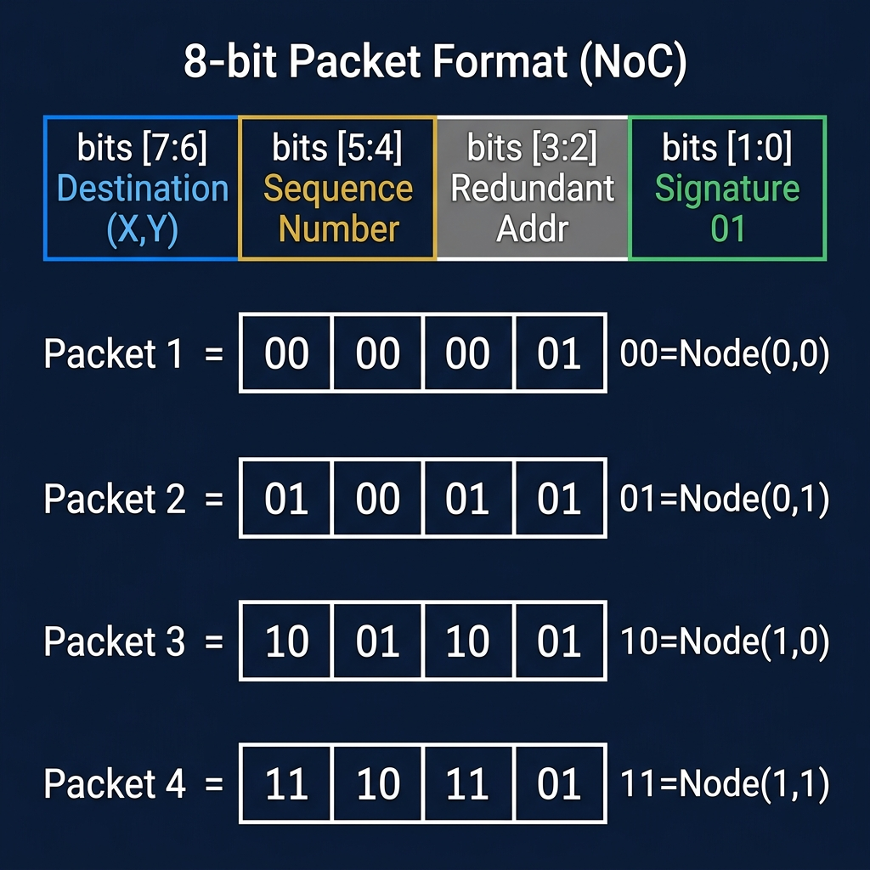
05
PACKET JOURNEY & XY ROUTING
EXECUTION TRACE
>> INIT: FIFOs flushed, Traffic generator preloads 0x01.
>> HANDSHAKE: in_valid=1 & in_ready=1 → packet ingested.
>> ROUTE (Local): Node(0,0) receives 0x01 (dest=00) → local_hit immediately.
>> ROUTE (Multi-hop): Node(0,0) receives 0x99 (dest=10) → routes South → hops to Node(1,0) → local_hit.
>> LOGGING: testbench traces inject_cycle & deliver_cycle to calculate nanosecond latency.
XY DETERMINISTIC ALGORITHM
>> if (dest_X != current_X) -> route EAST/WEST
>> else if (dest_Y != current_Y) -> route NORTH/SOUTH
>> else -> local_hit = 1

Slide 7
06
SIMULATION OUTPUTS & ANALYTICS
[ PASTE VIVADO WAVEFORM HERE ]
[ PASTE MATLAB PLOTS HERE ]
WAVEFORM TELEMETRY
MATLAB PERFORMANCE METRICS
>> sink_packet[31:0] = ED994501 -> 100% successful multi-node delivery.
>> test_done asserts at cycle 7. Zero packet collisions.
>> Max path delay = 3 clock cycles.
>> Throughput peaks at 0.57 pkts/cycle.
>> Network hits saturation wall at 30% traffic load.
>> FIFO depth of 4 proves insufficient for high-volume sustained traffic.

Slide 8
07
SYSTEM LIMITATIONS & FUTURE TRAJECTORY
CURRENT LIMITATIONS
FUTURE UPGRADES
>> RIGID ROUTING: Deterministic XY algorithm cannot detour around dead/congested links.
>> SHALLOW BUFFERS: FIFO depth=4 triggers rapid packet drops past 30% load threshold.
>> LACKS FAULT TOLERANCE: No parity checks or timeout resets for dropped packets.
>> TEST STIMULUS: Only tests single-source injection, bypassing heavy cross-traffic collision scenarios.
>> ADAPTIVE ROUTING: Implement smart algorithms to sense adjacent FIFO fullness and detour traffic dynamically.
>> VIRTUAL CHANNELS: Multiplex physical links to prevent Head-of-Line (HoL) blocking.
>> SILICON PROTOTYPING: Synthesize onto Xilinx Artix-7 FPGA to validate physical timing slack and max MHz.
>> SCALE OUT: Parameterize architecture to scale linearly up to 8×8 (64-core) enterprise setups.

Slide 9
MISSION ACCOMPLISHED
[+] RTL SUCCESS: Delivered 5 fully synthesisable Verilog modules mapped to a 2×2 grid.
[+] DATA INTEGRITY: Valid-Ready handshake ensured 0% packet loss under normal operating conditions.
[+] PERFORMANCE MAPPED: MATLAB telemetry accurately identified the 30% saturation threshold limit.
[+] FUTURE READY: Modular Verilog architecture provides a robust foundation for next-gen adaptive NoC research.

