Slide 1
GIFT IFIH · YOUNG BUILDERS PROGRAM · IFSC
THE PROPOSITION
AETHER-
Over-the-counter derivatives move on collateral. When volatility spikes, the desks that have to move it are reading legal annexes, rebuilding exposure in spreadsheets and reaching for cash because cash is easy.
DERIVATIVES
AETHER deploys three agents over deterministic financial engines: one reads the Credit Support Annex, one turns exposure into a margin requirement, one selects the cheapest collateral that satisfies every contractual constraint — and every step leaves an auditable record.
Autonomous Margin & Collateral Intelligence
for Cross-Border OTC Derivatives
“From contract interpretation to collateral decision —
with deterministic financial computation
and an auditable trail.”
›
Legal intelligence
bespoke annexes, cited and confidence-scored
›
Deterministic risk
no model ever produces a margin number
›
Cheapest-to-deliver
constrained optimisation, not habit
AI interprets. Deterministic engines calculate.
Optimisation decides. Humans govern ambiguity.
›
Cross-border economics
FX drag priced, not assumed
All market data, counterparties and legal documents in this prototype are SIMULATED. No transaction is executed, no market infrastructure is connected, no regulatory approval is claimed.
Notes:
OPENING (15s)
"AETHER-Derivatives. Autonomous margin and collateral intelligence for cross-border OTC
derivatives."
"One sentence: an ISDA Credit Support Annex goes in, and a defensible margin call, a
cost-minimal collateral allocation and a tamper-evident audit trail come out."
Point at the four bullets on the right — that's the whole product.
Say the honesty line early; it buys credibility for everything after:
"Everything you'll see runs on simulated data, and the system says so on every screen."

Slide 2
THE PROBLEM
Margin calls are settled by people reading legal documents.
$600 TRILLION
4 – 6 HOURS
200+ PAGES
notional in global OTC derivatives markets
to recalculate variation margin manually when volatility spikes
of ISDA Master Agreement and Credit Support Annex per counterparty
During volatility, human risk desks work from spreadsheets and manual PDF searches across those annexes.
Read the annex
Rebuild exposure
Compute the call
Choose collateral
Instruct settlement
Defend it later
threshold · MTA · haircuts
netting set · mark to market
credit support amount
eligibility · concentration
custodian · value date
audit · dispute
Late margin calls
Cash-first habit
No single record
trigger default notices and frozen trading lines.
posts the most expensive asset on the balance sheet.
leaves disputes to be argued from four systems.
These decisions sit across legal documents, risk engines, treasury spreadsheets and operations workflows. AETHER connects them.
Market scale and manual-effort figures as stated in the AETHER Master Playbook. Not measured by this prototype.
AETHER-DERIVATIVES
02
Notes:
THE PROBLEM (25s)
"Over-the-counter derivatives are a six-hundred-trillion-dollar notional market, and
they move on collateral."
"When volatility spikes, the desks that have to move that collateral spend four to six
hours recalculating variation margin — because the terms that drive the calculation are
buried in a two-hundred-page annex, the exposure gets rebuilt in a spreadsheet, and the
collateral decision is made by habit."
"Three costs. Late calls trigger default notices. The cash-first habit posts the most
expensive asset you own. And when it's disputed, there's no single record."
Be precise about attribution — a finance judge will notice:
"Those market figures are from our problem research, not something this prototype
measured."
KEY TAKEAWAY: the difficulty is the chain, not any single calculation.

Slide 3
THE IDEA, WITHOUT THE JARGON
Think of it as an automated escrow desk.
Two parties trade. Prices move. Someone has to post security, and the contract decides how much and in what form.
01
02
03
THE CONTRACT AUDITOR
THE PIT BOSS
THE TREASURY MANAGER
Legal-Clause Agent
Risk-Engine Agent
Collateral-Optimizer Agent
Reads the agreement to establish the rules: which assets qualify as security, what minimum sizes apply, and what safety margin is taken on each.
Watches the position. When prices move, it works out exactly how much additional security is required right now, under those rules.
Looks across everything available — cash, government bonds, corporate paper, gold — and picks the cheapest combination the contract actually permits.
Threshold · Minimum Transfer Amount · eligible collateral · haircuts
Netting-set exposure · credit support amount · initial margin
Eligibility · concentration caps · FX · funding cost
Today all three roles are people, working in different systems, on different timelines. AETHER makes them one pipeline — and keeps a human in the loop exactly where the contract is ambiguous.
AETHER-DERIVATIVES
03
Notes:
PLAIN ENGLISH (25s)
"If the jargon is getting in the way — think of it as an automated escrow desk."
"Three roles. The contract auditor reads the agreement and establishes the rules: what
counts as security, what minimum sizes apply, what safety margin comes off each asset."
"The pit boss watches the position and works out how much is owed right now."
"And the treasury manager looks across everything you own — cash, government bonds,
corporate paper, gold — and picks the cheapest combination the contract permits."
"Today those are three people in three systems. AETHER makes them one pipeline."
KEY TAKEAWAY: this is an operations problem before it is an AI problem.

Slide 4
WHY THIS NEEDS MORE THAN A CHATBOT
A prompt wrapper cannot do this job.
LAYER
WHY A GENERIC LLM OR RAG FAILS
WHY AN AGENTIC SWARM SUCCEEDS
LEGAL
EXTRACTION
Standard retrieval cannot correlate nested clauses — a Threshold modified by a credit-rating downgrade trigger sits in two paragraphs that never appear together.
The agent audits the annex systematically and emits a structured schema: typed values, each with a citation, each with a confidence, ambiguity routed to a human.
RISK
ENGINE
Language models hallucinate arithmetic. They cannot be trusted with a nine-figure margin number, and no amount of prompting changes that.
The agent never calculates. It invokes audited deterministic functions through a typed tool boundary and the engine returns every figure.
COLLATERAL
OPTIMISATION
Fixed rules cannot weigh cross-asset yields, haircuts, concentration caps and FX conversion simultaneously. Desks fall back on ‘post cash’.
The agent hands the problem to a linear program that solves it exactly — and returns the shadow price of every binding constraint.
AI interprets. Deterministic engines calculate.
AETHER-DERIVATIVES
04
Notes:
WHY NOT A CHATBOT (25s)
"The obvious question is why this needs agents at all."
"Three reasons, one per layer. On legal extraction, retrieval fails because the clauses
are nested — a Threshold qualified 'subject to' a ratings trigger sits in two paragraphs
that never appear together."
"On risk, language models hallucinate arithmetic. You cannot prompt that away. So our
agents never calculate — they invoke audited deterministic functions through a typed
boundary, and the engine returns every figure."
"On collateral, fixed rules can't weigh yields, haircuts, concentration caps and FX at
once. So the agent hands it to a solver."
THE LINE: "AI interprets. Deterministic engines calculate."
LIKELY Q: "So why not skip the AI entirely?"
A: "Because a rules engine needs structured inputs, and the interpretation step is
exactly what's missing. ISDA agreements are bespoke."

Slide 5
ARCHITECTURE
Three agents. One orchestrator. One auditable decision.
AETHER ORCHESTRATOR
state, routing and hand-off between agents
LEGAL-CLAUSE AGENT
RISK-ENGINE AGENT
COLLATERAL-OPTIMIZER AGENT
Interprets the contract
Quantifies the requirement
Decides what to deliver
›
Parses the ISDA Master Agreement
and Credit Support Annex
›
Marks the netting set to a pinned
market snapshot
›
Screens inventory for eligibility
under the annex's schedule
›
Extracts thresholds, minimum transfer
amounts and valuation percentages
›
Applies the CSA waterfall: threshold,
independent amount, MTA, rounding
›
Prices haircuts, FX and funding cost
per unit actually delivered
›
Cites the source span for every value
Flags ambiguity for human review
›
Computes initial margin alongside
Never performs arithmetic itself
›
Solves for cheapest feasible mix
Renders the settlement instruction
OUT → structured contractual terms
OUT → the margin requirement
OUT → the collateral decision
DECISION RECORD → AUDIT CHAIN
Each agent's request and each engine's result is recorded separately.
AETHER-DERIVATIVES
05
Notes:
ARCHITECTURE (25s)
"Three agents under one orchestrator, and each one owns a stage."
"Legal-Clause interprets the contract and hands over structured terms. Risk-Engine turns
those terms plus the market into a margin requirement. Collateral-Optimizer decides what
to deliver against it."
"Read the middle column carefully: 'never performs arithmetic itself'. The agent chooses
which deterministic tool to invoke and with which references. The engine returns the
number."
"And the bar at the bottom is what makes that checkable — each agent's request and each
engine's result are recorded as separate events."
LIKELY Q: "What stops an agent inventing a number anyway?"
A: "The type of a tool call. Arguments are identifiers and flags only — a Decimal raises
at construction. I can show you the test."

Slide 6
THE WORKFLOW
One decision pipeline, from contract to collateral.
LEGAL DOCUMENT
The rule the pipeline is built on
ISDA Master Agreement + Credit Support Annex
A contractual value crosses from the model into the engine exactly once — through a validated schema, carrying a quote from the source document, past a human when confidence is low.
LEGAL-CLAUSE AGENT
AGENT
reads, extracts, cites, scores confidence
HUMAN REVIEW
HUMAN
only where the contract is genuinely ambiguous
After that point, no language model touches a number.
STRUCTURED TERMS
frozen — this version governs the calculation
RISK / MARGIN ENGINE
WHAT EACH STAGE LEAVES BEHIND
ENGINE
exposure, credit support amount, MTA, rounding
Extraction
model, prompt version, confidence, citations
COLLATERAL OPTIMISER
ENGINE
Human review
reviewer identity, decision, written rationale
cheapest feasible mix under every constraint
Terms freeze
version number, document content hash
SETTLEMENT INSTRUCTION
structured message, pending human approval
Each engine call
inputs, outputs, engine version, snapshot
AUDIT RECORD
Decision
action, amount, and why it was taken
CHAIN
Chained by hash, so altering one record breaks every record after it.
who decided what, on what basis, in what order
AETHER-DERIVATIVES
06
Notes:
THE WORKFLOW (25s)
"This is the pipeline end to end. Document at the top, audit record at the bottom."
"Two things I'd point out. Third row down: human review. It only fires where the
contract is genuinely ambiguous — not on every field, which would defeat the purpose."
"And the box on the right is the rule the whole thing is built on: a contractual value
crosses from the model into the engine exactly once, through a validated schema,
carrying a quote from the source document. After that point no language model touches a
number."
"The lower right panel is what each stage leaves behind. That's the difference between a
demo and infrastructure — you can reconstruct the decision months later."

Slide 7
THE PRODUCT
Four capabilities — and where each one stands today.
01
MULTI-MODAL LEGAL PARSER
Ingests the ISDA Master Agreement and Credit Support Annex and extracts threshold tiers, minimum transfer amounts and valuation percentages — every field cited to its source paragraph.
BUILT
Native PDF and markdown today. Scanned documents without a text layer are refused, not guessed.
02
DETERMINISTIC RISK ENGINE
Turns a netting set and a pinned market snapshot into a margin requirement: exposure, credit support amount, minimum transfer gate, directional rounding — plus initial margin alongside.
BUILT
Two initial margin methods. Neither is ISDA SIMM: the weights are ours, uncertified, and documented as such.
03
COLLATERAL OPTIMISATION
Evaluates the whole inventory — cash, sovereigns, corporate paper, gold — against haircut, eligibility, concentration and FX, and solves for the cheapest mix that satisfies every constraint.
BUILT
A linear program, with the shadow price of every binding constraint returned alongside the allocation.
04
SETTLEMENT MESSAGE GENERATION
Renders the approved allocation as the structured collateral messages a margin call actually uses, reconciled line by line to the delivery amount.
PARTIAL
ISO 20022 and MT527 message SHAPE only. Nothing is transmitted — no network, no membership. Connectivity is roadmap.
Status is stated per capability rather than implied. What is built is demonstrable in the next two slides; what is not is named as roadmap.
AETHER-DERIVATIVES
07
Notes:
THE PRODUCT (25s)
"Four capabilities, and I've put the status on each one rather than letting you assume."
"Legal parser: built. Native PDF and markdown. A scanned document with no text layer is
refused with a stated reason, not guessed at."
"Risk engine: built. Two initial margin methods — and neither is ISDA SIMM. The weights
are ours, uncertified, and the code says so four times over."
"Collateral optimisation: built. A real linear program, and it returns the shadow price
of every binding constraint."
"Settlement: partial. We generate the messages in ISO 20022 and MT527 shape. Nothing is
transmitted — no network, no membership, no BIC. Connectivity is roadmap and I'm not
going to claim otherwise."
KEY TAKEAWAY: the honest labelling is the point. Three built, one partial.

Slide 8
THE COMMERCIAL THESIS
The expensive part of a margin call is what you deliver.
Two assets can satisfy the same call and cost very different amounts to give up.
THE RANKING THAT DECIDES THE ALLOCATION
ON ONE VERIFIED RUN
cost / effective unit = funding spread ÷ effective valuation %
Cash-first, as most desks post
USD 23,002.41
An asset with a low headline spread and a heavy haircut delivers less collateral per unit encumbered.
Optimised allocation
USD 5,496.52
THE CONSTRAINTS IT MUST SATISFY SIMULTANEOUSLY
Eligibility
Wrong-way risk
MODELLED REDUCTION
does the annex's schedule admit this asset at all?
never the counterparty's own paper
76.10%
USD 17,505.89
on this one call
Haircut
Inventory
what percentage of market value actually counts?
what is genuinely available to encumber
WHAT THE SOLVER ALSO RETURNS
Concentration
FX
The shadow price of every binding constraint — what relaxing it by one unit would save:
issuer, asset class and sector ceilings
non-base currency takes a further haircut
Coverage
6.80bp
Corporate cap
2.61bp
Gold cap
1.22bp
Single-issuer cap
1.09bp
MODELLED reduction vs a cash-first baseline in one synthetic scenario. Not a guarantee, not annualised.
AETHER-DERIVATIVES
08
Notes:
COLLATERAL THESIS (30s)
"Everyone focuses on how much is owed. The expensive question is what you deliver."
"The ranking that decides it is cost per effective unit — funding spread divided by
effective valuation percentage. An asset with a low headline spread and a heavy haircut
delivers less collateral per unit you encumber. That single ratio is the product."
"And it has to satisfy six constraints at once — eligibility, haircut, concentration,
wrong-way risk, inventory, FX. That's a solver's job, not a spreadsheet's."
"On one verified run: cash-first costs twenty-three thousand a year. Optimised costs
five and a half. Seventy-six percent lower."
SAY THE QUALIFIER, DON'T HIDE IT:
"Modelled, against a cash-first baseline, in one synthetic scenario. Not a guarantee."
"And the solver gives you something a spreadsheet never will — the shadow price of every
binding constraint. Your corporate bond cap is costing you 2.61 basis points. That's your
own credit policy, priced."

Slide 9
GIFT CITY · IFSC
Cross-border collateral has to be priced, not assumed.
An IFSC banking unit trades a USD-based agreement while funding rupee assets at home. Those two facts pull in opposite directions.
THE ADVANTAGE
THE COST
Local paper is cheaper to fund at home. On headline spread it beats the alternative.
It is not in the agreement's base currency, so the annex takes a further FX haircut on top of the schedule valuation.
AETHER resolves the tension by pricing it. On the verified run:
Headline funding spread
Schedule valuation
FX haircut on top
Effective valuation
Delivered cost
Cheapest alternative
9 bp
94.00%
× 92%
86.48%
10.41 bp
8.04 bp
cheaper than the 8 bp alternative
eligible collateral schedule
non-base currency provision
94% × 92%
cost per unit actually delivered
US Treasury bill
THE OPTIMISER'S DECISION
OF WHICH, THE FX DRAG ALONE
NOT SELECTED
0.83 bp
the price of posting cross-border, isolated from the schedule haircut
The rupee asset was evaluated, priced, and declined — the Treasury bill delivered the same coverage for less.
Elsewhere in the same inventory EUR cash is 28 bp on paper and 30.43 bp delivered — dearer than 30 bp USD cash.
The GIFT City case is that cross-border collateral is priced on delivered economics — not favoured because it is local.
AETHER-DERIVATIVES
09
Notes:
GIFT CITY (30s) — the slide that earns the venue
"An IFSC banking unit has a structural tension. It trades a dollar-based agreement, and
it funds rupee assets more cheaply at home. Those pull in opposite directions."
"AETHER resolves it by pricing it. Walk the ladder: nine basis points headline — cheaper
than the eight-point alternative. Ninety-four percent schedule valuation. Then a further
eight percent FX haircut because it isn't the base currency. Eighty-six point four eight
percent effective. Ten point four one basis points delivered."
"The Treasury bill delivers at eight point zero four. So the optimiser declines the
rupee asset."
THE LINE THAT LANDS — say it slowly:
"We did not force a GIFT City asset into the allocation because this is a GIFT City
hackathon. The system produced the inconvenient answer and we kept it."
"And the argument doesn't depend on that outcome. Same inventory: euro cash is
twenty-eight basis points on paper and thirty point four three delivered — dearer than
thirty-point-zero dollar cash. The FX haircut reverses the ranking. That's the thesis."
LIKELY Q: "So rupee collateral is never worth posting?"
A: "It's worth posting when delivered economics say so. Change the inventory or the caps
and it enters the allocation. What matters is that the decision is priced, not assumed."

Slide 10
WHY THIS CAN BE TRUSTED
Financial AI earns trust by refusing to guess.
DETERMINISTIC BY CONSTRUCTION
HUMAN AT THE AMBIGUITY
EVIDENCE FOR EVERY STEP
Every figure comes from a pure function of contract terms and a pinned market snapshot. No clock, no live feed, no randomness inside a calculation.
Where a clause is conditional — a threshold qualified by a ratings trigger the document cannot resolve — the pipeline stops and asks.
Extraction, human confirmation, each engine call and the final decision are recorded in order and chained by hash.
The same inputs produce byte-identical results, every time.
Freezing is refused server-side while any field awaits a decision.
Altering one record breaks every record after it.
AND WHAT AETHER DELIBERATELY DOES NOT CLAIM
ISDA SIMM
Public BCBS-IOSCO schedule plus our own uncertified sensitivity weights. Neither is SIMM.
Guaranteed savings
76.10% is modelled, in one synthetic scenario. Not annualised, not extrapolated.
SWIFT connectivity
Messages are generated in ISO 20022 shape and never transmitted. No network, no membership.
Measured legal accuracy
In replay the cached extraction is hand-authored, so the score demonstrates the harness.
Real-time market data
Pinned snapshots. Published data can be ingested — but pinned before any calculation reads it.
Production readiness
No authentication, no persistence, no multi-tenancy. A deliberately scoped MVP.
AETHER-DERIVATIVES
10
Notes:
TRUST (25s)
"Three pillars, and then the part most decks leave out."
"Deterministic by construction — every figure is a pure function of contract terms and a
pinned snapshot. No clock, no live feed, no randomness. Same inputs, byte-identical
results."
"Human at the ambiguity — where a clause is conditional, the pipeline stops. And it's not
a greyed-out button; the server refuses to freeze while any field awaits a decision."
"Evidence for every step — extraction, confirmation, every engine call, chained by hash."
NOW THE BOTTOM HALF — slow down, this is the credibility moment:
"And here's what we deliberately do not claim. This isn't SIMM. We're not connected to
SWIFT. The market data is pinned, not live. The seventy-six percent is modelled, not
guaranteed. The accuracy score demonstrates the harness, not the model. And this is not
production-ready."
"We wrote that list before we wrote the pitch. It's served by the API, so the interface
can't drift from it."
KEY TAKEAWAY: financial AI becomes trustworthy when the system is willing to produce an
inconvenient answer.

Slide 11
WHERE THIS GOES
From a verified prototype to institutional infrastructure.
NOW
NEXT
FUTURE
VERIFIED PROTOTYPE
PRODUCTION INTEGRATION
INSTITUTIONAL SCALE
·
Legal extraction with citations
·
Live market-data feeds, pinned on ingest
·
Multi-entity collateral pools
·
Deterministic margin waterfall
·
Real portfolio and trade ingestion
·
Many netting sets in one optimisation
·
Collateral optimisation with duals
·
Persistent, versioned agreement state
·
Continuous intraday recalculation
·
FX-aware cross-border pricing
·
Authentication and multi-user review
·
Multi-currency optimisation at scale
·
Human review gate
·
Production databases and observability
·
Real settlement connectivity
·
Settlement message generation
·
Custodian and tri-party connectivity
·
Enterprise multi-tenant deployment
·
Hash-chained audit trail
·
Scanned-document ingestion
·
Dispute attribution
The decision engine scales conceptually — the linear program is indifferent to inventory size. Production infrastructure is the next engineering layer.
01
FINANCIALLY MEANINGFUL
02
TECHNICALLY DEFENSIBLE
03
GIFT CITY RELEVANT
Collateral selection treated as a constrained optimisation, with every binding constraint priced.
Agent orchestration over deterministic engines, a real solver, and a reproducible audit chain.
Cross-border collateral evaluated on delivered economics, FX drag included.
AETHER turns fragmented margin operations into one traceable decision pipeline.
AETHER-DERIVATIVES
11
Notes:
ROADMAP AND CLOSE (25s)
"Everything in the NOW column runs today, offline, on a laptop. NEXT is production
integration — live feeds, persistent state, authentication, custodian connectivity.
Those are engineering, not research. FUTURE is institutional scale."
"The honest line: the decision engine scales conceptually — the linear program doesn't
care whether the inventory has eleven assets or eleven hundred. The production
infrastructure is a separate layer and I'm not going to claim we've built it."
"Three reasons this matters. Financially meaningful — collateral selection is an
optimisation problem and we treat it as one. Technically defensible — deterministic
engines, a real solver, a reproducible audit chain. And GIFT City relevant, because
cross-border collateral is priced on delivered economics."
FINAL LINE:
"AETHER turns fragmented margin operations into one traceable decision pipeline."
Then: "Let me show you it running."

Slide 12
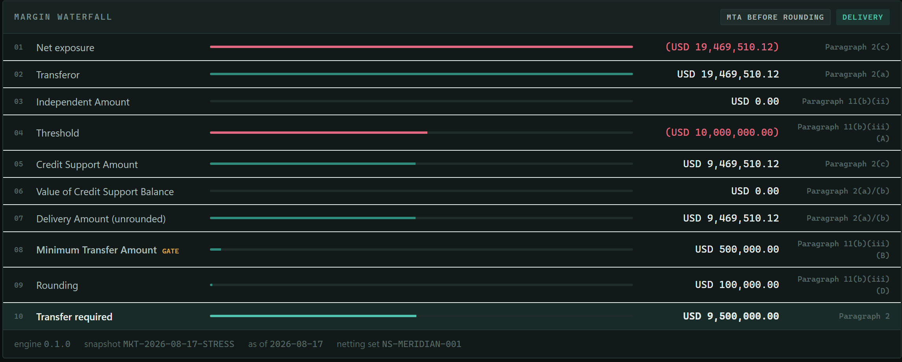
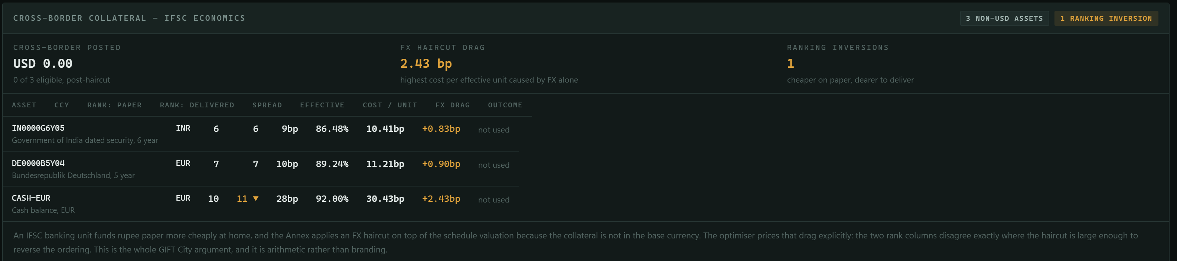
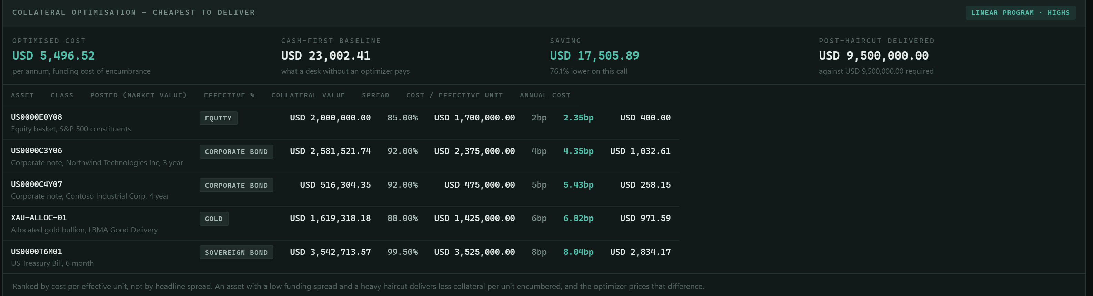
WORKING DEMO · LIVE APPLICATION
The calculation, running.
01
Margin waterfall
03
Cross-border · IFSC economics
Every non-USD asset with its paper rank beside its delivered rank, FX drag isolated. The rupee asset is priced at 10.41bp and declined.
02
Collateral optimisation · cheapest to deliver
Exposure of (USD 19,469,510.12) less a USD 10m threshold gives a credit support amount of USD 9,469,510.12; the MTA gate and rounding produce USD 9,500,000.00.
ON THIS RUN
Cash-first baseline
USD 23,002.41
Optimised allocation
USD 5,496.52
Modelled reduction
76.10%
Binding constraints priced
4
Five assets, ranked by cost per effective unit rather than headline spread.
Wrong-way asset
refused
AETHER-DERIVATIVES
Live screenshots — not mockups
12
Notes:
DEMO I — THE CALCULATION (25s)
"These are screenshots of the application running, not mockups."
"One — the margin waterfall. Exposure of nineteen point four seven million against us,
threshold of ten million comes off, credit support amount nine point four seven, and the
MTA gate and rounding give nine and a half million. Every line names the clause it came
from."
"Two — the optimiser. Five assets, ranked by cost per effective unit. Five thousand four
hundred against twenty-three thousand for cash-first."
"Three — and this is the one I'd linger on — cross-border economics. Every non-dollar
asset with its paper rank next to its delivered rank, and the FX drag isolated. The
rupee asset is priced at ten point four one and declined, with the reason on screen."
"Note the panel on the right: four binding constraints, and the wrong-way asset refused
outright — that's the counterparty's own paper, which the annex forbids."

Slide 13
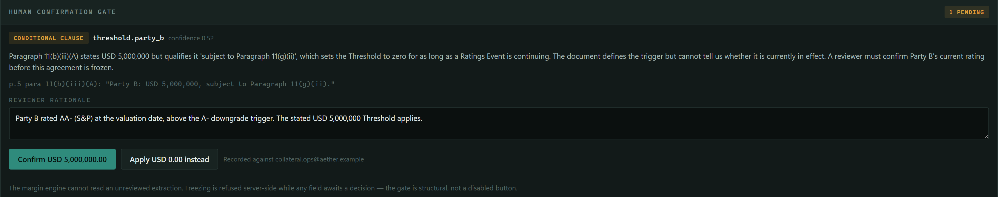
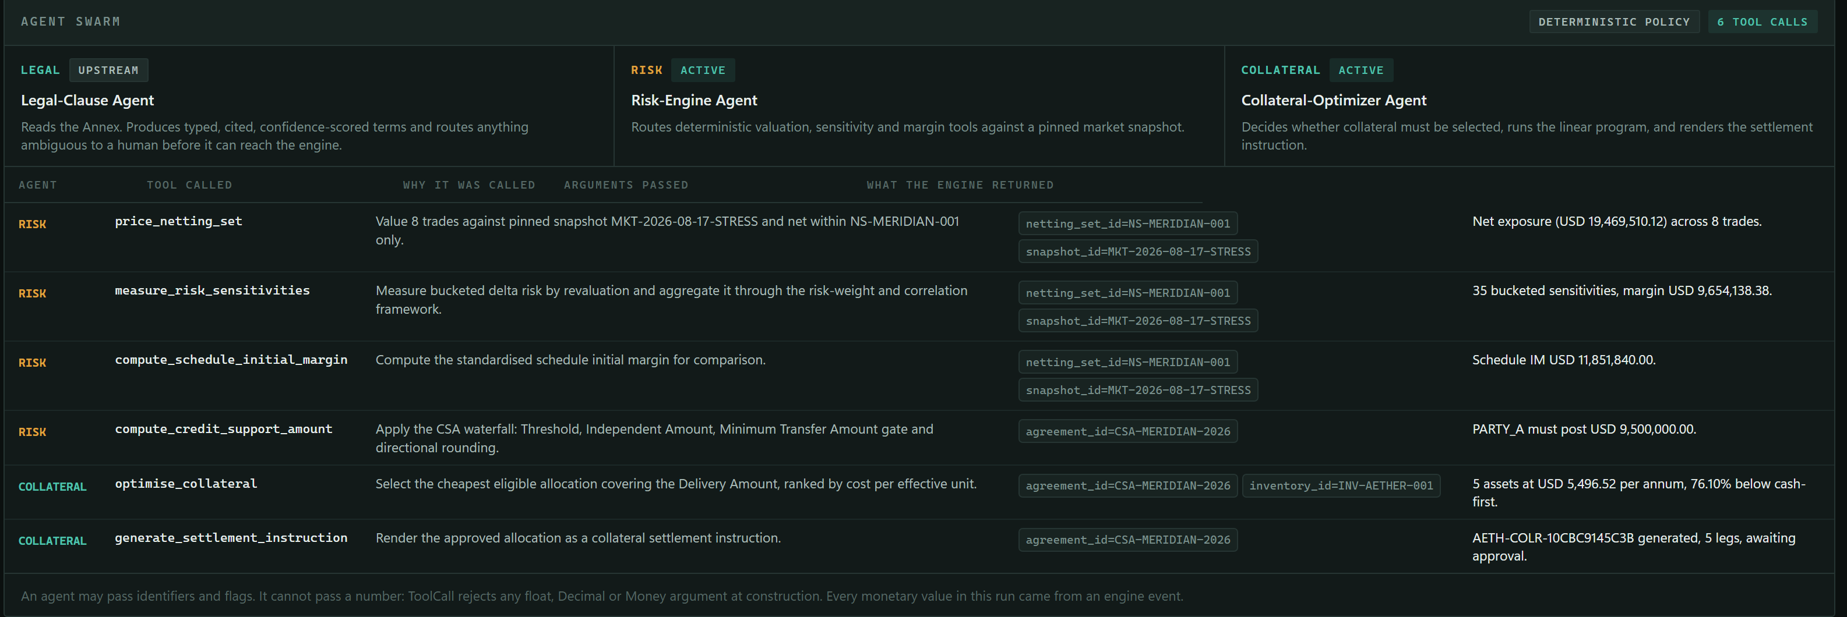
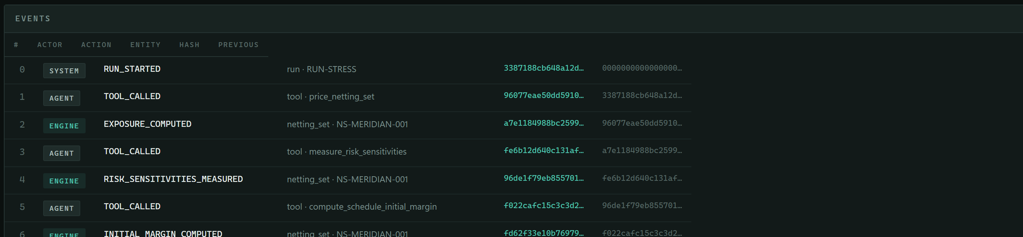
WORKING DEMO · LIVE APPLICATION
The governance, running.
04
Human confirmation gate · the pipeline stops
FLAGGED FIELD
threshold.party_b
CONFIDENCE
0.52
below the
0.85 gate
FREEZE
HTTP 409
A conditional clause: the threshold is stated, then qualified by a ratings trigger the document cannot resolve. The agent does not guess — it flags the field, and the server refuses to freeze the agreement until a human decides.
05
Agent swarm · the tool boundary
06
Audit chain · 15 events, verified
Agent decision, then engine computation, alternating.
406
tests
100%
reproducible
0
network calls
Every argument an agent passes is an identifier — never a number.
AETHER-DERIVATIVES
Live screenshots — not mockups
13
Notes:
DEMO II — THE GOVERNANCE (25s)
"Four — the moment that matters most. Paragraph 11(b)(iii)(A) says Party B's threshold is
five million dollars. But it says it 'subject to' another paragraph, which drops the
threshold to zero while a ratings downgrade is in effect."
"The document defines the trigger. It cannot tell us whether the trigger is currently
pulled. That is not a question a document can answer — so the agent scores it at 0.52
confidence and stops. And this is not a disabled button: the server returns a 409."
"Five — the agent trace. Look at the arguments column. Every one is an identifier:
netting_set_id, snapshot_id, agreement_id. Never a number. A tool call rejects a monetary
value at construction, so a hallucinated figure cannot reach the engine."
"Six — the audit chain. Agent decision, engine computation, alternating, fifteen events,
verified."
CLOSE ON THE STRIP:
"Four hundred and six tests, byte-reproducible, and zero network calls. It runs on a
laptop with the wifi off."

