Slide 1

Money For Nothing
Stock application

Slide 2
Introduction
Team Members
Elevator Pitch
Concepts
Description
Motivation
User Story
Process:
Technologies
Breakdown of tasks and roles
Challenges
Successes
Demo
Directions for Future Development
Links

Slide 3
Team Grand
Adam Aranha,
Bill Hronis,
Bronwen Nicholson,
Catherine Shaw, and
Jordan Mossing.

Slide 4
Elevator Pitch
“ This financial tracking tool that lets people with little-to no financial experience look up stocks and company information. They can save a specific company to a watchlist and revisit the stock’s performance. Users can also keep abreast of the top headlines in business news. It is a particularly great tool for people new to business or the stock market.”

Slide 5
Concepts
Description
News overview and stock application at your fingertips.
Motivation for Development
Interest in stocks and financial information
Clearest path forward
Available API’s
Common understanding of topic
Achievable goal for novice developers
User Story
Use the search bar to look up a company.
Pick the company from top three suggested options.
Display stock and earning information.
Option to save company on watchlist.
Latest business headlines available to help with stock choices

Slide 6
Process
Technologies Used
API’s:
New York Times
Top Stories (Business News)
Alpha Vantage
Daily Time Series (stock info)
Company Overview(earnings/rev/exchange)
Search Endpoint (symbol)
Local Storage
Bootstrap
CSS
JavaScript
HTML
Breakdown of Tasks/Roles
GitHub
Javascript
Adam
Bill
Jordan
CSS
HTML
Bronwen
Catherine

Slide 7
Challenges and Successes
Challenges
GitHub workflow (pulling, pushing & merging)
All remote
It’s all new to us:
API’s
Local storage
Successes
Accomplished our goal (MVP++)
Improved our understanding of all technologies used
Great teamwork – helpful and patient

Slide 8
Lessons Learned
Need to make better use of KanBan:
Hard to delegate because unclear of strengths
Better process for how to manage pushes and pulls from GitHub
Communication improved over the week – better understanding of strengths
Improved understanding of how technologies work together
Teamwork makes trial and error much easier – great ideas about what to try next
Started each day with a re-cap to ensure a common understanding

Slide 9
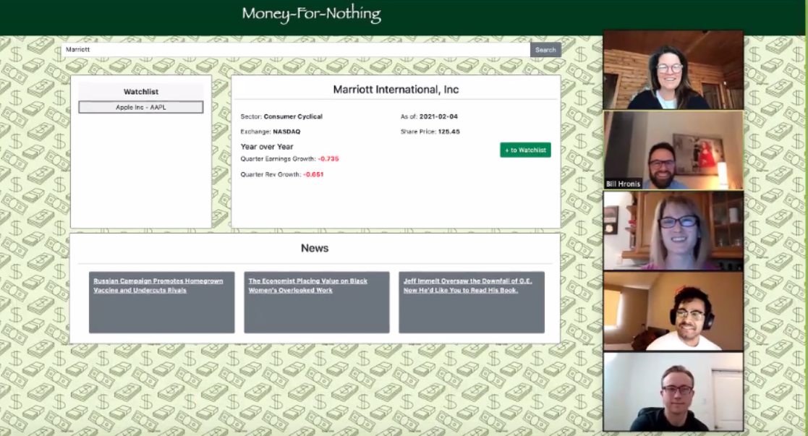

Slide 10
Links…
https://catherinebshaw.github.io/Money-for-Nothing/
https://github.com/catherinebshaw/Money-for-Nothing

Slide 11
Future Features
Ability to graph share price and earnings over time
Watchlist button to include current price
Company-specific headlines in news section
Real-time updates
Play $$ feature - Ability to invest a specific amount of money in a pretend portfolio
More precise searches and better use of API’s

Slide 12
Created By:
Adam Aranha, Bill Hronis, Bronwen Nicholson, Catherine Shaw, and Jordan Mossing.

